Slide 3
Introduction
describe a collection of urinary symptoms including dysuria, frequency and urgency
The symptoms are caused by inflammation of the bladder, which may be due to infection
the most common bacterium is Escherichia coli, and the source is often the gastrointestinal (GI) tract.
About half of the cases will resolve within 3 days even without treatment.
Cystitis is common in women but rare in men

Slide 5
What you need to know
Age -Adult, child
Male or female
Symptoms (Urethral irritation Urinary urgency, frequency Dysuria (pain on passing urine) Haematuria (blood in the urine) Vaginal discharge

Slide 6
Associated symptoms
Back pain (Lower abdominal (suprapubic) pain Fever, chills Nausea/vomiting )
Duration
Previous history
Medication

Slide 7
Chlamydial infection
Sexually transmitted infection
most commonly seen in women aged 16–24years.
Chlamydia can cause pelvic inflammatory disease (PID) and infertility.
National Chlamydia Screening Program (NCSP) offers screening to men and women under 25 years
Treatment, usually with azithromycin or doxycycline,

Slide 8
Cystitis after sex
Sexual intercourse may precipitate an attack of cystitis due to minor trauma or resulting infection when bacteria are pushed along the urethra.
honeymoon cystitis
Trimethoprim prescribed by a doctor to be taken within 2 h of sex.

Slide 9
Other precipitating factors
irritant effects of toiletries (e.g.bubble baths and vaginal deodorants)
other chemicals (e.g. spermicides and disinfectants).
Use of a diaphragm for contraception can also cause symptoms of cystitis.

Slide 10
Postmenopausal women
Oestrogen deficiency in postmenopausal women leads to thinning of the lining of the vagina.
Lack of lubrication
treated with OTC lubricants or prescribed products (e.g.oestrogen creams)

Slide 11
When to refer
All men, children
Pregnancy
Fever, nausea/vomiting
Loin pain or tenderness

Slide 12
Haematuria
Vaginal discharge
Duration of longer than 2 days
Recurrent cystitis
Failed medication

Slide 13
Treatment timescale Women’sHealth If symptoms have not subsided within 2 days of beginning the treatment, the patient should see her doctor.

Slide 14
Management
For pain relief, offer paracetamol or ibuprofen for up to 2 days
Alkalinize the urine and provide symptomatic relief

Slide 15
Potassium and sodium citrate
The acidic urine produced as a result of bacterial infection is thought to be responsible for dysuria
alkalinising the urine will not produce an antibacterial effect,
potassium citrate, should not be recommended anyone taking potassium sparing diuretics, aldosterone antagonists or angiotensin-converting enzyme inhibitors

Slide 16
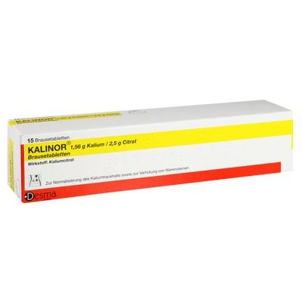
Sodium citrate should not be recommended for hypertensive patients, anyone with heart disease or pregnant women.
Patients should be reminded not to exceed the stated dose of products containing potassium citrate

Slide 17
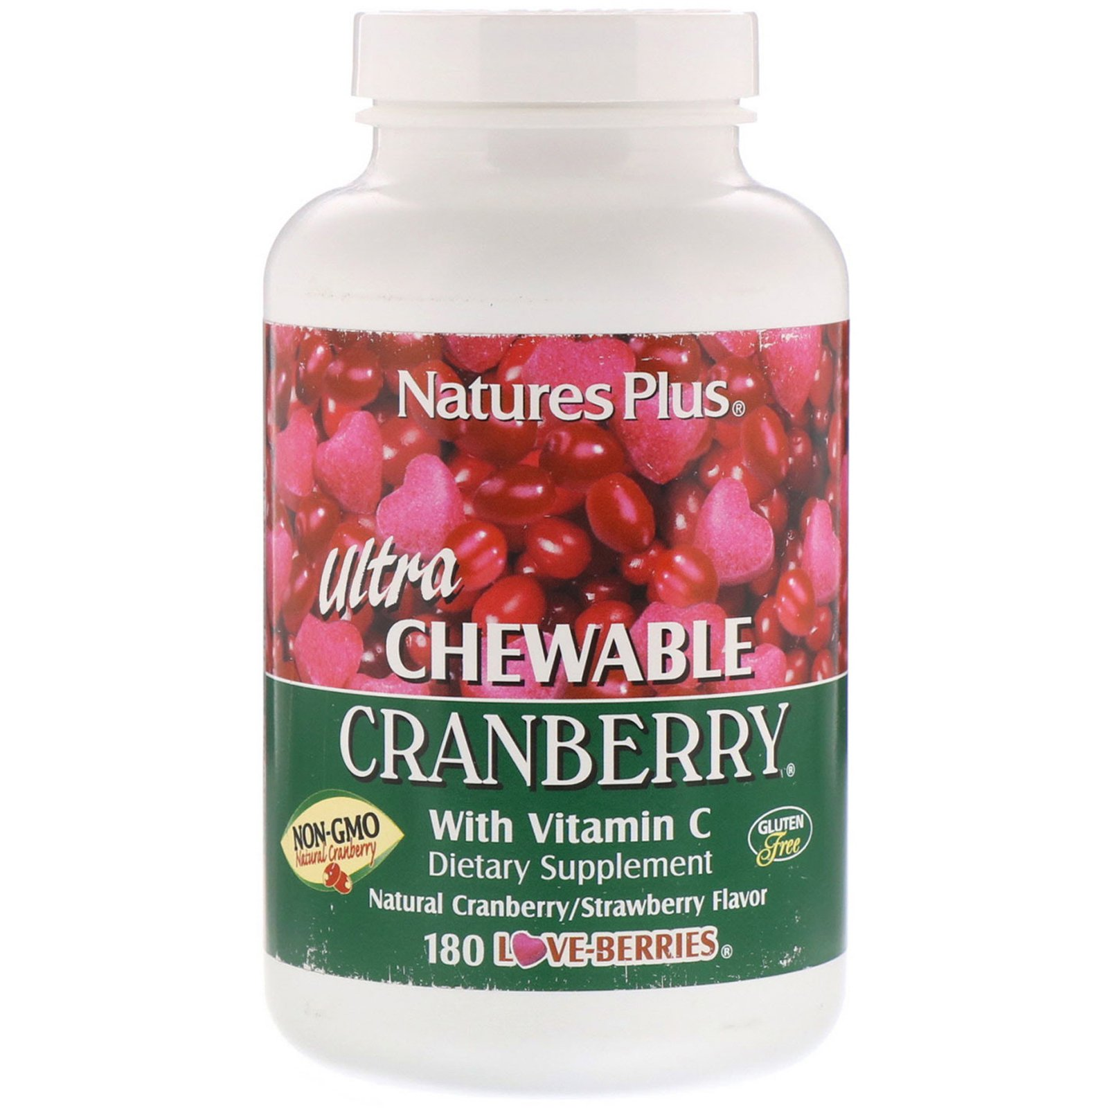
Complementary therapies
Cranberry juice or capsules are also unlikely to be effective in the treatment of acute cystitis.
Patients taking warfarin should not take cranberry products.

Slide 18
Practical points
Drinking large quantities of fluids
During urination the bladder should be emptied completely
After a bowel motion wiping toilet paper from front to back
Urination immediately after sexual intercourse
Reduced intake of coffee and alcoho

Slide 19
Date

