Slide 1
Principles of pharmacy practice
Percent and ratio strength calculations

Slide 2
Percent and ratio strength calculations
Percentage
The term percent and its corresponding sign (%) mean ‘‘by the hundred’’ or ‘‘in a hundred,’’ and percentage means ‘‘rate per hundred’’ , so 50 percent (or 50%) and a percentage of 50 are equivalent expressions.
A percent may also be expressed as a ratio, represented as a common or decimal fraction. For example, 50% means 50 parts in 100 of the same kind, and may be expressed as 50⁄100 or 0.50
For the purposes of computation, percents are usually changed to equivalent decimal fractions. This change is made by dropping the percent sign (%) and dividing the expressed numerator by 100. Thus,
12.5% = 12.5/100 = 0.125

Slide 3
The percentage concentrations of active and inactive constituents in various types of pharmaceutical preparations are defined as follows by the United States Pharmacopeia1
Percent weight-in-volume (w/v) expresses the number of grams of a constituent in 100 mL of solution or liquid preparation and is used regardless of whether water or another liquid is the solvent or vehicle. Expressed as: % w/v.
Percent volume-in-volume (v/v) expresses the number of milliliters of a constituent in 100 mL of solution or liquid preparation. Expressed as: % v/v.
Percent weight-in-weight (w/w) expresses the number of grams of a constituent in 100 g of solution or preparation. Expressed as: % w/w.
The term percent, or the symbol %, when used without qualification means:
• for solutions or suspensions of solids in liquids, percent weight-in-volume;
• for solutions of liquids in liquids, percent volume-in-volume;
• for mixtures of solids or semisolids, percent weight-in-weight

Slide 4
Percentage weight in volume
weight-in-volume expressions, the ‘‘correct’’ strength of a 1% (w/v) solution or other liquid preparation is defined as containing 1 g of constituent in 100 mL of product
Multiply the required number of milliliters by the percentage strength, expressed as a decimal, to obtain the number of grams of solute or constituent in the solution or liquid preparation.
The volume, in milliliters, represents the weight in grams of the solution or liquid preparation as if it were pure water.
Volume (mL, representing grams) x % (expressed as a decimal) = grams (g) of solute or constituent

Slide 5
How many grams of dextrose are required to prepare 4000 mL of a 5% solution?
4000 mL represents 4000 g of solution
5% = 0.05
4000 g x 0.05 = 200 g, answer.
How many grams of potassium permanganate should be used in compounding the following prescription?
Potassium Permanganate 0.02%
Purified Water ad 250 mL
Sig. as directed.
250 mL represents 250 g of solution
0.02% = 0.0002
250 g x 0.0002 = 0.05 g, answer

Slide 6
How many grams of aminobenzoic acid should be used in preparing 8 fluidounces of a 5% solution in 70% alcohol?
8 fl. oz. = 8 x 30 mL = 240 mL
240 mL represents 240g of solution
5% = 0.05
240 g x 0.05 =12 g, answer.

Slide 7
Percentage volume in volume
In preparing 250 mL of a certain lotion, a pharmacist used 4 mL of liquefied phenol. What was the percentage (v/v) of liquefied phenol in the lotion?

Slide 10
Percent weight in weight

Slide 11
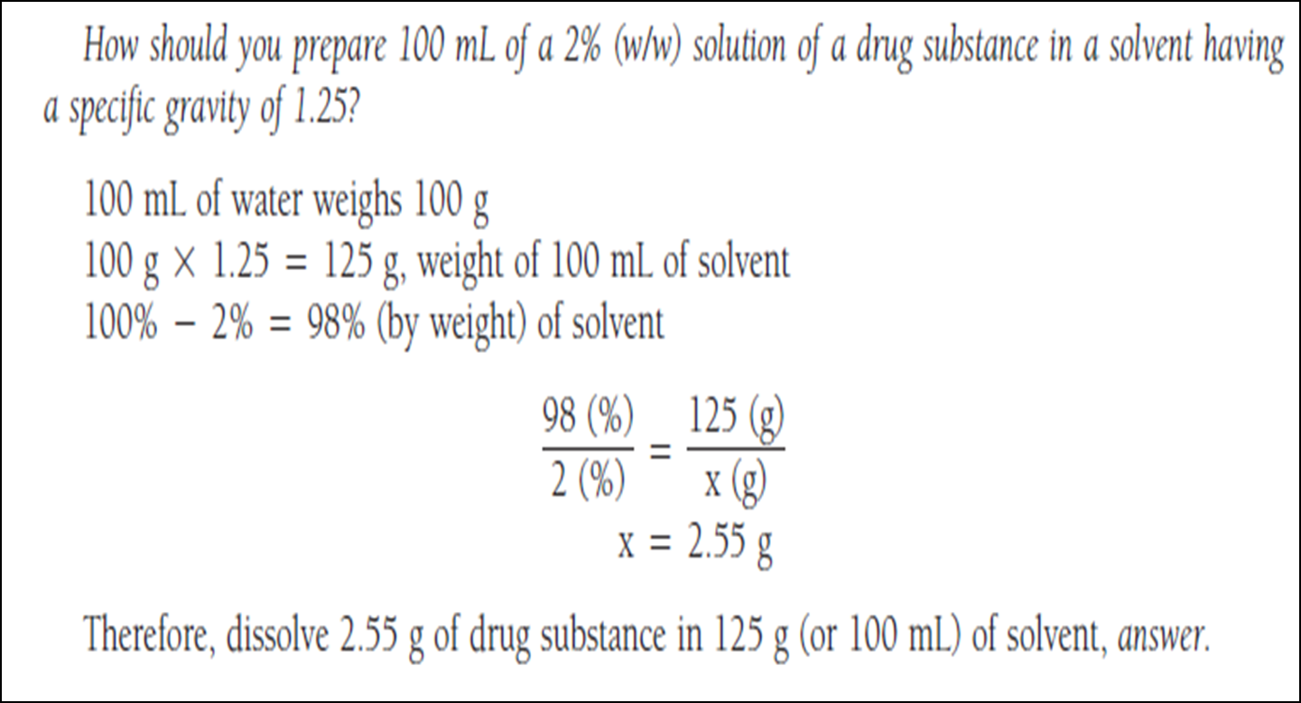

Slide 12
Calculating Percentage Strength Weight-in-Weight
If the weight of the finished solution or liquid preparation is not given when calculating its percentage strength, other data must be supplied from which it may be calculated: the weights of both ingredients, for instance, or the volume and specific gravity of the solution or liquid preparation.
If 1500 g of a solution contains 75 g of a drug substance, what is the percentage strength (w/w) of the solution?

Slide 15
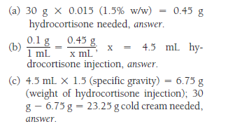

Slide 16
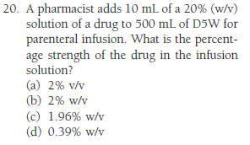

Slide 17
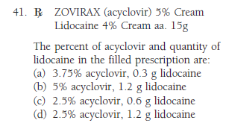

Slide 19
The concentrations of weak solutions are frequently expressed in terms of ratio strength. Because all percentages are a ratio of parts per hundred When a ratio strength, for example, 1:1000, is used to designate a concentration, it is to be interpreted as follows
For solids in liquids 1g of solute or constituent in 1000 mL of solution or liquid preparation.
• For liquids in liquids 1 mL of constituent in 1000 mL of solution or liquid preparation.
• For solids in solids 1g of constituent in 1000 g of mixture.
The ratio and percentage strengths of any solution or mixture of solids are proportional, and either is easily converted to the other by the use of proportion.

Slide 20
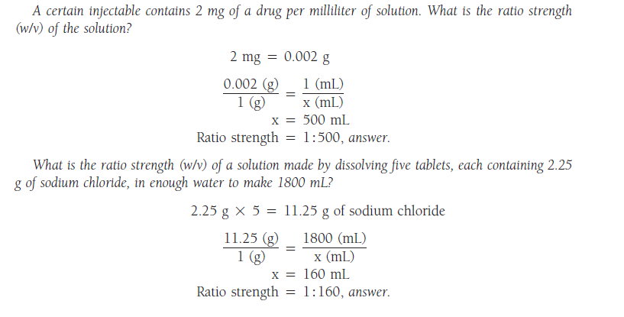

Slide 22
Occasionally, pharmacists, particularly those practicing in patient care settings, need to convert rapidly product concentrations expressed as percentage strength, ratio strength, or as grams per liter (as in IV infusions) to milligrams per milliliter (mg/mL)

Slide 24
The strengths of very dilute solutions are commonly expressed in terms of parts per million (ppm) or parts per billion (ppb), i.e., the number of parts of the agent per 1 million or 1 billion parts of the whole

