Slide 1
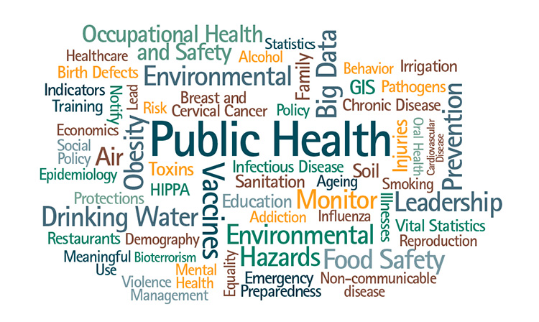
COMMUNICABLE DISEASES:
INFECTIONS THROUGH THE
GASTRO-INTESTINAL TRACT
Dr. Mayssaa Essam

Slide 2
HEAD LINES
■ Infective agents
■ Control of the infections acquired through the gastro-intestinal tract
■ Diarrhoeal diseases
■ Viral infections
■ Bacterial infections
■ Protozoal infections
■ Helminthic infections

Slide 3
INFECTIVE AGENTS
A number of important pathogens gain entry through the gastro-intestinal tract. Some of these cause diarrhoeal diseases (e.g. Salmonella and Shigella spp.) whilst others pass through the intestinal tract to cause disease in other organs (e.g. poliomyelitis, viral hepatitis). The pathogens include viruses, bacteria, protozoa and helminths.
Viral infections :Poliomyelitis (poliovirus)
Viral hepatitis (hepatitis A and E viruses)
Bacterial infections
Enteric fevers (Salmonella typhi, S. paratyphi)
Gastro-enteritis (Escherichia coli, Campylobacter spp.)
Protozoal infections
Amoebiasis (Entamoeba histolytica)
Giardiasis (Giardia lamblia)
Helminthic infections
Nematodes (roundworms)
Cestodes (tapeworms)
Trematodes (flukes)

Slide 4
PHYSICAL AND BIOLOGICAL CHARACTERISTICS
The epidemiology of these infections, it is useful to note some of the physical and biological properties of each infective agent. The organisms vary in their ability to withstand physical conditions such as high or low temperatures and drying, and they also differ in their susceptibility to chemical agents, including chlorine. The vegetative form ?of Entamoeba histolytica is rapidly destroyed in the stomach but the cyst form? survives digestion by gastric juices. Differences in the sizes of the
organisms are also of epidemiological importance. Thus, simple filtration through a clay filter will eliminate most of the large organisms – bacteria, protozoa, and the eggs or larvae of helminths – from polluted water, but the filtrate will contain the smaller organisms such as viruses.

Slide 5
TRANSMISSION
Viruses, bacteria and cysts of protozoa are directly infectious to man as they are passed in the faeces, but in the case of helminths, the egg may become infectious only after maturation in the soil (e.g. Ascaris) or after passing through an intermediate host (e.g. Taenia saginata). The most important pattern of transmission is the passage of infective material from human faeces into the mouth of a new host and this is known as ‘faeco-oral’ or ‘intestino-oral’ transmission, not all the pathogens which infect through the mouth are excreted in the faeces; for example guinea worm infection is acquired by mouth but the larvae escape through the skin. On the other hand, the ova of hookworm are passed in faeces but the route of infection is most frequently by direct penetration of the skin by the infective larvae.

Slide 6
The faeco-oral route
Faeco-oral transmission occurs mostly through inapparent faecal contamination of food, water and hands – the three main items that regularly make contact with the mouth It should be noted that minute quantities of faeces can carry the infective dose of various pathogens.
Thus, dangerously polluted water may appear sparkling clear, contaminated food may be free of objectionable odour or taste, and apparently clean hands may carry and transmit disease.
The housefly mechanically transfers faecal pollution by:
■ Carrying faeces on its hairy limbs
■ Regurgitating the contents of its stomach on to solid food as a means of liquefying it (‘vomit drop’);
■ Defecating on the food: its faeces may contain surviving organisms derived from human faeces.

Slide 7
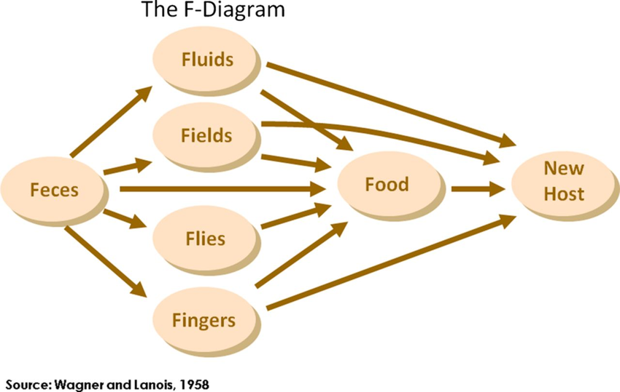
As shown in Figure below, food occupies a central and important position. Not only can it be contaminated directly by faeces but it can also be contaminated indirectly through polluted water, dirty hands, contaminated soil and filth flies. Water may be polluted directly by faeces but also indirectly from the polluted soil on the riverbank. There are many opportunities for the contamination of hands: the person may contaminate hands on cleaning after defaecation or in touching or handling contaminated objects, including soil. Contamination of the soil with faeces plays an essential role in the transmission of certain helminths which must undergo a period of maturation before becoming infectious (e.g. Ascaris).
Pathways of faceo-oral transmission

Slide 8
Epidemic patterns in relation to the mode of transmission
Some of the infections that are acquired through the gastro-intestinal tract characteristically occur in epidemic form, for example typhoid. The pattern of an epidemic is affected by the route of transmission. A water-borne epidemic is typically explosive: it may affect people over a wide area who have no other traceable connection but the use of the same water supply. Food-borne outbreaks may be more localized, affecting persons from the same household or board in institution, those who feed communally at a hotel, restaurant, aeroplane or staff canteen, or those who have taken part in a festive dinner or picnic.

Slide 9
HOST FACTORS
Non-specific factors in the host pay some part in preventing infection through the gastro-intestinal tract. The high acid content and the antibacterial lysozyme in the stomach, and the digestive juices in the upper part of the intestinal tract destroy potentially infective organisms but do not constitute an immune barrier to infection. More significant is the specific immunity which can be derived from previous infections or from artificial immunization? Immunity is in part related to specific antibodies in the sera of those previously infected or artificially immunized. It has also been demonstrated that the intestinal mucosa may acquire resistance to certain pathogens such as cholera or poliomyelitis: this local resistance is mediated through a fraction of immunoglobins (IgA) which are secreted by the mucosa.

Slide 10
CONTROL OF THE INFECTIONS
ACQUIRED THROUGH THE
GASTRO-INTESTINAL TRACT
Control can operate on each of the three components of infection:
1. The infective agent:
■ sanitary disposal of faeces;
■ elimination of human and animal reservoirs.
2 .The route of transmission:
■ provision of safe water supply;
■ protection of food from contamination;
■ control of flies;
■ improvement of personal hygiene.
3 .The host:
■ specific immunization;
■ chemoprophylaxis;
■ specific treatment

Slide 11
DIARRHOEAL DISEASES
Diarrhoeal diseases, as a group, remain a major cause of death in developing countries, especially in preschool children. Children under 3 years of age may experience as many as 10 episodes of diarrhoea per year. The main agents are:
■ Enteroviruses, :rotavirus.
■ Escherichia coli:( bacteria)
(a) Enterotoxigenic E. coli (ETEC)
(b) Localized-adherent E. coli (LA-EC)
(c) Diffuse-adherent E. coli (DA-EC)
(d) Enteroinvasive E.coli (EIEC)
(e) Enterohaemorrhagic E. coli (EHEC)
■ Campylobacter spp.
■ Shigella
■ Vibrio cholerae 01 and 0139
■ Salmonella (non-typhoid)
■ Entamoeba histolytica(an anaerobic parasitic amoebozoan)
■ Giardia lamblia
■ Cryptosporidium.

Slide 12
ACUTE DIARRHOEA
Most episodes of diarrhoea last less than 7 days and can be effectively treated with oral rehydration, combined with an appropriate diet. Limited evidence suggests that vitamin A deficiency predisposes to increased risk of diarrhoeal illness and to increased risk of death in preschool children. Children with diarrhoea but no dehydration should receive extra fluids at home. If the child is severely dehydrated – swollen eyes, drinking poorly – take child to nearest hospital.

Slide 13
PERSISTENT DIARRHOEA
Persistence of an acute diarrhoeal episode for at least 14 days occurs in 3–20% of cases. This leads to significantly increased mortality: 14% of persistent cases are fatal compared with 1% of acute cases. Risk factors in the development of persistent diarrhoea include:
■ age.
■ nutritional status.
■ immunological status.
■ previous infections.
■ concomitant or associated enteropathogenic bacteria (e.g. enteroadherent E. coli; enteropathogenic E. coli
and cryptosporidia)

Slide 14
CONTROL
Programmes for the reduction of morbidity and mortality include:
■ oral rehydration therapy – highly effective in preventing death from dehydration in acute episodes.
■ promotion of breast-feeding (exclusively for 4 months: continue for 2 years).
■ improving weaning practices (soft & small serving of vegetable oil).
■ improving water supply and sanitation (safe water: use of latrines: safe disposal of stools).
■ promoting personal and domestic hygiene (handwashing: prevent contamination of food).
■ immunization (measles).
■ specific chemotherapy for invasive bowel infections or presence of Helicobacter pylori.
■ zinc supplementation.
Not all interventions are appropriate everywhere. Each country must decide which package of measures is likely to be most feasible and cost-effective. Rota viruses and cholera immunization must await the results of field trials of the new vaccines.

Slide 15
VIRAL INFECTIONS
The most common viral infections transmitted through the gastro-intestinal tract are:
■ Rotaviruses.
■ Poliomyelitis.
■ Viral hepatitis A.
ROTAVIRUSES
Rotaviruses are the most common cause of diarrhoea
worldwide, virtually all children have been infected by the age of 4 years. The incubation period is short – 24–48 hours – with vomiting, fever and a watery diarrhoea the presenting clinical features.
Epidemiology
Most infections are caused by group A viruses, The reservoir of infection is humans and transmission occurs by the faeco-oral route due to poor standards of personal and environmental hygieneVirus shedding continues for about 8 days. The peak age-specific prevalence is in children between 6 and 24 months.

Slide 16
Diagnosis
Rotaviruses are identified in the stool by ELISA, electron microscopy, or passive particle agglutination techniques?.
Control
INDIVIDUAL
Oral, subcutaneous or intravenous rehydration.
COMMUNITY
High standards of personal hygiene and sanitary practices should be employed, although these may not be entirely successful because the virus survives in contaminated water, on hands and is resistant to commonly used disinfectants. An effective vaccine was produced but has recently been withdrawn because of unexpected and serious adverse effects. Newer vaccines are being evaluated.

