Slide 1
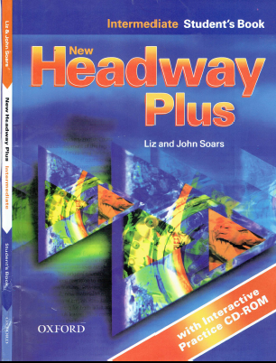
Class Reference book
English Language
For 3rd Year Students
College Pharmacy
Al-Mustansiriyah University
Chapter Four
Modal Verbs

Slide 2
Introduction to modal verbs
Past Simple
Past Continuous
Past Simple or Past Continuous
Past Perfect
Past Tenses Passive

Slide 3
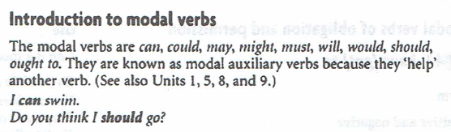

Slide 4
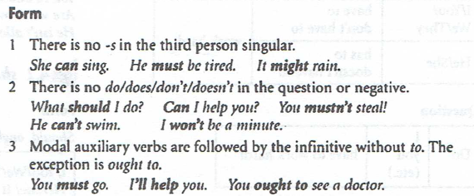

Slide 5
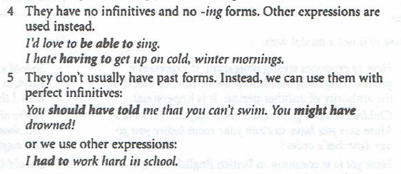

Slide 6
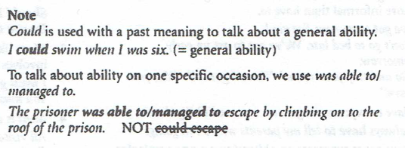

Slide 7
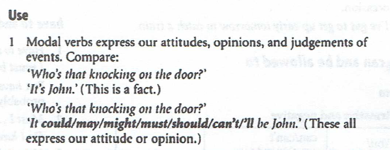

Slide 8
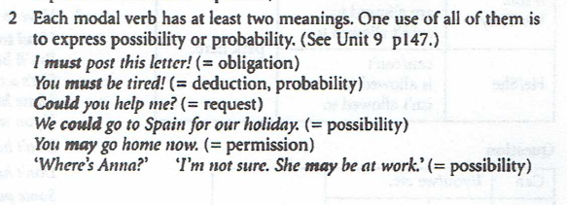

Slide 9
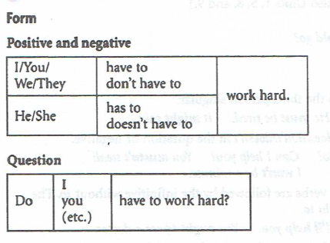
1.1 have (got) to

Slide 10
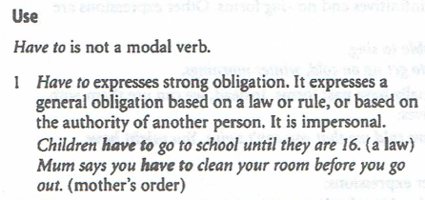
1.1 have (got) to

Slide 11
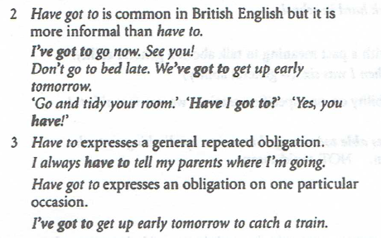
1.1 have (got) to

Slide 12
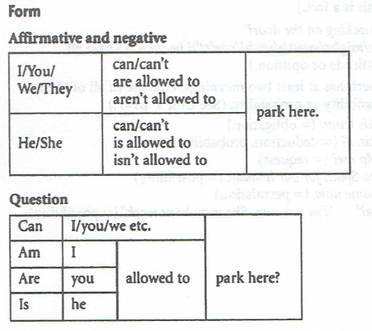
1.2 can and be allowed to

Slide 13
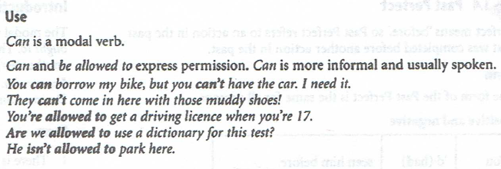
1.2 can and be allowed to

Slide 14
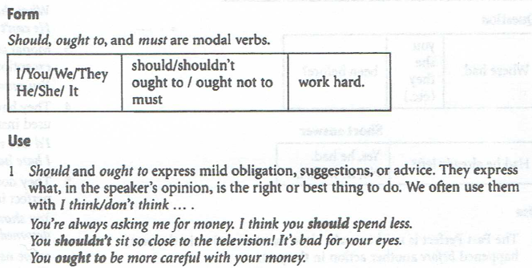
2.1 should, ought to, and must

Slide 15
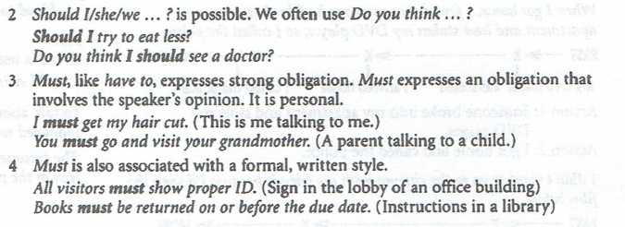
2.1 should, ought to, and must

Slide 16
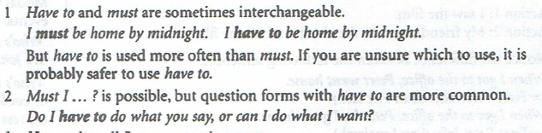
2.2 have to and must, don’t have to and mustn’t

Slide 17
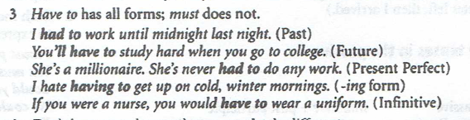
2.2 have to and must, don’t have to and mustn’t

Slide 18
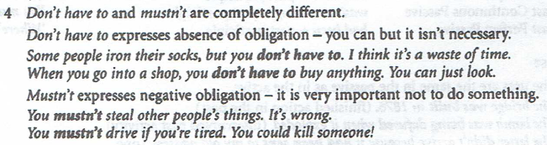
2.2 have to and must, don’t have to and mustn’t

Slide 19
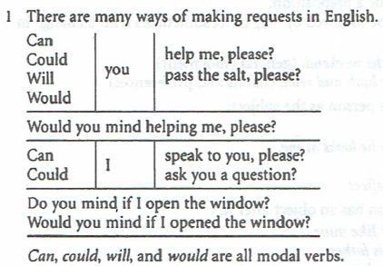
3. Making requests: can, could, will and would

Slide 20
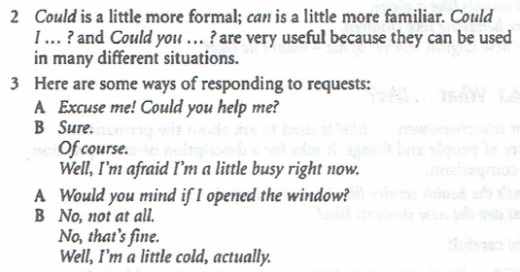
3. Making requests: can, could, will and would

Slide 21
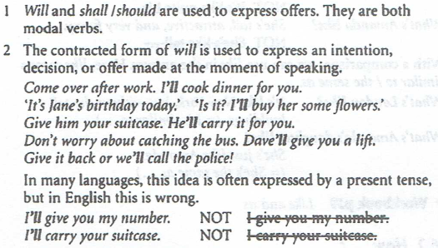
3. Making offers: will and shall/should

Slide 22
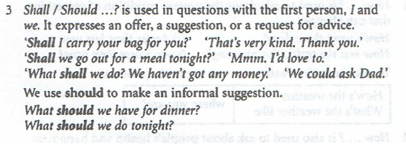
3. Making offers: will and shall/should

Slide 23
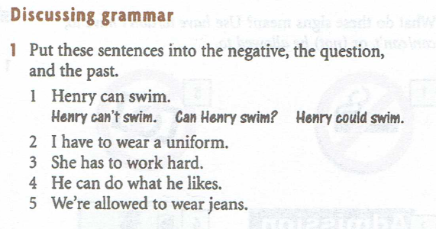
Practice

Slide 24
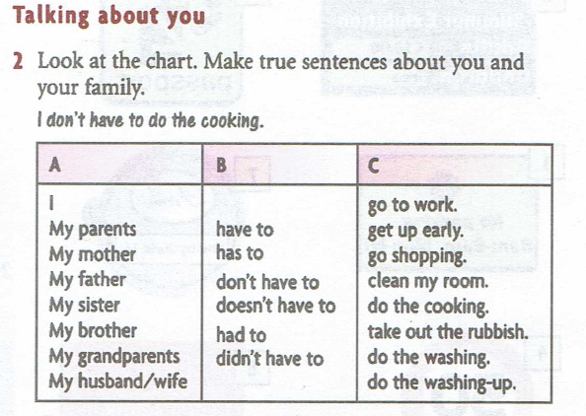
Practice

Slide 25
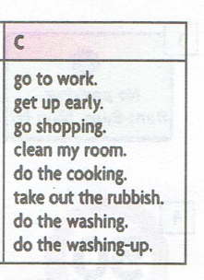
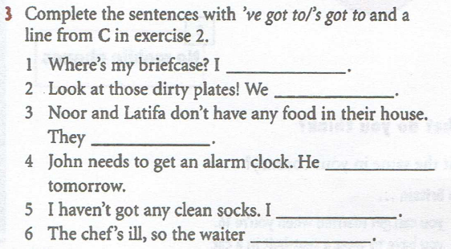
Practice

