Slide 1
The binding role of amides
Many of the lead compounds currently studied in medicinal chemistry are peptides or polypeptides consisting of amino acids linked together by peptide or amide bonds.
The carbonyl oxygen atom can act as a hydrogen bond acceptor and has the potential to form two hydrogen bonds.
Both the lone pairs involved are in sp²-hybridized orbitals which are located in the same plane as the amide group.
Th e nitrogen cannot act as a hydrogen bond acceptor because the lone pair interacts with the neighbouring carbonyl group

Slide 2
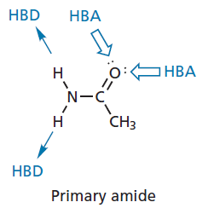
The binding role of amides

Slide 3
The binding role of amides
The most common type of amide in peptide lead compounds is the secondary amide.
Suitable analogues that could be prepared to test out possible binding interactions are shown below.
All the analogues, except the primary and secondary amines, could be used to check whether the amide is acting as a hydrogen bond donor.
The alkenes and amines could be tested to see whether the amide is acting as a hydrogen bond acceptor.
The amide group is planar and does not rotate because of its partial double bond character.

Slide 4
The binding role of amides

Slide 5
The binding role of amides
The ketone, the secondary amine, and the tertiary amine analogues have a single bond at the equivalent position which can rotate.
This would alter the relative positions of any binding groups on either side of the amide group and lead to a loss of binding, even if the amide itself was not involved in binding.
Therefore, a loss of activity would not necessarily mean that the amide is important as a binding group.
With these groups, it would only be safe to say that the amide group is not essential if activity is retained.

Slide 6
The binding role of amides
The primary amine and carboxylic acid may be found to have no activity, but this might be due to the loss of important binding groups in one half of the molecule.
These particular analogues would only be worth considering if the amide group is peripheral to the molecule (e.g. R-NHCOMe or R-CONHMe) and not part of the main skeleton.
The alkene would be a particularly useful analogue to test because it is planar, cannot rotate, and cannot act as a hydrogen bond donor or hydrogen bond acceptor.
However, the synthesis of this analogue may not be simple.

Slide 7
The binding role of amides
In fact, it is likely that all the analogues described would have to be prepared using a full synthesis.
Amides are relatively stable functional groups and, although several of the analogues described might be attainable directly from the lead compound, it is more likely that the lead compound would not survive the forcing conditions required.
Amides which are within a ring system are called lactams which can form intermolecular hydrogen bonds.
If the ring is small and suffers ring strain, the lactam can undergo a chemical reaction with the target leading to the formation of a covalent bond.

Slide 8
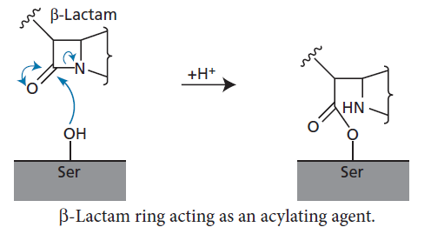
The binding role of amides
The best examples of this are the penicillins, which contain a four-membered β-lactam ring.
This acts as an acylating agent and irreversibly inhibits a bacterial enzyme by acylating a serine residue in the active site

Slide 9
Binding role of quaternary ammonium salts
Quaternary ammonium salts are ionized and can interact with carboxylate groups by ionic interactions.
Another possibility is an induced dipole interaction between the quaternary ammonium ion and any aromatic rings in the binding site. The positively charged nitrogen can distort the π electrons of the aromatic ring such that a dipole is induced, whereby the face of the ring is slightly negative and the edges are slightly positive.
This allows an interaction between the slightly negative faces of the aromatic rings and the positive charge of the quaternary ammonium ion. This is also known as a π–cation interaction.

Slide 10
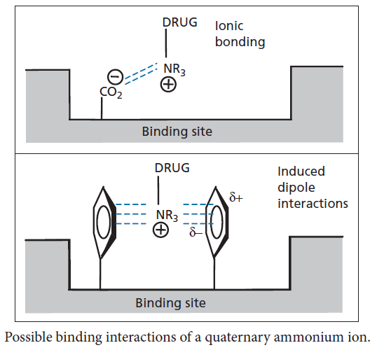
Binding role of quaternary ammonium salts

Slide 11
Binding role of quaternary ammonium salts
The importance of these interactions could be tested by synthesizing an analogue that has a tertiary amine group rather than the quaternary ammonium group.
Of course, it is possible that such a group could ionize by becoming protonated and then interact in the same way.
Converting the amine to an amide would prevent this possibility.
The neurotransmitter acetylcholine has a quaternary ammonium group which is thought to bind to the binding site of its target receptor by ionic bonding and/or induced dipole interactions

Slide 12
Binding role of carboxylic acids
The carboxylic acid group is reasonably common in drugs.
It can act as a hydrogen bond acceptor or as a hydrogen bond donor. Alternatively, it may exist as the carboxylate ion.
This allows the possibility of an ionic interaction and/or a strong hydrogen bond where the carboxylate ion acts as the hydrogen bond acceptor.
The carboxylate ion is also a good ligand for metal ion cofactors present in several enzymes, for example zinc metalloproteinases

Slide 13
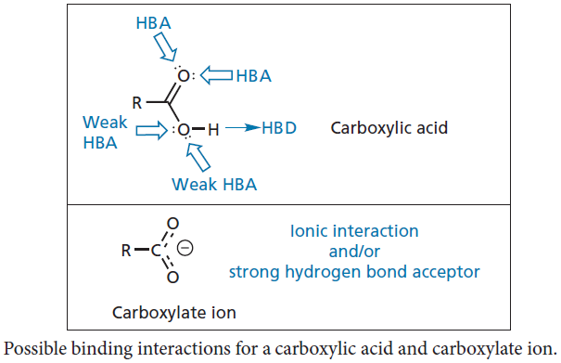
Binding role of carboxylic acids

Slide 14
Binding role of carboxylic acids
In order to test the possibility of such interactions, analogues such as esters, primary amides, primary alcohols, and ketones could be synthesized and tested.
None of these functional groups can ionize, so a loss of activity could imply that an ionic bond is important.
The primary alcohol could shed light on whether the carbonyl oxygen is involved in hydrogen bonding, whereas the ester and ketone could indicate whether the hydroxyl group of the carboxylic acid is involved in hydrogen bonding.

Slide 15
Binding role of carboxylic acids

Slide 16
It may be possible to synthesize the ester and amide analogues directly from the lead compound, but the reduction of a carboxylic acid to a primary alcohol requires harsher conditions and this sort of analogue would normally be prepared by a full synthesis.
The ketone would also have to be prepared by a full synthesis.

Slide 17
Binding role of esters
An ester functional group has the potential to interact with a binding site as a hydrogen bond acceptor only.
The carbonyl oxygen is more likely to act as the hydrogen bond acceptor than the alkoxy oxygen, as it is sterically less hindered and has a greater electron density.
The importance of the carbonyl group could be judged by testing an equivalent ether, which would require a full synthesis.
Esters are susceptible to hydrolysis in vivo by metabolic enzymes called esterases.

Slide 18
Binding role of esters
This may pose a problem if the lead compound contains an ester that is important to binding, as it means the drug might have a short lifetime in vivo.
There are several drugs that do contain esters and are relatively stable to metabolism thanks to electronic factors that stabilize the ester or steric factors that protect it.
Esters that are susceptible to metabolic hydrolysis are sometimes used deliberately to mask a polar functional group, such as a carboxylic acid, alcohol, or phenol, in order to achieve better absorption from the gastrointestinal tract.

Slide 19
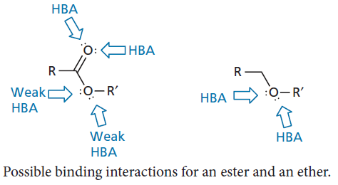
Binding role of esters

Slide 20
Binding role of esters
Once in the blood supply, the ester is hydrolysed to release the active drug. This is known as a prodrug strategy.
Special mention should be made of the ester group in aspirin.
Aspirin has an anti-inflammatory action resulting from its ability to inhibit an enzyme called cyclooxygenase (COX) which is required for prostaglandin synthesis.
It is often stated that aspirin acts as an acylating agent and that its acetyl group is covalently attached to a serine residue in the active site of COX.

Slide 21
Binding role of esters

Slide 22
Binding role of alkyl and aryl halides
Alkyl halides involving chlorine, bromine, or iodine tend to be chemically reactive as the halide ion is a good leaving group.
As a result, a drug containing an alkyl halide is likely to react with any nucleophilic group that it encounters and become permanently linked to that group by a covalent bond—an alkylation reaction.
This will cause a problem, as the drug is likely to alkylate a large variety of macromolecules which have nucleophilic groups, especially amine groups in proteins and nucleic acids.
It is possible to moderate the reactivity to some extent, but selectivity is still a problem and leads to severe side effects.

Slide 23
Binding role of alkyl and aryl halides
These drugs are, therefore, reserved for life-threatening diseases, such as cancer. Alkyl fluorides, however, are not alkylating agents because the C–F bond is strong and not easily broken.
Fluorine is commonly used to replace a proton as it is approximately the same size, but has different electronic properties.
It may also protect the molecule from metabolism.
Aryl halides do not act as alkylating agents and pose less of a problem in that respect. As the halogen substituents are electron-withdrawing groups, they affect the electron density of the aromatic ring and this may have an influence on the binding of the aromatic ring.

Slide 24
Binding role of alkyl and aryl halides
Th e halogen substituents chlorine and bromine are hydrophobic in nature and may interact favourably with hydrophobic pockets in a binding site. Hydrogen bonding is not important.
Although halide ions are strong hydrogen bond acceptors, halogen substituents are poor hydrogen bond acceptors.
Aliphatic and aromatic analogues lacking the halogen substituent could be prepared by a full synthesis to test whether the halogen has any importance towards the activity of the lead compound.

Slide 25
Binding role of heterocycles
Heterocycles are cyclic structures that contain one or more heteroatoms, such as oxygen, nitrogen, or sulphur.
The heterocycles can be aliphatic or aromatic in character and have the potential to interact with binding sites through a variety of bonding forces.
For example, the overall heterocycle can interact through van der Waals and hydrophobic interactions, while the individual heteroatoms present in the structure could interact by hydrogen bonding or ionic bonding.

Slide 26
Binding role of heterocycles
Th e position of the heteroatom in the ring and the orientation of the ring in the binding site can be crucial in determining whether or not a good interaction takes place.
For example, adenine can take part in six hydrogen bonding interactions: three as a hydrogen bond donor and three as a hydrogen bond acceptor.
Van der Waals interactions are also possible to regions of the binding site above and below the plane of the ring system.

Slide 27
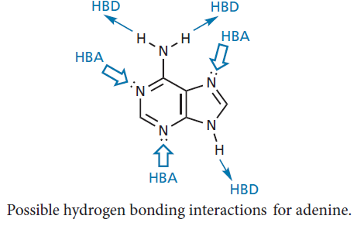
Binding role of heterocycles
Heterocycles can be involved in quite intricate hydrogen bonding networks within a binding site.
For example, the anticancer drug methotrexate contains a diaminopteridine ring system that interacts with its binding site

Slide 28
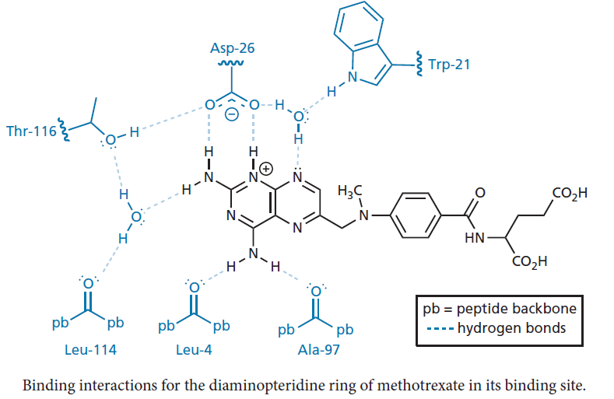
Binding role of heterocycles

Slide 29
Binding role of heterocycles
If the lead compound contains a heterocyclic ring, it is worth synthesizing analogues containing a benzene ring or different heterocyclic rings to explore whether all the heteroatoms present are really necessary.
A complication with heterocycles is the possibility of tautomers .
This played an important role in determining the structure of DNA.
The structure of DNA consists of a double helix with base-pairing between two sets of heterocyclic nucleic acid bases.
Base-pairing involves three hydrogen bonds between the base pair guanine and cytosine, and two hydrogen bonds between the base pair adenine and thymine.

Slide 30
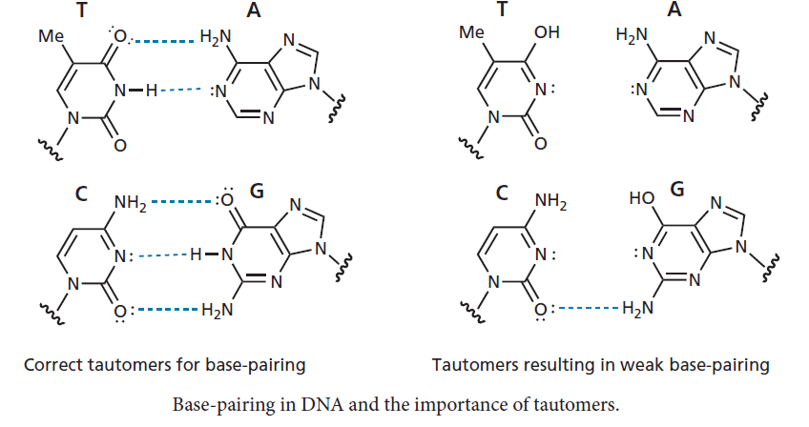
Binding role of heterocycles

Slide 31
Binding role of heterocycles
The rings involved in the base-pairing are coplanar, allowing the optimum orientation for the hydrogen bond donors and hydrogen bond acceptors.
This, in turn, means that the base pairs are stacked above each other allowing van der Waals interactions between the faces of each base pair.
However, it was incorrectly assumed that the preferred tautomers for the nucleic acid bases were as shown in the right-hand part of above figure.
With these tautomers, the required hydrogen bonding is not possible and would not explain the base-pairing observed in the structure of DNA.

Slide 32
Binding role of heterocycles
With heterocyclic compounds, it is possible for a hydrogen bond donor and a hydrogen bond acceptor to be part of a conjugated system.
Polarization of the electrons in the conjugated system permits π-bond cooperativity, where the strength of the hydrogen bond donor is enhanced by the hydrogen bond acceptor and vice versa.
This has also been called resonance-assisted hydrogen bonding.
This type of hydrogen bonding is possible for the hydrogen bond donors and acceptors for the nucleic acid base pairs

Slide 33
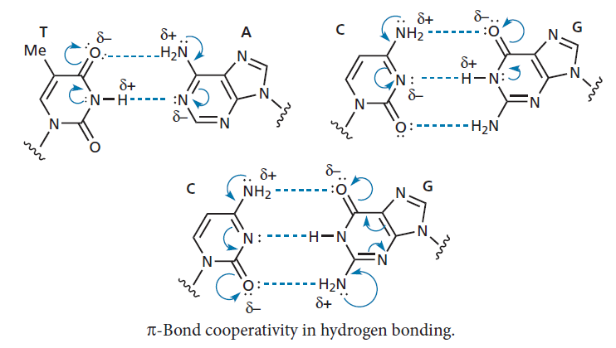
Binding role of heterocycles

