Slide 1
Dissolution test (official test)
Lab 6

Slide 2
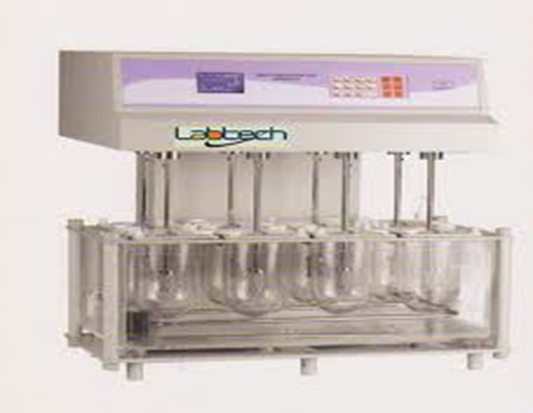
Dissolution test
Dissolution Test
For complete assessment of a drug release from tablets (in-vivo bioavailability should be accomplished) but its use is restricted, thus in-vitro dissolution test have been used and developed and it is un-direct measurement of drug availability.

Slide 3
Why In-vitro dissolution studies?
To show that the release of the drug from the tablet is as close to 100%.
To show that the rate of drug release is uniform batch to batch.
And to show that the release is equivalent to those batches proven to be bioavailable and clinically effective.

Slide 4
USP/NF monograph specify:
The dissolution test medium
Apparatus to be used
Time limits of the test
The assay procedure
Volume (dissolution medium)
The speed (rpm) of the test to be performed

Slide 5
Dissolution test Types of dissolution tests used:
1. Basket method (apparatus I )
A single tablet is placed in a small wire mesh basket attached to the bottom of the shaft connected to a variable speed motor. The basket is immersed in a dissolution medium (as specified in monograph) contained in a 1000 ml flask. The flask is cylindrical with a hemispherical bottom. The flask is maintained at 37 ± 0.5⁰C by a constant temperature bath. The motor is adjusted to turn at the specified speed and sample of the fluid are withdrawn at intervals to determine the amount of drug in solutions.

Slide 6
Notes:
The most common rotation speed for basket method is 100 rpm.
It is generally preferred for capsules and dosage forms that tend to float or disintegrate slowly.

Slide 7
2. Peddle type (apparatus 2)
The most common rotating speed is 50 rpm.
It is generally preferred for tablets.
It involves replacing basket with peddle (shaft and plate) as a stirring element. Then tablet is sunk at bottom of the flask before stirring. The results are plotting Conc. vs. time.

Slide 8
Test tolerance (Q)
Is expressed as a percentage of the labeled amount of the drug dissolved in the time limit .
Example: In methyldopa tablet, the dissolution test calls for a medium of 900 ml of 0.1 N HCL, apparatus 2 turning at 50 rpm and time limit 20 min. is not less than 80 % of the labeled amount of methyl dopa.

Slide 9
Dissolution testing and interpretation IP standards
S. no. | Quantity Stage/level | Number of tablets tested | Acceptance criteria
1 | S1 | 6 | Each unit not less than Q* + 5 percent**
2 | S2 | 6 | Average of 12 units (S1 +S2) is equal to or greater than (>)Q, and no unit is less than Q - 15 percent**
3 | S3 | 12 | Average of 24 units (S1+S2+S3) is equal to or greater than (>)Q, not more than 2 units are less than Q-15 percent** and no unit is less than Q-25 percent**
*Q is the amount of dissolved active ingredient specified in the individual monograph, expressed as a percentage of the labelled content.
** Percentages of the labelled content.

