Slide 1
Pharmaceutical technology
Disperse system
Lab 7

Slide 2
Disperse system
Disperse system composed from:
Dispersed phase : which is the substance distributed.
Dispersion medium : which is the vehicle

Slide 3
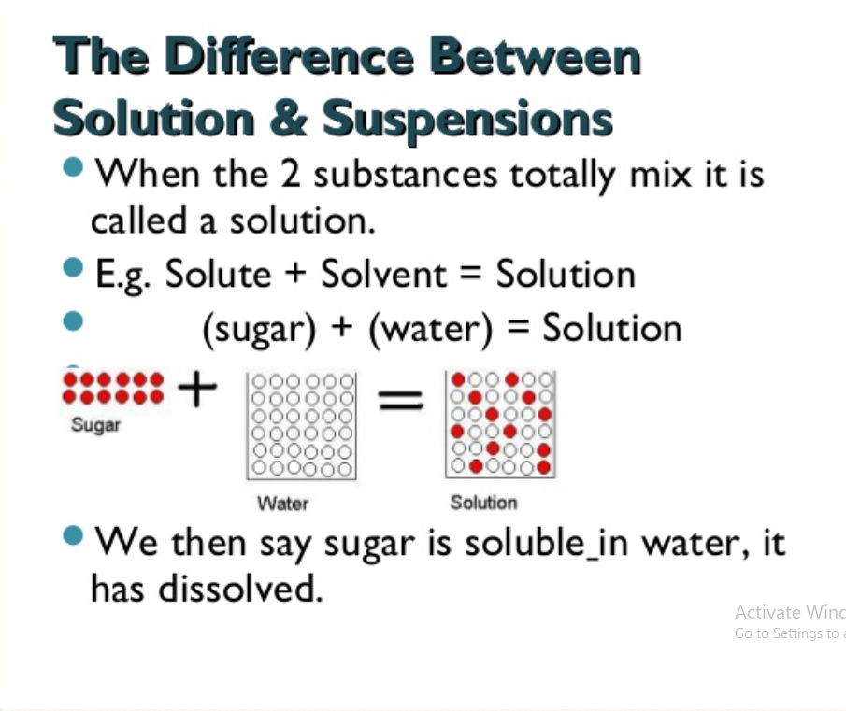

Slide 4
Type of dispersion according to dosage form
Emulsion (liquid in liquid)
Ointment, paste ( solid in solid )
Suspension (solid in liquid)

Slide 5
Type of dispersion according to particle size
1.Coarse dispersion : (10-50 µm)
2. Fine dispersion : (0.5-10 µm)
3.colloidal dispersion : (1nm- 0.5 µm)

Slide 6
Suspension
Preparation containing finely divided particles (referred as suspensoid) distributed somewhat uniformly through out a vehicle in which drug exhibit a minimum degree of solubility ).
Advantages of suspensions :
it is used in preparation of certain drugs that are chemically unstable in solution form (ex. Antibiotics)
It is used to overcome the disadvantages of disagreeable taste of certain drugs when given in solution form (ex. metronidazol suspension)

Slide 7
Features desired in pharmaceutical suspension
A properly prepared pharmaceutical suspension should settle slowly and should be readily redispersed upon gentle shaking.
The characteristics of suspension should be such that the particle size of suspension remains fairly constant through out long periods of undistributed standing (i.e should not able to form hard cake )
The suspension should pour readily and evenly from it´s container .

Slide 8
Classification of suspension
Suspension containing diffusible solids.
Suspension containing indiffusible solids.
Suspension containing precipitate –forming liquid.
Suspension containing poorly wettable solids.
Suspension produced by chemical reaction.

Slide 9
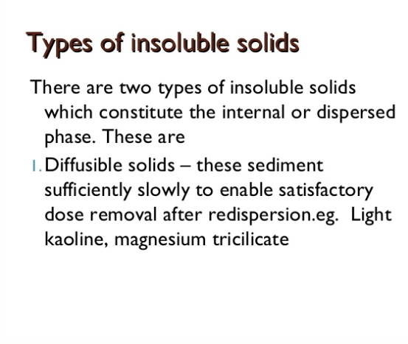

Slide 10
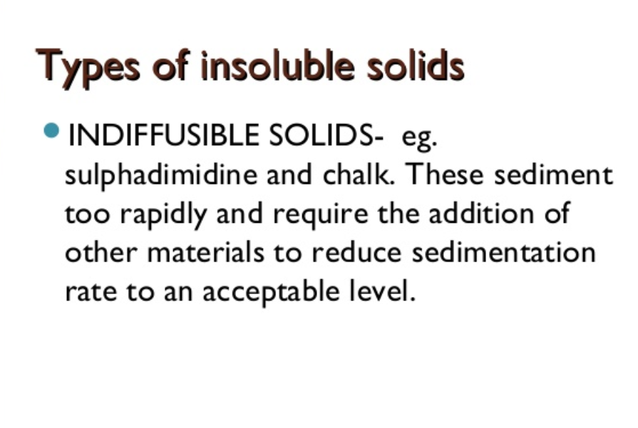

Slide 11
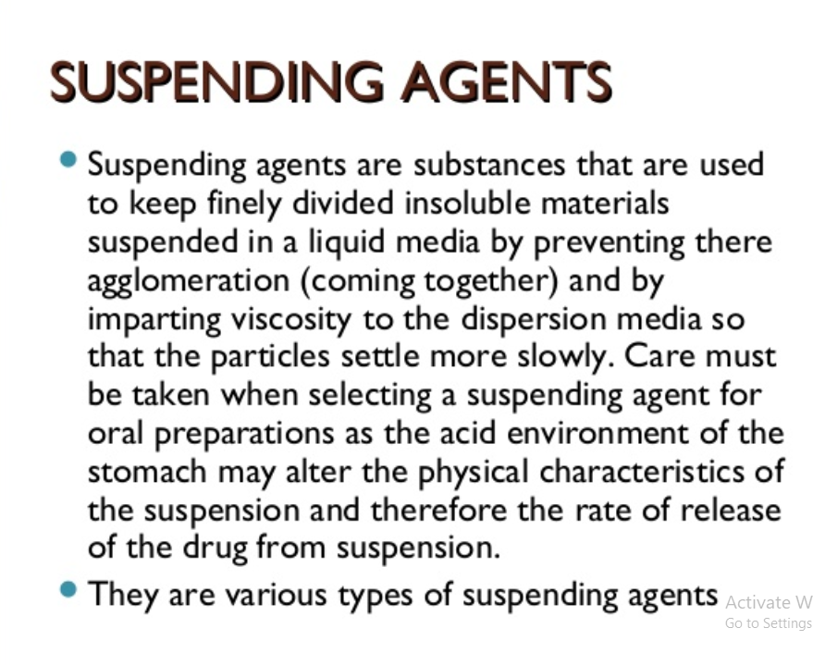

Slide 12
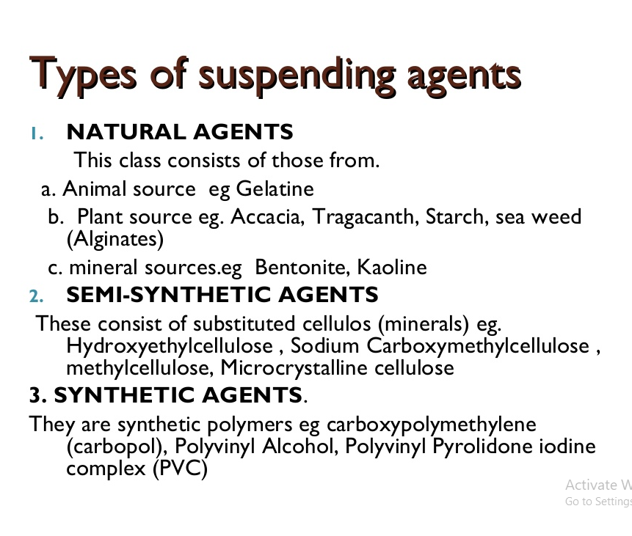

Slide 13
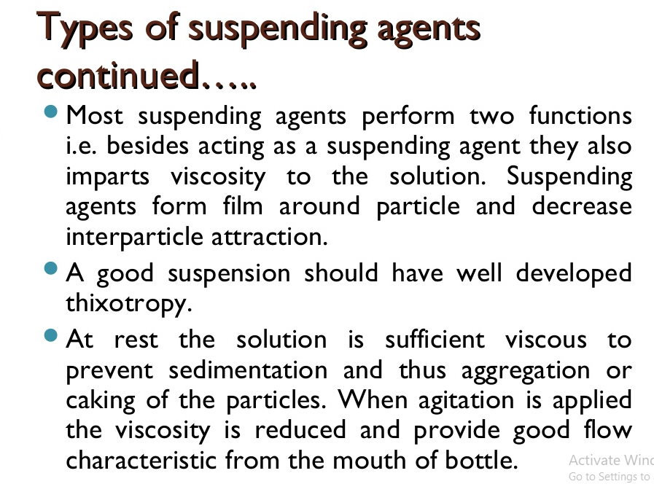

Slide 14
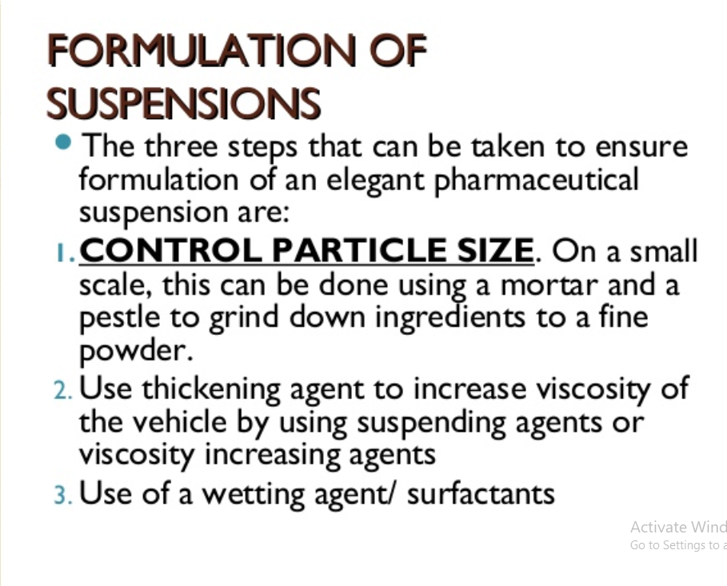

Slide 15
1-Suspension containing diffusible solids
Diffusible powders are light and easily wetted by water. they mix readily with water, so on shaking , the powders are evenly diffused throughout the liquid for sufficient time to ensure uniform distribution in each dose.
General method of preparation of suspensions containing diffusible solids:
Grind down the solid ingredients to fine powder by using a mortar and pestle.
Mix insoluble powder in mortar beginning firstly by ingredient of smallest bulk and diluting it with others in increasing order of bulk using amount approximately equal to the bulk already in mortar , this process is called (geometric dilution ).
Subtract the volume of liquid ingredients from ¾ of the vehicle.
The remaining amount of the vehicle divided into 3 parts :
First part added to mortar in order to prepare a smooth paste by trituration .
The second part add to dilute the smooth paste.
While the third part add to wash the mortar .
Filter by muslin gauze.
add the liquid ingredients .
Transfer the content of mortar to measuring cylinder and complete the volume of the prescription to the final volume by addition of the remaining amount of vehicle.

Slide 16
Notes:-
The soluble non volatile materials added to the portion of vehicle used for dilution.
Volatile material added to the suspensions before complete the volume.
Syrup and glycerin added to the powder in the mortar before the formation of smooth paste.
dye added after the formation of smooth paste before dilution in order to penetrate the insoluble particles.

Slide 17

Experimental work
Rx1
Light magnesium carbonate gr x
Sodium bicarb. gr xv
Chloroform water q.s i
Ft. Mist.
Mitt. iv
Sig. Ss q.i.d

Slide 18
Rx2
Light kaolin gr x
Bismuth carbonate gr xii
Heavy magnesium gr x
Tincture of belladonna
Peppermint water q.s
Ft. mist.
Mitt. iii
Sig. P.r.n
Procedure:
By general method
Notes :
This prescription is used to treat diarrhea
Bismuth carbonate (insoluble salt) has protective action and antiseptic action in gastric ulcer ,it protects the ulcerated surface from secretions of stomach it act as antacid.

Slide 19
RX3
Boric acid
Distilled water q.s 100 g
Ft.mist.
Mitt 25 ml
Sig. topically as directed
Procedure:
By general method
Notes:
boric acid in concentration less than 4% is soluble and used to irrigate the eye due to its buffer action, it is weak antiseptic and it is non irritant, also it is used as mouth wash and bladder irrigating .
Boric acid in concentration more than 4%is insoluble, but by increasing the temperature the solubility will be increased but after cooling it will become insoluble again.
Method of preparation :
By general procedure method.

