Slide 1
Experiment No.(1)
Preparation and standardization of Approximately 0.1 M(HCl) hydrochloric acid solution

Slide 2
Theory
Hydrochloric acid is produced in solutions up to 38% HCl (concentrated grade). Higher concentrations up to just over 40% are chemically possible, but the evaporation rate is then so high that storage and handling need extra precautions, such as pressure and low temperature. Laboratory grade hydrochloric acid is not sufficiently pure to be used as a primary standard, because it evaporates easily. In this experiment, a standard solution of sodium carbonate is used to determine the exact concentration of a hydrochloric acid solution. The neutralization reaction that occurs is as follows:

Slide 3
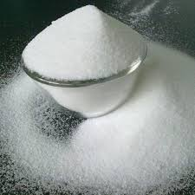
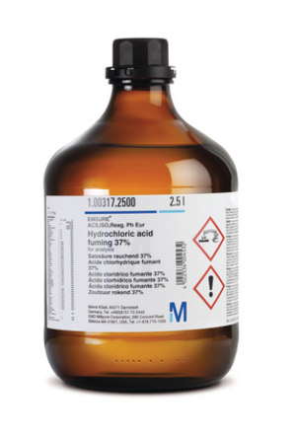
Na2CO3 + 2HCl = 2NaCl + H2 CO3
Na2CO3
HCL

Slide 4
primary and secondary standards
primary
secondary
Primary stander solution are solution made out of primary stander substances .
Extremely pure (about 99.9 %).
Less or not reactive .
Not hygroscopic .
Used standardize secondary standards and other reagent
Secondary stander solution are solution made specifically for a certain analysis .
Not very pure .
Comparatively more reactive .
Somewhat hygroscopic.
Used for specific analytical experiments

Slide 5
Procedure
. Preparing (50 ml) 0.1 M HCl Solution:38 % HCL shows density 1.19 g/mL and we can find M by next Just an example : -
M = sp.gr * % * 1000
M.wt
Calculate the volume of HCl (conc.):- We must dilute it to preparing 0.1 M HCl in 50 ml from next:
(N* V) conc. = (N * V) dilute

Slide 6
Procedure
1- Preparing (50 ml) 0.1 M Na2CO3 Solution:-calculate amount from sodium
carbonate for prepare 0.1 M in 50 ml –
M = Wt.(gm) /M.Wt.* 1000 /V(ml)
0.1 = Wt.(gm) 1000 106 50 *
Wt. =0.53 gm

Slide 7
Procedure
2- Preparing (50 ml) 0.1 M Na2CO3 Solution:-calculate amount from sodium carbonate for prepare 0.1 M in 50 ml –
M = Wt.(gm) /M.Wt.* 1000/ V(ml)
0.1 = Wt.(gm)* 1000 /106* 50
Wt. =0.53 gm

Slide 8
Procedure
Weigh 0.53 gm. from Na2CO3 in clean and dry beaker and dilute in 30 ml D.W, transfer solution to volumetric flask capacity 50 ml and complete the volume to the mark by D.W.
3. Transfer known volume of 5 ml the sodium carbonate solution, with a pipette, to a conical flask then add one or two drops of methyl orange to this solution.

Slide 9
Procedure
4. Add the acid unknown solution from the burette gradually with continuous swirling of the solution in the conical flask and near the end point, the acid is added drop by drop. Continue the addition of the acid until the color of the solution passes from yellow to faint red.
5.Repeat the experiment three times and tabulate your results then take the mean of the three readings.

Slide 10
Discussion
1.What the difference between primary and secondary standard substances? 2.Calculate the volume of conc. HCl required for preparing 250 ml 0.1 M? 3.Calculate the weight of Na2CO3 required for preparing 100 ml 0.1 M?
4.Why is sodium carbonate primary solution?
5.Why standard solution should be colorless?
6.Why is HCl not primary solution?
7.What is the titration?

Slide 11
Lecture . Mohammed abdullah ahmed

