Slide 1
Drugs of hyperlipidemia
4th Stage
Dr. Dalia Abd Al- Kader
PhD Pharmacology

Slide 2
Coronary heart disease (CHD) is correlated with elevated levels of low-density lipoprotein cholesterol (LDL-C; “bad” cholesterol) and triglycerides and low levels of high-density lipoprotein cholesterol (HDL-C; “good cholesterol”).
Other risk factors include cigarette smoking, hypertension, obesity, and diabetes.
Cholesterol levels may be elevated due to lifestyle factors (lack of exercise or diet containing excess saturated fats).
Hyperlipidemias can also result from an inherited defect in lipoprotein metabolism or, more commonly, from a combination of genetic and lifestyle factors. Appropriate lifestyle changes, along with drug therapy, can lead to a 30% to 40% reduction in CHD mortality.

Slide 3
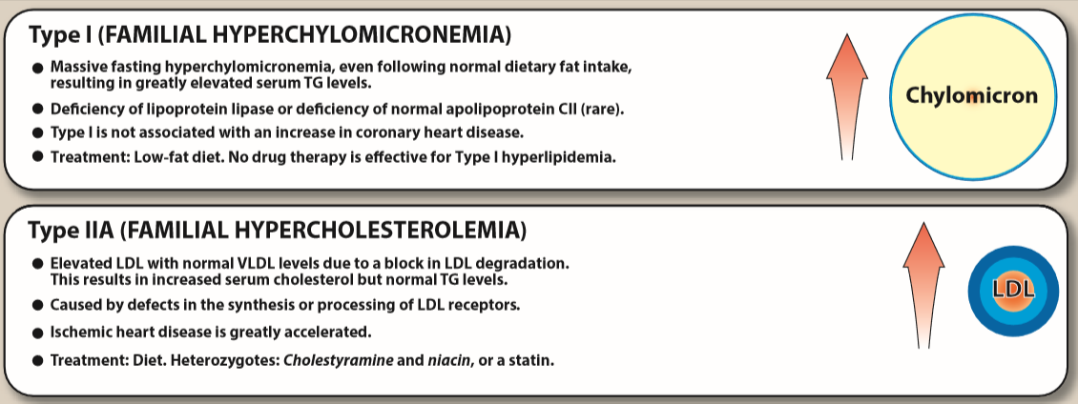

Slide 4
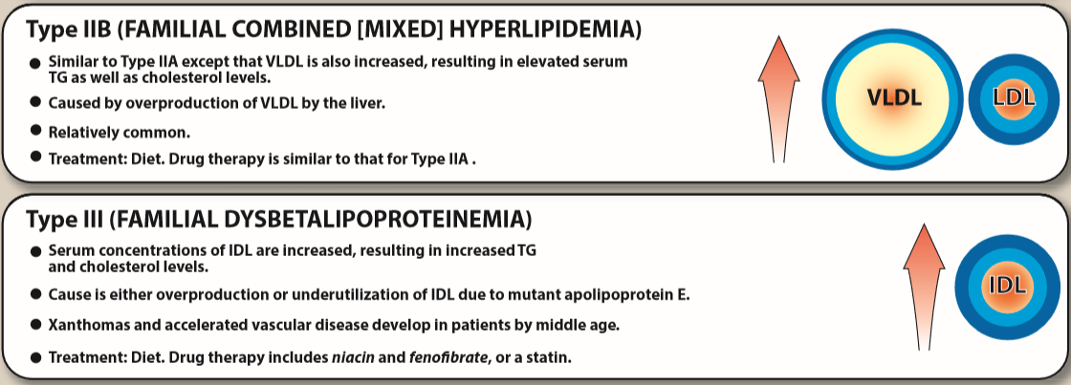

Slide 5
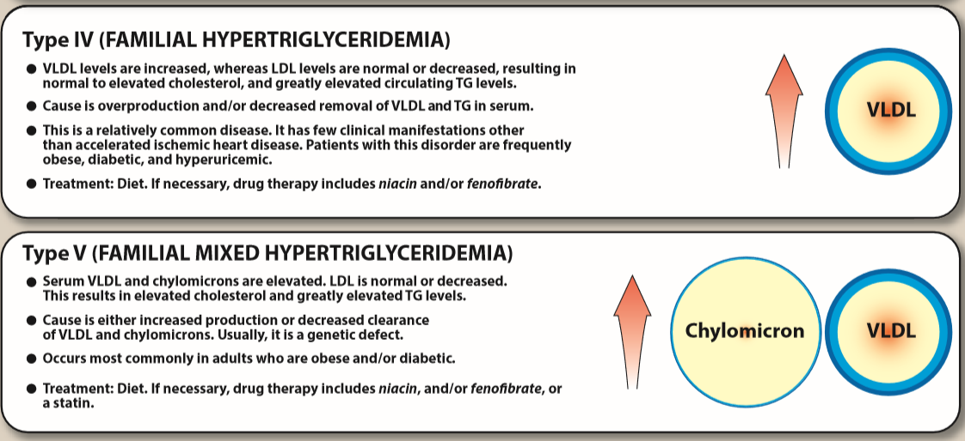

Slide 6
TREATMENT GOALS
Plasma lipids consist mostly of lipoproteins, which are spherical complexes of lipids and specific proteins (apolipoproteins).
The clinically important lipoproteins, listed in decreasing order of atherogenicity, are LDL, VLDL, chylomicrons, and HDL.
The occurrence of CHD is positively associated with high total cholesterol and more strongly with elevated LDL-C.
Total cholesterol is the sum of LDL-C, VLDL-C, and HDL-C
In contrast to LDL-C, high levels of HDL-C have been associated with a decreased risk for heart disease.
Reduction of LDL-C is the primary goal of cholesterol- lowering therapy.

Slide 7
Treatment options for hypercholesterolemia Lifestyle changes, such as diet, exercise, and weight reduction, can lead to modest decreases in LDL-C and increases in HDL-C.
However, most patients are unable to achieve significant LDL-C reductions with lifestyle modifications alone, and drug therapy may be required. Treatment with HMG CoA reductase inhibitors (statins) is the primary treatment option for hypercholesterolemia.

Slide 8
Treatment options for hypertriglyceridemia Elevated triglycerides are independently associated with increased risk of CHD. Diet and exercise are the primary modes of treating hypertriglyceridemia.
-niacin
-fibric acid derivatives
-Omega-3 fatty acids (fish oil)

Slide 9
DRUGS FOR HYPERLIPIDEMIA
3-Hydroxy-3-methylglutaryl coenzyme A
reductase inhibitors (HMG CoA) reductase inhibitors (statins)
lower elevated LDL-C, resulting in a substantial reduction in coronary events and death from CHD.
Therapeutic benefits include plaque stabilization, improvement of coronary endothelial function, inhibition of platelet thrombus formation, and anti-inflammatory activity.

Slide 10
Mechanism of action: Lovastatin , simvastatin, pravastatin , atorvastatin , fluvastatin , pitavastatin, and rosuvastatin are competitive inhibitors of HMG CoA reductase, the rate-limiting step in cholesterol synthesis. By inhibiting cholesterol synthesis, they deplete the intracellular supply of cholesterol which cause increase the number of cell surface LDL receptors that can bind circulating LDLs. Thus, plasma cholesterol is reduced, by both decreased cholesterol synthesis and increased LDL catabolism.

Slide 11
Therapeutic uses:
These drugs are effective in lowering plasma cholesterol
levels in all types of hyperlipidemias. However, patients
who are homozygous for familial hypercholesterolemia lack
LDL receptors and, therefore, benefit much less from
treatment with these drugs.
Pharmacokinetics:
Lovastatin and simvastatin are lactones that are hydrolyzed to
the active drug. The remaining statins are all administered in
their active form.
Absorption of the statins is variable (30% to 85%) following oral
administration.
All statins are metabolized in the liver, with some metabolites
retaining activity.
Excretion takes place principally through bile and feces, but some
urinary elimination also occurs.

Slide 12
Adverse effects:
Elevated liver enzymes may occur. (liver function should be evaluated prior to starting therapy and if a patient has symptoms consistent with liver dysfunction).
Hepatic insufficiency can cause drug accumulation
Myopathy and rhabdomyolysis (disintegration of skeletal muscle; rare). In most of these cases, patients usually had renal insufficiency or were taking drugs such as erythromycin, gemfibrozil, or niacin. Simvastatin is metabolized by cytochrome P450 3A4, and inhibitors of this enzyme may increase the risk of rhabdomyolysis. Plasma creatine kinase levels should be determined in patients with muscle complaints.
increase the effect of warfarin. Thus, it is important to evaluate international normalized ratio (INR) frequently.
contraindicated during pregnancy and lactation.

Slide 13
2. Niacin (nicotinic acid)
can reduce LDL-C by 10% to 20% and is the most effective agent for increasing HDL-C.
It also lowers triglycerides by 20% to 35% at typical doses of 1.5 to 3 grams/day.
Niacin can be used in combination with statins, and a fixed-dose combination of lovastatin and long-acting niacin is available.
Mechanism of action: At gram doses, niacin strongly
inhibits lipolysis in adipose tissue, thereby reducing
production of free fatty acids. The liver normally uses
circulating free fatty acids as a major precursor for
triglyceride synthesis. Reduced liver triglyceride levels
decrease hepatic VLDL production, which in turn
reduces LDL-C plasma concentrations.

Slide 14
Therapeutic uses:
lowers plasma levels of both cholesterol and
triglycerides, it is useful in the treatment of familial hyperlipidemias.
used to treat other severe hypercholesterolemias,
often in combination with other agents.
Pharmacokinetics:
administered orally
converted in the body to nicotinamide
Niacin, its nicotinamide derivative, and other metabolites are excreted in the urine.

Slide 15
Adverse effects:
intense cutaneous flush (accompanied by an
uncomfortable feeling of warmth) and pruritus.
Administration of aspirin prior to taking niacin
decreases the flush, which is prostaglandin mediated.
nausea and abdominal pain.
Slow titration of the dosage or usage of the sustained-release formulation of niacin reduces bothersome initial adverse effects.
Niacin inhibits tubular secretion of uric acid and, thus, predisposes to hyperuricemia and gout.
Impaired glucose tolerance and hepatotoxicity have also been reported. The drug should be avoided in hepatic disease.

Slide 16
3. Fibrates Fenofibrate and gemfibrozil are derivatives of fibric acid that lower serum triglycerides and increase HDL levels.

Slide 17
Mechanism of action: The peroxisome proliferator–activated receptors (PPARs) are members of the nuclear receptor family that regulates lipid metabolism. Upon binding to antihyperlipidemic drugs, PPARs are activated. They then bind to peroxisome proliferator response elements, which ultimately leads to decreased triglyceride concentrations through increased expression of lipoprotein lipase.
Fenofibrate is more effective than gemfibrozil in lowering triglyceride levels.
Fibrates also increase the level of HDL cholesterol by increasing the expression of apo AI and apo AII.

Slide 18
Therapeutic uses: used in the treatment of
hypertriglyceridemias. They are
particularly useful in treating type III hyperlipidemia
(dysbetalipoproteinemia), in which intermediate
density lipoprotein particles accumulate.
Pharmacokinetics:
Gemfibrozil and fenofibrate are completely absorbed after oral administration
distribute widely, bound to albumin.
Fenofibrate is a prodrug, which is converted to
fenofibric acid.
undergo extensive biotransformation
excreted in the urine as glucuronide conjugates.

Slide 19
Adverse effects:
mild GI disturbances.
Because these drugs increase biliary cholesterol excretion,
there is a predisposition to form gallstones.
Myositis (inflammation of a voluntary muscle).
Patients with renal insufficiency may be at risk.
Myopathy and rhabdomyolysis have been reported in patients taking gemfibrozil and statins together.
The use of gemfibrozil is contraindicated with simvastatin.
Both fibrates may increase the effects of warfarin. INR should, therefore, be monitored more frequently when a patient is taking both drugs.
Fibrates should not be used in patients with severe hepatic or renal dysfunction or in patients with preexisting gallbladder disease.

Slide 20
4. Bile acid–binding resins Bile acid sequestrants (resins)
have significant LDL cholesterol– lowering effects, although the benefits are less than those observed with statins.
Mechanism of action: Cholestyramine, colestipol, and colesevelam are anion-exchange resins that bind negatively charged bile acids and bile salts in the small intestine . The resin/bile acid complex is excreted in the feces, thus lowering the bile acid concentration. This causes hepatocytes to increase conversion of cholesterol to bile acids, which are essential components of the bile. Consequently, intracellular cholesterol concentrations decrease, which activates an increased hepatic uptake of cholesterol- containing LDL particles, leading to a fall in plasma LDL-C. [Note: This increased uptake is mediated by an up-regulation of cell surface LDL receptors.]

Slide 21
Therapeutic uses: The bile acid–binding resins are useful (often in combination with diet or niacin) for treating type IIA and type IIB hyperlipidemias.
Cholestyramine can also relieve pruritus caused by accumulation of bile acids in patients with biliary stasis. Colesevelam is also indicated for type 2 diabetes due to its glucose-lowering effects.

Slide 22
Pharmacokinetics:
insoluble in water and have large molecular weights.
After oral administration, they are neither absorbed nor metabolically altered by the intestine( totally excreted in feces).
Adverse effects:
GI disturbances, such as constipation, nausea, and flatulence.
Colesevelam has fewer GI side effects than other bile acid sequestrants.
impair the absorption of the fat-soluble vitamins (A, D, E, and K
interfere with the absorption of many drugs (digoxin, warfarin, and thyroid hormone). Other drugs should be taken at least 1 to 2 hours before, or 4 to 6 hours after, the bile acid–binding resins.
may raise triglyceride levels and are contraindicated in patients with significant hypertriglyceridemia (≥400 mg/dL).

Slide 23
5. Cholesterol absorption inhibitor Ezetimibe
selectively inhibits absorption of dietary and biliary cholesterol in the small intestine, leading to a decrease in the delivery of intestinal cholesterol to the liver. This causes a reduction of hepatic cholesterol stores and an increase in clearance of cholesterol from the blood.
Ezetimibe lowers LDL cholesterol by approximately 17%. Due its modest LDL-lowering effects, ezetimibe is often used as an adjunct to statin therapy or in statin-intolerant patients.
primarily metabolized in the small intestine and liver via glucuronide conjugation, with subsequent biliary and renal excretion. Patients with moderate to severe hepatic insufficiency should not be treated with ezetimibe.
Adverse effects are uncommon with use of ezetimibe.

Slide 24
6. Omega-3 fatty acids
Omega-3 polyunsaturated fatty acids (PUFAs) used for triglyceride lowering. inhibit VLDL and triglyceride synthesis in the liver. The omega-3 (EPA) and (DHA) are found in marine sources as tuna, halibut, and salmon.
Approximately 4 g of marine-derived omega-3 PUFAs daily decreases serum triglyceride concentrations by 25% to 30%, with small increases in LDL-C and HDL-C.
Over-the-counter or prescription fish oil capsules (EPA/DHA) can be used for supplementation.
Icosapent ethyl is a prescription product that contains only EPA and, unlike other fish oil supplements, does not significantly raise LDL-C.
Omega-3 PUFAs can be considered as an adjunct to other lipid-lowering therapies for individuals with significantly elevated triglycerides (≥500 mg/dL). Although effective for triglyceride lowering, omega-3 PUFA supplementation has not been shown to reduce cardiovascular morbidity and mortality.
side effects :GI effects (abdominal pain, nausea, diarrhea) and a fishy aftertaste. Bleeding risk can be increased in those who are concomitantly taking anticoagulants or antiplatelets.

Slide 25
7. Combination drug therapy
It is often necessary to use two antihyperlipidemic drugs to achieve treatment goals in plasma lipid levels.
The combination of an HMG CoA reductase inhibitor with a bile acid–binding agent has been shown to be very useful in lowering LDL-C levels.
Simvastatin and ezetimibe, as well as simvastatin and niacin, are currently available combined in one pill to treat elevated LDL cholesterol.
Combination drug therapy is not without risks. Liver and muscle toxicity occurs more frequently with lipid-lowering drug combinations.

