Slide 1

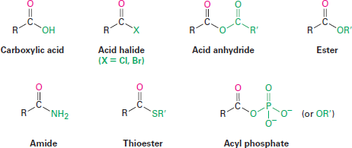
Carboxylic Acid Derivatives: Nucleophilic Acyl Substitution Reactions
Closely related to the carboxylic acids discussed in the previous chapter are the carboxylic acid derivatives, compounds in which an acyl group is bonded to an electronegative atom or substituent that can act as a leaving group in the nucleophilic acyl substitution reaction that we saw briefly in the Preview of Carbonyl Chemistry:
Many kinds of acid derivatives are known, but we’ll be concerned primarily with four of the more common ones: acid halides, acid anhydrides, esters, and amides. Acid halides and acid anhydrides are used only in the laboratory, while esters and amides are common in both laboratory and biological chemistry. In addition, carboxylic acid derivatives called thioesters and acyl phosphates are encountered primarily in biological chemistry. Note the structural similarity between acid anhydrides and acyl phosphates.
Naming Carboxylic Acid Derivatives Acid Halides, RCOX
Acid halides are named by identifying first the acyl group and then the halide. The acyl group
name is derived from the carboxylic acid name by replacing the -ic acid or -oic acid ending with
-oyl, or the -carboxylic acid ending with -carbonyl. To keep things interesting, however, IUPAC recognizes eight exceptions for which a -yl rather than an -oyl ending is used: formic (formyl), acetic (acetyl), propionic (propionyl), butyric (butyryl), oxalic (oxalyl), malonic (malonyl),
succinic (succinyl), and glutaric (glutaryl).

Slide 2
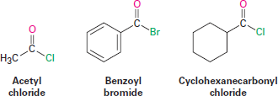
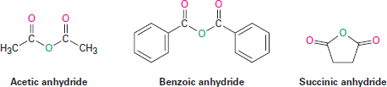

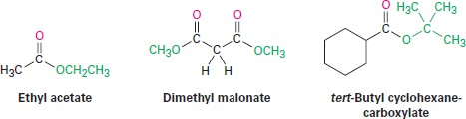

Acid Anhydrides, RCO₂COR/
Symmetrical anhydrides of unsubstituted monocarboxylic acids and cyclic anhydrides of
dicarboxylic acids are named by replacing the word acid with anhydride.
Unsymmetrical anhydrides those prepared from two different carboxylic acids are named by listing the two acids alphabetically and then adding anhydride.
Esters, RCO₂R/
Esters are named by first identifying the alkyl group attached to oxygen and then the carboxylic
acid, with the -ic acid ending replaced by -ate.
Amides, RCONH₂
Amides with an unsubstituted -NH₂ group are named by replacing the -oic acid or -ic acid
ending with -amide, or by replacing the -carboxylic acid ending with -carboxamide.

Slide 3
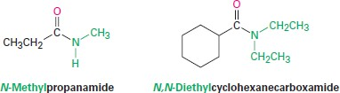
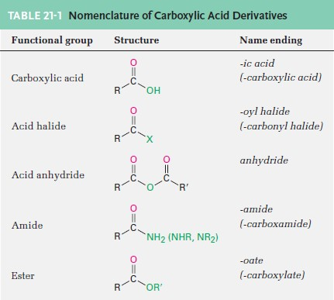
If the nitrogen atom is further substituted, the compound is named by first identifying the substituent groups and then the parent amide. The substituents are preceded by the letter N to identify them as being directly attached to nitrogen.
A summary of nomenclature rules for carboxylic acid derivatives is given in Table 21-1.
Nucleophilic Acyl Substitution Reactions
When a nucleophile adds to a carboxylic acid derivative, however, a different reaction path is
taken. The initially formed tetrahedral intermediate eliminates one of the two substituents
originally bonded to the carbonyl carbon, leading to a net nucleophilic acyl substitution reaction (Figure 21-1). The difference in behavior between aldehydes/ketones and carboxylic acid derivatives is a consequence of structure. Carboxylic acid derivatives have an acyl carbon bonded to a group -Y that can act as a leaving group, often as a stable anion. As soon as the tetrahedral intermediate is formed, the leaving group is expelled to generate a new carbonyl

Slide 4
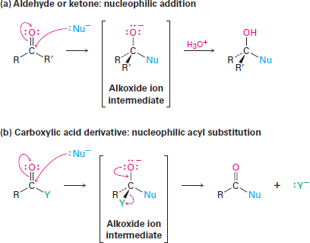
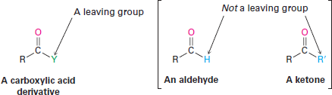
compound. Aldehydes and ketones have no such leaving group, however, and therefore don’t undergo substitution.
Figure 21-1 the general mechanisms of nucleophilic addition and nucleophilic acyl substitution reactions. Both reactions begin with addition of a nucleophile to a polar C=O bond to give a tetrahedral, alkoxide ion intermediate. (a) The intermediate formed from an aldehyde or ketone is protonated to give an alcohol, but (b) the intermediate formed from a carboxylic acid derivative expels a leaving group to give a new carbonyl compound.
The net effect of the addition/elimination sequence is a substitution of the nucleophile for the -Y
group originally bonded to the acyl carbon. Thus, the overall reaction is superficially similar to
2
the kind of nucleophilic substitution that occurs during an S_{N} reaction, but the mechanisms of
2
the two reactions are completely different. An S_{N} reaction occurs in a single step by backside
displacement of the leaving group, while a nucleophilic acyl substitution takes place in two steps and involves a tetrahedral intermediate.

Slide 5
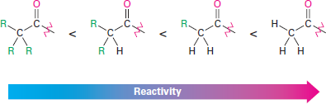
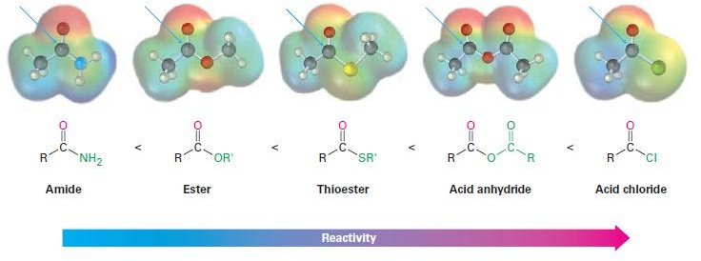
Relative Reactivity of Carboxylic Acid Derivatives
Both the initial addition step and the subsequent elimination step can affect the overall rate of a
nucleophilic acyl substitution reaction, but the addition is generally the rate-limiting step. Thus,
any factor that makes the carbonyl group more reactive toward nucleophiles favors the substitution process. Steric and electronic factors are both important in determining reactivity.
Sterically, we find within a series of similar acid derivatives that unhindered, accessible carbonyl groups react with nucleophiles more readily than do sterically hindered groups. The reactivity
order is
Electronically, we find that strongly polarized acyl compounds react more readily than less polar ones. Thus, acid chlorides are the most reactive because the electronegative chlorine atom withdraws electrons from the carbonyl carbon, whereas amides are the least reactive. Although subtle, electrostatic potential maps of various carboxylic acid derivatives indicate these differences by the relative blueness on the C=O carbons. Acyl phosphates are hard to place on this scale because they are not often used in the laboratory, but in biological systems they appear to be somewhat more reactive than thioesters.
The way in which various substituents affect the polarization of a carbonyl group is similar to the way they affect the reactivity of an aromatic ring toward electrophilic substitution. A chlorine substituent, for example, inductively withdraws electrons from an acyl group in the same way that it withdraws electrons from and thus deactivates an aromatic ring. Similarly, amino, methoxyl, and methylthio substituents donate electrons to acyl groups by resonance in the same way that they donate electrons to, and thus activate, aromatic rings.

Slide 6
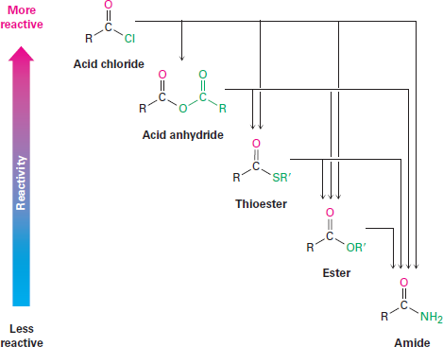
As a consequence of these reactivity differences, it’s usually possible to convert a more reactive acid derivative into a less reactive one. Acid chlorides, for instance, can be directly converted into anhydrides, thioesters, esters, and amides, but amides can’t be directly converted into esters, thioesters, anhydrides, or acid chlorides. Remembering the reactivity order is therefore a way to keep track of a large number of reactions (Figure 21-2). Another consequence, as noted previously, is that only acyl phosphates, thioesters, esters, and amides are commonly found in nature. Acid halides and acid anhydrides react so rapidly with water that they can’t exist for long in living organisms.
Figure 21-2 interconversions of carboxylic acid derivatives. A more reactive acid derivative can be converted into a less reactive one, but not vice versa.
In studying the chemistry of carboxylic acid derivatives in the next few sections, we’ll be concerned largely with the reactions of just a few nucleophiles and will see that the same kinds of reactions tend to occur (Figure 21-3).
Hydrolysis Reaction with water to yield a carboxylic acid
Alcoholysis Reaction with an alcohol to yield an ester
Aminolysis Reaction with ammonia or an amine to yield an amide
Reduction Reaction with a hydride reducing agent to yield an aldehyde or an alcohol
Grignard reaction with an organometallic reagent to yield a ketone or an alcohol

Slide 7
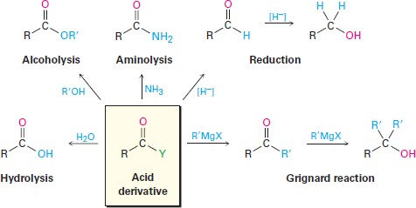

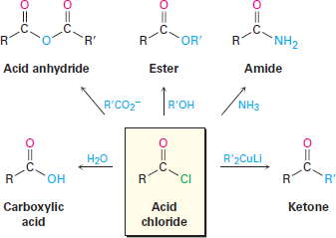
Figure 21-3 some general reactions of carboxylic acid derivatives.
Chemistry of Acid Halides Preparation of Acid Halides
Acid chlorides are prepared from carboxylic acids by reaction with thionyl chloride (SOCl₂).
Similar reaction of a carboxylic acid with phosphorus tribromide (PBr₃) yields the acid bromide.
Reactions of Acid Halides
Acid halides are among the most reactive of carboxylic acid derivatives and can be converted
into many other kinds of compounds by nucleophilic acyl substitution mechanisms. The halogen can be replaced by -OH to yield an acid, by -OCOR to yield an anhydride, by -OR to yield an ester, by -NH₂ to yield an amide, or by R/ to yield a ketone. In addition, the reduction of an acid halide yields a primary alcohol, and reaction with a Grignard reagent yields a tertiary alcohol.
Although the reactions we’ll be discussing in this section are illustrated only for acid chlorides, similar processes take place with other acid halides.

Slide 8


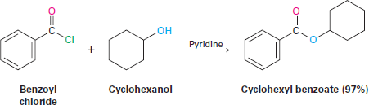
Conversion of Acid Halides into Acids: Hydrolysis
Acid chlorides react with water to yield carboxylic acids. This hydrolysis reaction is a typical
nucleophilic acyl substitution process and is initiated by attack of water on the acid chloride
carbonyl group. The tetrahedral intermediate undergoes elimination of Cl⁻ and loss of H⁺ to give the product carboxylic acid plus HCl.
Because HCl is formed during hydrolysis, this reaction is often carried out in the presence of a base such as pyridine or NaOH to remove the HCl and prevent it from causing side reactions.
Conversion of Acid Halides into Anhydrides
Nucleophilic acyl substitution reaction of an acid chloride with a carboxylate anion gives an acid
anhydride. Both symmetrical and unsymmetrical acid anhydrides can be prepared.
Conversion of Acid Halides into Esters: Alcoholysis
Acid chlorides react with alcohols to yield esters in a process analogous to their reaction with
water to yield acids. In fact, this reaction is probably the most common method for preparing esters in the laboratory. As with hydrolysis, alcoholysis reactions are usually carried out in the presence of pyridine or NaOH to react with the HCl formed.
The reaction of an alcohol with an acid chloride is strongly affected by steric hindrance. Bulky groups on either partner slow down the reaction considerably, resulting in a reactivity order among alcohols of primary>secondary>tertiary. As a result, it’s often possible to selectively esterify an unhindered alcohol in the presence of a more hindered one. This can be important in complex syntheses in which it’s sometimes necessary to distinguish between similar functional groups. For example,

Slide 9
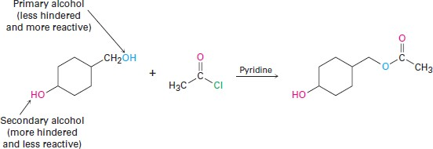
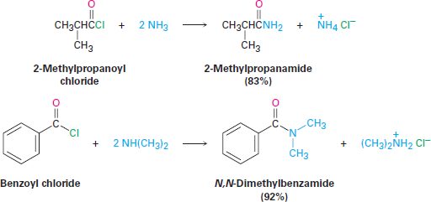
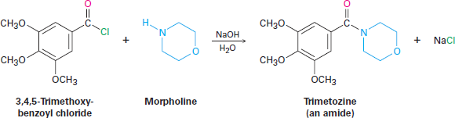
Conversion of Acid Halides into Amides: Aminolysis
Acid chlorides react rapidly with ammonia and amines to give amides. As with the acid chloride
plus-alcohol method for preparing esters, this reaction of acid chlorides with amines is the most commonly used laboratory method for preparing amides. Both monosubstituted and disubstituted
amines can be used, but not trisubstituted amines (R₃N).
Because HCl is formed during the reaction, two equivalents of the amine must be used. One equivalent reacts with the acid chloride, and one equivalent reacts with the HCl by product to form an ammonium chloride salt. If the amine component is valuable, amide synthesis is often carried out using one equivalent of the amine plus one equivalent of an inexpensive base such as NaOH. For example, the sedative trimetozine is prepared commercially by reaction of 3,4,5- trimethoxybenzoyl chloride with the amine morpholine in the presence of one equivalent of NaOH.

Slide 10
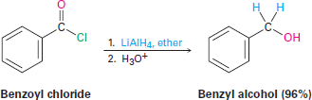
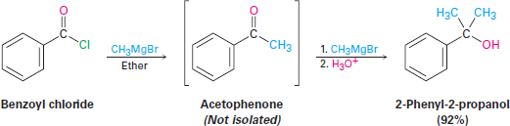
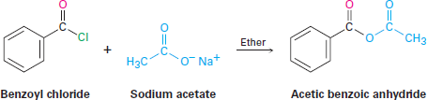
Conversion of Acid Chlorides into Alcohols:
Reduction and Grignard Reaction
Acid chlorides are reduced by LiAlH₄ to yield primary alcohols. The reaction is of little practical value, however, because the parent carboxylic acids are generally more readily available and can themselves be reduced by LiAlH₄ to yield alcohols.
Reduction occurs via a typical nucleophilic acyl substitution mechanism in which a hydride ion
(H:⁻) adds to the carbonyl group, yielding a tetrahedral intermediate that expels Cl⁻. The net effect is a substitution of -Cl by -H to yield an aldehyde, which is then further reduced by LiAlH₄ in a second step to yield the primary alcohol.
Grignard reagents react with acid chlorides to yield tertiary alcohols with two identical substituents. The mechanism of the reaction is similar to that of LiAlH₄ reduction. The first equivalent of Grignard reagent adds to the acid chloride, loss of Cl₂ from the tetrahedral intermediate yields a ketone, and a second equivalent of Grignard reagent immediately adds to the ketone to produce an alcohol.
Chemistry of Acid Anhydrides Preparation of Acid Anhydrides
Acid anhydrides are typically prepared by nucleophilic acyl substitution reaction of an acid chloride with a carboxylate anion. Both symmetrical and unsymmetrical acid anhydrides can be prepared in this way.

Slide 11
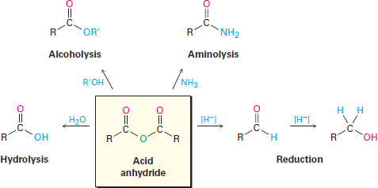
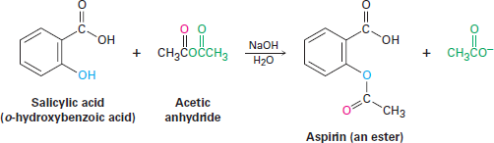
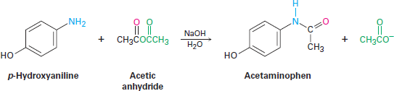
Reactions of Acid Anhydrides
The chemistry of acid anhydrides is similar to that of acid chlorides, although anhydrides react
more slowly. Thus, acid anhydrides react with water to form acids, with alcohols to form esters,
with amines to form amides, and with LiAlH₄ to form primary alcohols. Only the ester- and amide-forming reactions are commonly used, however.
Conversion of Acid Anhydrides into Esters
Acetic anhydride is often used to prepare acetate esters from alcohols. For example, aspirin
(acetylsalicylic acid) is prepared commercially by the acetylation of o-hydroxybenzoic acid (salicylic acid) with acetic anhydride.
Conversion of Acid Anhydrides into Amides
Acetic anhydride is also commonly used to prepare N-substituted acetamides from amines. For example, acetaminophen, a drug used in over-the-counter analgesics such as Tylenol, is prepared by reaction of p-hydroxyaniline with acetic anhydride. Only the more nucleophilic -NH₂ group reacts rather than the less nucleophilic -OH group.

Slide 12
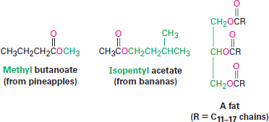
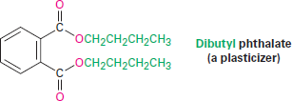
Notice in both of the previous reactions that only “half” of the anhydride molecule is used, while the other half acts as the leaving group during the nucleophilic acyl substitution step and produces acetate ion as a by-product. Thus, anhydrides are inefficient, and acid chlorides are normally preferred for introducing acyl substituents other than acetyl groups.
Chemistry of Esters
Esters are among the most widespread of all naturally occurring compounds. Many simple esters
are pleasant-smelling liquids that are responsible for the fragrant odors of fruits and flowers. For
example, methyl butanoate is found in pineapple oil, and isopentyl acetate is a constituent of banana oil. The ester linkage is also present in animal fats and in many biologically important molecules.
The chemical industry uses esters for a variety of purposes. Ethyl acetate, for instance, is a commonly used solvent, and dialkyl phthalates are used as plasticizers to keep polymers from becoming brittle. You may be aware that there is current concern about the possible toxicity of phthalates at high concentrations, although a recent assessment by the U.S. Food and Drug Administration found the risk to be minimal for most people, with the possible exception of male infants.
Esters are usually prepared from carboxylic acids by the methods already discussed. Thus,
2
carboxylic acids are converted directly into esters by S_{N} reaction of a carboxylate ion with a
primary alkyl halide or by Fischer esterification of a carboxylic acid with an alcohol in the presence of a mineral acid catalyst. In addition, acid chlorides are converted into esters by treatment with an alcohol in the presence of base.

Slide 13
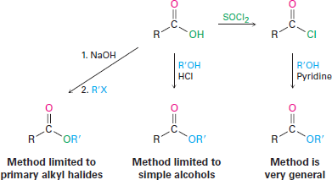



Reactions of Esters
Esters undergo the same kinds of reactions that we’ve seen for other carboxylic acid derivatives,
but they are less reactive toward nucleophiles than either acid chlorides or anhydrides. All their reactions are applicable to both acyclic and cyclic esters, called lactones.
Conversion of Esters into Carboxylic Acids: Hydrolysis
An ester is hydrolyzed, either by aqueous base or aqueous acid, to yield a carboxylic acid plus an
alcohol. Ester hydrolysis in basic solution is called saponification, after the Latin word sapo,
meaning “soap.” soap is in fact made by boiling animal fat with aqueous base to hydrolyze the ester linkages. Ester hydrolysis occurs through a typical nucleophilic acyl substitution pathway
in which hydroxide ion is the nucleophile that adds to the ester carbonyl group to give a tetrahedral intermediate. Loss of alkoxide ion then gives a carboxylic acid, which is deprotonated to give the carboxylate ion. Addition of aqueous HCl, in a separate step after the saponification is complete, protonates the carboxylate ion and gives the carboxylic acid.
The mechanism is supported by isotope-labeling studies. When ethyl propanoate labeled with ¹⁸O in the ether-like oxygen is hydrolyzed in aqueous NaOH, the ¹⁸O label shows up exclusively in the ethanol product. None of the label remains with the propanoic acid, indicating that saponification occurs by cleavage of the C-OR/ bond rather than the CO-R/ bond.

Slide 14
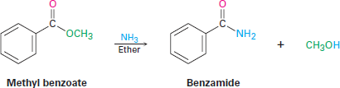
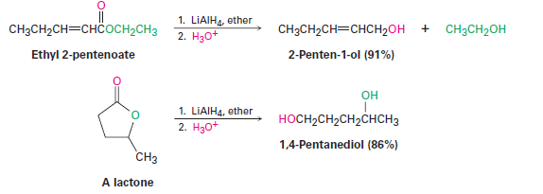
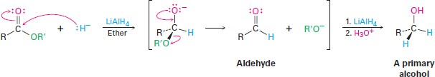
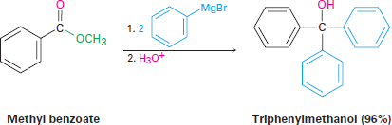
Conversion of Esters into Amides: Aminolysis
Esters react with ammonia and amines to yield amides. The reaction is not often used, however,
because it’s usually easier to prepare an amide by starting with an acid chloride
Conversion of Esters into Alcohols: Reduction
Esters are easily reduced by treatment with LiAlH₄ to yield primary alcohols
The mechanism of ester reduction is similar to that of acid chloride reduction in that a hydride ion first adds to the carbonyl group, followed by elimination of alkoxide ion to yield an aldehyde. Further reduction of the aldehyde gives the primary alcohol.
Conversion of Esters into Alcohols: Grignard Reaction
Esters react with 2 equivalents of a Grignard reagent to yield a tertiary alcohol in which two of
the substituents are identical. The reaction occurs by the usual nucleophilic substitution mechanism to give an intermediate ketone, which reacts further with the Grignard reagent to yield a tertiary alcohol.

Slide 15
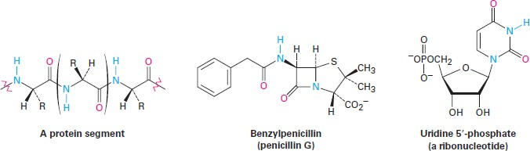
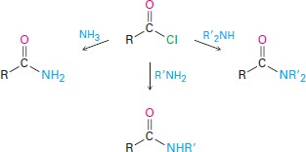
Chemistry of Amides
Amides, like esters, are abundant in all living organisms. Proteins, nucleic acids, and many
pharmaceutical agents have amide functional groups. The reason for this abundance of amides is that they are stable in the aqueous conditions found in living organisms. Amides are the least reactive of the common acid derivatives and undergo relatively few nucleophilic acyl substitution reactions.
Preparation of Amides
Amides are usually prepared by reaction of an acid chloride with an amine. Ammonia, monosubstituted amines, and
disubstituted amines all undergo this reaction.
Reactions of Amides
Conversion of Amides into Carboxylic Acids: Hydrolysis
Amides undergo hydrolysis to yield carboxylic acids plus ammonia or an amine upon heating in
either aqueous acid or aqueous base. The conditions required for amide hydrolysis are more extreme than those required for the hydrolysis of acid chlorides or esters, but the mechanisms are
similar. Acidic hydrolysis reaction occurs by nucleophilic addition of water to the protonated amide, followed by transfer of a proton from oxygen to nitrogen to make the nitrogen a better leaving group, and subsequent elimination. The steps are reversible, with the equilibrium shifted toward product by protonation of NH₃ in the final step.

Slide 16
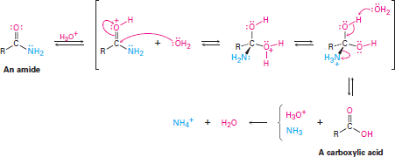

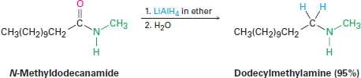
Basic hydrolysis occurs by nucleophilic addition of OH⁻ to the amide carbonyl group, followed by elimination of amide ion (⁻NH₂) and subsequent deprotonation of the initially formed carboxylic acid by ammonia. The steps are reversible, with the equilibrium shifted toward product by the final deprotonation of the carboxylic acid. Basic hydrolysis is substantially more difficult than the analogous acid-catalyzed reaction because amide ion is a very poor leaving group, making the elimination step difficult.
Conversion of Amides into Amines: Reduction
Like other carboxylic acid derivatives, amides can be reduced by LiAlH4. The product of the reduction, however, is an amine rather than an alcohol. The net effect of an amide reduction reaction is thus the conversion of the amide carbonyl group into a methylene group This kind of reaction is specific to amides and does not occur with other
carboxylic acid derivatives.
Amide reduction occurs by nucleophilic addition of hydride ion to the amide carbonyl group, followed by expulsion of the oxygen atom as an aluminate anion leaving group to give an iminium ion intermediate. The intermediate iminium ion is further reduced by LiAlH4 to yield the amine.

Slide 17
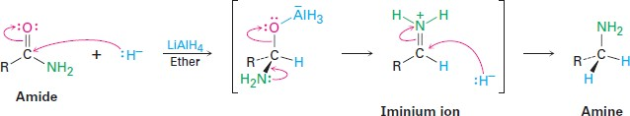

The reaction is effective with both acyclic and cyclic amide (lactams). and is a good method for preparing cyclic amines.

