Slide 1
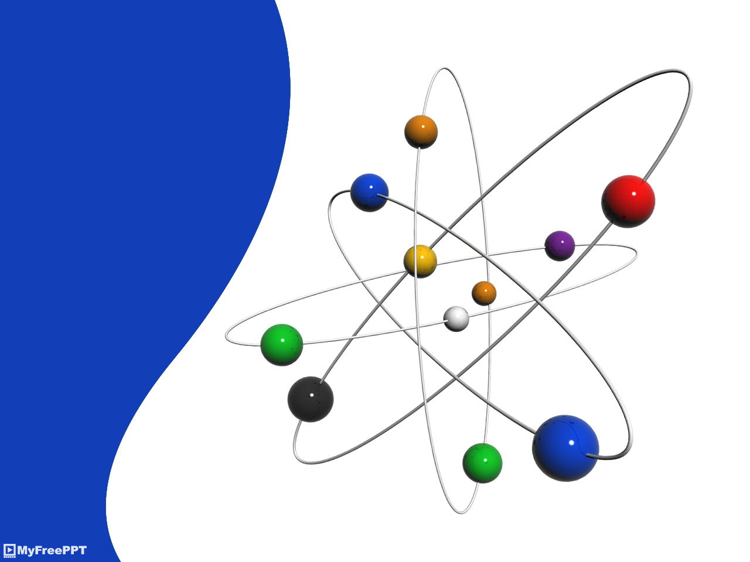
Carboxylic Acids
Dr. Basma Mounjed Al-Kadhi

Slide 2
Carboxylic acids, RCO2H,
occupy a central place among carbonyl compounds. Not only are they valuable in themselves, they also serve as starting materials for preparing numerous carboxylic acid derivatives such as acid chlorides, esters, amides, and thioesters. In addition, carboxylic acids are present in the majority of biological pathways.

Slide 3
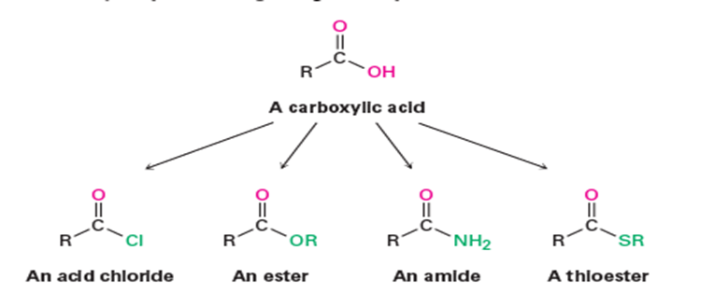

Slide 4
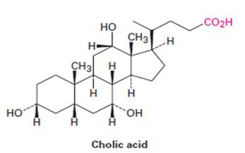
A great many carboxylic acids are found in nature: acetic acid, CH₃CO₂H, is the chief organic component of vinegar; butanoic acid, CH₃CH₂CH₂CO₂H, is responsible for the rancid odor of sour butter; and hexanoic acid (caproic acid), CH₃(CH₂)₄CO₂H, is responsible for the unmistakable aroma of goats and dirty gym socks (the name comes from the Latin caper, meaning “goat”). Other examples are cholic acid, a major component of human bile, and long- chain aliphatic acids such as palmitic acid, CH₃(CH₂)₁₄CO₂H, a biological precursor of fats and vegetable oils.

Slide 5
Naming Carboxylic Acids, RCO₂H
Simple carboxylic acids derived from open-chain alkanes are systematically named by replacing the terminal -e of the corresponding alkane name with -oic acid. The CO₂H carbon atom is numbered C1.

Slide 6

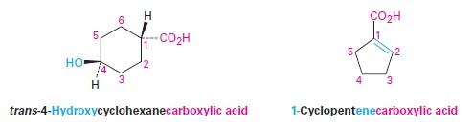
Compounds that have a -CO2H group bonded to a ring are named using the suffix -carboxylic acid. The CO2H carbon is attached to C1 in this system and is not itself numbered. As a substituent, the CO2H group is called a carboxyl group.

Slide 8
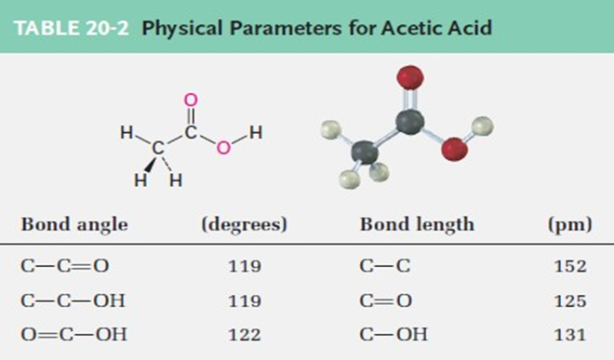
Structure and Properties of Carboxylic Acids
Carboxylic acids are similar in some respects to both ketones and alcohols. Like ketones, the carboxyl carbon is sp2-hybridized, and carboxylic acid groups are therefore planar with bond angles of approximately 120°
(Table 20-2).

Slide 9
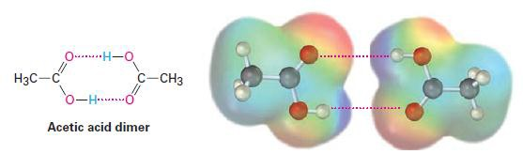
Like alcohols, carboxylic acids are strongly associated because of hydrogen-bonding. Most carboxylic acids exist as cyclic dimers held together by two hydrogen bonds. This strong hydrogen-bonding has a noticeable effect on boiling points, making carboxylic acids boil far less easily than their corresponding alcohols. Acetic acid, for instance, has a boiling point of 117.9°C, versus 78.3 °C for ethanol, even though both compounds have two carbons.

Slide 10
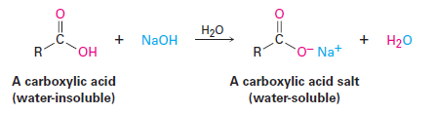
The most obvious property of carboxylic acids is implied by their name: carboxylic acids are acidic. They therefore react with bases such as NaOH and NaHCO3 to give metal carboxylate salts, RCO-M+. Carboxylic acids with more than six carbons are only slightly soluble in water,
but the alkali metal salts of carboxylic acids are often highly water-soluble. In fact, it’s often possible to purify an acid by extracting its salt into aqueous base, then reacidifying and extracting the pure acid back into an organic solvent.

Slide 11
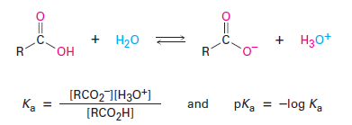
Carboxylic acids dissociate slightly in dilute aqueous solution to give H₃O⁺ and the corresponding carboxylate anions, RCO₂⁻. The extent of dissociation is given by an acidity constant, Ka.

Slide 12
A list of Ka values for various carboxylic acids is given in Table 20-3. For most, Ka is approximately 10-4 to 10-5. Acetic acid, for instance, has Ka=1.75x10-5 at 25 °C, which corresponds to a pKa of 4.76. In practical terms, a Ka value near 10-5 means that only about 0.1% of the molecules in a 0.1 M solution are dissociated, as opposed to the 100% dissociation found with strong mineral acids like HCl.

Slide 13
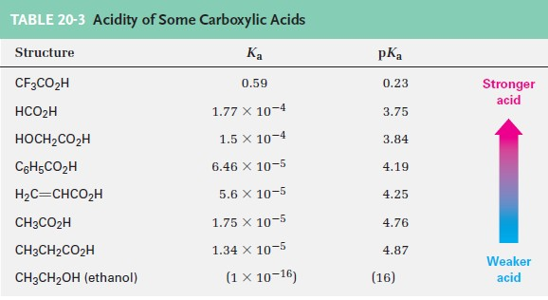

Slide 14
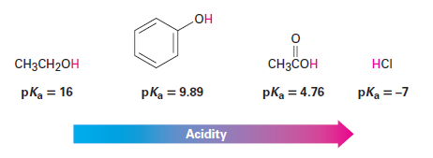
Although much weaker than mineral acids, carboxylic acids are nevertheless much stronger acids than alcohols and phenols. The Ka of ethanol, for example, is approximately 10⁻¹⁶, making it a weaker acid than acetic acid by a factor of 10¹¹.

Slide 15
Why are carboxylic acids so much more acidic than alcohols, even though both contain -OH groups? An alcohol dissociates to give an alkoxide ion, in which the negative charge is localized on a single electronegative atom. A carboxylic acid, however, gives a carboxylate ion, in which the negative charge is delocalized over two equivalent oxygen atoms (Figure 20-1). In resonance terms, a carboxylate ion is a stabilized resonance hybrid of two equivalent structures. Since a carboxylate ion is more stable than an alkoxide ion, it is lower in energy and more favored in the dissociation equilibrium.

Slide 16
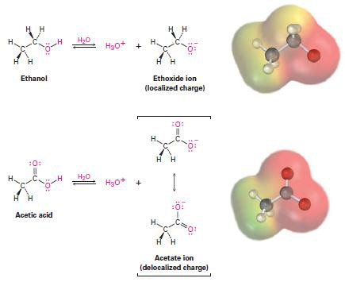
Figure 20-1 an alkoxide ion has its charge localized on one oxygen atom and is less stable, while a carboxylate ion has the charge spread equally over both oxygens and is therefore more stable.

Slide 17
Substituent Effects on Acidity
The listing of pKa values shown previously in Table 20-3 indicates that there are substantial differences in acidity from one carboxylic acid to another. For example, trifluoroacetic acid (Ka 5 0.59) is 33,000 times as strong as acetic acid (Ka=1.75x10-5). How can we account for such differences?
Because the dissociation of a carboxylic acid is an equilibrium process, any factor that stabilizes the carboxylate anion relative to undissociated carboxylic acid will drive the equilibrium toward increased dissociation and result in increased acidity. For instance, three electron-withdrawing fluorine atoms delocalize the negative charge in the trifluoroacetate anion, thereby stabilizing the ion and increasing the acidity of CF₃CO₂H. In the same way, glycolic acid (HOCH₂CO₂H; pKa= 3.83) is stronger than acetic acid because of the electron-withdrawing effect of the electronegative oxygen atom.

Slide 18
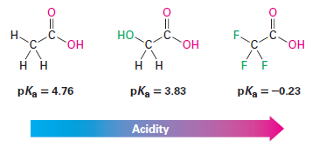
Because inductive effects operate through s bonds and are dependent on distance, the effect of halogen substitution decreases as the substituent moves farther from the carboxyl. Thus, 2- chlorobutanoic acid has pKa =2.86, 3-chlorobutanoic acid has pKa=4.05, and 4-chlorobutanoic acid has pKa =4.52, similar to that of butanoic acid itself

Slide 19
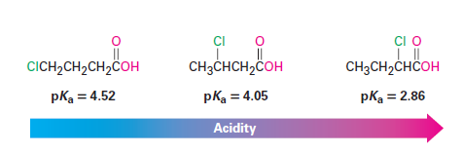
Substituent effects on acidity are also found in substituted benzoic acids. Aromatic rings with electron-donating groups are activated toward further electrophilic substitution, and aromatic rings with electron-withdrawing groups are deactivated. Exactly the same effects can be observed on the acidity of substituted benzoic acids (Table 20-4).

Slide 20
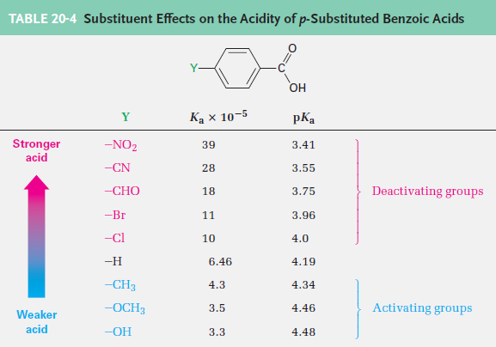

Slide 21
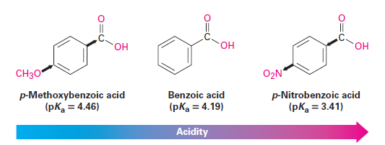
As Table 20-4 shows, an electron-donating (activating) group such as methoxy decreases acidity by destabilizing the carboxylate anion, and an electron-withdrawing (deactivating) group such as nitro increases acidity by stabilizing the carboxylate anion.

Slide 22
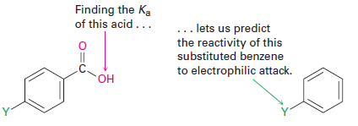
Because it’s much easier to measure the acidity of a substituted benzoic acid than it is to determine the relative reactivity of an aromatic ring toward electrophilic substitution, the correlation between the two effects is useful for predicting reactivity. If we want to know the effect of a certain substituent on electrophilic reactivity, we can simply find the acidity of the corresponding benzoic acid

Slide 23

Preparing Carboxylic Acids
Oxidation of substituted alkyl benzene: with KMnO4 or Na2Cr2O7 gives a substituted benzoic acid. Both primary and secondary alkyl groups can be oxidized, but tertiary groups are not affected.

Slide 24
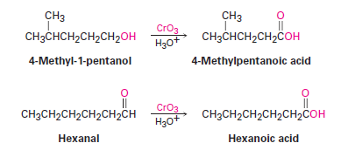
Oxidation of a primary alcohol or an aldehyde: yields a carboxylic acid. Primary alcohols are often oxidized with CrO3 in aqueous acid, and aldehydes are similarly oxidized.

Slide 25

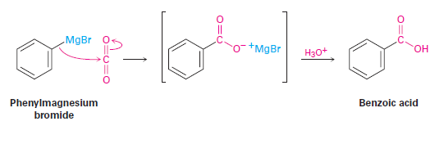
Carboxylation of Grignard reagents:
Another method for preparing carboxylic acids is by reaction of a Grignard reagent with CO2 to yield a metal carboxylate, followed by protonation to give a carboxylic acid. This carboxylation reaction is usually carried out by bubbling a stream of dry CO2 gas through a solution of the Grignard reagent. The organomagnesium halide adds to a CPO bond of carbon dioxide in a typical nucleophilic carbonyl addition reaction, and protonation of the carboxylate by addition of aqueous HCl in a separate step then gives the free carboxylic acid. For example:

Slide 26

2- Hydrolysis of nitriles
Carboxylic acids can be prepared from nitriles on heating with aqueous acid or base by a
mechanism. Since nitriles themselves are usually made by SN
reaction of a primary or secondary
alkyl halide with CN-, the two-step sequence of cyanide displacement followed by nitrile hydrolysis is a good way to make a carboxylic acid from an alkyl halide
Note that the product acid has one more carbon than the starting alkyl halide. One example occurs in a commercial route for the synthesis of the nonsteroidal anti- inflammatory drug ibuprofen.

Slide 27
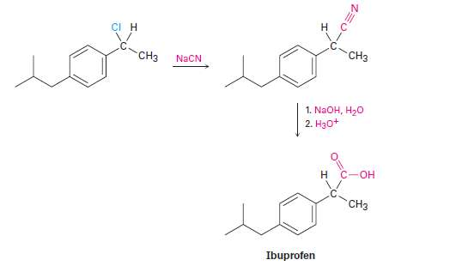

Slide 28
Reactions of Carboxylic Acids:
Carboxylic acids are similar in some respects to both alcohols and ketones. Like alcohols, carboxylic acids can be deprotonated to give anions, which are good nucleophiles in SN2 reactions. Like ketones, carboxylic acids undergo addition of nucleophiles to the carbonyl group. However, carboxylic acids also undergo other reactions characteristic of neither alcohols nor ketones. Figure 20-2 shows some of the general reactions of carboxylic acids.

Slide 29
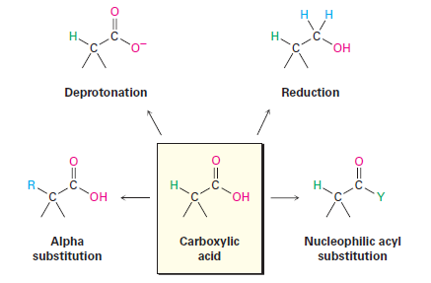
Figure 20-2 some general reactions of carboxylic acids.

Slide 30

Conversion into acid derivatives
1- Conversion into acid chlorides
In the laboratory, carboxylic acids are converted into acid chlorides by treatment with thionyl chloride, SOCl2.

Slide 31
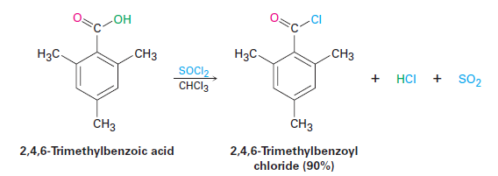
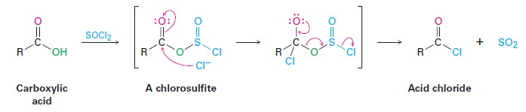
This reaction occurs by a nucleophilic acyl substitution pathway in which the carboxylic acid is first converted into an acyl chlorosulfite intermediate, thereby replacing the ] OH of the acid with a much better leaving group. The chlorosulfite then reacts with a nucleophilic chloride ion. An analogous chlorosulfite is involved in the reaction of an alcohol with SOCl2 to yield an alkyl chloride.

Slide 32
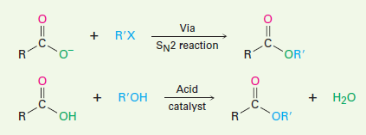
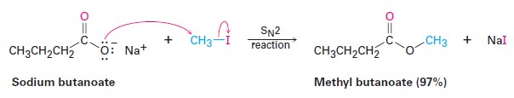
The most useful reaction of carboxylic acids is their conversion into esters. There are many methods for accomplishing this, including the SN2 reaction of a carboxylate anion with a primary alkyl halide.
Esters can also be synthesized by an acid-catalyzed nucleophilic acyl substitution reaction of a carboxylic acid with an alcohol, a process called the Fischer esterification reaction. Unfortunately, the need for an excess of a liquid alcohol as solvent effectively limits the method to the synthesis of methyl, ethyl, propyl, and butyl esters.

Slide 33
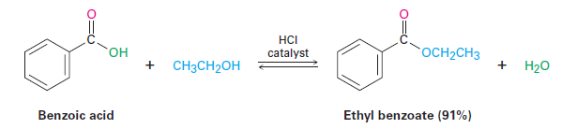
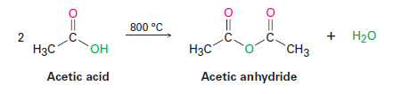

c) Conversion into acid anhydrides
Acid anhydrides can be derived from two molecules of carboxylic acid by heating to remove 1 equivalent of water. Because of the high temperatures needed, however, only acetic anhydride is commonly prepared this way.
d) Conversion into amides

Slide 34
This DCC-induced method of amide formation is the key step in the laboratory synthesis of small proteins, or peptides. For instance, when one amino acid with its NH2 rendered unreactive and a second amino acid with its -CO2H rendered unreactive are treated with DCC, a dipeptide is formed.

Slide 35
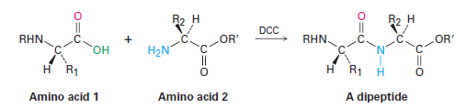

2- Reduction to yield primary alcohols
Carboxylic acids are reduced by LiAlH4 to give primary alcohols, but we deferred a discussion of the reaction mechanism at that time. In fact, the reduction is a nucleophilic acyl substitution reaction in which -H replaces -OH to give an aldehyde, which is further reduced to a primary alcohol by nucleophilic addition. The aldehyde intermediate is much more reactive than the starting acid, so it reacts immediately and is not isolated.

Slide 36
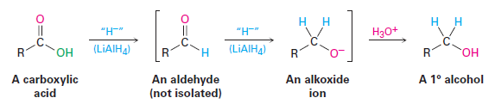
Alternatively, borane in tetrahydrofuran (BH3/THF) is a useful reagent for reducing carboxylic acids to primary alcohols. Reaction of an acid with BH3/THF occurs rapidly at room temperature, and the procedure is often preferred to reduction with LiAlH4 because of its relative ease and safety. Borane reacts with carboxylic acids faster than with any other functional group, thereby allowing selective transformations such as that on p-nitrophenylacetic acid. If the reduction of p-nitrophenylacetic acid were done with LiAlH4, both the nitro and carboxyl groups would be reduced.

Slide 37
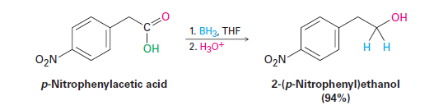
3. Alpha bromination of carboxylic acids
Carboxylic acids, however, can be a brominated by a mixture of Br2 and PBr3 in the Hell– Volhard–Zelinskii (HVZ) reaction
The Hell–Volhard–Zelinskii reaction is a bit more complex than it looks and actually involves a substitution of an acid bromide enol rather than a carboxylic acid enol. The process begins by reaction of the carboxylic acid with PBr3 to form an acid bromide plus HBr. The HBr then catalyzes enolization of the acid bromide, and the resultant enol reacts with Br2 in an a- substitution reaction to give an a-bromo acid bromide. Addition of water hydrolyzes the acid bromide in a nucleophilic acyl substitution reaction and yields the a-bromo carboxylic acid product.

Slide 38
