Slide 1
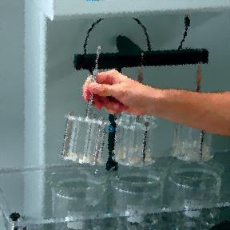
Disintegration test & Dissolution test
(official test)
Lab 6

Slide 2
Disintegration test (U.S.P.) :
For a drug to be readily available to the body , it must be in solution.
For most tablets, the first important step toward solution is break down of the tablet into smaller particles or granules, a process called disintegration.

Slide 3
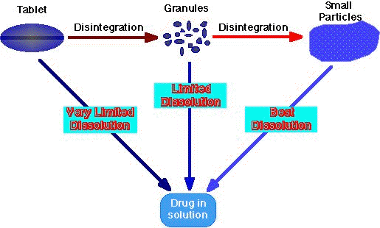

Slide 4
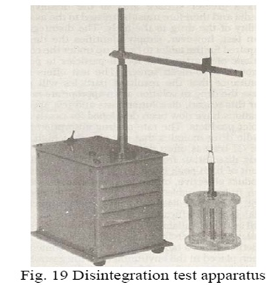
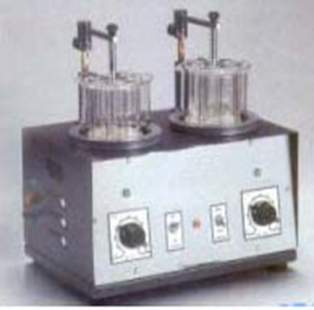
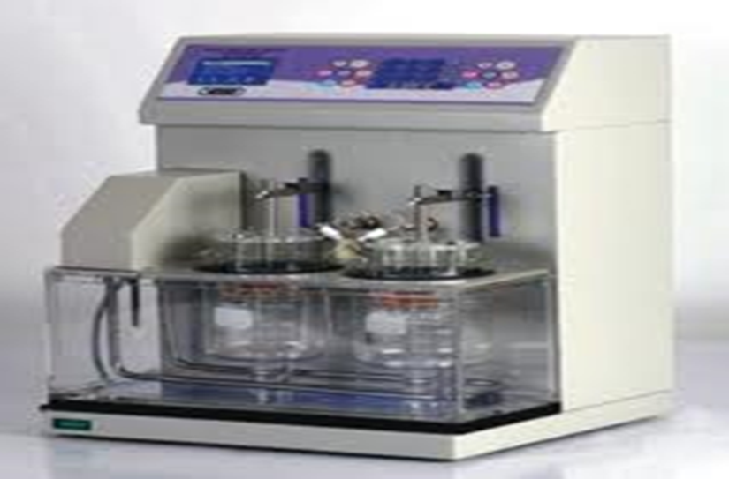
Disintegration test apparatus

Slide 5
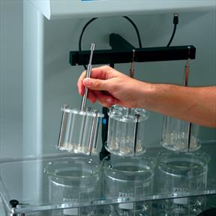

Slide 6
Complete disintegration: is a state in which any residue remain is a soft mass having no palpable firm core except fragments of insoluble coating remaining on the screen of the apparatus.
Procedures are stated for running disintegration times for (uncoated tablets, plain coated tablets, enteric coated tablets, buccal tablets and sublingual tablets).
Uncoated USP tablets have disintegration time as low as 5 minutes, but the majority have max. disintegration time of 30 minutes.

Slide 7
To be in compliance with USP standards, the end time of the test at which all parts of the tablet must disintegrate and pass (eliminated) through the mesh screen (from the set of tubes) in which the tabs held during agitation (lowering and rising process).
The lowering and rising process (agitation) held at constant frequency (28-32 cycle)/min in such away that the highest position of the tubes ensure that the screen remain below the surface of water.
Note: Enteric coated tablets are similarly tested. Except that the tablets are tested in simulated gastric fluid for one hour, after which no sign of disintegration, cracking or softening must be seen. They are immersed in simulated intestinal fluid for the time specified in the monograph, during which time the tablets disintegrate completely for a positive test.

Slide 8
Disintegration time: The U.S.P. device (disintegrator) uses 6 glass tubes that are 3 inches long; open at the top and 10 mesh screen at the bottom end. To test for disintegration time, one tablet is placed in each tube and the basket rack is positioned in a 1-L beaker of water, simulated gastric fluid or simulated intestinal fluid at 37 ± 2⁰ C such that the tablet remain 2.5 cm below the surface of liquid on their upward movement and not closer than 2.5 cm from the bottom of the beaker in their downward movement. Move the basket containing the tablets up and down through a distance of 5-6 cm at a frequency of 28 to 32 cycles per minute. Floating of the tablets can be prevented by placing perforated plastic discs on each tablet.

Slide 9
Disintegration test: (Experiment done 3 times) we start with 6 tablets (each tablet in each tube), if one or two tablets failed to disintegrate completely, test should be repeated for additional 12 tablets, the requirement met if not fewer than 16 of the total 18 are disintegrated.
Note: The rationale for using disintegration test is the fact that as the tablet breakdown into small granules, it offers a greater surface area to the dissolving media and thus must be related to the availability of the drug in the body. But this test offers no assurance that the resultant particles will release the drug in solution at appropriate rate, that’s why the dissolution test has been developed.

Slide 10
Factors affecting the disintegration time
Content : especially the quantity and quality of the disintegrant and lubricant (mixing condition and time of addition of lubricant), the lubricant increase the disintegration time by decreasing the wettability of the tablets due to its hydrophobicity.
Hardness: amount of binder , compression force.
Design of granulation procedure which will affect the physical properties of the granules.

Slide 11
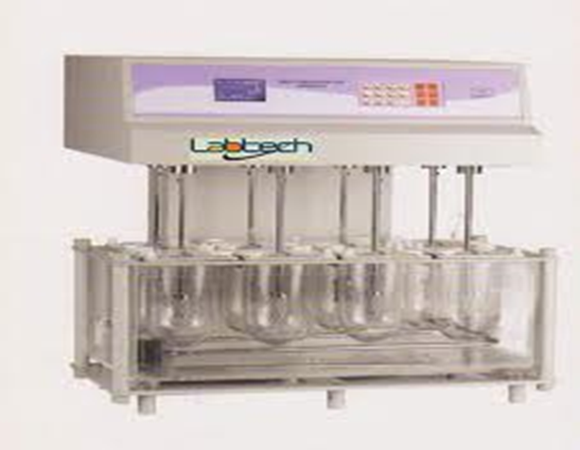
Dissolution test
Dissolution Test
For complete assessment of a drug release from tablets (in-vivo bioavailability should be accomplished) but its use is restricted, thus in-vitro dissolution test have been used and developed and it is un-direct measurement of drug availability.

Slide 12
Why In-vitro dissolution studies?
To show that the release of the drug from the tablet is as close to 100%.
To show that the rate of drug release is uniform batch to batch.
And to show that the release is equivalent to those batches proven to be bioavailable and clinically effective.

Slide 13
USP/NF monograph specify:
The dissolution test medium
Apparatus to be used
Time limits of the test
The assay procedure
Volume (dissolution medium)
The speed (rpm) of the test to be performed

Slide 14
Dissolution test
Types of dissolution tests used:
1. Basket method (apparatus I )
A single tablet is placed in a small wire mesh basket attached to the bottom of the shaft connected to a variable speed motor. The basket is immersed in a dissolution medium (as specified in monograph) contained in a 1000 ml flask. The flask is cylindrical with a hemispherical bottom. The flask is maintained at 37 ± 0.5⁰C by a constant temperature bath. The motor is adjusted to turn at the specified speed and sample of the fluid are withdrawn at intervals to determine the amount of drug in solutions.

Slide 15
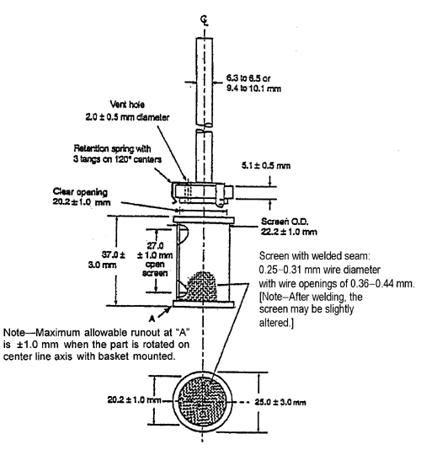
Notes:
The most common rotation speed for basket method is 100 rpm.
It is generally preferred for capsules and dosage forms that tend to float or disintegrate slowly.

Slide 16
2. Peddle type (apparatus 2)
The most common rotating speed is 50 rpm.
It is generally preferred for tablets.
It involves replacing basket with peddle (shaft and plate) as a stirring element. Then tablet is sunk at bottom of the flask before stirring. The results are plotting Conc. vs. time.

Slide 17
Test tolerance (Q)
Is expressed as a percentage of the labeled amount of the drug dissolved in the time limit .
Example: In methyldopa tablet, the dissolution test calls for a medium of 900 ml of 0.1 N HCL, apparatus 2 turning at 50 rpm and time limit 20 min. is not less than 80 % of the labeled amount of methyl dopa.

Slide 18
Dissolution testing and interpretation IP standards
S. no. | Quantity Stage/level | Number of tablets tested | Acceptance criteria
1 | S1 | 6 | Each unit not less than Q* + 5 percent**
2 | S2 | 6 | Average of 12 units (S1 +S2) is equal to or greater than (>)Q, and no unit is less than Q - 15 percent**
3 | S3 | 12 | Average of 24 units (S1+S2+S3) is equal to or greater than (>)Q, not more than 2 units are less than Q-15 percent** and no unit is less than Q-25 percent**
*Q is the amount of dissolved active ingredient specified in the individual monograph, expressed as a percentage of the labelled content.
** Percentages of the labelled content.

Slide 19
Content uniformity test:
Factors contribute directly in content uniformity problems of tablet:
1- Non-uniform distribution of the drug substance throughout the powder mixture or granulation.
2- segregation of the powder mixture or granulation during various manufacturing process.
3- Tablet wt. variation.

Slide 20
Notes:
Content uniformity or wt. variation for highly active ingredient tablets 90-95% having no problems to calculate.
Small dose drug having problem of content uniformity and wt. variation so each calculate individually.
Content uniformity for low dose drugs (to assure uniform potency):
Test 30 tablets by randomly selected for the sample.
At least 10 tablets of them assayed individually (nine of them must contain not less than 85% or more than 115% of the labeled drug content. The tenth tab. Must not be less than 75% or more than 125% of the labeled content), if these conditions not met then the remaining 20 tablets is individually assayed and non of them falls outside the range of 85-115%

Slide 21


