Slide 1
Biochemical Tests
Asst. Prof. Dr. Dalya Basil

Slide 2
In this lecture….
Coagulase test
Catalase test
Oxidase test

Slide 3
Principle of Coagulase Test
Coagulase test is used to differentiate Staphylococcus aureus (positive) which produce the enzyme coagulase, from S. epidermis and S. saprophyticus (negative) which do not produce coagulase. i.e Coagulase Negative Staphylococcus (CONS).
Coagulase is an enzyme-like protein and causes plasma to clot by converting fibrinogen to fibrin. Staphylococcus aureus produces two forms of coagulase: bound and free.
Bound coagulase (clumping factor) is bound to the bacterial cell wall and reacts directly with fibrinogen. This results in an alternation of fibrinogen so that it precipitates on the staphylococcal cell, causing the cells to clump when a bacterial suspension is mixed with plasma. This doesn’t require coagulase-reacting factor.

Slide 4
Principle of Coagulase Test
Free coagulase involves the activation of plasma coagulase-reacting factor (CRF), which is a modified or derived thrombin molecule, to from a coagulase-CRF complex. This complex in turn reacts with fibrinogen to produce the fibrin clot.

Slide 5
Procedure and Types of Coagulase Test
Slide Test (to detect bound coagulase)
Place a drop of physiological saline on each end of a slide, or on two separate slides.
With the loop, straight wire or wodden stick, emulsify a portion of the isolated colony in each drops to make two thick suspensions.
Add a drop of human or rabbit plasma to one of the suspensions, and mix gently.
Look for clumping of the organisms within 10 seconds.
No plasma is added to the second suspension to differentiate any granular appearance of the organism from true coagulase clumping.

Slide 7
Procedure and Types of Coagulase Test
Tube Test (to detect free coagulase)
The tube test uses rabbit plasma that has been inoculated with a staphylococcal colony ( Gram-positive cocci ). The tube is then incubated at 37 °C for 1.5 hours. If negative, then incubation is continued up to 18 hours.
If 'positive' (e.g., the suspect colony is S. aureus), the plasma will coagulate, resulting in a clot (sometimes the clot is so pronounced, the liquid will completely solidify).

Slide 9
Catalase test
This test demonstrate the presence of catalase, an enzyme that catalyses the release of oxygen from hydrogen peroxide (H₂O₂).
Catalase test is used to differentiate those bacteria that produces an enzyme catalase, such as staphylococci, from non-catalase producing bacteria such as streptococci.

Slide 10
Catalase test
The enzyme catalase mediates the breakdown of hydrogen peroxide into oxygen and water. The presence of the enzyme in a bacterial isolate is evident when a small inoculum is introduced into hydrogen peroxide, and the rapid elaboration of oxygen bubbles occurs. The lack of catalase is evident by a lack of or weak bubble production. The culture should not be more than 24 hours old.
2H2O2 2H2O + O2 (gas bubbles)
catalase

Slide 11
Catalase test
Bacteria thereby protect themselves from the lethal effect of Hydrogen peroxide which is accumulated as an end product of aerobic carbohydrate metabolism.
Catalase-positive bacteria include strict aerobes as well as facultative anaerobes. They all have the ability to respire using oxygen as a terminal electron acceptor.

Slide 12
Catalase test
Catalase-negative bacteria may be anaerobes, or they may be facultative anaerobes that only ferment and do not respire using oxygen as a terminal electron acceptor (ie. Streptococci).

Slide 13
Uses Catalase Test Results
The catalase test is primarily used to distinguish among Gram-positive cocci: members of the genus Staphylococcus are catalase-positive, and members of the genera Streptococcus and Enterococcus are catalase-negative.
Catalase test is used to differentiate aerotolerant strains of Clostridium, which are catalase negative, from Bacillus species, which are positive.

Slide 14
Uses Catalase Test Results
Catalase test can be used as an aid to the identification of Enterobacteriaceae. Members of Enterobacteriaceae family are catalase positive e.g., (E. coli, Citrobacter, Enterobacter, Klebsiella, Shigella, Yersinia, Proteus, Salmonella, Serratia).

Slide 15
Procedure of Catalase test (Slide Test)
Transfer a small amount of bacterial colony to a surface of clean, dry glass slide using a loop or sterile wooden stick
Place a drop of 3% H₂O₂ on to the slide and mix.
A positive result is the rapid evolution of oxygen (within 5-10 sec.) as evidenced by bubbling.
A negative result is no bubbles or only a few scattered bubbles.

Slide 16
Tube Catalase Test-Procedure
Add 4 to 5 drops of 3% H2O2 (Hydrogen peroxide) to in a test tube
Using a wooden applicator stick, collect a small amount of organism from a well-isolated 18- to 24-hour colony and place into the test tube.
Place the tube against a dark background and observe for immediate bubble formation (O2 + water = bubbles) at the end of the wooden applicator stick.

Slide 17
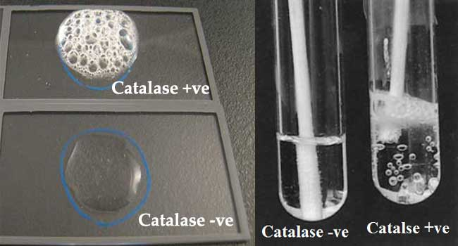
Results
Catalase Positive reactions: Evident by immediate effervescence (bubble formation)
Catalase Negative reaction: No bubble formation (no catalase enzyme to hydrolyze the hydrogen peroxide).

Slide 18
Oxidase test
The oxidase test detects the presence of a cytochrome oxidase system that will catalyse the transport of electrons between electron donors in the bacteria and a redox dye- tetramethyl-p-phenylene-diamine. The dye is reduced to deep purple color. This test is used to assist in the identification of Pseudomonas, Neisseria, Aeromonas, Campylobacter, Vibrio, Brucella and Pasteurella, all of which produce the enzyme cytochrome oxidase.

Slide 19
Oxidase test
A number of reagents can be used for this test.
Kovacs Oxidase Reagent:
1% tetra-methyl-p-phenylenediamine dihydrochloride, in water
Gordon and McLeod’s Reagent:
1% dimethyl-p-phenylenediamine dihydrochloride, in water
Gaby and Hadley (indophenol oxidase) Reagent:
1% α-naphthol in 95% ethanol
1% p-aminodimethylaniline HCL

Slide 20
Principle of Oxidase Test
The Cytochrome containing organisms produce an intracellular oxidase enzyme. This oxidase enzyme catalyzes the oxidation of cytochrome c. Organisms which contain cytochrome c as part of their respiratory chain are oxidase-positive and turn the reagent blue/purple.
Organisms lacking cytochrome c as part of their respiratory chain do not oxidize the reagent, leaving it colorless within the limits of the test, and are oxidase-negative.

Slide 21
Principle of Oxidase Test
The cytochrome system is usually only present in aerobic organisms which are capable of utilizing oxygen as the final hydrogen receptor. The end product of this metabolism is either water or hydrogen peroxide (broken down by catalase).

Slide 23
Filter paper method

Slide 24
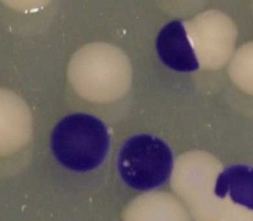
Direct plate method

Slide 25
Swab method

Slide 26
Impregnated oxidase strip method

Slide 27
Test tube method

