Slide 1
Evaluation of tablet
Lab 5

Slide 2
Evaluation of tablet
Done by quality control department (Q.C.)
Role of Q.C. department (small part of quality assurance –QA-):
concerned with sampling, testing and documentation during and after completion of manufacturer.
Q.C.: set of steps taken during the manufacturing to ensure that the product meets the requirements and is reproducible. It also monitoring the product after manufacture and comparing it with standards to find out the causes of deviation from standards thus ensure the quality product not once but every time.

Slide 3
Quality control steps for tablet
General appearance
  Size, shape and thickness
  Size and shape: can be controlled by size and shape of punches and die of tab. machine.
  Tablet thickness (dimensional variation) related to:
  Constant compression load: tab. Thickness varies with tab. Weight, die fill and P.S. distribution.
  Constant die fill: thickness varies with compression load.
  Note: Tablet thickness controlled within +/- 5% variation, If not then problems of variation in tab thickness that restrict packaging process and a variable in fill level of the same container with a given no. of dosage units.

Slide 4

Tablet thickness can be measured by:
Micrometer: measure individual tab. thickness (so accurate information on variation between tab.).
Holding tray: measure total tab. Thickness of 5-10 tab. With a sliding caliper scale (not accurate information provider on variation between tabs but overall estimation) to give more rapid readings.

Slide 5
Shape:
Shape of tab. Influence the choice of tab. Machine used with special slotted punches that run at lower speed than conventional punches that produce round tablets.
Non-uniform forces involved within tab.
Due to

Slide 6
2. Organoleptic properties (color uniformity, odor and taste)
Color uniformity:
To identify the product and give good impression to the consumer while mottling (unequal distribution of the color on tab.) give bad idea to the manufacturer.
Odor:
Presence of odor in a batch of tab. Could indicate stability problems like: odor of acetic acid in degrading aspirin tablet.
Taste:
It is important in chewable tab.

Slide 7
Non official tests:
B. Hardness (tablet crushing strength)
Tablet hardness: is the force required to break a tablet in a diametric compression test.
Tabs required a certain amount of strength or hardness and resistance to friability in order to:
Withstand mechanical shock of handling in manufacture, packaging and shipping.
In addition the tabs should be able to withstand reasonable abuse when in the hands of consumer.

Slide 8

Methods for hardness measurement
Monsanto hardness tester (manual)
Pfizer tester (simple, low cost and rapid)
Erweka tester (electrical)
Schilenger tester (electrical) –widely used because its fast and reproducible-.
Unit of hardness is expressed in $kg$

Slide 9
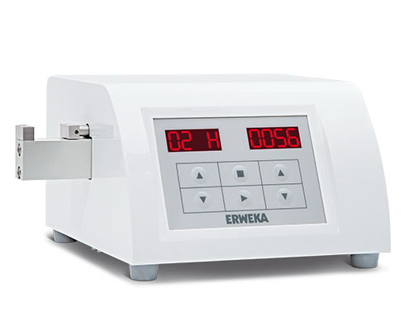
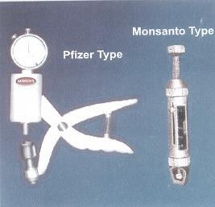
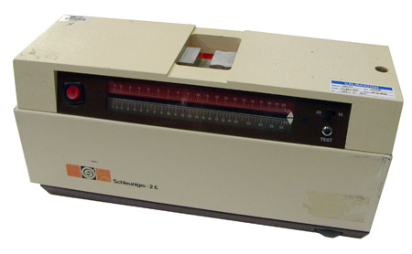

Slide 10
Hardness of tab like its thickness is a function of:
(Die fill constant) then additional compression force result in more hardness and less thickness
(Compression force constant–fixed distance between upper and lower punches) then hardness increase with increase in die fill and decrease with lower die fill.
Quantity and quality of binder (good binder result in appropriate tab hardness and not hinder the release of drug from tab.).
Lubricant can affect tab hardness (if too high conc. or long time mixing)

Slide 11
Hardness of different types of tablet
Ordinary tab. 4-8 kg
Chewable tab. 3 kg to prevent harmful effect on teeth
Lozenges (troches) and sustained release 10-20 kg

Slide 12
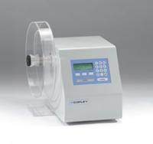
Non official tests:
C. Friability (abrasion and shock)
Friable tab.: tab that tend to powder, chip and fragment when handled result in:
Lack elegance and consumer acceptance.
Create excessively dirty process in area of manufacturing as coating and packaging.
Tab’s weight variation or content uniformity problems

Slide 13
Factors affecting friability:
Addition of large amount of fine powder to the formula.
Over drying of granules (moisture content).
Use of material that is not cohesive to the formula.
Note: Some chewable tabs. And most effervescent tab. Undergo high friability loss so special stack packing that required for these types of tab.

Slide 14
Laboratory friabilator tester:
Roche friabilator
(subject 20 tabs to the combined effect by utilizing a plastic chamber that revolves at 25RPM, dropping the tab. From a distance of 6 inches with each revolution, normally a pre-weigh tabs are placed in the friabilator which is then operated for 100 revolution (4min), the tabs are then dusted and reweighed, the friability (loss in weight) less than 0.5%-1% are acceptable).
W1-W2= Wt. loss
% of loss= W1-W2/ W1 *100%
Erweka friabilator (contain plates and depend on tumbling).

Slide 15
Notes:
When capping observed on friability testing the tab. Should not be considered for commercial use regardless of the value of % loss.
When concave and deep concave punches are used in tableting and especially when the punches are in poor condition or worn at their surface edges. The tab. Produced result in whiskering at tab. Edges such tab. Has a higher than normal friability value because the whiskers are removed in testing.
The tab. Friability may also influenced by the moisture content of the tab. Granulation and finished tabs. (low but acceptable) moisture level frequently act as binder, very dry granulation often produce more friable tab.

Slide 16
Pharmacopeial or official tests:
A- Weight variation
The limited weight variation according to USP:
Take 20 tabs and weigh individually and calculate the average weight and compare the individual tab. Weight with the average then no more than 2 tabs should be outside percentage limit.
Allowance | 10% | 7.5% | 5%
Average wt. (mg) | Less than 130 mg | 130-324mg | More than 324 mg

Slide 17
Note: Wt. variation method used to determine drug content uniformity, if powder of tab. Contain 90-95% active ingredient, while wt. variation test is not sufficient to assure potency uniformity for moderate to low dose drugs in which excipients make up the bulk of the tab. weight.
Factors affecting wt. variation:
Use of insufficient quantity of lubricant
Variation in the adjustment of the upper and lower punch
Poor mixing
Poor flow
Segregation of the powder

Slide 18


