Slide 1
Practical Clinical Toxicology Toxicity of Digitalis Glycosides Lab. 6 5th Year 2019-2020 University of Mustansiriyah/College of Pharmacy Department of Pharmacology & Toxicology Lecturer Rua Abbas Al-Hamdy

Slide 2
Introduction:
Digitalis glycosides are life-saving drugs when used in therapeutic doses in the treatment of congestive heart failure (CHF), & for management of certain supraventricular arrhythmia.
Digoxin is the one of the most widely prescribed drugs.
Digoxin acts through inhibition of the Na⁺/K⁺-adenosine triphosphatase (ATPase) enzyme as shown in figure 1.

Slide 3
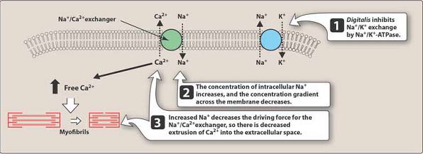
Figure 1. Mechanism of action of cardiac glycosides, or digitalis. ATPase = adenosine triphosphatase.

Slide 4
It is estimated that 20-30% of patients taking a digitalis preparation will experience toxicity because the drugs have an extremely narrow therapeutic index.
The serum concentration of digoxin for therapeutic activity is in the normal range of 1.2-1.7 ng/mL & clinically significant toxicity usually occurs with concentrations 2-3 times higher.
The mortality rate with toxic dose is reported to be as great as 25%.

Slide 5
Factors that increase the risk of toxicity to digitalis
glycosides:
Concurrent administration of a diuretic that induces potassium loss is reported to be the most frequent cause of toxicity.
Individuals with Eubacterium lentum in their colon may require larger doses of digitalis to achieve the desired therapeutic serum concentrations.

Slide 6
Since 60-80% of digoxin is excreted through the kidneys as shown in table 1, decreased renal excretion would result in accumulation of digoxin & toxicity.
Interactions with other drugs such as verapamil & quinidine (they cause increase in plasma concentration of digoxin probably by digoxin displacement from tissue-binding sites),
Hypokalemia, &
Hypothyroidism.

Slide 7
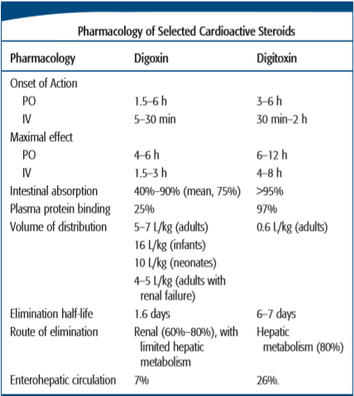
Table 1

Slide 8
Characteristics of poisoning:
Early manifestations of intoxication that occur in approximately 50% of all cases generally involve the gastrointestinal tract.
Anorexia, nausea, vomiting, & abdominal pain are common.
Nausea & vomiting occur from direct drug action on the chemoreceptor trigger zone (CTZ).

Slide 9
Blurred vision, loss of visual acuity, & green yellow halos have been described as early-appearing symptoms.
CNS effects include a variety of neuropsychiatric disturbances.
Digitalis intoxication can provoke a large number of arrhythmias. These include bradyarrhythmias or tachyarrhythmias, or a combination of both.

Slide 10
Management of poisoning:
Management of acute digitalis toxicity involves removal of ingested drug, maintenance of a normal potassium concentration, reversal of arrhythmias, & the use of a specific antidote (digoxin immune Fab).
Gastric lavage should be performed to remove the unabsorbed drug, although vomiting may already have accomplished this.
Repeated administration of activated charcoal or cholestyramine is recommended to enhance elimination of the glycoside by interrupting to entero-hepatic cycling exhibited by digitoxin, & possibly digoxin.

Slide 11
Hyperkalemia (5.5-13.5 mEq/L) is caused by acute digitalis toxicity, while hypokalemia is more common with chronic digitalis use.
Hyperkalemia may require treatment with insulin plus glucose, & sodium bicarbonate.
If hypokalemia is encountered with tachy- or bradyarrhythmias, continuous potassium replacement alone may be sufficient.
For atrial & ventricular arrhythmias that do not respond to potassium therapy, the treatment of choice includes phenytoin & lidocaine.

Slide 12
Potassium administration in a person with digitalis- induced hyperkalemia can result in heart block.
If digitalis has produced atrioventricular (AV) block, atropine is given to produce vagolytic effect to increase the heart rate & AV conduction.
β-blockers, such as propranolol, are useful to suppress supraventricular & ventricular arrhythmias but may depress the sinoatrial (SA) node & AV conduction especially in a patient with an already failing heart, that limiting their usefulness.

Slide 13
Because digoxin has a large volume of distribution, hemodialysis is not a successful method to enhance elimination of digoxin. However, hemodialysis is still sometimes required…..why?

Slide 14
Digoxin Immune Fab (Digibind):
Digoxin immune Fab is used as an antidote reserved for life-threatening overdoses.
Indications of such toxicity include:
ingestion of more than 10 mg of digoxin by healthy adults or 4 mg by children,
Steady-state serum concentrations greater than 10 ng/mL; or
if blood potassium concentration exceeds 5 mEq/L.

Slide 15
Dosage of digibind can be calculated according to the amount of digoxin or digitoxin in the patient’s body.
When steady-state serum concentrations of digoxin or digitoxin is known, the total body load can be estimated as shown below:
Body load(mg)= (SDC)(mean Vd)(wt in Kg)
1000
SDC is the serum digitalis concentration in ng/mL.
Vd: volume of distribution
Vd of digoxin = 5.6 L/kg
Vd of digitoxin = 0.56 L/kg

Slide 16
Each vial of antidote contains 40 mg of digibind. This will bind 0.6 mg digoxin or digitoxin.
The total number of vials needed can be obtained by dividing the total body load of drug in mg, by 0.6 mg/vial.
Adverse effects to digibind have been minimal including sensitivity, erythema at the site of injection, rash, & urticaria have been reported.

Slide 17
How many milligrams & vials of digoxin-specific antibody fragment are required to treat a 40 years old male patient, weighing 70 kg in whom digoxin assay revealed a steady state serum concentration of 0.015 μg/mL?
Body load(mg)= (SDC)(mean Vd)(wt in Kg)
1000
Serum digitalis concentration in ng/mL= 15
Vd of digoxin = 5.6 L/kg
Body load= 15 x 5.6 x 70/1000= 5.88 mg of digoxin.

Slide 18
Each vial of digibind contains 40 mg
40 mg of digibind would bind 0.6 mg of digoxin
40 mg (digibind) x (digibind)
0.6 mg (digoxin) 5.88 mg
X = 392 mg of digibind
392 mg
40 mg/vial
=
= 9.8 which means 10 vials

