Slide 1
Practical Clinical Toxicology Lab. 6 Acetaminophen Toxicity Department of Pharmacology & Toxicology College of Pharmacy/ Al-Mustansiriyah University 2019-2020

Slide 2
Acetaminophen
( N -acetyl- p -aminophenol [APAP])
Most commonly used OTC analgesic and antipyratic drug
It has weak anti inflammatory and antiplatelet properties
Antipyresis and analgesia are predominantly mediated by the central indirect COX-2 inhibition where as anti inflammatory and antiplatelets effect due to mild, peripheral inhibition of COX-2 and minimal COX-1 inhibition.

Slide 3
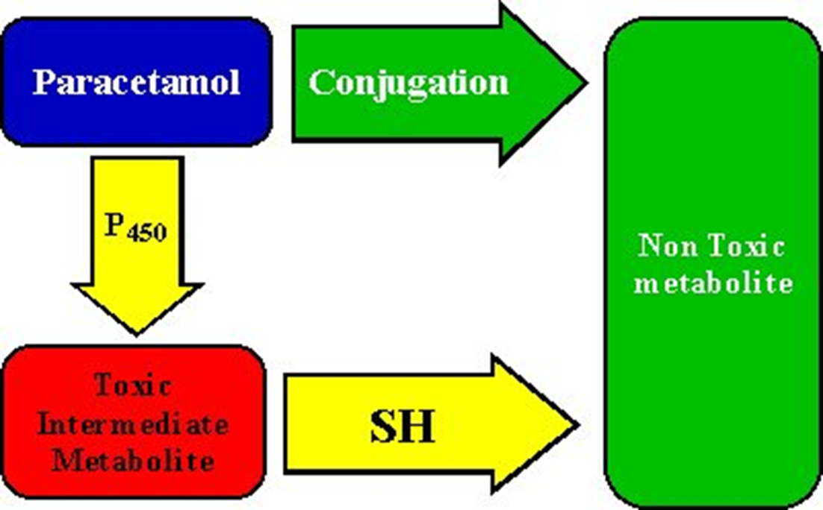
Acetaminophen metabolism
60% glucuronide conjugates
30% to sulfate conjugates
4% is metabolized by the cytochrome P450 mixed-function oxidase system (CYP 2E1 ) to the potentially toxic reactive intermediate N-acetyl-p-benzoquinoneimine (NAPQI).
LIVER
conjugated with glutathione to form nontoxic cysteine and mercapturic acid conjugates

Slide 4
Mechanism of toxicity
Nontoxic sulfation metabolism of APAP may become saturated,and the amount of N -acetyl- p benzoquinoneimine (NAPQI) (toxic metabolite) formed is increased by CYP2E1 and outstrip the supplying of (glutathion)GSH, resulting in free NAPQI rapidly binding to hepatocyte constituents lead to centrilubular necrosis.
Hepatic toxicity becomes evident only when hepatic GSH falls to 30% of baseline

Slide 6
Factors that may predispose patients to hepatotoxicity:
Increased frequency and duration of acetaminophen dosing
Increased capacity for CYP2E1 activation to NAPQI for example: Long-term treatment with CYP 450 inductors (e.g., carbamazepine, rifampicin) and long term administeration of alcohol.
Decreased GSH availability by:
people with acute or chronic starvation
Eating disorders (e.g., anorexia or bulimia)
Patients with chronic debilitating illnesses (e.g., cystic fibrosis, AIDS, alcoholism, or hepatitis C)
Decreased capacity for glucuronidation and sulfation
Children

Slide 7
Concentrations of acetaminophen and their interpretation

Slide 8
Clinical Manifestations
Stage II toxicity
24 to 72hours, right upper quadrant abdominal pain, anorexia, N/V,
Tachycardia and hypotension , Raised liver function test
Stage III toxicity
72 to 96 hours, N/V/abdominal pain, Maximal liver injury (jaundice, coagulopathy,
hypoglycemia, and hepatic encephalopathy), Acute renal failure,
Death from multiorgan failure
Stage IV toxicity
The recovery phase, Patients who survive stage III

Slide 9
Monitoring and Testing
Laboratory tests
*Serum acetaminophen levels
Management is dependent on the serum acetaminophen level and the time of ingestion
Rumack/Matthew nomogram or acetaminophen nomogram is an acetaminophen toxicity nomogram plotting serum concentration of acetaminophen against the time since ingestion in an attempt to prognosticate possible liver toxicity as well as allowing a clinician to decide whether to proceed with N-Acetylcysteine (NAC) treatment or not.
Paracetamol concentrations taken between 4 and 24 hours after ingestion.
Generally, a serum plasma concentration (APAP) of 140–150 microgram/mL (or milligrams/L) at 4 hours post ingestion, indicates the need for NAC treatment.

Slide 11
Cont…
Liver function tests
alanine aminotransferase [ALT]
aspartate aminotransferase [AST]
bilirubin [total and fractionated]
alkaline phosphatase
Prothrombin time (PT) with international normalized ratio (INR)
Glucose
Renal function studies (electrolytes, BUN, creatinine)

Slide 12
Treatment of Acetaminophen Overdose
Gastric emptying
Activated charcoal
NAC (N-acetylcysteine),antidote given orally, from 4-8 hrs from ingestion. It is
a sulfhydryl donor, replenishes glutathione stores
Loading dose of 140 mg/kg then 70 mg/kg given every 4 hours
Total treatment duration of 72 hours
It causes vomiting when given by mouth or nausea when given intravenously
Asthma, this treated by interrupting the acetylcysteine infusion and providing symptomatic relief with an antihistamine such as chlorpheniramine and nebulized salbutamol.
Liver transplantation, for patients with severe hepatotoxicity and potential to progress to hepatic failure, Metabolic acidosis, Renal failure, Coagulopathy and Encephalopathy

