Slide 1
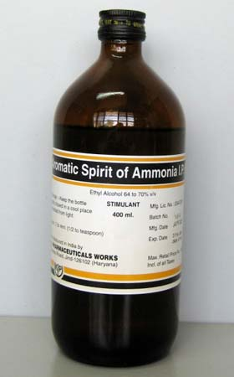
Spirits

Slide 2
Spirits
Are alcoholic or hydro alcoholic solutions of volatile principle (mostly volatile oil)
spirits could be classified according to their uses:
Therapeutic spirits: which contain therapeutic volatile substances.
flavouring spirits : which contain flavouring volatile substances.

Slide 3
spirits also known as essences.
Spirits prepared by distillation, but nowadays there are prepared by dissolving the volatile substances in alcohol.
The amount of volatile substance in spirits varies greatly and no fixed percentage can be given ,but in all cases, volatile substances in the spirits is more than that of aromatic water.
Amount of alcohol differ from one spirit to another ,the lowest amount of alcohol found in internal spirits as(aromatic spirit of ammonia) which contain 62-68% alcohol while (camphor spirit) which is used externally contain 80-87%.
Spirits when taken orally , they are generally mixed with portion of water to reduce from pungency.
In preparation of spirits we must keep in mind that the oil dissolved in alcohol is precipitated causing turbidity when the solutions are mixed with water other than specified in the formula ,so all equipment should be dry and filter paper should be moisten with alcohol.
Spirits should be stored in light resistant containers and in cool place to prevent evaporation of alcohol and volatilization of volatile substance or active ingredients and to limit oxidative changes.

Slide 4
Methods of preparation of spirits
-Simple solution method
-Maceration
-Chemical reaction
-Distillation

Slide 5
Spirits of orange B.P
Rx
Oil of orange 200 ml
Oil of lemon 50 ml
Oil of coriander 20 ml
Oil of anise 5 ml
Alcohol Q.S 1000 ml
Method:
According to simple solution method, mix oils with sufficient alcohol to make the product measure 1000 ml.
Note :
Anise oil use as carminative and mild expectorant (as cough mixtures and lozenges)

Slide 6
Compound spirit of cardamom B.P
Rx
Oil of cardamom 20 ml
Oil of orange 20 ml
Of cinnamon 2 ml
Oil of clove 1 ml
Anethol 1 ml
Oil of carawya 0.2 ml
Alcohol Q.S 200 ml
Method:
Mix the oils and anethol with sufficient alcohol to make the product measure 200 ml.
Notes: -
Carawya oil used as antispasmodic agent ,mainly in children mixtures.
Cinnamon oil used as carminative and flavouring agent.
Cardamom used as carminative and flavouring agent.
Anethol used as mild expectorant in cough mixtures and lozenges, also as flavouring agent.
Aromatic spirit of ammonia
Rx
Ammonium carbonate 34 g
Dilute solution of ammonia 90 ml
Oil of lemon 10 ml
Oil lavender 1 ml
Oil of myristica 1 ml
Alcohol 700 ml
D.W Q.S 1000 ml

Slide 7
Method:
Dissolve the solid agent in dilute solution of ammonia with little amount of water , while the oil dissolved in alcohol also with little amount of water, and then add the aqueous solution into alcoholic one after filtering each one.
Note :
In preparation of aromatic spirit of ammonia we make filtration due to the presence of water with alcohol that lead to precipitation of volatile oil
uses of official spirits :
Carminative (aromatic spirit of ammonia)
Antacid (aromatic acid of ammonia)
Mild reflex circulatory stimulant (camphor spirit)
Flavouring agent (cinnamon spirit)

Slide 8
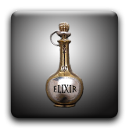
Elixir

Slide 9
Elixirs
Elixirs: are clear, sweetened hydroalcoholic solutions intended for oral use, and are usually flavoured to enhance their palatability.
Medically they are classified to:
Non medicated elixirs: these employed as vehicles for medicinal substances. Ex elixir of glycerin.
Medicated elixirs: these contain ingredients giving them therapeutic value.

Slide 10
Notes :
The proportion of alcohol present in elixirs varies widely since the individual components of the elixirs have different water and alcohol solubility characteristics (each elixir require a specific blend of alcohol and water to maintain all of components in solution.
In addition of alcohol and water other ingredients may be used in elixirs such as :
Glycerin and propylene glycol which used as adjunct solvents.
Sucrose , saccharine, and sorbitol as sweetening agent
Flavouring materials to increase their palatability.
colouring agents to enhance their appearance.
Elixirs containing over 10-12% of alcohol are usually self preserving .
Elixirs should be stored in tight ,light resistant containers and protected from excessive heat because of their usual content of volatile oil and alcohol.

Slide 11
Differences between elixirs and syrups
Elixirs are usually less sweet and less viscous than syrups because they contain a lower proportion of sugar and consequently are less effective than syrups in masking the taste of medicinal substances.
Elixirs are better able than aqueous syrups to maintain both water soluble and alcohol soluble components in solution because of their hydroalcoholic character.
From manufacturing stand point, elixirs are preferred over syrup due to their stability and ease of preparation (by simple solution).

Slide 12
Preparation of elixir
Elixirs are usually prepared by simple solution method with agitation and / or by the admixture of two or more liquid ingredients.
Alcohol soluble and water soluble components are generally dissolved separately in alcohol and purified water, respectively. Then the aqueous solution is added to alcoholic solution rather than the reverse, in order to maintain the highest possible alcoholic strength at all times so that minimal separation of alcohol- soluble components occurs.
When the two solutions are completely mixed the mixture is made to volume with specified solvent or vehicle.

Slide 13
Note :-
In preparation of elixirs frequently the final mixture will not be clear (cloud) due to separation of some flavouring oils by reduced alcoholic concentrations. If this occurs the elixir is usually permitted to stand for a prescribed number of hours , to ensure the saturation of hydro-alcoholic solvents and to permit the oil globules to coalesce so that they are more easily removed by filtration.
comparison between elixirs and spirits
Elixirs spirits
1.Contain sweetening agent 1. not contain
2.More viscous 2. less viscous
3.Need preservative if the 3. not need
alcohol content is less than 10-12%
4.Water and alcohol 4. alcohol is usually the primary
are usually the primary solvent
5.For internal use only 5. used internally and externally
6. Concentration of alcohol is 4-40% 6. concentration of alcohol is 62-87%

Slide 14
Phenobarbital elixir U.S.P
Rx
Phenobarbital 4 g
Tr. of orange peel 30 ml
Solution of amaranth 10 ml
Alcohol 125 ml
Glycerin 450 ml
Syrup 250 ml
D.W Q.S 1000 ml
Method:
Dissolve the phenobarbital in alcohol
Add the tincture of orange peel ,glycerin, syrup, amaranth solution and add sufficient water to produce 1000 ml ,mix well and filter.
Notes :
The phenobarbital elixir used as sedetive and hypnotic.
Glycerin used as thicknening agent ,also increase the solubility of phenobarb .
Tr.of orange peel used as flavouring agent.
Solution of ammaranth used as colouring agent.
Syrup used as sweetening agent.

Slide 15
Pediatric paracetamol elixir B.P
Rx
Paracetamol 120 mg
Alcohol 0.5 ml
Chloroform spirit 0.1 ml
Propylene glycol 0.5 ml
Conc. rose berry juice 0.125 ml
Amaranth solution 0.01 ml
Invert syrup 1.375
Glycerol Q.S 5ml
Method:
Dissolve paracetamol in alcohol.
Add chloroform spirit ,propylene glycol, juice, amaranth solution, invert syrup.
Complete the volume by addition of glycerol.

Slide 16
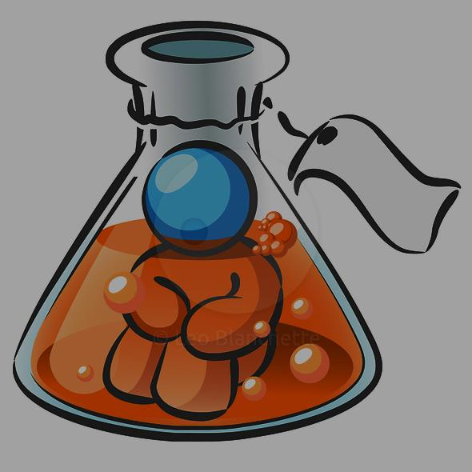
Thank you

