Slide 1
Since the partitioning behavior is dependent on temperature, the separation column is usually contained in a thermostat-controlled oven.
Separating components with a wide range of boiling points is accomplished by starting at a low oven temperature and increasing the temperature over time to elute the high-boiling point components.

Slide 2
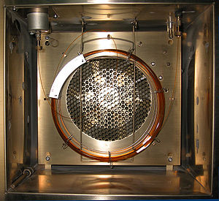
A gas chromatography oven, open to show a capillary column

Slide 3
Pressure
regulator
Flow
controller
Gas Supply
Gas
supply
The mobile phase (carrier gas) should be chemically inert, dry, and free from O₂ (helium, argon, nitrogen and hydrogen).
The carrier gas should be of high purity; impurities in the carrier gas such as water vapour, air and trace gaseous hydrocarbons can cause reactions with sample and cause column deterioration and affect detector performance.
The gas supply is associated with pressure regulator and flow controller.

Slide 4
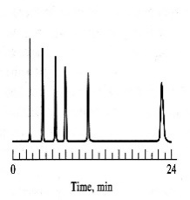
Flow
controller
Flow meter
Pressure
regulator
Injector
Septum
Detector
GC
chart
Sample Injection System
Ο
Recorder
Oven
Gas
supply
Column
Preparation of the Sample :
Samples GC must be volatile.
Samples which are non volatile are converted into a volatile derivative.
GC Column
Most GC columns are made from high-purity fused silica capillary, the inner wall of the capillary coated with the stationary phase.
GC columns vary in length from less than 2 m to 50 m or more.
In order to fit into the column oven, they are usually formed as coils.
The control of column’s temperature is critical to attain a good separation in GC, thus the column is located inside a thermostated oven to control the temperature.

Slide 5
GC Detectors
Thermal conductivity detector (TCD)
Flame ionization detector (FID)
Nitrogen phosphorous detectors (NPD)

Slide 6
GC Applications:
Food Analysis
Analysis of foods is concerned with confirming the presence
and determination the quantities of the analytes (lipids,
proteins, carbohydrates, preservatives, flavors, colorants,
and also vitamins, steroids, and pesticide residues).
Drug Analysis
GC is widely applied to identification of the active components, possible impurities as well as the metabolites.

Slide 7
Environmental Analysis
The environmental contaminants; e.g. (DDT) is present in the environment at very low concentrations and are found among many of other compounds. GC, with its high sensitivity and high separating power, is mostly used in the analysis of environmental samples.
Forensic Analysis
In forensic cases, very little sample is available, and the
concentration of the sample components may be very low.
GC is a useful due to its high sensitivity and separation efficiency.

Slide 8
Comparison of HPLC and GC
Sample Volatility
Sample Polarity
HPLC
HPLC
No volatility requirement
Sample must be soluble in mobile phase
Separates both polar and non polar compounds
GC
GC
Sample must be volatile
Samples are nonpolar and polar

Slide 9
Comparison of HPLC and GC
Sample Preparation
Sample Size
HPLC
HPLC
Sample must be filtered
Sample should be in same solvent as mobile phase
Sample size based upon column.
GC
GC
Solvent must be volatile and generally lower boiling than analytes
Typically 1 - 5 μL

Slide 10
Comparison of HPLC and GC
Separation Mechanism
Detectors
HPLC
HPLC
Both stationary phase and mobile phase take part
Most common UV-Vis
Wide range of non- destructive detectors
3-dimensional detectors
GC
GC
Most common FID, universal to organic compounds
Mobile phase is a sample carrier only

Slide 11
Thank you

