Slide 1
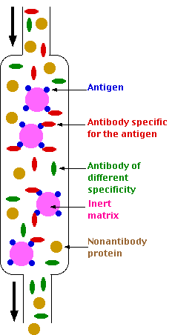
Affinity Chromatography

Slide 2
Mobile phase
Mobile phase is a liquid as water or dilute alcohol.
Separation mechanism
Based on difference between the solutes molecular weights.
Molecules will distribute themselves outside & inside the pores according to their size.
Larger are excluded, medium sized enter half-way & smallest permeate all the way.

Slide 3
The retention volume Vo of a substance is inversely proportional to the molecular weight (M. Wt) of the solute.
Vo ~ 1 / M.wt
Vo = retention volume
M.wt = Molecular Weight

Slide 4
Applications of GPC to natural products
Determination of M. wt. of peptides, proteins & polysaccharides.
Desalting of colloids e.g. desalting of albumin prepared with 2% (NH₄)₂SO₄.
Separation of mixture of mono- & polysaccharides.
Separation of amino acids from peptides & proteins.
Separation of proteins of different molecular weights.
Separation of mucopolysaccharides & soluble RNA.
Separation of myoglobin & haemoglobin.
Separation of alkaloids & purification of enzymes.

Slide 5
Ion Exchange Chromatography
Principle
Process by which ions of an electrolyte solution are brought into contact with an ion exchange resin.
The ion exchange resin is an insoluble polymer consisting of a "matrix" (Lattice or framework) that carries fixed charges (not exchangeable) and mobile active ions "counter ions" which are loosely attached to the matrix.
In water, the counter-ions move more or less freely in the framework & can be replaced by ions of the same sign present in the surrounding solution.
The "matrix" (framework) of a "cation exchanger" is considered as a crystalline non-ionized "polyanion" & the matrix of an "anion exchanger" as a non-ionized "polycation".

Slide 6
Cation Exchangers
Active ions (counter ions) are cations.
The polar groups attached to the matrix are acidic (sulphonic acids, carboxylic acids, phenols, phosphoric acids) e.g. a cation exchanger in the free carboxylic acid form:
X-COO⁻ H⁺
X = Frame work (matrix)
-COO⁻ = Fixed charge (anionic),
Non-exchangeable
H⁺ = Counter ion (cation), Exchangeable

Slide 7
They are usually (but not always) supplied in the Na⁺ form: X-COO⁻Na+

Slide 8
Anion Exchangers
Active ions (counter ions) are anions.
The polar groups attached to the matrix are tertiary or quaternary ammonium groups (basic).
e.g. Anion exchanger in the quaternary ammonium form:
X. NR3⁺OH –
X = Framework (matrix)
-NR3 ⁺ = Fixed charge (cationic)
Non exchangeable
-OH– = counter ion (anion), Exchangeable

