Slide 1
Paper Chromatography

Slide 2
Paper Chromatography
A method of partition chromatography using filter paper strips as carrier or inert support.
The factor governing separation of mixtures of solutes on filter paper is the partition between two immiscible phases.
One is usually water adsorbed on cellulose fibres in the paper (stationary phase).
The second is the organic solvent flows past the sample on the paper (stationary phase).

Slide 4
Partition occurs between the mobile phase and the stationary aqueous phase bound by the cellulose.
The isolation depends on partition coefficient of the solute.
Where,
K:Is the partition coeffcient.
C (Stationary: Is the concentration of the solute in the stationary.
C (Mobile): Is the concentration of the solute in the mobile.

Slide 5
General Procedure
1- Choice of paper and solvent to be used.
2- Desalting of sample.
3- Application of the sample.
4- Equilibration of paper.
5- Development.
6- Detection.
7- Identification of substances.

Slide 6
Techniques of development with various flow directions
Radial development
Ascending development
Descending development

Slide 7
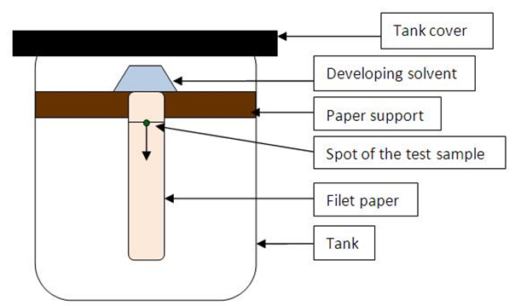
Descending Chromatography

Slide 8
Multiple chromatography
Multiple chromatography includes all procedures in which the development is repeated after one development is completed.
A- multiple development: the chromatogram is repeatedly developed in the same direction and thus the complete resolution of two or more substances which have R_{f} values close together can be obtained.
As the mobile phase one can use either the same solvent system or different solvent systems.

Slide 9
B- two-dimensional chromatography:
When large numbers of substances are to be separated on a single chromatogram.
Development in a direction perpendicular to the first, and with a solvent system different from that used initially is often necessary.
The sample is applied on one corner of a square piece of paper and after development with the first solvent, the paper is dried , rotated 90º and developed in the second direction.
Usually, different types of solvents systems are used in each direction. It is essential that the first solvent be completely volatile.

