Slide 1
Chromatography

Slide 2
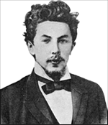
History
Mikhail Tswett, Russian, 1872-1919
Botanist
  In 1906 Tswett used to chromatography to separate plant pigments
  He called the new technique chromatography because the result of the analysis was 'written in color' along the length of the adsorbent column
    Chroma means “color” and graphein means to “write”

Slide 3
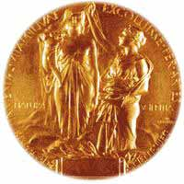
Importance
Chromatography has application in every branch of the physical and biological sciences
  12 Nobel prizes were awarded between 1937 and 1972 alone for work in which chromatography played a vital role

Slide 4
Chromatography is a physical method of separation in which the components to be separated are distributed between two phases
one of which is stationary (stationary phase) while the other (the mobile phase) moves through it in a definite direction.
The chromatographic process occurs due to differences in the distribution constant of the individual sample components.

Slide 5
Chromatography
Is a technique used to separate and identify the components of a mixture.
Works by allowing the molecules present in the mixture to distribute themselves between a stationary and a mobile medium.
Molecules that spend most of their time in the mobile phase are carried along faster.

Slide 6
Classification of chromatography according to mobile phase:
1- Liquid chromatography: mobile phase is a liquid. (LLC, LSC).
2- Gas chromatography : mobile phase is a gas. (GSC, GLC).

Slide 7
Classification according to the packing of the stationary phase:
1- Thin layer chromatography (TLC): the stationary phase is a thin layer supported on glass, plastic or aluminium plates.
2- Paper chromatography (PC): the stationary phase is a thin film of liquid supported on an inert support.
3- Column chromatography (CC): stationary phase is packed in a glass column.

Slide 8
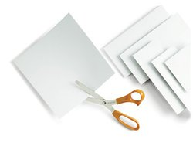
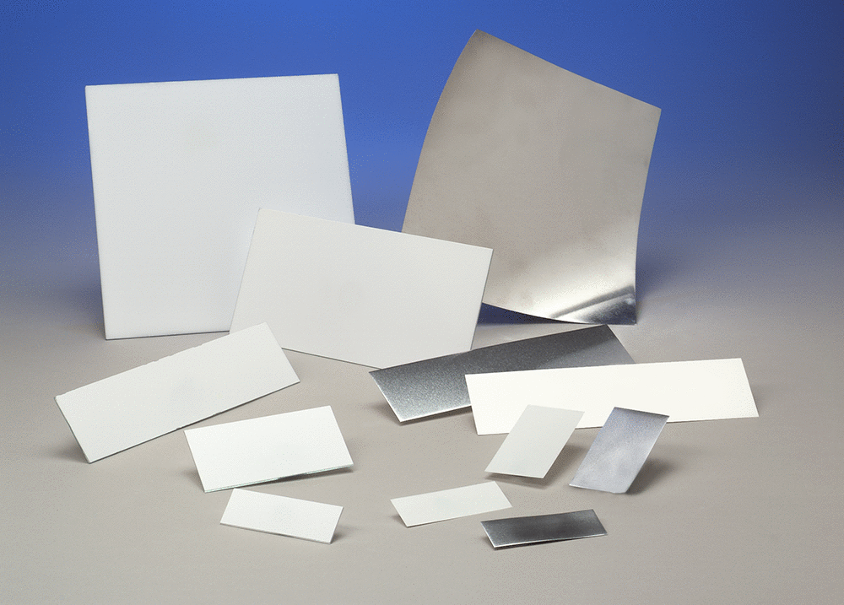
Plastic TLC Sheets
Aluminum TLC Sheets

Slide 9
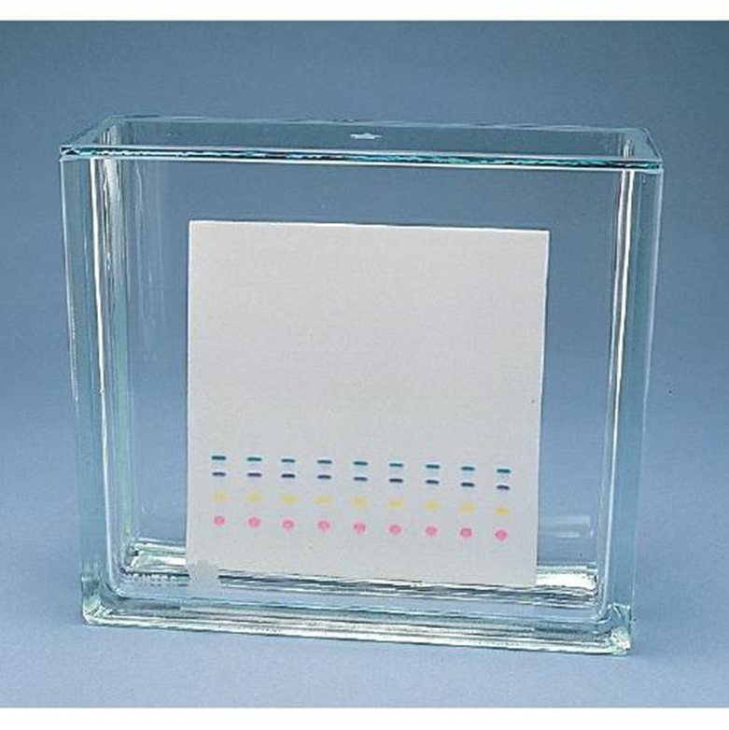
Glass TLC

Slide 10
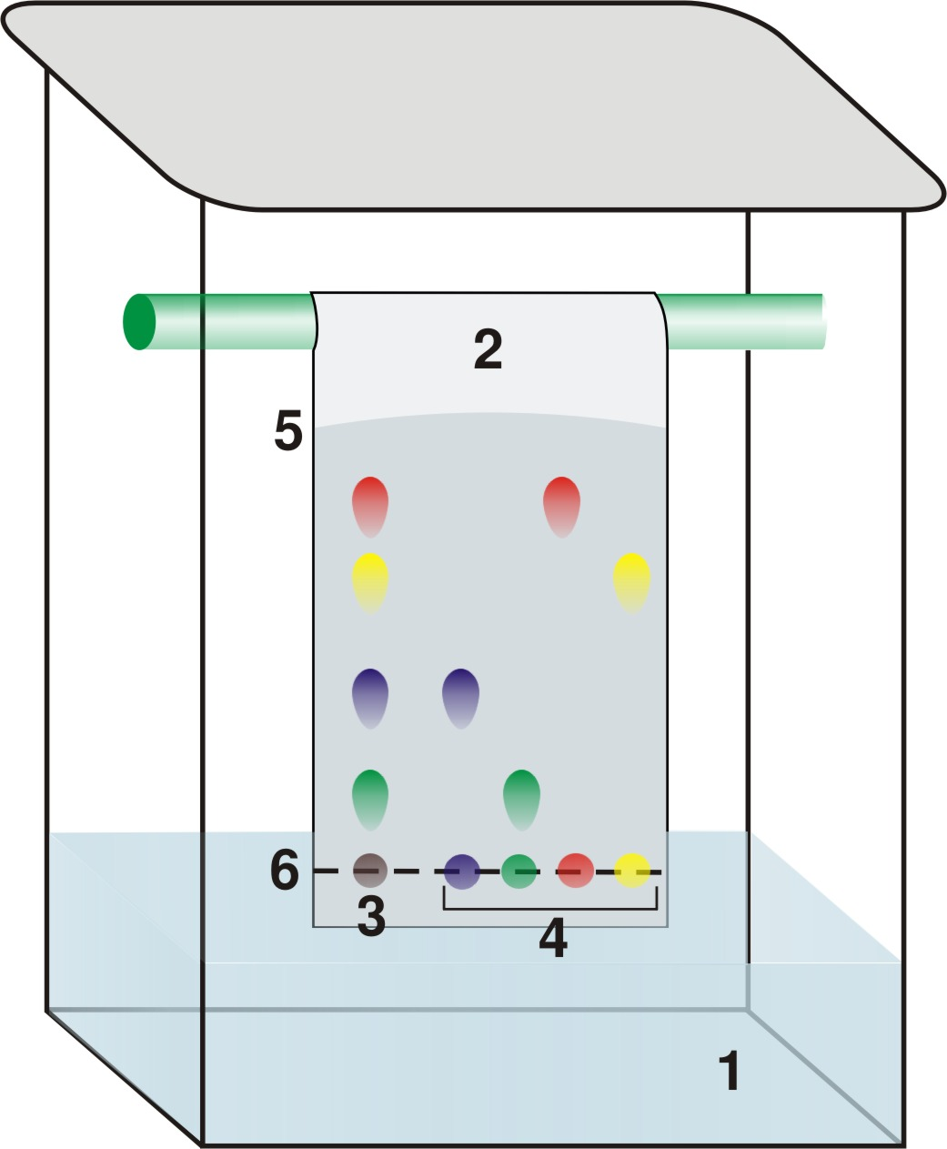
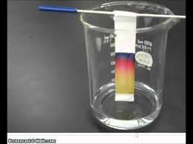
PC

