Slide 1
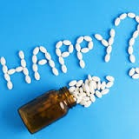
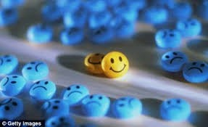
Antidepressants

Slide 2
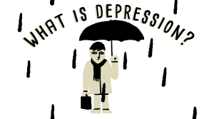
Antidepressants
Depression: feelings of sadness & hoplessness,
as well as, inability to experience pleasure in usual activities, changes in sleep patterns & appetite, loss of energy & suicidal thoughts
Mania (opposite behavior):enthusiasm, anger, rapid
thought & speech patterns, extreme self-confidence,
& impaired judgment
Biogenic amine theory???

Slide 3
Monoamine Hypothesis of Depression
Depression is related to a deficiency in the amount or functionof cortical and limbic serotonin (5-HT), norepinephrine (NE), and dopamine (DA).
Evidence to support, ----Reserpine????

Slide 4
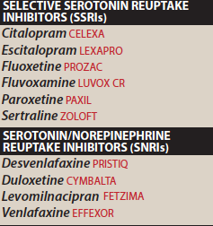
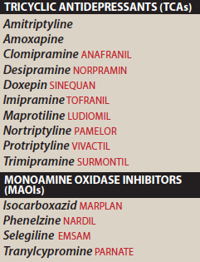
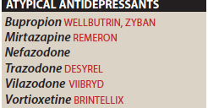
Antidepressants

Slide 5
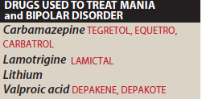

Slide 6
MECHANISM OF ANTIDEPRESSANT DRUGS
Antidepressant drugs potentiate, either directly or indirectly, the actions of NE &/or 5-HT in the brain
The biogenic amine theory
Mania is caused by an overproduction of these neurotransmitters.

Slide 7
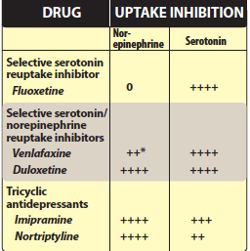
Selective serotonin Reuptake Inhibitors (SSRIs)
Higher selectivity to 5-HT (3000 x 5-HT> NE)
low activity on M, H1, ⍺-adrenergic??
Replaced TCA & MAOIs
Fluoxetine, Citalopram, Escitalopram, Fluvoxamine, Paroxetine, Sertaline

Slide 8
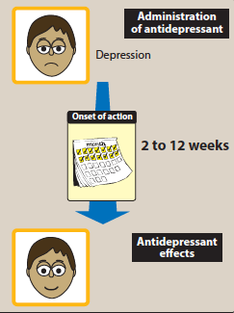
2 weeks for improvement in mood up to 12 weeks

Slide 9
Therapeutic Uses
Depression
Obsessive-compulsive disorder
Panic disorder
Generalised anxiety disorder
Premenstrual dysphoric disorder
Bulimia nervosa

Slide 10
Pharmacokinetics
Well absorbed orally, 2-8 hrs., t1/2=16-36 hrs
Food, sertaline???
Hepatic metabolism
Fluoxetine (S-norfluoxetine), sustained prep.
Fluoxetine & paroxetine inhibitors of CYP2D6 / TCA
CYP2C9/19, CYP3A4 / SSRI???

Slide 11
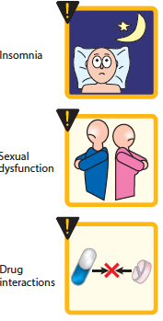
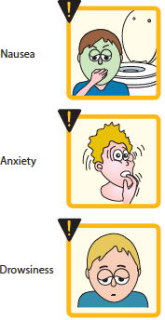
Adverse Effects
Headache, sweating, anxiety, agitation
GIT disturbances (NVD)
Weakness, fatigue, sleep disturb.
Drug-Drug interaction
Hyponatremia

Slide 12
Sleep disturbance
paroxetine, fluvoxamine / sedating
fluoxetine, sertaline / activating
Sexual Disturbance
libido, delayed ejaculation, anorgasmia
(change or move to bupropion, mirtazapine)
Use in Children & Teenagers
(1/50 suicidal ideation)
fluoxetine, sertaline, fluvoxamine / obsessive disorders
fluoxetine, escitalopram / childhood depression

Slide 13
Overdose
No cardiac arrhythmias, with the exception of citalopram, which may cause QT prolongation
Seizures are a possibility because ?????
SSRIs have the potential to cause serotonin syndrome, especially when used in the presence of an MAOI or other highly serotonergic drug
Serotonin syndrome may include: hyperthermia, muscle rigidity, sweating, myoclonus (clonic muscle twitching), and changes in mental status and vital signs

Slide 14
Discontinuation syndrome
Mainly the agents with shorter t_{1/2} and inactive metabolites
Fluoxetine has the lowest risk of causing an SSRI discontinuation syndrome due to its longer half-life and active metabolite
Possible signs and symptoms of SSRI discontinuation syndrome include: headache, malaise and flu-like symptoms, agitation and irritability, nervousness, and changes in sleep pattern

Slide 15
Serotonine/Norepinephrine Reuptake Inhibitors (SNRI)
Venlafaxine, Desvenlafaxine, Levomilnacipran, & Duloxetine
potent inhibitor (at med., & high doses)
treating depression in patients are not responding to SSNRIs
little activity at α -adrenergic, M or H Rs
Both SNRIs & TCAs relieve pain
used in the treatment of pain syndromes, such as diabetic peripheral neuropathy, postherpetic neuralgia, fibromyalgia, and low back pain
SE: N,headache sexual dysfunction, increase HR & BP

Slide 16
Venlafaxine:
is a potent inhibitor of 5-HT and, at medium to higher doses, is an inhibitor of NE reuptake
minimal inhibition of the CYP450 isoenzymes and is a substrate of the CYP2D6 isoenzyme
Desvenlafaxine:
is the active, demethylated metabolite of venlafaxine.
The most common side effects of venlafaxine are nausea, headache, sexual dysfunction, dizziness, insomnia, sedation, and constipation
At high doses, there may be an increasein blood pressure and heart rate.

Slide 17
Duloxetine
inhibits 5-HT & NE reuptake at alldoses.
It is extensively metabolized in the liver to inactive metabolites
GI side effects, nausea, dry mouth, and constipation, insomnia, dizziness, somnolence, sweating, and sexual dysfunction
may increase blood pressure or heart rate.
is a moderate inhibitor of CYP2D6 isoenzymes and may increase concentrations of drugs metabolized by this pathway, such as antipsychotics.

Slide 18
Atypical antidepressants
Mixed group of agents (bupropion, mirtazapine, nefazodone, trazodone, vilazodone and vortioxetine)
Bupropion
weak DA & NE reuptake inhibitor
used to decrease craving & attenuating withdrawal symptom in patients trying to quit nicotine
SE: dry mouth, sweating, nervousness, tremor, and dose dependent increased risk for seizures.
very low incidence of sexual dysfunction
metabolized by the CYP2B6 pathway
relatively low risk for drug–drug interactions???
inhibit CYP2D6
should be avoided in patients at risk for seizures & who have eating disorders such as bulimia

Slide 19
Mirtazapine (enhances 5-HT & NE transmission)
antagonist to presynaptic ⍺ 2 to 5-HT2 R
No antiM, SE Marked sedation???
Increase appetite & weight
Nefazadone & Trazadone
weak inhibitors of 5-HT reuptake
block postsynaptic 5-HT 2⍺
Sedative (H1 blocking effect), hepatotoxicity (nefazodone)
Trazadone / off label / insomnia / priapism (persistent and painful erection of the penis)
⍺1 antagonist?????

Slide 20
Vilazodone
Serotonin reuptake inhibitor & a 5-HT1a receptor partial agonist
it is unique from that of the SSRIs
The adverse effect profile is similar to the SSRIs, including a risk for discontinuation syndrome if abruptly stopped.

Slide 21
Vortioxetine
A combination of 5-HT reuptake inhibition, HT1a agonism, and 5-HT3 and 5 -HT7 antagonism
The common adverse effects include nausea, constipation,
and sexual dysfunction, which may be expected due to its
serotonergic mechanism

Slide 22
Tricyclic Antidepressants
Block 5-HT & NE
Amitriptyline, imipramine, doxepin, clomipramine (3◦ amine)
Nortriptyline, desipramine (2◦ amine)
Maprotyline, amoxapen (tetracyclic)
Mechanism of Action:
TCAs and Amoxapine are potent SNRIs
Maprotiline & Desipramine are relatively selective inhib. of NE reuptake.
block 5-HT, α -adrenergic, H receptors & M receptors
Amoxapine also blocks 5-HT2 & DA 2 receptors

Slide 23
Therapeutic Uses
Used for moderate to severe depression & panic disorders
Imipramine / bed-wetting in children / vasopressin / enuresis alarm
Amitriptyline / prevent migraines / chronic pain syndrome
Low doses (Doxeoin)/ insomnia

Slide 24
Tricyclic Antidepressants
Well absorbed orally / lipophilic /CNS
widely distributed
Hepatic metabolism (microsomal system), glucuronide conj / urine

Slide 25
Side Effects of TCAs
Muscarinic blockade
Alpha adrenergic block
H1 blockade
Weight gain
Lower sexual dysfunction
caution with patient with mania
Narrow TI
Excacerbate benign prostatic hyperplasia, epilepsy, and preexisting arrhythmias.

Slide 26
Drug-Drug Interactions

Slide 27
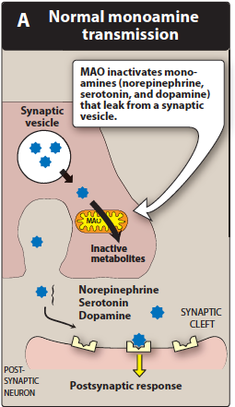
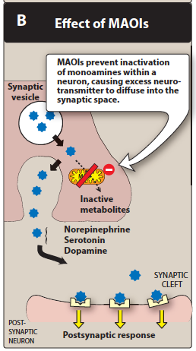
Mononamin Oxidase Inhibitors
Phenelzine, tranylcypromine, selegeline, isocarboxazide

Slide 28
Mononamin Oxidase Inhibitors
irreversible or reversible complex
act centrally & peripherally
effect is delayed several wks (2)
phenelzine, tranylcypromine , isocarboxazid & Selegiline
Limited use / complexity
used for persons who are unresponsive to TCA
well abs. orally
Drug-food interaction (tyramine)
hypertensive crisis,, headache, stiff neck, - - -
phentolamine & prazocin used to treat tyramine induced

Slide 29
Mononamin Oxidase Inhibitors (cont.)
Mostly, form stable complexes with the enzyme, causing irreversible inactivation (accumulation of NE, 5-HT & DA), e.g. Phenelzine
Brain, GIT & liver ( catalyzes oxidative deamination of drugs and potentially toxic substances, such as tyramine)
High incidence of drug–drug and drug–food interactions
Selegiline / transdermal patch may produce less inhibition of gut and hepatic MAO at low doses because it avoids first-pass metabolism.
Response delayed for several weeks
Selegiline and tranylcypromine have an amphetamine-like stimulant effect that may produce agitation or insomnia.

Slide 30
Therapeutic uses
Pharmacokinetics
Adverse effects
drug–food and drug–drug interactions
hypertensive crisis, with signs and symptoms such as occipital headache, stiff neck, tachycardia, nausea, hypertension, cardiac arrhythmias, seizures and, possibly, stroke.
Phentolamine and prazosin
drowsiness, orthostatic hypotension, blurred vision, dry mouth, and constipation.
CI: combination with other antidepressants

Slide 32
Treatment of Mania & Bipolar Disorder
Lithium
for acute & prophylaxis
low TI
Unknown mechanic
SE: headache, dry mouth, polyuria, poldepsia, tremor, - - etc
SE due to high doses:
ataxia, slurred speech, tremor, confusion, convulsion
Thyroid function may be decreased and should be monitored

Slide 33
Other Drugs for Mania & Bipolar
Several antiepileptic drugs, e.g. carbamazepine, valproic acid, and lamotrigine are approved
(chlorpromazine and haloperidol) and newer antipsychotics
Atypical antipsychotics risperidone, olanzapine,ziprasidone, aripiprazole, asenapine, cariprazine
Quetiapine, lurasidone, and the combination of olanzapine and fluoxetine have been approved for bipolar depression

