Slide 1
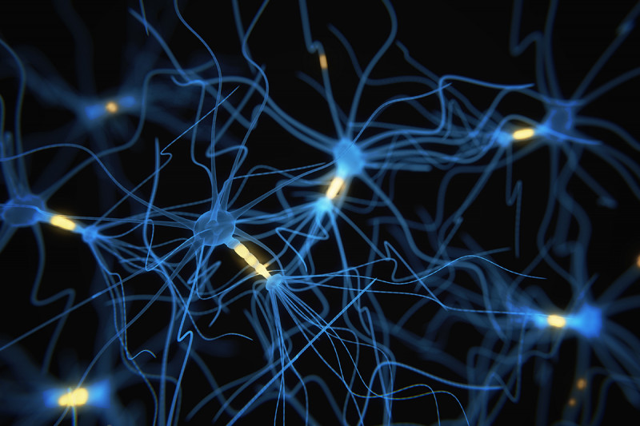
Drugs Affecting the Central Nervous System
Asst Prof Dr Inam S. Arif
isamalhaj@yahoo.com
Pharm.dr.isamalhaj@uomustansiriyah.edu.iq

Slide 3
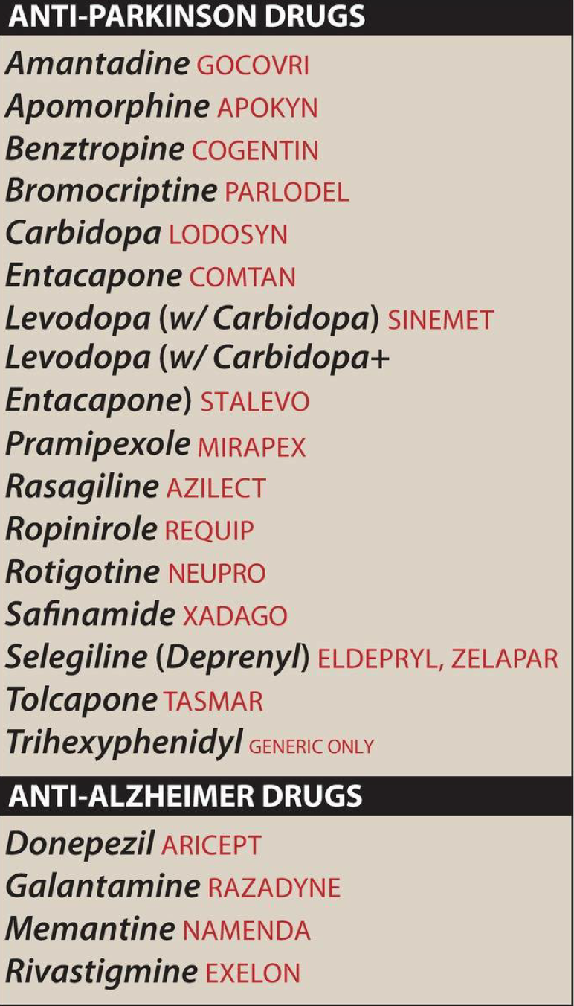
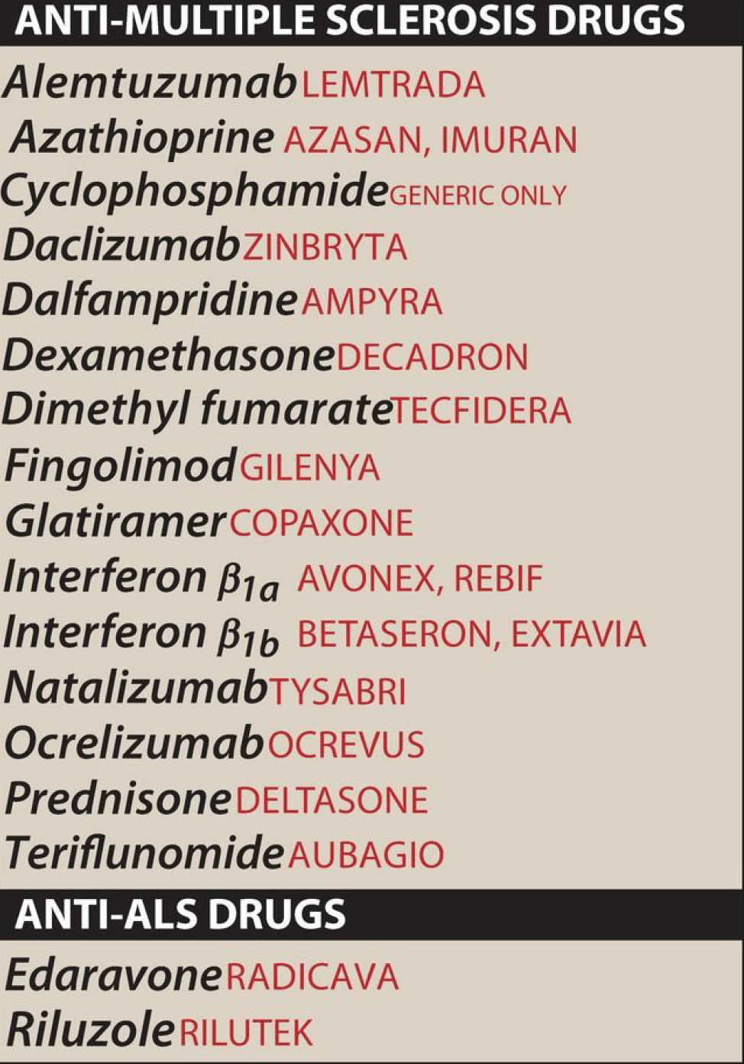

Slide 4
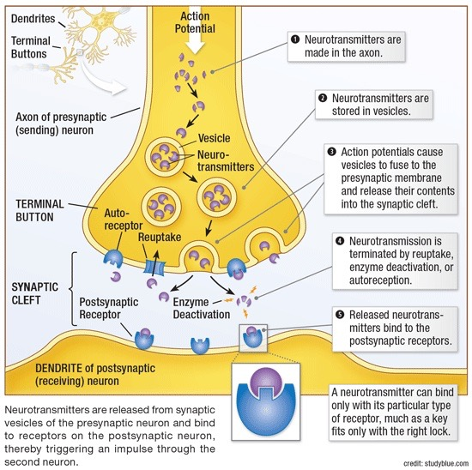

Slide 5
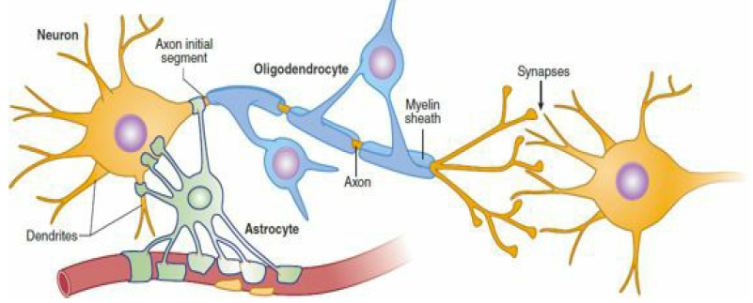
What are the differences between CNS & ANS ???

Slide 6
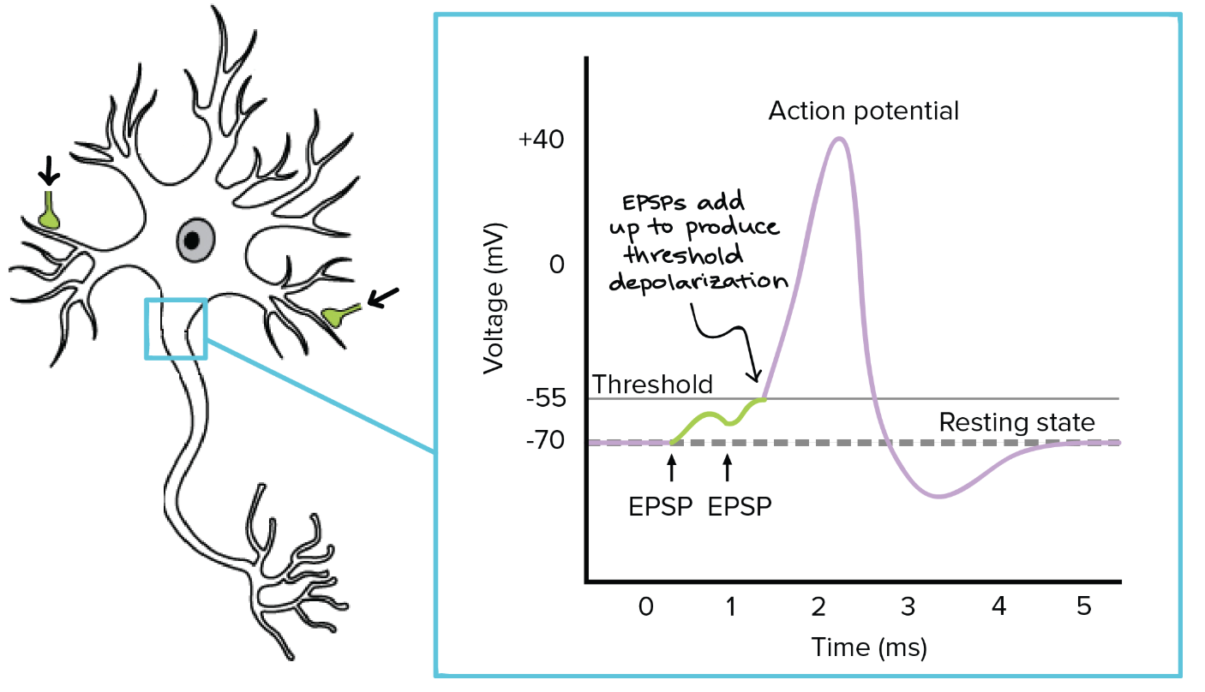
Communication between Neurons

Slide 7
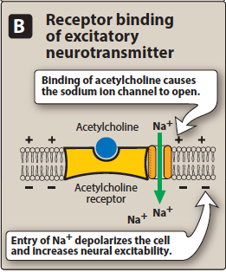
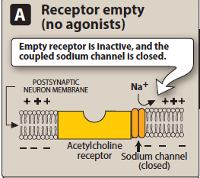

Slide 8
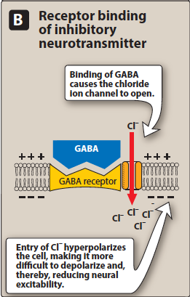
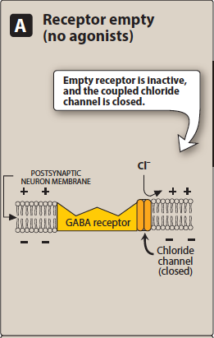

Slide 9
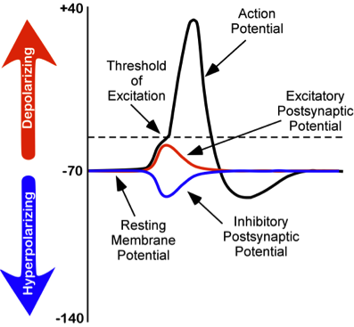

Slide 10
Combined effects of the EPSP and IPSP
Most neurons in the CNS receive both EPSP and IPSP input.
The overall action is the summation of actions of the various neurotransmitters on the neuron.
The neurotransmitters are not uniformly distributed in the CNS but are localized in specific clusters of neurons

Slide 11
Neurodegenerative Diseases
Parkinson’s Disease
Multiple Sclerosis
Alzheimer’s Disease
Amyotrophic Lateral Sclerosis
Progressive loss of selected neutrons in discrete brain areas disorders of movement, cognition or both

Slide 12
Parkinson’s Disease
A progressive neurodegenerative disease that adversely affects motor neuron control (M movement)
Major early symptoms are tremor at rest, bradykinesia, muscle rigidity, postural & gait abnormalities and flat facial affect.
If untreated, the condition worsens, leading eventually to complete immobility and early mortality.
The prevalence is approximately 1-2% in persons older than 65 years

Slide 13
Parkinson’s Disease
Characterised by:
tremor
muscular rigidity
bradykinesia
postural & gait abnormalities
Sadly, symptoms don’t appear until> 80% of neutrons
have died

Slide 15
Bradykinesia
slowness of movement is one of the three main signs of Parkinson’s, along with tremor and rigidity (It describes slowness in carrying out, rather than initiating, movements)
Up to 98% of all people with Parkinson’s experience slowness of movement.
Dyskinesia
is an involuntary movement that you cannot control
can affect just one part of the body, like the head or an arm, or it can affect the entire body
can range from mild to severe and painful, and interfere with normal daily activities
can also differ in frequency and time of day that it occurs

Slide 16
Gait ( our manner or pattern of walking)
When we walk our body is normally upright, neither leaning forwards nor backwards
with an even stride and arms swinging at the sides
When we hold ourselves in this upright position our center of gravity is held so we should have good balance
Parkinsonian gait’ is a distinctive
less steady walk that arises from changes in posture
slowness of movement (bradykinesia) and a shortened stride
characterized by some, but not necessarily all, of the following:
a tendency to lean forwards in a stooped position when walking
the head dropped forwards, with shoulders down
feet dragging on the ground, resulting in shuffling steps
a reduced length of stride
a reduced arm swing

Slide 17
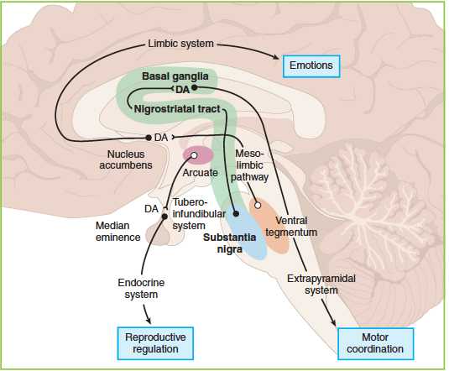
Etiology of Parkinson’s Disease

Slide 18
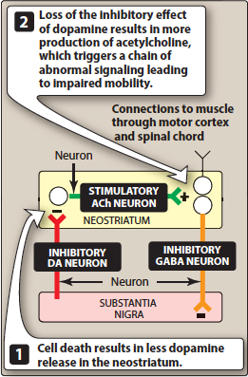
Role of substantia nigra in Parkinson disease

Slide 19
Secondary Parkinsonism
Phenothiazines & haloperidol / pseudoparkinsonism

