Slide 1
General Urine Examination and
General Stool Examination
Asst. Prof. Dr. Dalya Basil Hanna

Slide 2
Urine analysis
Urine is a liquid mainly consisting of water and waste products of our body, generated through filtering the blood by the kidneys.
Urine contains residual nitrogen substances such as urea, uric acid, creatinine and a small dose of mineral salts and enzymes. Among these substances, there is also the urochrome, which is the pigment that gives urine the typical amber yellow color. Bilirubin and urobilin also make the urine yellow.

Slide 3
Urine analysis
Urine analysis: is the term used to refer to the test used to evaluate a urine sample.
  Because urine removes toxins and excess liquids from the body, its contents can provide vital health information.
  Obvious abnormalities in the color, clarity, and cloudiness may suggest different diseases, such as metabolic disorders and kidney disease.
  Urinalysis can also be used to uncover evidence of drug abuse.

Slide 4
Urinalysis Basics
Urinalysis consists of the following:
  Macroscopic Examination
  Chemical Analysis
  Microscopic Examination

Slide 5
  Macroscopic Examination
Observing the physical properties of the urine:
  Color:
    Normal urine should be a shade of yellow ranging from a straw to amber color. Normal urine volume is 750 to 2000 ml/24hr.
    Abnormal urine can be: colorless, dark yellow, orange, pink, red, green, brown, or black.
  Clarity (transparency):
    Normal urine should be clear
    Abnormal urine can be: hazy, cloudy, or turbid

Slide 6
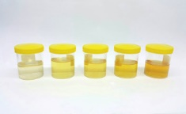
Macroscopic Examination
Pale straw color: Normal, healthy, well-hydrated.
Transparent: Colorless urine may indicate over-hydration which can dilute essential salts, such as electrolytes, creating a chemical imbalance in the blood.
Transparent yellow: Normal.
Dark yellow: Normal, but suggestive of mild dehydration.
Amber or honey: Possibly dehydrated.
Light orange: Possibly dehydrated, but may also be caused by liver or bile duct problems.
Orange: Some medications, such as rifampin or phenazopyridine, can cause this coloration.

Slide 7
Macroscopic Examination
Red: This color could be a worrisome sign of many things. Blood in the urine, called hematuria, idiopathic or a sign of a kidney stone, infection or tumor in the urinary tract. It may signal a problem with the prostate. Or a group of rare inherited disorders known as porphyrias.
Blue: Some medications and food dyes produce bluish urine. So too does a rare inherited metabolic disorder known as familial hypercalcemi or “blue diaper syndrome,” which is characterized by incomplete intestinal breakdown of tryptophan, a dietary nutrient.
Dark brown or black: Some medications darken urine. Copper or phenol poisoning or melanoma, can result in blackish urine called melanuria.
White or milky: This may be caused by an overabundance of certain minerals, such as calcium or phosphate, a urinary tract infection or excessive proteins.

Slide 8
Chemical Analysis
The chemical properties of urine, including pH, specific gravity, protein content, glucose content, ketone content, and others are tested.
pH
  Test measures if urine is acidic, basic or neutral
  Normal urine ranges from 4.6 to 8.0
Specific Gravity:
  Test measures the concentration of particles in the urine and evaluates the body’s water balance.
  The more concentrated the urine, the higher the urine specific gravity.
  The most common increase in urine specific gravity is the result of dehydration.
  Normal urine ranges between 1.002 to 1.028

Slide 9
Chemical Analysis
Ketones:
  Test measures the presence or absence of ketones, the endpoint of rapid or excessive fat breakdown, in the urine.
  Normal urine does not contain ketones
Protein:
  Normal urine levels of proteins (called albumin) are very small, usually approximately 0 to 8 mg/dl.
Glucose:
  The test measures the amount of sugar in a urine sample.
  Normal urine does not contain glucose.

Slide 10
Chemical Analysis (Urine test strips)
A standard urine test strip may comprise up to 10 different chemical pads or reagents which react (change color) when immersed in, and then removed from, a urine sample. The test can often be read in as little as 60 to 120 seconds after dipping.
Routine testing of the urine with multiparameter strips is the first step in the diagnosis of a wide range of diseases. The analysis includes testing for the presence of proteins, glucose, ketones, haemoglobin, bilirubin, urobilinogen, acetone, nitrite and leucocytes as well as testing of pH and specific gravity or to test for infection by different pathogens.

Slide 11
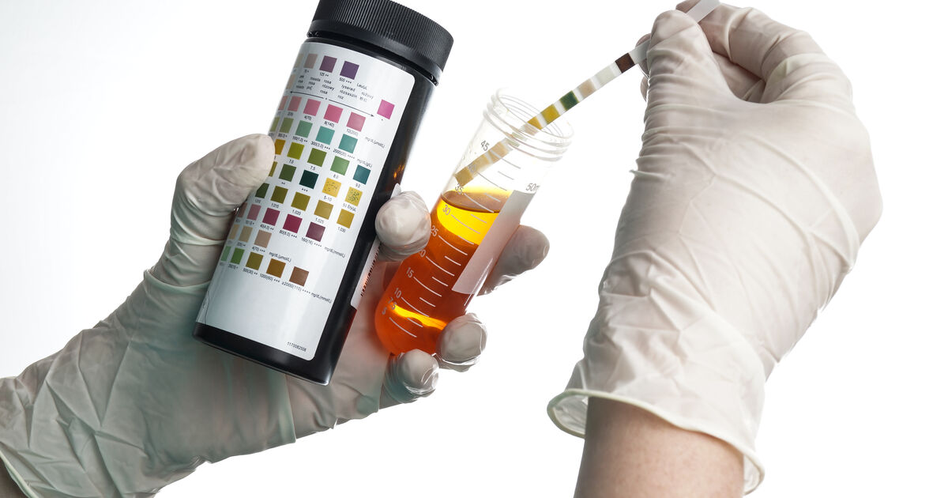
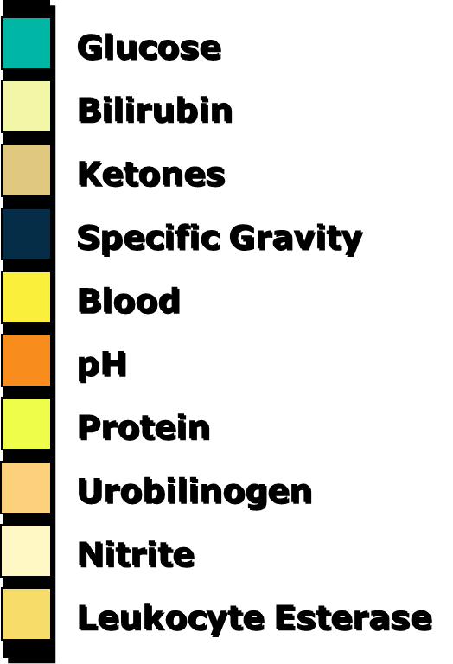

Slide 12
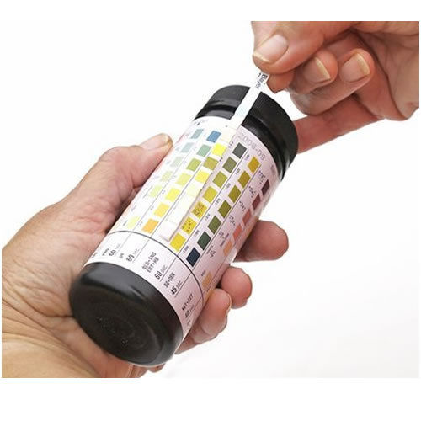

Slide 13
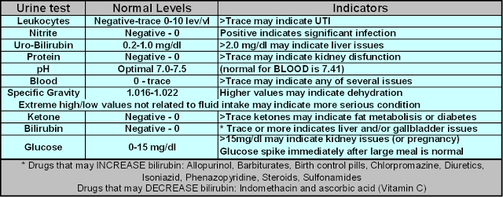
Chemical Analysis

Slide 14
  Microscopic Examination
In microscopy, a sample of urine is centrifuged to obtain some sediment, a variety of normal and abnormal cellular elements may be seen in urine when looked at under a microscope, including:
  Red blood cells
  White blood cells
  Epithelial cells
  Crystals
  Bacteria

Slide 15
Microscopic Examination
Red Blood Cells:
Hematuria is the presence of abnormal numbers of red cells in urine due to:
a. Glomerular damage
b. Tumors
c. Urinary tract stones
d. Upper and lower urinary tract infections

Slide 16
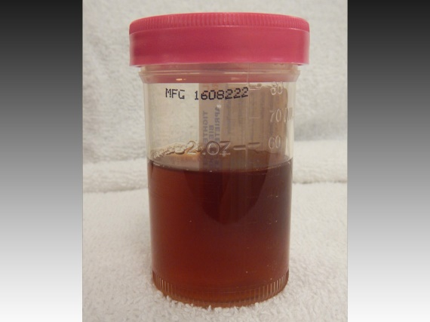
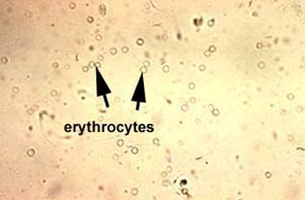
Microscopic Examination
Two Types of Hematuria
Gross hematuria means that the blood can be seen by the naked eye. The urine may look pinkish, brownish, or bright red.
Microscopic hematuria means that the urine is clear, but blood cells can be seen under a microscope.

Slide 17
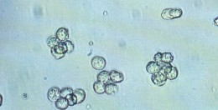
Microscopic Examination
White blood cells: Pyuria refers to the presence of abnormal numbers of leukocytes that may appear with infection in either the upper or lower urinary tract or with acute glomerulonephritis.
WBCs - ≤2-5 WBCs/hpf

Slide 18
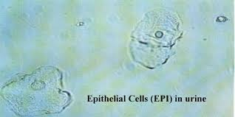
Microscopic Examination
Epithelial cells: Renal tubular epithelial cells, contain a large round or oval nucleus and normally slough into the urine in small numbers. However, with nephrotic syndrome and in conditions leading to tubular degeneration, the number sloughed is increased.
Normal range: ≤15-20 squamous epithelial cells/hpf

Slide 19
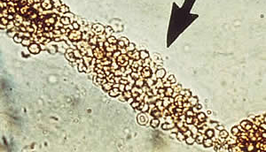
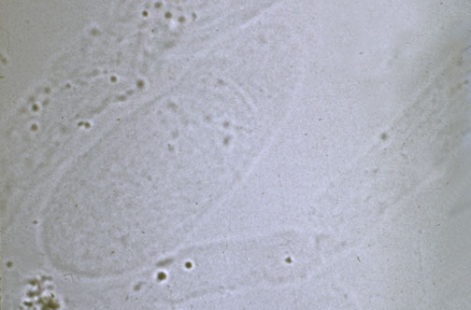
Microscopic Examination
Urinary casts may be made up of cells (such as white blood cells, red blood cells, kidney cells) or substances such as protein.
Hyaline casts are composed primarily of a mucoprotein (Tamm-Horsfall proteins) secreted by tubule cells.

Slide 20
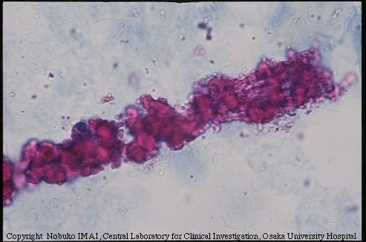
Microscopic Examination
Bence Jones proteins are small proteins found in the urine. Testing for these proteins is done to diagnose and monitor multiple myeloma and other similar diseases.
Bence Jones proteins are considered the first tumor marker.
A tumor marker is a substance, made by the body, that is linked to a certain cancer, or malignancy. Bence Jones proteins (myeloma casts) are made by plasma cells, a type of white blood cell. The presence of these proteins in a person's urine is associated with a malignancy of plasma cells.

Slide 21
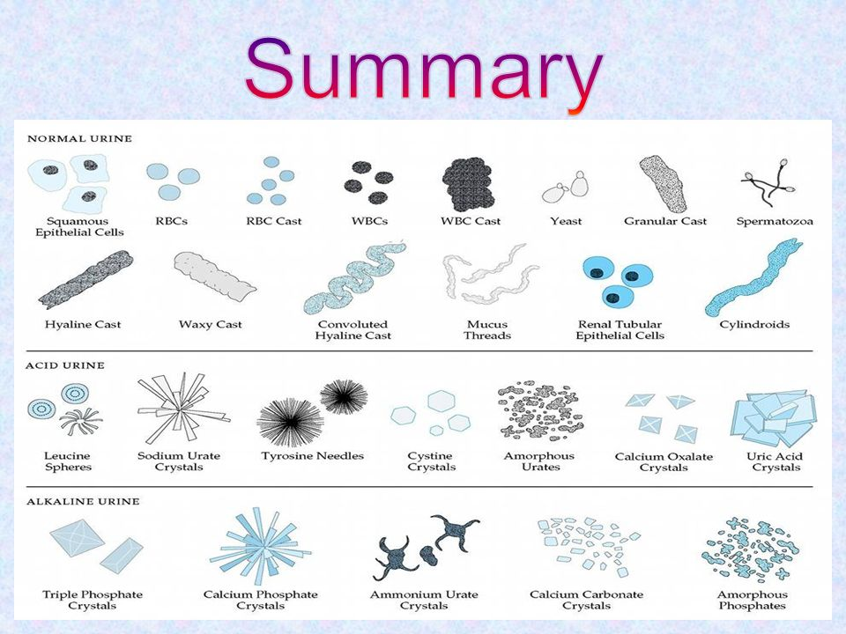

Slide 22
General Stool Examination
A stool analysis is a test on a stool (feces) sample to help diagnose certain conditions affecting the digestive tract.
Collection of Fecal Specimens:
Collect about 10-15 gm the stool in a dry, clean, container. Make sure no urine, water, soil or other material gets in the container.
If it is not possible to obtain feces collect a specimen by inserting a cotton wool swab into rectum for about 10 sec.
Label the specimen with the patient’s name, date and time of collection and send it with a request form to reach laboratory as soon as possible.
Fresh stool should be examined immediately, or preserved .

Slide 23
General Stool Examination
Direct saline wet mount
Place a drop of saline on the slide.
Pick up a small amount of fecal material on the end of an applicator stick.
Emulsify in the saline and cover with a cover slip.
Examine on low and high power.
The entire preparation must be examined for the presence of eggs, larvae and protozoa.
Note: Take small amounts of material from several different areas (stool surface and deep inside), especially from bloody and/or mucoid areas.

Slide 24
Stool analysis Basics
Stool analysis consists of the following:
  Macroscopic (Physical) Examination
  Chemical Analysis
  Microscopic Examination

Slide 25
  Macroscopic (Physical) Examination
1- The color of stool
2- Odor
3- Consistency of stool
4- Naked eye parasite
5- Gross blood
6- Mucus

Slide 26
Macroscopic (Physical) Examination
Normal color of stool is brown. The characteristic brown color of feces is due to stercobilin and urobinin, both of which are produced by bacterial degradation of bilirubin.
Abnormal color:
Black color: indicate iron medication (for treatment of anemia ) or upper GIT bleeding (due to peptic ulcer or stomach carcinoma).
Bright red color (Hematochezia): indicate lower GIT bleeding (due to anal fissure).
Pale brown color: with a greasy consistency indicate pancreatic deficiency causing malabsorption of fat (often with offensive odor).
Yellow-green color: occurs in the stool of breast-fed infants who lack normal intestinal flora (low bile conversion) and may also occurs due to rapid transit of feces through the intestines.
Red brown color: indicate drugs as Tetracyclines, and Rifambicin antibiotics.

Slide 27
Macroscopic (Physical) Examination
Normal odor of stool is offensive results from gases produced by bacterial metabolism, including skatole, mercaptans, indole and hydrogen sulfide formed by bacterial fermentation and putrefaction.
Abnormal odor is Very offensive: usually seen in cases of constipation and with certain types of food that produce excessive gases, Bacterial infection and malabsorption.
Consistency: Normally well formed
Abnormal:
Very hard: seen in cases of constipation
Semi formed: seen in the cases of parasitic infection
Soft: seen in the cases of parasitic infection
Loose: seen in the cases of diarrhea
Watery: mostly seen in cases of bacterial infection

Slide 28
Macroscopic (Physical) Examination
Naked eye parasite : Normal: no parasites or larva appear in the stool but in some cause the whole worm or part of its body appear in the stool and can be seen by naked eye like(segment of tap worm )
Two worms can be seen by naked eye in the stool:
Ascaris lumbericoides and Entrobius vermicularis
Gross blood: Normally no blood seen in the stool.
Abnormal fresh blood (Hematochezia) seen in cases of lower GIT bleeding and also known as "bright red blood per rectum" and abbreviated BRBPR

Slide 29
Macroscopic (Physical) Examination
Mucus: Normally undetectable amount produce by GIT and found in the stool.
Abnormal mucus in the sample appears as white patches and according to the amount of mucus it can be graded using signs (+, ++, +++).
Mucus abnormally can be found in the stool in the following cases:
Spastic colon (translucent mucus on the surface of stool)
Ulcerative colitis
Bacillary dysentery (mucus with fresh pus)
Amoebic dysentery (mucus with fresh blood)

Slide 30
Chemical Analysis
pH is Normally variable and diet dependent and is based on bacterial fermentation in the small intestine.
High alkaline stool- Physiological: cause by using High protein diet
Pathological : Colitis or Antibiotic use (impaired colonic fermentation)
High acidic stool- Physiological :High carbohydrate diet
Pathological: Poor fat absorption
Fat in stool: Increased Fats is associated with Malabsorption Syndromes, such as Coeliac disease, Crohn’s disease, Enteritis and Pancreatic diseases, Surgical removal of section of Intestine, and others.

Slide 31
Chemical Analysis
Faecal occult blood test (FOBT): Detect blood which is present in amount or form not visible macroscopically.
When the bleeding is chronic with only small amounts of blood being passed in the feces, the blood (or its breakdown products) is not recognized in the feces and is referred to as occult (hidden) blood.
An average, healthy person passes up to 2.0 mL of blood per 150 g of stool into the GIT daily. Passage of more than 2.0 mL of blood in the stool in 24 hours is pathologically significant.

Slide 32
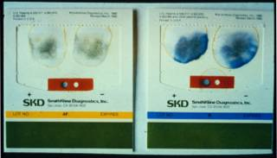
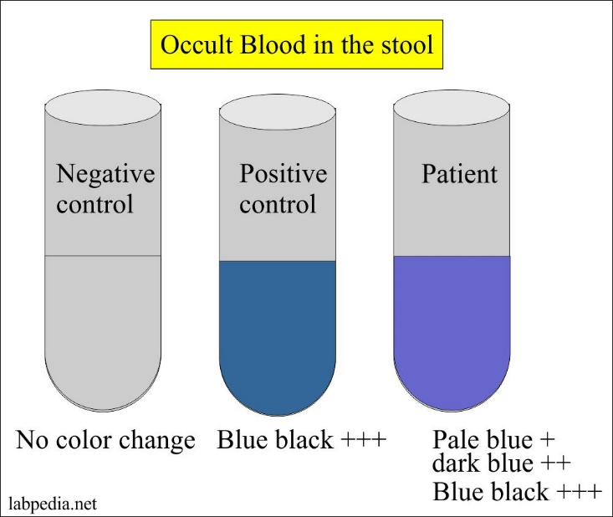
Chemical Analysis
BENZIDINE TEST, GUAIAC TEST, and ORTHOTOLIDINE TEST are used in FOBT
Principle of the test: The principle of chemical tests to detect occult blood is based on the fact that hemoglobin and its derivatives react in a similar way to peroxidase enzymes– by catalyzing the transfer of an oxygen atom from the peroxide to a chromogen such as benzidine, o-toludine, guaiac or aminophenazone. Oxidation of the chromogen is indicated by the production of a blue, blue-green or pink color.

Slide 33
Microscopic Examination
The microscopic examination may be used to determine the presence of leukocytes and erythrocytes in a fecal smear. This will very quickly give the clinician information on the patients disease state. Determination of the presence of leukocytes may be useful in the diagnosis of patients with diarrhea due to bacterial infection.
Microscopic examination of stool can be done by Gram stain, Wrights Stain, and by wet mount procedure.

Slide 34
Microscopic Examination
For the diagnosis of microscopic elements:
Trophozoites and its movements are better seen in unstained preparation of a fresh material.
Cystic forms &Nuclear character are better seen in stained preparation(iodine)
Gycogen mass- stained with iodine
Chromatoid bars- unstained preparation
N.B – Both stained and unstained materials are
to be prepared

Slide 35
Microscopic Examination
Procedure for the microscopic examination of faecal samples for parasites
1. place a drop of saline a clean slide.
2. place a small piece of stool on the slide and mix with saline, cover with a cover slip. If the specimen contain mucus, the examination prefer to be done without saline. The mucus is put on the slide and covered with cover slip.
3. examine under 10X and 40X objectives.
Using of Saline: Normal saline (0.85%) is used for routine examination of stool samples, as it is isotonic.
Using of Iodine: Iodine is used to examine the nuclei of cysts.
Using of Eosin 1%: this provide a pink background and that will help to clear the unstained objects.

Slide 36

Thank You

Slide 37
References
Urinalysis: Part 1. 2006 The University of Iowa (accessed 17 Aug 2007) Available from: http://www.medicine.uiowa.edu/cme/clia/modules.asp?testID=19
http://www.utmem.edu/nephrology/documents/powerpoint-urinalysis-files/frame.htm
http://www.texascollaborative.org/spencer_urinalysis/ds_overview.htm
http://www.nlm.nih.gov/medlineplus/ency/article/003583.htm
http://www.nlm.nih.gov/medlineplus/ency/article/003587.htm
http://www.medicineplus.com

