Slide 1
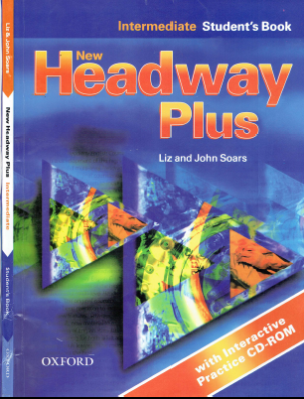
Class Reference book
English Language
For 3rd Year Students
College Pharmacy Al-Mustansiriyah University
Chapter Two

Slide 2
Past Simple
Past Continuous
Past Simple or Past Continuous
Past Perfect
Past Tenses Passive

Slide 3
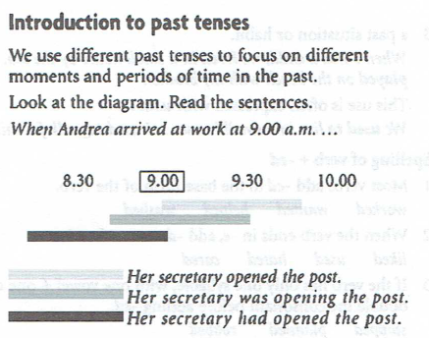

Slide 4
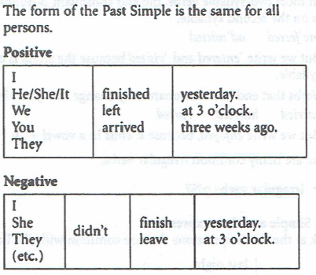
1. Past Simple

Slide 5
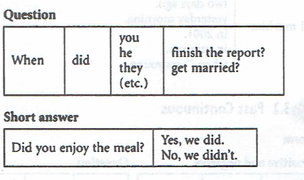
1. Past Simple

Slide 6
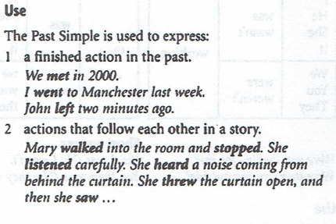
1. Past Simple

Slide 7
1. Past Simple

Slide 8
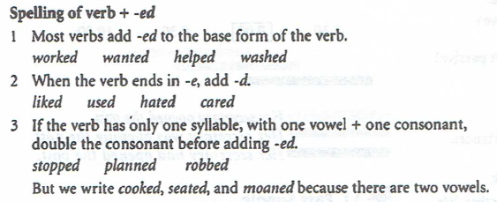
1. Past Simple

Slide 9
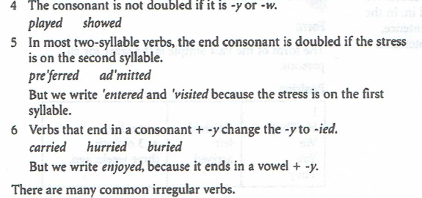
1. Past Simple

Slide 10
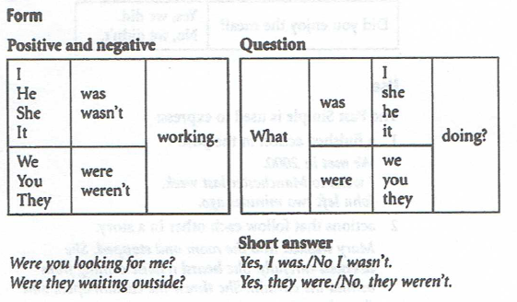
2. Past Continuous

Slide 11
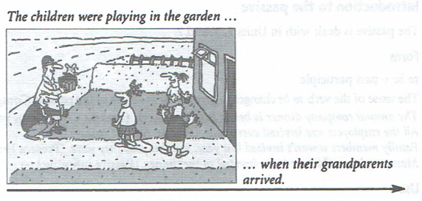
2. Past Continuous

Slide 12
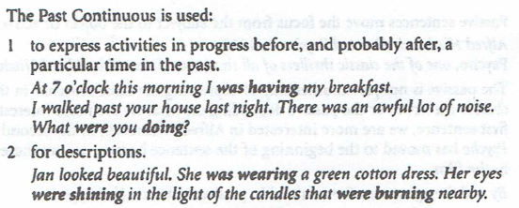
2. Past Continuous

Slide 13
2. Past Continuous

Slide 14
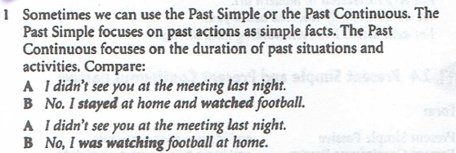
3. Past Simple or Past Continuous?

Slide 15
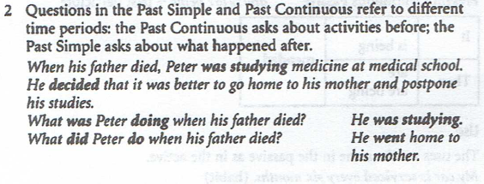
3. Past Simple or Past Continuous?

Slide 16
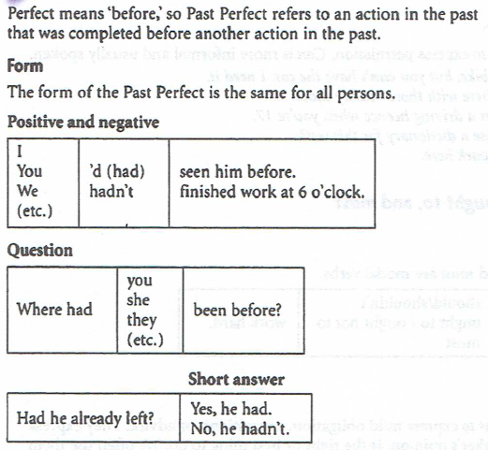
4. Past Perfect

Slide 17
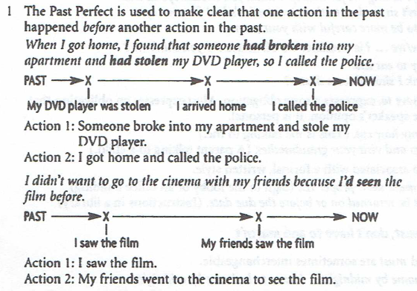
4. Past Perfect

Slide 18
4. Past Perfect

Slide 19
5. Past Tenses in Passive

Slide 20
5. Past Tenses in Passive

Slide 21
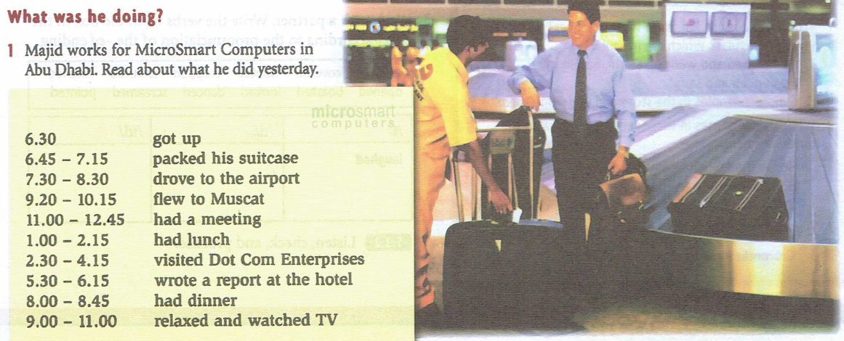
Practice

Slide 22
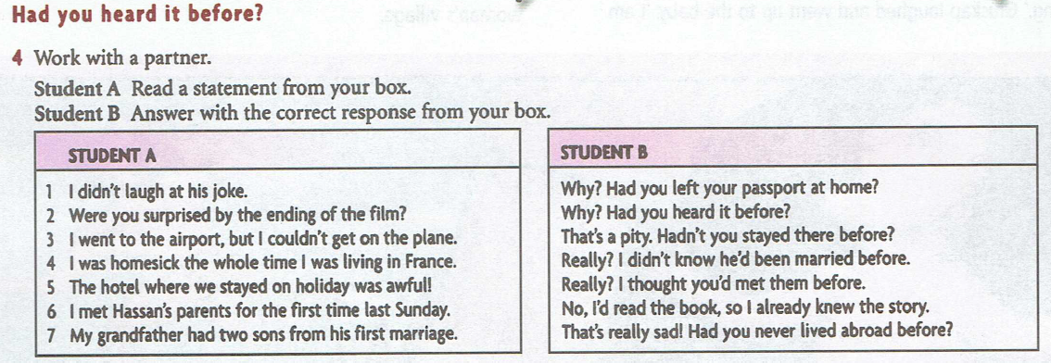
Practice

Slide 23
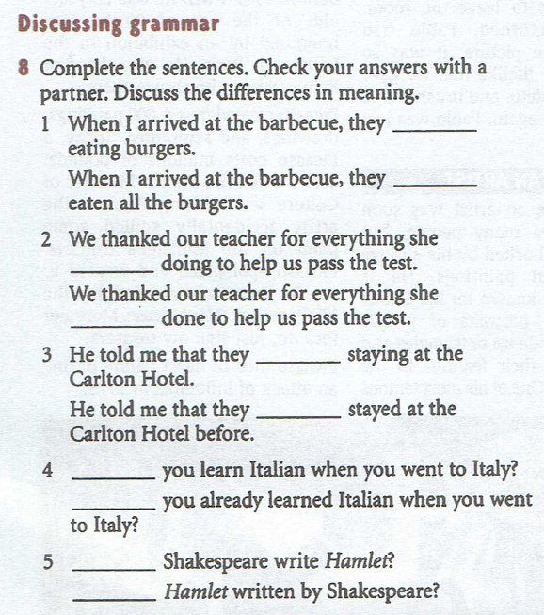
Practice

