Slide 1
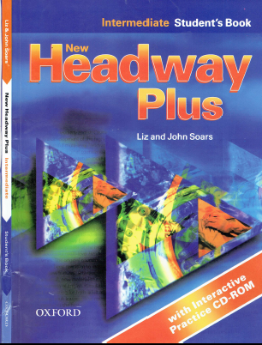
Class Reference book
English Language
For 3rd Year Students
College Pharmacy Al-Mustansiriyah University
Chapter Two

Slide 2
Present Simple
Present Continuous
State verbs
Present Simple and Present Continuous Passive

Slide 3
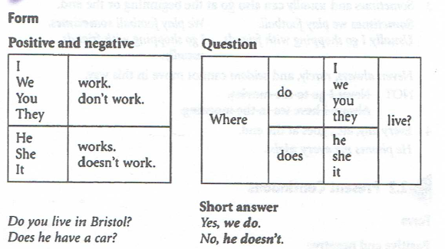
1. Present Simple

Slide 4
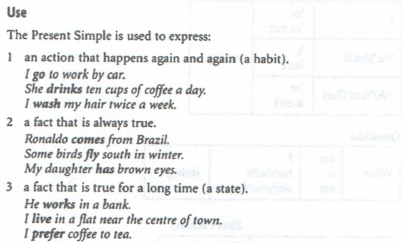
1. Present Simple

Slide 5
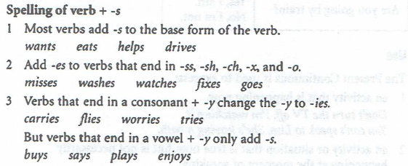
1. Present Simple

Slide 6
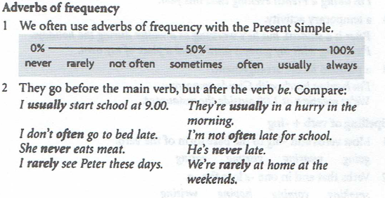
1. Present Simple

Slide 7
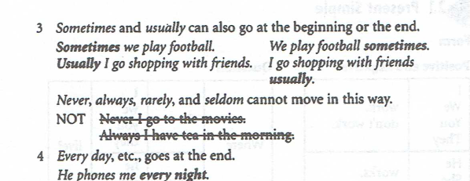
1. Present Simple

Slide 8
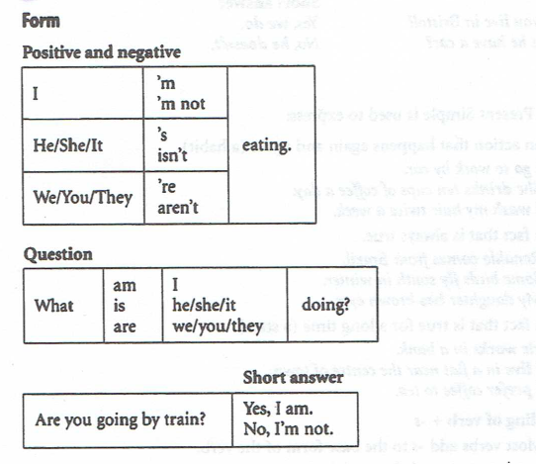
2. Present Continuous

Slide 9
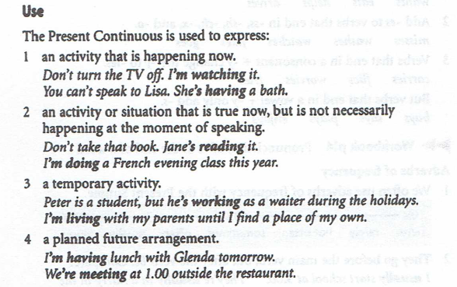
2. Present Continuous

Slide 10
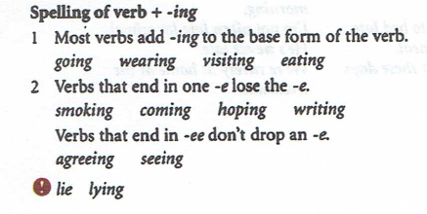
2. Present Continuous

Slide 11
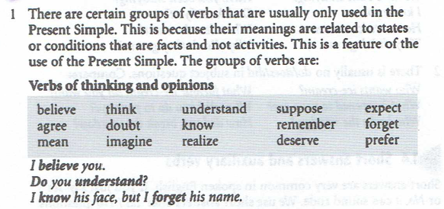
3. State verbs

Slide 12
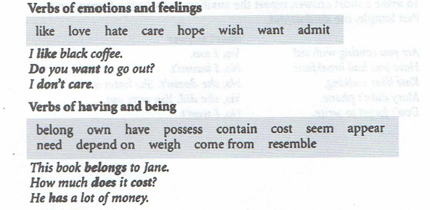
3. State verbs

Slide 13
3. State verbs

Slide 14
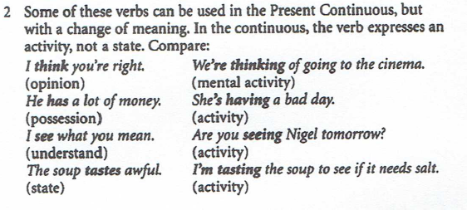
3. State verbs

Slide 15
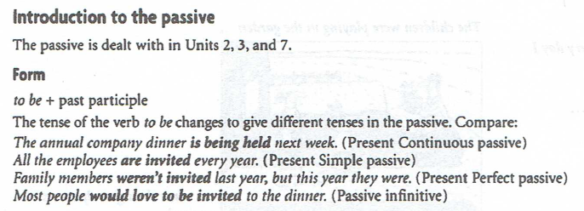
3. State verbs

Slide 16
3. State verbs

Slide 17
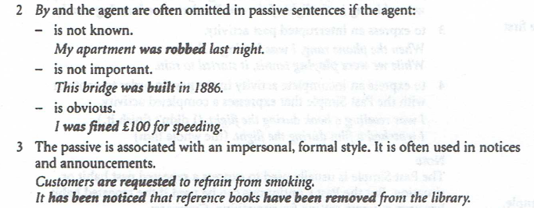
3. State verbs

Slide 18
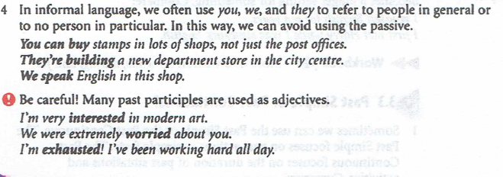
3. State verbs

Slide 19
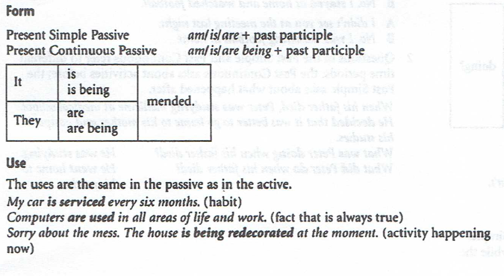
4. Present Simple and Present Continuous passive

Slide 20
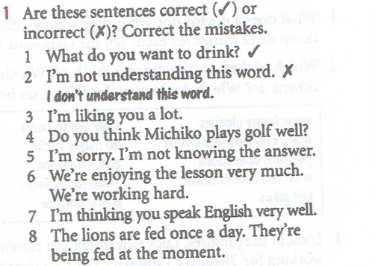
Practice

Slide 21
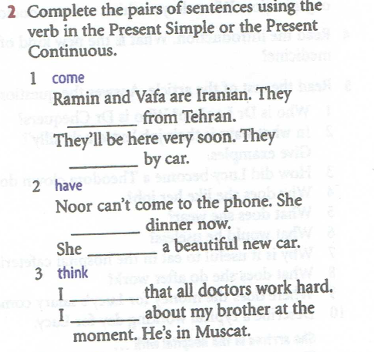
Practice

Slide 22
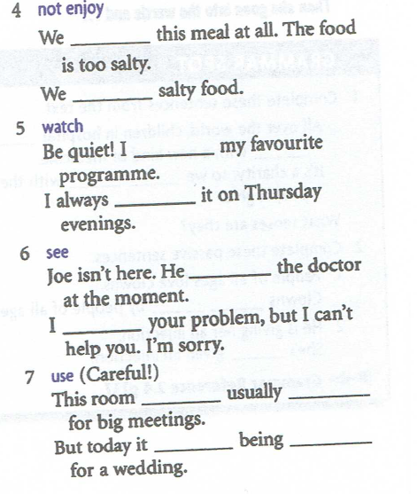
Practice

