Slide 1
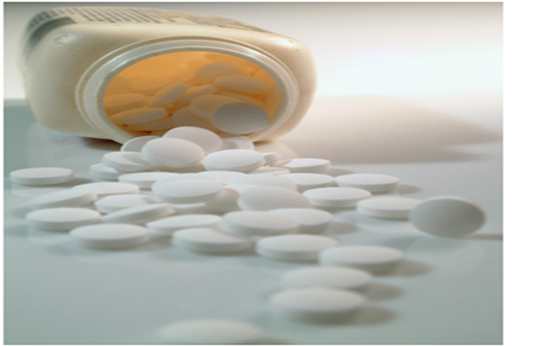
LAB.2
Tablet Production Methods

Slide 2
Tablet production methods
Dry methods
  Direct compression
  Dry granulation
Wet methods
  Wet granulation
Regardless whether tablets are made by direct compression or granulation, the first step, milling and mixing, is the same; subsequent step differ.

Slide 3
Direct compression
Consists of compressing the substances together with any substance of physical property enable to compress directly with good flowability.
It involves only two unit operations:
Powder milling and mixing
Tabletting.

Slide 4
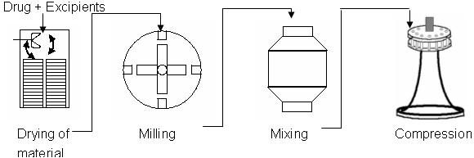

Slide 5
A crystalline structure, is more easily to compress than amorphous form because of the creation of certain cohesive bonds between crystals due to the pressure of compression, whereas in amorphous form it will not.
Addition of a disintegrant to the formulation will helps to avoid the major problems in disintegration like (long time dissolution and melting).

Slide 6
Not all materials can be easily or directly compressed:
  Most materials having weak intermolecular attracting forces.
  Materials are covered with a film of adsorbed gas that hinder compaction.
  Large doses drugs that do not lend themselves to this technique due to:
    Need of additives in a ratio of 1:1 for e.g. active constituent 500mg and diluent 500mg so will form (large tab., costly, difficult to swallow and not accepted by patients).
  Small doses drugs can’t be compressed directly like digoxin because there may be not sure to distribute uniformly.
Direct compression used for moderate doses only (81-325)mg

Slide 7
Ideal direct compression excipients:
Flowability
Stable, inert, compatible
Compressibility
Particle size should be of high range, to meet the particle size of the drug (be close to it) Otherwise segregation (demixing) will occur leading to lack of content uniformity
Low cost
Provide high pressure-hardness profile.

Slide 8
Advantages of Direct Compression:
Low cost
Few workers
Elimination of heat and moisture, thus increasing not only the stability but also the suitability of the process for thermolabile and moisture sensitive API’s.
fewer processing steps
Space needed is low

Slide 9
Disadvantages of Direct Compression
There is little number of materials having crystalline forms.
The product has long disintegration time lead to decrease in absorption.
Drugs of low dose like digoxin (0.25 mg) can not be compressed directly.
Large doses can not be compressed directly.
Reactions of excipients with the drug like reaction of spray dry lactose with amine resulting in yellowish discoloration while the original color is brown (incompatibility).
The process is carried out in dry conditions, static charges may exist and result in mixing problems (hindrance of flowability).
Differences in particle size lead to segregation.

Slide 10
Experiment Part
Aim of experiment :
Preparation of aspirin tablets by direct compression
Preformulation test:
Organoleptic properties
  (crystalline –tubular or needle shape)
  Bitter or slightly acidic taste
  Odorless or have odor due to formation of acetic acid and S.A. in the presence of moisture.

Slide 11
Solubility
  Slightly soluble in water (1:300), highly soluble in organic solvent (1:5-7 alcohol, 2:10-17 ether, 1:17 chloroform).
  P.C. high (high solubility in lipids) and thus having good absorption in GIT wall so it is highly absorbed from stomach but also having good absorption from small intestine due to large surface area.
Stability
  (unstable in water) due to decomposition (hydrolysis) so it dissolves in aq. Solution of carbonate and alkali hydroxyl with decomposition

Slide 12
Preparations of aspirin

Slide 13
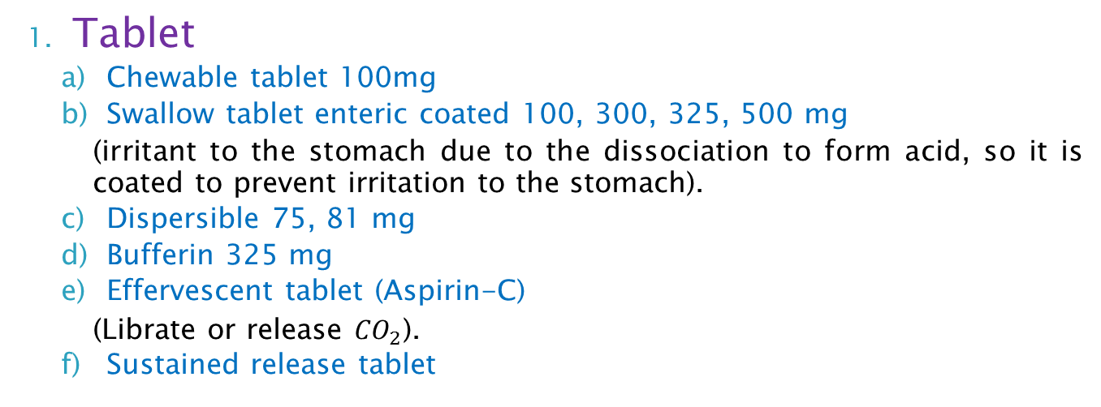
Tablet
  Chewable tablet 100mg
  Swallow tablet enteric coated 100, 300, 325, 500 mg
    (irritant to the stomach due to the dissociation to form acid, so it is coated to prevent irritation to the stomach).
  Dispersible 75, 81 mg
  Bufferin 325 mg
  Effervescent tablet (Aspirin-C)
    (Librate or release ${CO}_{2}$).
  Sustained release tablet
Injection (Aspegic 0.5gm, 900mg equivalent to 500mg of aspirin dissolve in 5cc water for inj.)
D- Lysine and Glycine acetyl salisylic acid (dervative of aspirin) with improving solubility of aspirin by forming complex with lysine and glycine (inert aminoacids)
Powder for oral solution (Aspegic 100, 250,500 and 1000mg papers packaged in paper saschet) D- Lysine acetylsalisylate

Slide 14
Salt of aspirin
  (phenyl salicylate, sodium salicylate, methyl salicylate) toxic orally, used in topical ointment (high percutaneous absorption) so used in White field ointment (S.A., benzoic acid).
  Algesin (dimethylamine salicylate) Salicylamide, they have 1:500 water solubility but more stable than aspirin so widely used.
  Calcium acetyl salicylate used in prophylaxis in MI.
Aspirin suppository
Aspirin in cold tablet (promethasone, salicylamide, phenylephrine, paracetamol)
Powders (for pharyngitis and tonsillitis locally used)

Slide 15
From the organoleptic properties of aspirin (crystalline and unstable in water)
Wet method can not be used
It can be prepared by dry method (dry granulation or direct compression) -for good crystalline and free flow materials like NaOH, NaBr, Benzoic acid-

Slide 16
Formula
Aspirin 75mg
Starch 3mg
Lactose 40mg
Mg stearate 2mg
(Active constituent)
(Disintegrant)
(Diluent)
(Lubricant)

Slide 17
Main procedure
Mix all ingredients together after weighing (aspirin, disintegrant , diluent) for 15 minutes
Then add the lubricant and mix for not more than 5 minutes
Directly compress
Question : lubricant is added at last step . Why?

Slide 18


