Slide 1
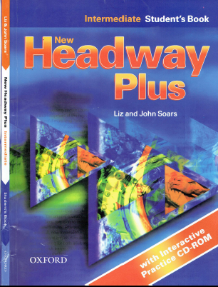
Class Reference book
English Language
For 3rd Year Students
College Pharmacy Al-Mustansiriyah University
Chapter One
Reading and Speaking

Slide 4
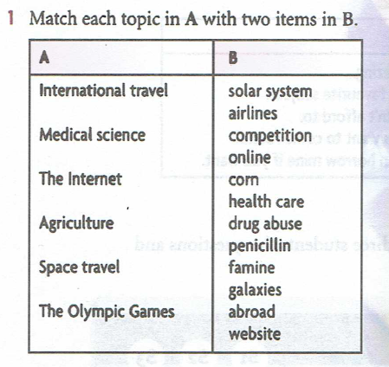
Practice

Slide 5
Practice
1. The Internet
2. Space
3. Health Care
4. Travel
5. The Olympic Games
6. Agriculture

Slide 6
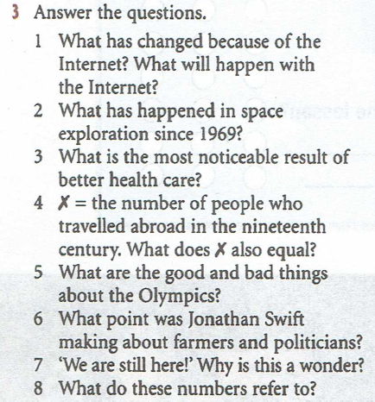
Practice

