Slide 1
Lecture 1[ Pharmacy practice and the healthcare system]
Assisstant lecturer:Zahraa Abdul Ghani

Slide 2
Impact of pharmacy on patient care
There are five main areas in which pharmacy makes major contributions to health outcomes:
1- Management of prescribed medicines:
– drug development
– dispensing of medicine
– counselling
2- Management of chronic conditions:
– repeat prescribing
– monitoring therapeutic outcomes
– improvement in quality of life
3 -Management of common ailments:
– counselling
– recommendation of line of action
.

Slide 3
4 -Promotion and support of healthy lifestyles:
– health education
– health screening
5- Advice and support for other healthcare professionals:
– provision of information on clinical and technical aspects of use of medicines
– participation in research and development programmes to transfer science into practice

Slide 4
Pharmacist interventions in the healthcare system
• Ensuring rational use of medicines: participation in the development of formularies, clinical guidelines and protocols, and analysis of prescribing information and drug use evaluation data.
• Disease management: contributing towards enhancement of compliance, adherence to evidence-based clinical guidelines and monitoring patient outcomes.
• Management of drug therapy: ensuring that safe and effective drug products are used and are accessible, collaboration with health professionals to ensure that prescribing is carried out for definite objectives, accessing patients’ profiles and medical records, undertaking counselling about safe use of drugs, patient monitoring to identify problems and suggest actions to solve problems.

Slide 5
Patient pharmaceutical needs assessment
By identifying patients who would mostly benefit from pharmacist interventions, pharmacist-dedicated services can be directed towards individual patient groups to ensure minimal drain of resources while at the same time giving patients the pharmacy service particular to their needs.

Slide 6
The patient pharmaceutical needs assessment should take the following into consideration:
• Access to pharmacy facilities: Do patients who are house-bound have access to a pharmacist domiciliary service? Do patients visiting a pharmacy have access to the pharmacist? Do patients feel that they need more time with the pharmacist during outpatient visits at hospital clinics?
• Need for compliance aids: Do patients require memory aids or pill boxes to organise their medication?
• Social behaviour: Patients living on their own who may not have family or friends able to support them through their medication.
• Does the patient have special needs?

Slide 7
Identifying groups of patients with special needs
1• Patients suffering from certain diseases, such as:
– acute myocardial infarction
– chronic pain
– mental health problems
– learning difficulties

Slide 8
2• Age groups: extremes of age – the young and the elderly
3• Drug treatment:
– narrow therapeutic index drugs
– expensive drugs: consider use of generic formulations – what are the pharmaceutical implications of switching to a different pharmaceutical formulation?
4• Taking medicines for chronic disease:
– repeat prescriptions
– medication review
5• Patients in particular health settings:
– hospital, residential home, nursing home
6• Patients transferring from one health setting to another.

Slide 9
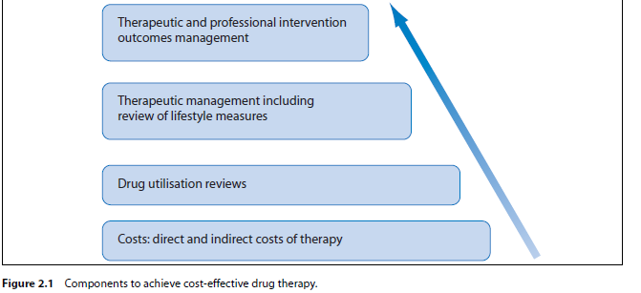
Achieving cost-effective patient care
Within a healthcare system, pharmacists can participate in the four domains necessary for cost-effective patient care (Figure 2.1).

Slide 10
Quality assurance
This establishes an acceptable level of performance and incorporates mechanisms to identify when that standard of performance is not met.
Quality improvement
This comprises information-driven processes that involve the implementation of monitoring procedures to ensure that adequate standards are obtained and maintained. It has two main components: total quality management (TQM) and continuous quality improvement (CQI).
Total quality management (TQM)
• Defines measures of quality
• Measures current performance
• Analyses process
• Identifies improvement actions.

Slide 11
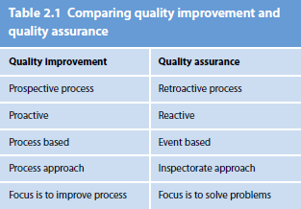
See Table 2.1 for a comparison of quality improvement and quality assurance.
Measuring outcomes
• Use diagnostic results
• Use medical records
• Maintain databases that provide information to allow periodical reviews
• Assess patient satisfaction.

Slide 12
Assessing outcomes
• Clinical: response to treatment
• Functional: improvement in physical function
• Financial: cost-effective therapy
• Perceptual: patient’s satisfaction with outcomes, care received and providers.
Difficulties in implementation of outcomes management
• Compilation of data is time-consuming
• Resistance from health professionals.

Slide 13
Case example for quality assessment in a hospital
• Documentation and analysis of pharmacist intervention on the ward
• Cost-effectiveness study of medications used
• Patient satisfaction questionnaire – developed to assess patient satisfaction with outcomes of therapy, care received, atmosphere on ward, communication with health professionals.

Slide 14

