Slide 1
Solutions
Pharmaceutical Technology
Stage three
Lab no. 1

Slide 2
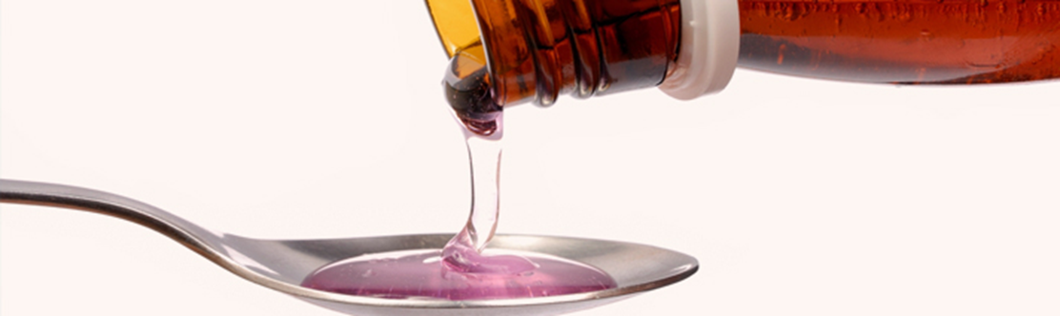
Solutions are liquid pharmaceutical preparation contain one or more chemical substance dissolved in one or more suitable solvent to produce single phase system

Slide 3
Standard solution
Standard or (stock solution):-
are solutions of known concentrations (i.e. concentrations are exactly measured ) these are strong solutions from which weaker solutions are present ).

Slide 4
Types of solutions
1-Solutions of liquid in liquid , such as (alcohol in water)
2-Solutions of gas in liquid , such as (ammonia solution)
3-Solutions of solid in liquid , such as (NaCl in water )

Slide 5
Classifications of solutions according to the procedure of preparation
Solutions prepared by simple solution method
Solution prepared by chemical reactions
Solution prepared by simple solution with sterilizations such as ophthalmic solution, anticoagulant ,irrigating solution , physiological solution
Solution prepared by extraction.

Slide 6
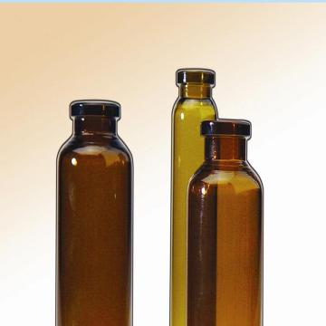
Classification of solutions according to dosage forms
Syrup (aqueous solution containing sugar.
Elixirs (combination of water and alcohol).
Spirits (solution of aromatic materials if the solvent is alcoholic).
Aromatic waters (solutions of aromatic material if the solvent is aqueous).
Tinctures or fluid extracts (solution prepared by extracting active constituents from crude drugs depending on their methods of preparation and their concentration).
Injections (solutions prepared to be sterile pyrogen – free and intended for parenteral administration).

Slide 7
Notes :-
We can overcome some problems that may occur during preparation of solutions by following:
To increase the solubility of substances ,we can reduce the particle size by using mortar and pestle (example crystal form ,large particles)
If we have two solvents in the same prescriptions , we dissolve the solid substance in the solvent that have more ability to dissolve it (alcohol, water).
If we have material that has very fine particle size we must not use stirrer in dissolving it because particles will adhere around stirrer, so we use circulating of the beaker instead of stirrer .
If there is liberation of any gas , the container must be opened , without using stopper , until liberation of gas .
Some times we need to increase the solubility by certain method ex. pH , complexation ….

Slide 8
General procedure of preparation of simple solution
1-Weigh the solid ingredient and put it in beaker
5-Convert the content of the beaker into the measuring cylinder and complete the volume up to the required amount by addition of the vehicle
6-transfer the content of the measuring cylinder to a wide mouth bottle and put suitable label (label of external use is pink ,while label for internal use is white )
4-Add the liquid ingredient
3-dissolve the solid ingredients in the remaining amount of the vehicle
2-Subtract the volume of liquid ingredients (if present from ¾ of the final volume of prescription.

Slide 9
Carminative mixture for infants
Rx
Sodium bicarbonate 0.06 g
Aromatic spirit of ammonia 0.06 ml
Compound tincture of cardamom 0.12 ml
Glycerin 0.3 ml
Peppermint water Q.S 4 ml
Ft. mist
Mitt 40 ml
Sig t.i.d pc
Calculations
Factor = 40/4= 10
Sod. bicar.= 0.06 x 10= 0.6 gm
Ar.sp .of ammonia = 0.06 x 10= 0.6 ml
Comp. tr. of cardamom = 0.12 x 10= 1.2 ml
Glycerin = 0.3ml x 10= 3 ml
Peppermint water = 4 x 10= 40 ml
40 x ¾ = 30 ml
30 ml – (0.6+ 1.2+3ml) =25.2 ml

Slide 10
Procedure
Dissolve 0.6 g sod. bicarb in 25.2 ml of pepp. water in beaker.
Add 0.6 ml of Ar. spirit of ammonia ,1.2 ml of comp. tr. cardamom and 3 ml of glycerin to the content of the beaker .
Convert the content of the beaker into measuring cylinder and complete the volume up to 40 ml by addition of pepp. water .
Transfer the content of the measuring cylinder to a wide mouth bottle and put a suitable label.
Note:-
Glycerin act as soothing and sweetening agent .

Slide 11


Carminative mixture for adult (H.W)
Rx
Sodium bicarbonate gr vii
Aromatic spirit of ammonia xv
Compound tincture of cardamom x
Strong tincture of ginger i
Peppermint water Q.S f
Fit.mist
Mitt f iv
Sig. f ss t.i.d p.c.
Procedure
as the procedure of mist carminative of infant

Slide 12
Notes
Sodium bicarb .act as gastric antacid.
Aromatic spirit act as carminative agent.
Comp.tr. cardamom act as flavoring agent
Tr.of ginger act as flavoring and antispasmodic agent.
Pepp. water act as flavoring and carminative agent ,also it is diluting agent used as solvent.
Strong tr. of ginger which is used in carminative mixture of adult must not added for infant because it is strong for use to infant.

Slide 13
Aqueous iodine solution (lugals sol)
Rx
Iodine 50 g
Potassium iodide 100 g
Purified water Q.S 1000 ml
Sig 0.3 ml diluted with milk or water three times daily
Procedure
Dissolve iodine in concentrated KI solution
Shake well until iodine dissolved
Complete the volume with purified water to 1000 ml
Notes:
Lugals sol. Used internally in treatment of thyrotoxicosis (preoperative treatment ) and in hypothyroidism
We dissolve the iodine in KI instead of water because the iodine has more solubility in KI than in water.

Slide 14
Weak iodine solution (tr. Iodine)
Rx
Iodine 25 g
K. Iodide 15 g
Dis. Water 25 ml
Alcohol 90% 1000ml
Sig. bid used externally
Procedure
The same method as lugals sol. except completing the volume with alcohol 90% to 1000 ml
Strong iodine solution
Rx
Iodine 100 g
K. Iodide 60 g
Dis. Water 100 ml
Alcohol 90% 1000ml
Note :-
weak and strong iodine solution used as antiseptic

Slide 15
Mandles paint –throat paint
Rx
KI 25 g
Alcohol 90% 40 ml
Water 25 ml
Iodine 12.5 g
Peppermint oil 4ml
Glycerol Q.s 1000ml
Note :-
Throat paint used for tonsillitis and pharyngitis
Procedure
Dissolve 25 g of KI in 25 ml of water
Dissolve 12.5 g of iodine in KI solution
Dissolve 4 ml of peppermint oil in 40 ml of 90% alcohol ,and transfer it to iodine sol. then mix
Complete the volume to 1000 ml by glycerin
Note :-
Iodine used as antiseptic
Glycerol used as preservative
Pepp.oil used as flavouring agent
This paint dispensed in coloured bottles with stopper.

Slide 16
Sol. I and Sol. II
Sol I sodium thiosulfate 15-20%
Sol II tartaric acid 3-5%
Sig. apply sol I then after two minutes apply sol II on the skin.
Procedure
By simple solution method
Notes:-
This prescription used as antifungal
We can not mix sol I and sol II in the same bottle due to the chemical reaction between them which we use it to precipitate the sulphur in infected area of the skin as antifungal

Slide 17


