Slide 1
Physical Pharmacy lab Lab no. 1: Concentration Expression
Done By:
Assistant Lecturer Sura Zuhair
Assistant Lecturer Hiba Sabah
Assistant Lecturer Zeina Dawoad

Slide 2
Introduction
The term “physical pharmacy” stems from the application of physical chemistry principles to the area of pharmacy in the design of drug molecules and drug products.
When the physical chemical and biological properties of drug molecules (i.e. preformulation) are understood, it is possible to design dosage forms for designated routes of administration in humans or animals (i.e., formulation). Collectively, the scientific principles applied in the preformulation and formulation processes is termed “physical pharmacy,”
Lab for this course: Concentration expression, Two component systems containing liquid phases, Three component systems, The tie – line for three component system, Partition coefficient, Buffer solutions and Solubility product constant for slightly soluble salt

Slide 3
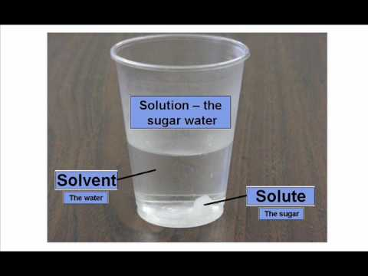
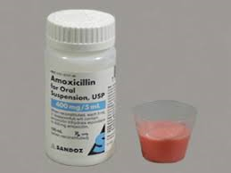
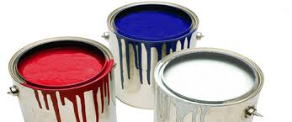
Pharmaceutical mixtures
True solution
(<1 nm) (one phase system)
Colloidal dispersion
(1-500 nm ) (as liposome, microsphere)
Coarse dispersion
(> 500 nm )( as emulsion and suspension)

Slide 4
Dispersion :- is pharmaceutical mixture that consist of at least 2phases with on or more dispersed (internal phase )contained in a single continuous (external )phase.
Phase :-is defined as the homogeneous physically distinct portion of the system separated from other parts of the system by bounding surface .

Slide 5
True solution will be focused and discussed in this lab. It can be classified according to the states in which the solute and solvent occur,
and because 3 states of matter exist, 9 types
of homogeneous mixtures of solute and
solvent are possible.

Slide 6
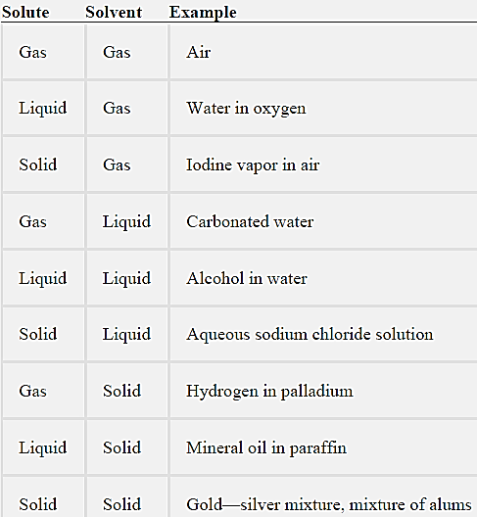
Types of Solutions

Slide 7
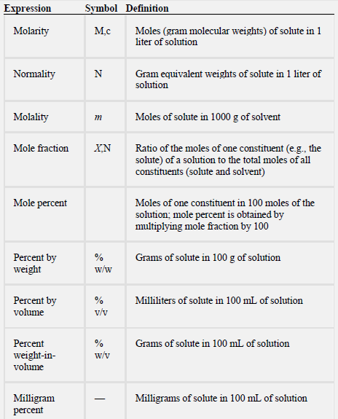
Concentration expressions

Slide 8
examples
Calculate the Molarity of solution containing 4 gm of NaOH in 500 ml solution (M.wt NaOH =40gm)
M = wt * 1000
M.wt V(ml)
M=4/40 * (1000/500) M= 0.2 M

Slide 9
Molality
Calculate Molality of solution containing 2gm NaOH in 50 gm solvent ?
molality = wt /M.wt * 1000/ gms of solvent
m= 2/40 * 1000/ 50
m= 1

Slide 10
Q/ How many grams of KI (M.wt=166) are needed to prepare 25ml of 0.75 N solution?
N= wt / eq.wt * 1000/ vol(ml)
0.75= wt / 166 * 1000 / 25
wt = 3.12 gm
Q/ Solution prepared by dissolving 1 mole ethyl alcohol in 3 moles of water. Calculate mole fraction of each one?
Mole fraction = moles of one constituent (solute)
the total moles of all constituents (solute & solvent)
Mole fraction of ethyl alcohol (x1) =1/1+3 = 1/4 = 0.25
Mole fraction of water (x2) = 3/1+3= 3/4 =0.75 (the sum of mole fraction is equal to one)

Slide 11
Mole percent
5%w/w NaOH mean 5 gm NaOH in 100 gm solvent
10%w/v NaOH = 10 gm NaOH in 100ml solvent
15 %v/v NaOH = 15 ml NaOH in 100ml solvent
Q/prepare 25 gm of 4%w/w NaOH?
4gm 100gm
X 25gm x= 1gm of NaOH with 24
gm of water
Q/prepare 25 ml of 4%w/v NaOH?
4gm 100gm
X 25ml x= 1gm of NaOH put in volumetric flask then complete the
volume to 25 ml

Slide 12
Disadvantages of molarity & normality:
1-changing in value with temperature because of expansion or contraction of liquid so can not be use when studying properties of solution at various temp.
2-because Solvent volume in M&N are not really known it is difficult to study properties such as vapor pressure & osmotic pressure which are related to the conc. of solvent.
(because Molality (m) has not the above disadvantages it is used more likely in theoretical studies more than N & M)

Slide 13
Experimental work:
Materials and equipment:
-NaCl, Na₂CO_{3.}, NaOH, Alcohol, water.
-Volumetric flasks (50cc), pipettes.
M.Wt of NaCl =58.5
M.Wt of Na₂CO₃ = 106
Density = mass\volume
Density of water =1
Prepare the following solution :
A. 50 ml of 0.5 M NaCl.
B . 50 ml of 2N NaCl.
C. 50 ml of 0.1N Na₂CO_{3.}
D. 50 ml of 0.1 M Na₂CO_{3.}
E . 50 gm of 2% w/w NaCl solution.
F. 50 ml of 10% w/v NaOH or NaCl.
G. 50 ml of 10% v/v alcohol.

