Slide 1
Organic medicinal chemistry
Drug Design Strategies
Dr. Hassan Ali

Slide 2
Statistical Prediction of Pharmacological Activity
It has been the goal of medicinal chemists to quantify the effect of a structural change on a defined pharmacological response.
This would meet three goals in drug design:
(a) to predict biological activity in untested
Compounds.
(b) to define the structural requirements required
for a good fit between the drug molecule and the receptor.

Slide 3
(c) To design a test set of compounds to maximize the amount of information concerning structural requirements for activity from a minimum number of compounds tested.
The goals of QSAR studies were first proposed about 1865 to 1870 by Crum-Brown and Fraser, They postulated that the physiological action ф, of a molecule is a function of its chemical constitution, C.

Slide 4
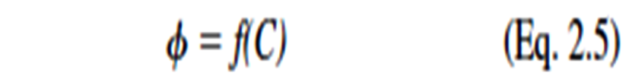
This can be expressed in Equation 2.5:
It has been found is that biological response can be predicted from physical chemical properties such as
vapor pressure
water solubility
electronic parameters
Steric descriptors
and partition coefficients

Slide 5
Let us assume that drug A’s ED₅₀ is 1 mmol and drug B’s ED₅₀ is 2 mmol.
Drug A is twice as potent as drug B. In other words, the smaller the ED₅₀ (or ED₉₀, LD₅₀, MIC, etc.), the more potent is the substance
being tested.

Slide 6

Partition Coefficient
The partition coefficient (P)
is the ratio of the molar concentration of chemical in the non aqueous phase (usually 1-octanol) versus that in the aqueous phase (Eq. 2.10).

Slide 7
The drug will go through a series of partitioning steps:
(a) leaving the aqueous extracellular fluids,
(b) passing through lipid membranes,
(c) entering other aqueous environments before reaching the receptor
In this sense, a drug is undergoing the same partitioning phenomenon that happens to any chemical in a separatory funnel containing water and a nonpolar solvent such as hexane, chloroform, or ether.

Slide 8
The difference between the separatory funnel model and what actually occurs in the body is that the partitioning
In the funnel will reach an equilibrium at which the rate of chemical leaving the aqueous phase and entering the organic
phase will equal the rate of the chemical moving from the organic phase to the aqueous phase.
This is not the physiological situation.

Slide 9
Upon administration, the drug will be pushed through the membranes because of the high concentration of drug in the extracellular fluids relative to the concentration in the intracellular compartments.
In an attempt to maintain equilibrium ratios, the flow of the drug will be from systemic circulation through the membranes onto the receptors.
As the drug is metabolized and excreted from the body, it will be pulled back across the membranes, and the concentration of drug at the receptors will decrease.

Slide 10
The question that now must be asked is what immiscible nonpolar solvent system best mimics the water/lipid membrane barriers found in the body?
One could argue that it was fortuitous that n-octanol was available in reasonable purity for the early partition coefficient determinations.
To appreciate why this is so, one must understand the chemical nature of the lipid membranes.

Slide 11
Chemical nature of the lipid membranes
These membranes are not exclusively anhydrous fatty or oily structures. As a first approximation, they can be considered
bilayers composed of lipids consisting of a polar cap and large hydrophobic tail. Phosphoglycerides are major components of lipid bilayers (Fig. 2.10).

Slide 12
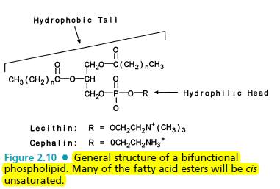

Slide 13
The final result is that these membranes are highly organized structures composed of channels for transport of important molecules such as metabolites, chemical regulators (hormones), amino acids, glucose, and fatty acids into the cell and removal of waste products and biochemically produced products out of the cell.

Slide 14
It turns out that n-octanol is not as nonpolar as initially might be predicted. Water-saturated octanol contains 2.3 M water because the small water molecule easily clusters around octanol’s hydroxy moiety.
n-Octanol–saturated water contains little of the organic phase because of the large hydrophobic 8-carbon chain of octanol.
The water in the n-octanol phase apparently approximates
the polar properties of the lipid bilayer, whereas the lack of
octanol in the water phase mimics the physiological aqueous compartments, which are relatively free of nonpolar components.

Slide 15
In contrast, partitioning systems such as hexane/water and chloroform/water contain so little water in the organic phase that they are poor models for the lipid bilayer/water system found in the body.
Remember that the n-octanol/water system is only an approximation of the actual environment found in the interface between the cellular membranes and the extracellular/intracellular fluids.

Slide 16
Method for determination of partition coefficients
H.W.

Slide 17
Other Physico-chemical properties
Hammett s constant (σ) (electronic parameter) represent electron withdrawing or donating group and its location on aromatic ring.
For electronic parameters such as , the location on an aromatic ring is important because of resonance versus inductive effects.
Ex.
Twofold differences seen between meta and para for the three aliphatic substituents and iodo, and severfold difference for methoxy, amino, fluoro, and phenolic hydroxyl.

Slide 18
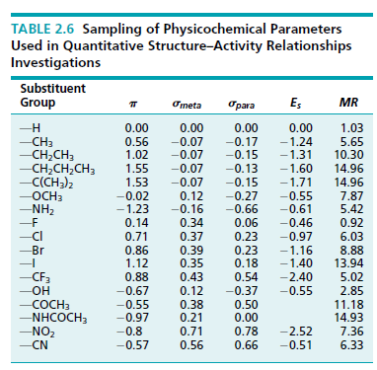

Slide 19
Medicinal chemists can use information from extensive tables of physicochemical parameters to minimize the number of substituents required to find out if the biological response is sensitive to electronic, steric, and/or partitioning effects.
This is done by selecting substituents in each of the numerical ranges for the different parameters. In Table 2.6, three ranges of MR values (0.92–2.85, 5.02–8.88, and 10.30–14.96); and two main clusters of values, one for the aliphatic substituents
and the other for the halogens.
In the ideal situation, substituents are selected from each of the clusters to determine the dependence of the biological response over the largest possible variable space.

Slide 20
QSAR model
There are three model of equations seen in QSAR analysis using logarithm of (P) as physico-chemical parameter
1.linear model
Log1/c=a(logP)+c
So linear increase p cause increase BR
1/c defined pharmacological respond (millmole) (ED50 ,LD50 , MIC)

Slide 21
Depending on the biological responses obtained from testing the new compounds, it is possible to determine if lipophilicity (partitioning), steric bulk (molar refraction), or electron-withdrawing/donating properties are important determinants of the desired biological response.

Slide 22
Ex.
A study of a group of griseofulvin analogs showed a linear relationship (Eq. 2.15) between the biological response and both lipophilicity (log P) and electronic character (σ). It was suggested that the antibiotic activity may depend on the enone system facilitating the addition of griseofulvin to a nucleophilic group such as the SH moiety in a fungal enzyme

Slide 23
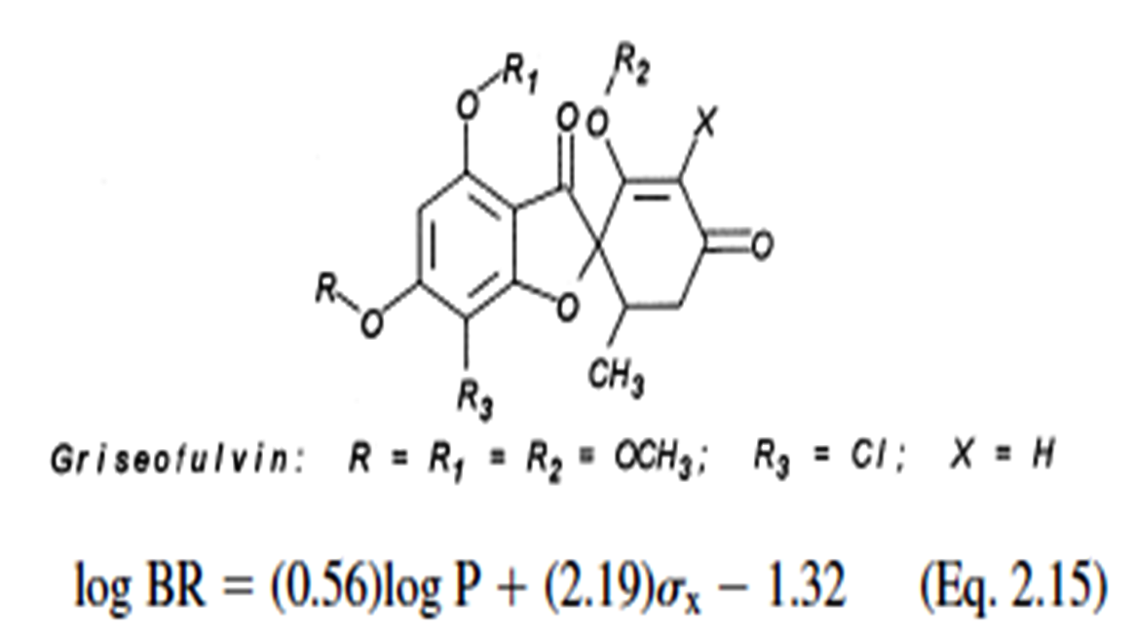

Slide 24
2. Nonlinear model ( parabolic relationship)
Because plot indicate nonlinear relationship between biological respond and P
Log1/c=a(logP)-b(logP)²+c
Ex. substituted acetylated salicylates (substituted aspirins) tested for anti-inflammatory activity.
A nonlinear relationship exists between the biological response and lipophilicity, and a significant detrimental steric effect is seen with substituents at position.

Slide 25
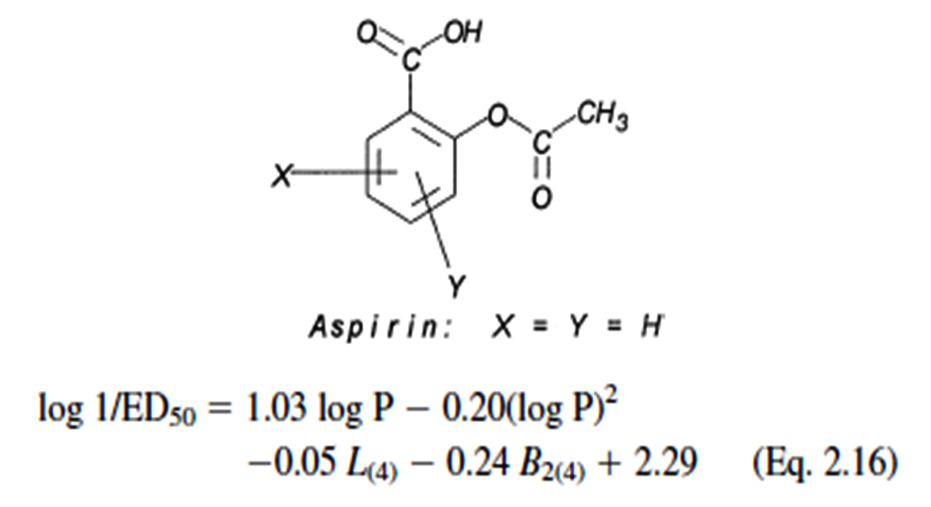
L, defined as the length of the substituent along the axis of the bond between the first atom of the substituent and the parent molecule, and B2, defined as a width parameter.

Slide 26
3. Bilinear model:
consist of two straight line one ascending and other descending β term connect two lines
Log1/c=a(logP)-b(logβp+1)+c

