Slide 1
Biopharmacy
Biopharmaceutics and pharmacokinetics
Arranged by
Assistant professor Widad Kamal Ali
Edited by
Assiastant lecturer Amera Radhi
Assistant lecturer Nora Zawar
Assistant lecturer Ashti mohamed

Slide 2
The practical course will cover the following experiments!!
Exp .1Construction of calibration curve of Salicylic acid with the application of statistics
EXP .2 In vitro evaluation of antacid
EXP .3 In vitro evaluation of bulk forming laxatives
EXP .4 Hydrolysis of acetyl salicylic acid solution in Sorensen phosphate buffer at pH 8
Exp.5 pH and solvent effect on drug solubility
EXP.6 In vitro dissolution of per-oral tablet

Slide 3
Introduction Biopharmaceutics and Pharmacokinetics
Biopharmaceutics : the study of influence of formulation on the therapeutic activity of drug products
Pharmacokinetics : deal with the mathematical description of biological processes which affect the time course of absorption and fate of drug in the body and which are themselves affected by drugs.

Slide 4
By kinetic we learn about :
Rate of absorption
Rate of elimination of a drug and can
Calculate the half life of a drug in the body
So we can predict what will be the duration of correct dosage regimen for maintaining a therapeutic level

Slide 5
During the practical course certain dosage form will be evaluated in vitro (means outside the body in the lab )
In vivo (means inside the body )

Slide 6
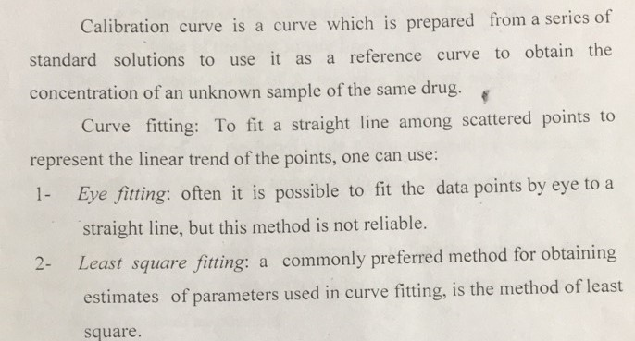
Lab 1 :Preparation of calibration curve of salicylic acid with the application of statistics

Slide 7
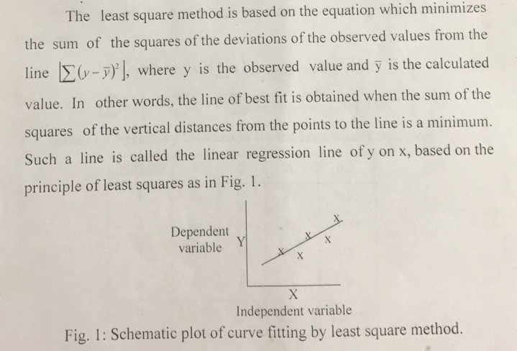

Slide 8
Let us watch the following scientific video

Slide 9
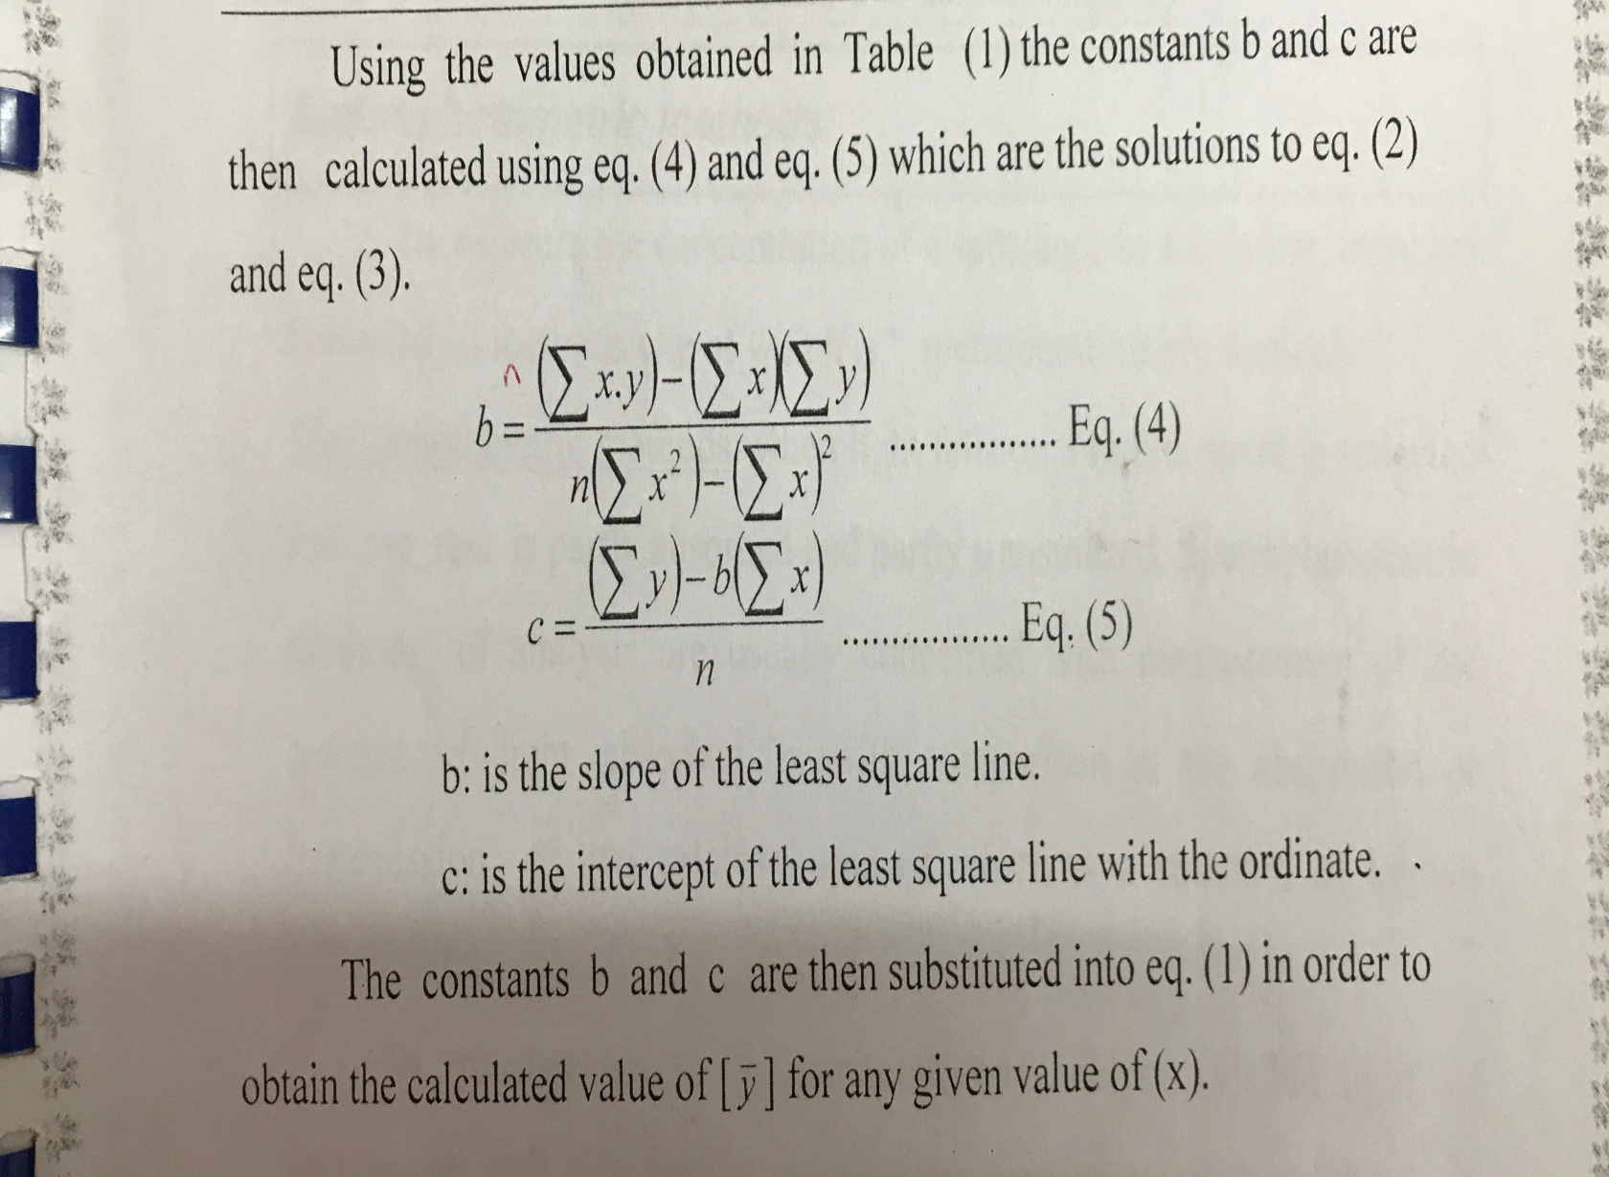

Slide 10
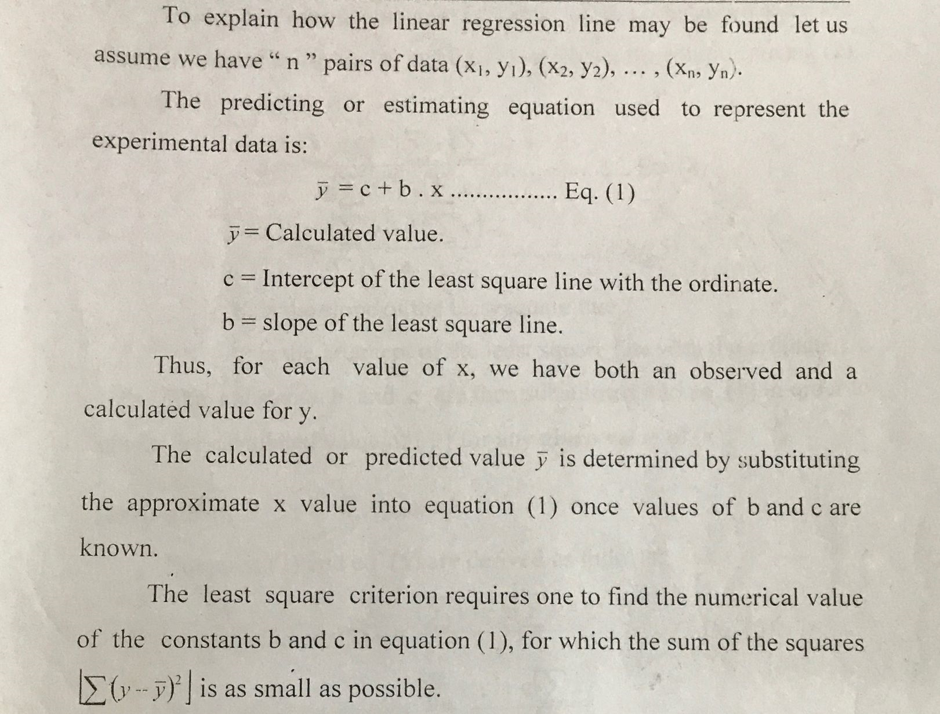

Slide 11
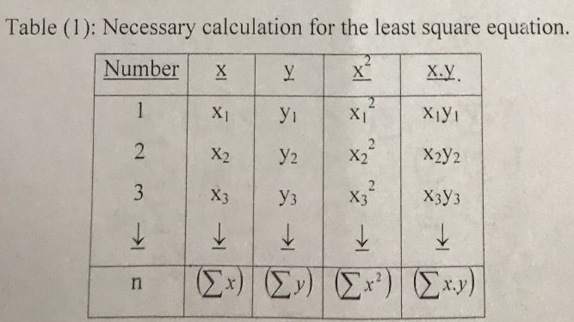

Slide 12
Spectrophotometric methods
To measure the conc. Of a substance in a solution , there are a number of methods one of which is spectrophotometric method
Spectrophotometric method : when light falls on a liquid , some is reflected and the rest is partly absorbed and partly transmitted.
spectrophotometric methods of analysis are usually concerned with measurement of the amount of light absorbed or with comparsion of the absorption or transmission of two solutions one of which is a standard of known composition.

Slide 13
In pharmaceutical spectrophotometric analysis
The measurement of the amount of visible or ultraviolet light of a definite wave length which is absorbed by a solution involve the use of spectrophotometer
Visible light , of wave length 400-760 nm
Ultraviolet , between 200-400 nm

Slide 14
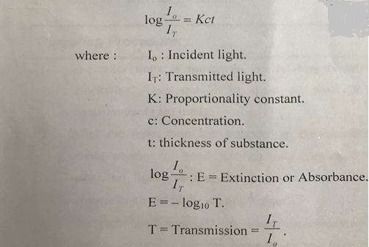
The fundamental relationship
Used in spectrophotometry is Beer and lambert laws in combination:

Slide 15
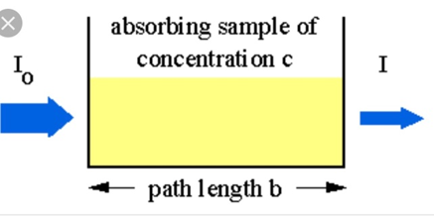

Slide 16
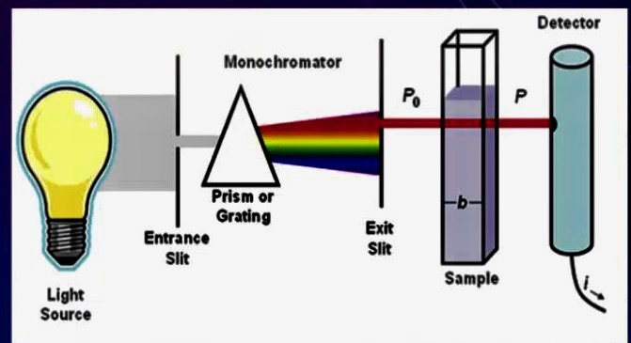
SPECTROPHOTOMETER

Slide 17
Aim of experiment
to prepare a calibration curve of salicylic acid from a series of standard solution to use it as a reference curve to obtain the concentration of unknown sample of the same drug .

Slide 18
Procedure and calculations:
1. prepare 250 ml of stock solution of sodium salicylate containing equivalent of 200 mg salicylic acid /100 ml
Note : sodium salicylate is readily soluble in cold water , so it is used to prepare the stock solution of sodium salicylate after calculating its equivalent content of the acid .while salicylic acid is sparingly soluble cold water (1 part in 550 parts of water ), but more soluble in hot water (1part acid in 15 parts of boiling water ), from which it can be recrystallized

Slide 19
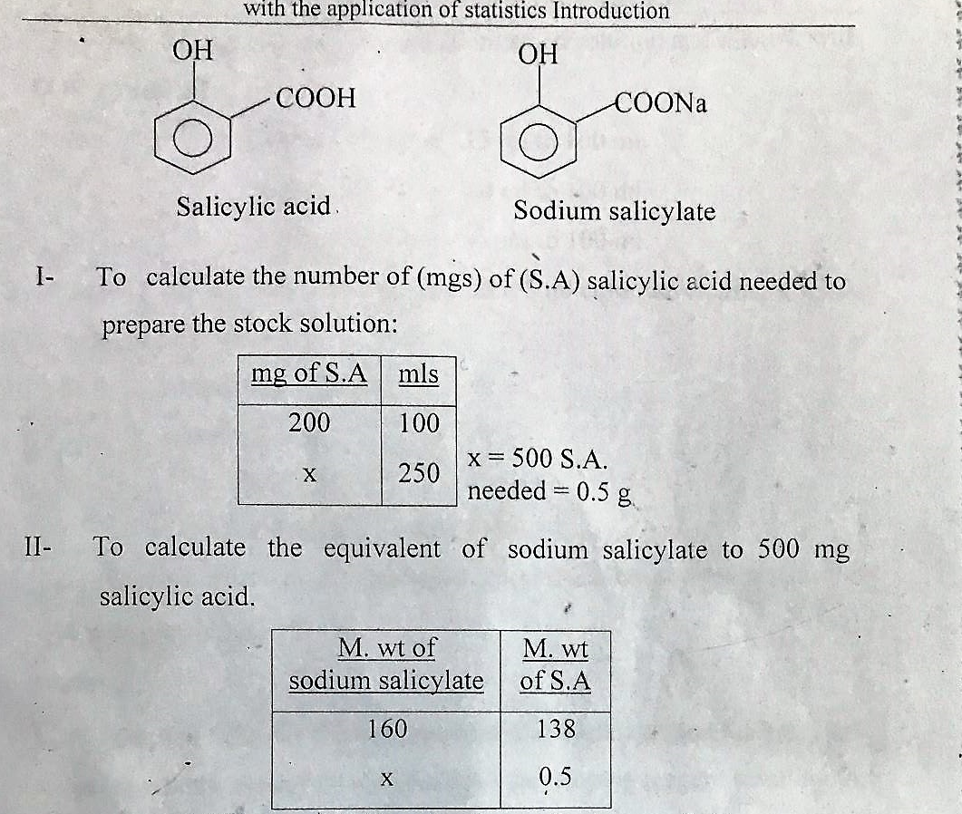

Slide 20
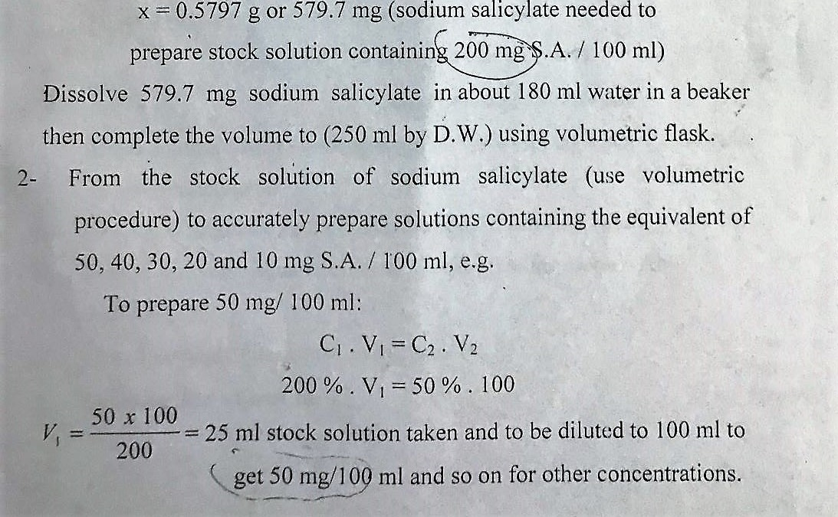

Slide 21
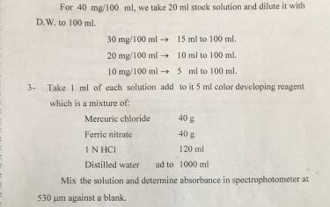

Slide 22
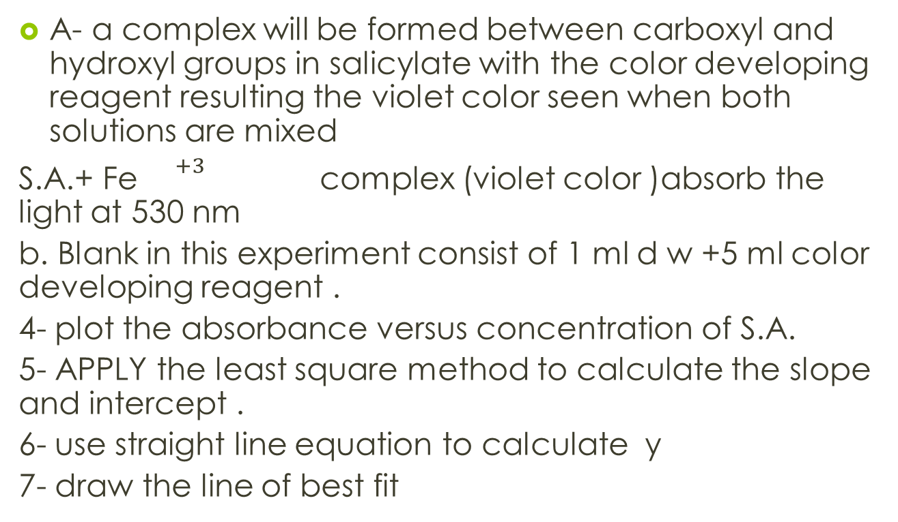
Notes:
A- a complex will be formed between carboxyl and hydroxyl groups in salicylate with the color developing reagent resulting the violet color seen when both solutions are mixed
S.A.+ Fe ${}^{+3}$ complex (violet color )absorb the light at 530 nm
b. Blank in this experiment consist of 1 ml d w +5 ml color developing reagent .
4- plot the absorbance versus concentration of S.A.
5- APPLY the least square method to calculate the slope and intercept .
6- use straight line equation to calculate y
7- draw the line of best fit

