Slide 1


Slide 2
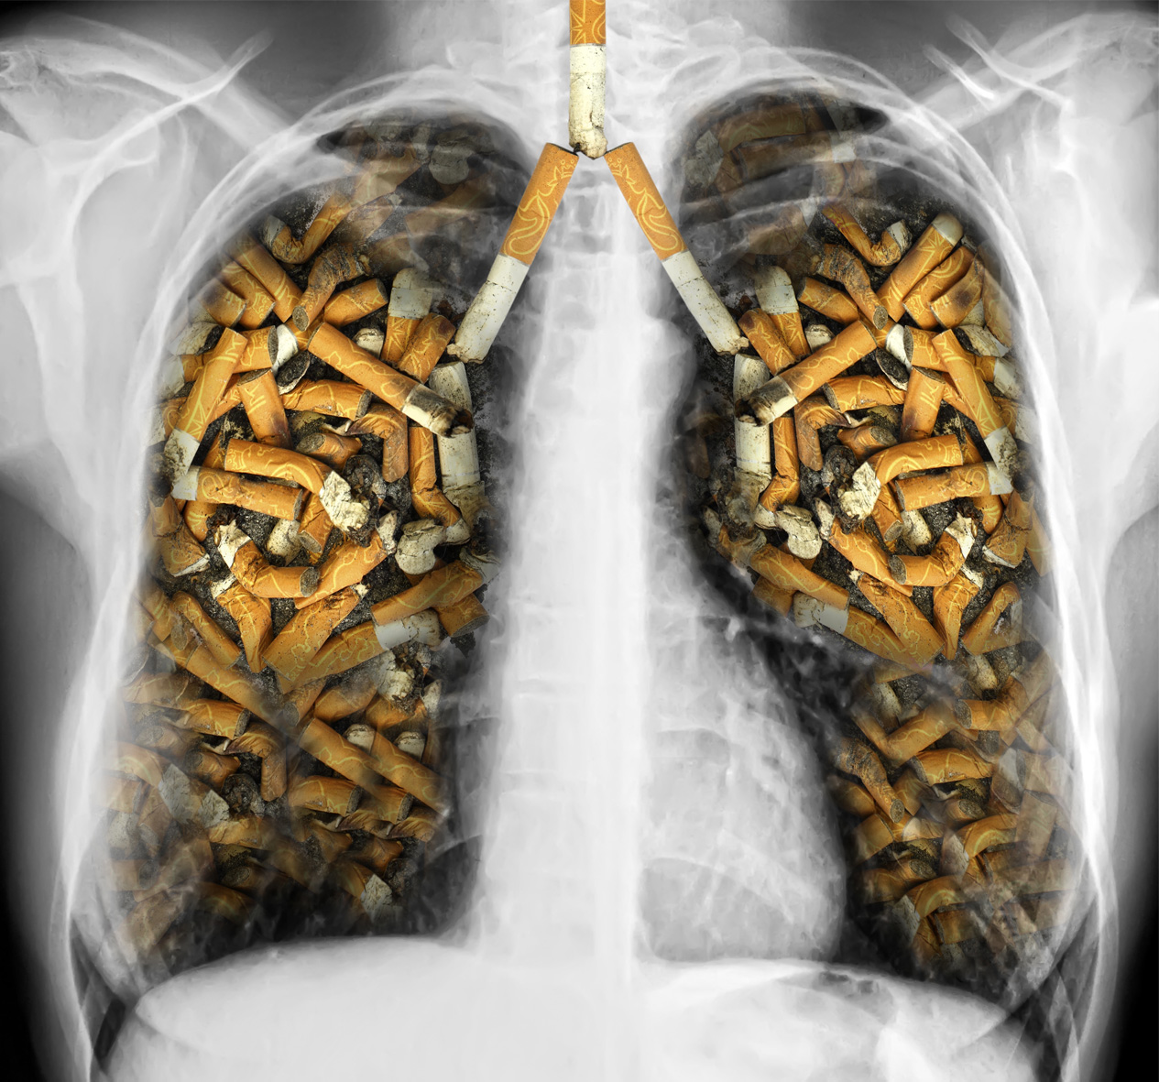

Slide 3
COPD
Airflow Limitation
Excessive mucus secretion
abnormal inflammatory response

Slide 4
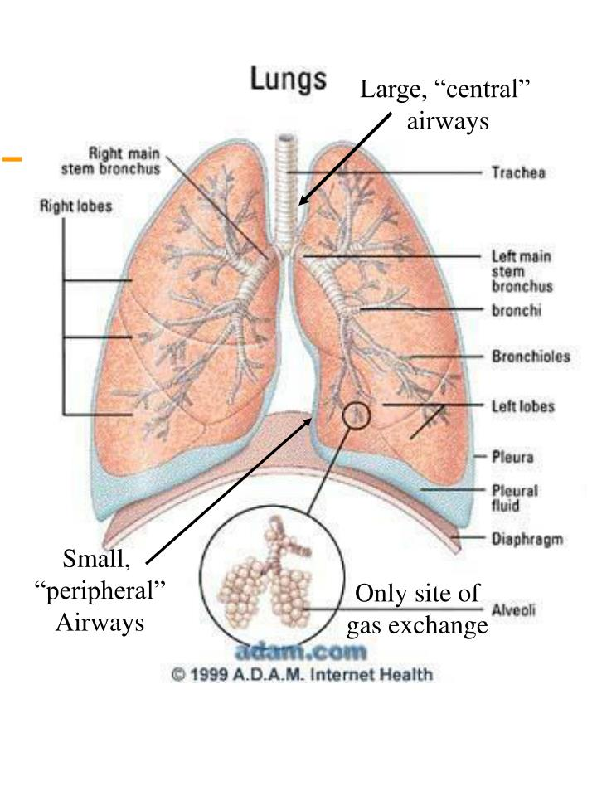

Slide 6
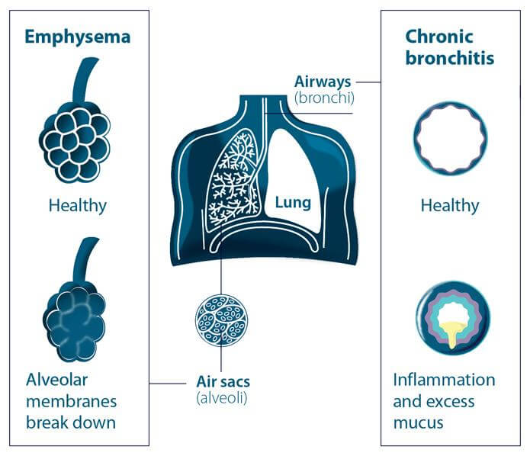

Slide 7
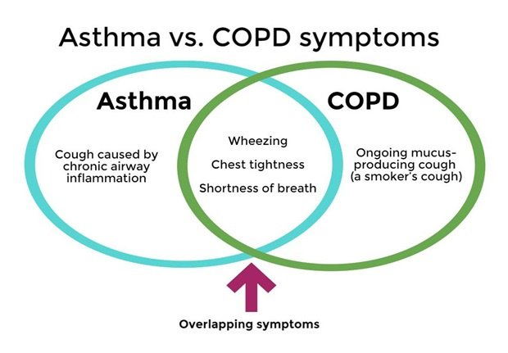

Slide 8
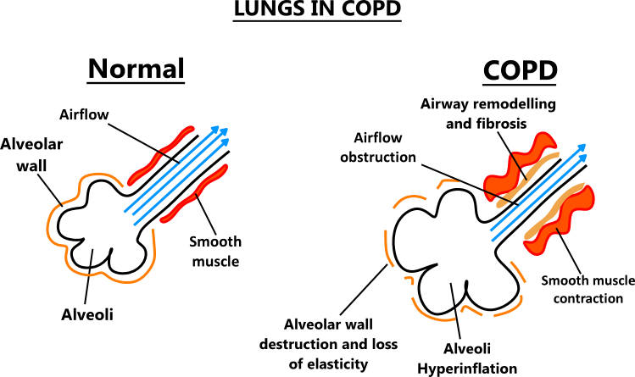

Slide 9
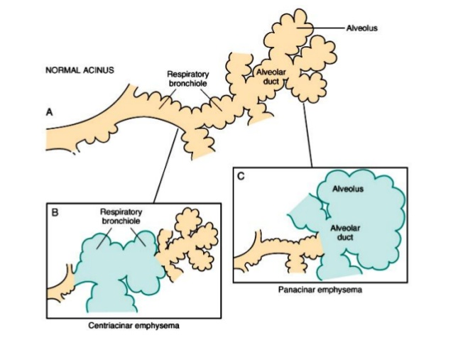

Slide 10
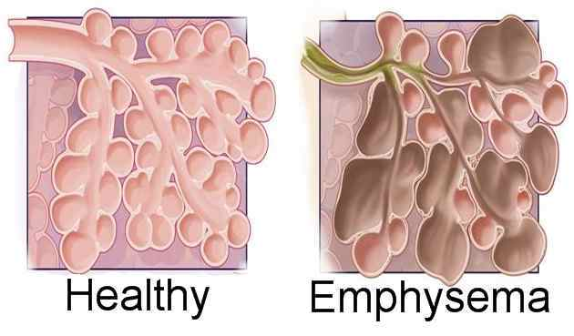

Slide 11
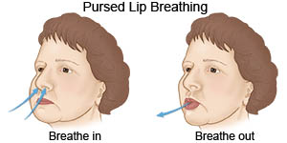

Slide 12
Lung function test
Vital capacity (VC)↓: the volume of air inhaled and exhaled during maximal ventilation;
Forced vital capacity (FVC) ↓ : the volume of air inhaled and exhaled during a forced maximal expiration after full inspiration;
Residual volume (RV)↑: the volume of air left in the lungs after maximal exhalation.
Airflow obstruction is defined as:
FEV1 less than 80% of that predicted for the patient and
FEV1/FVC less than 0.7

Slide 14
Fig. 26.1
Stepwise approach to the pharmacological management of chronic COPD

