Slide 1
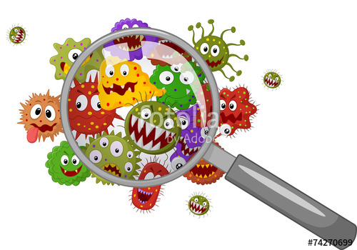
Culture media
Pure culture techniques
&
Bacterial colony

Slide 2
Microbiological culture media
The survival and growth of microorganisms depend on a available nutrients and favorable growth environment. In the laboratory, the nutrient preparations that are used for culturing microorganisms are called media.

Slide 3
Three physical forms are used
Liquid media ( broth )
Semi solid media
Solid media

Slide 4
1- liquid media (or broth) : such as nutrient broth , tryptic soy broth , brain heart infusion broth , can be used to propagate large numbers microorganisms in fermentation studies and for various biochemical tests.
For example:

Slide 5
2- semi solid media : can be used in fermentation studies , in determine bacterial motility , and in promoting an aerobic growth .
For example:

Slide 6
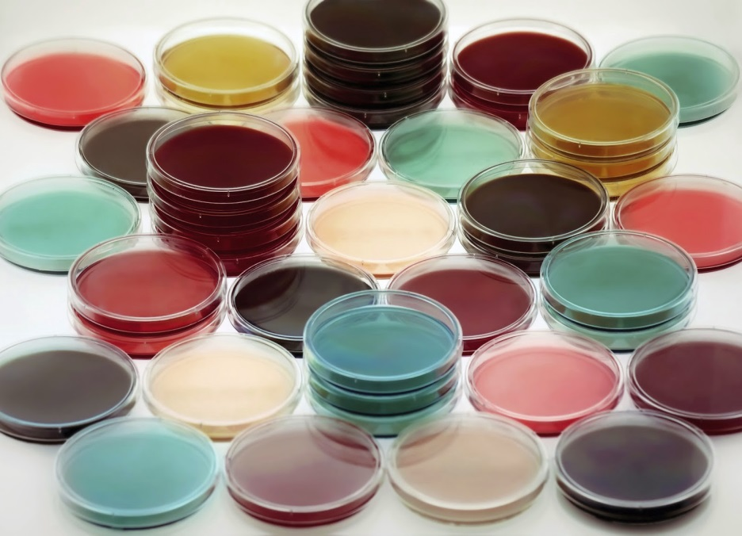
3- solid media: such as nutrient agar or blood agar are used:
For pure culture isolates.
For storage of cultures.
To observe specific biochemical reactions.
For the surface growth of microorganisms in order to observe colony appearance.

Slide 8
Pure culture techniques
Spread – plate technique
Streak – plate technique
Pour – plate technique

Slide 9
Spread – plate technique
Is an easy , direct way of achieving a pure culture. In this technique a small volume of dilute bacterial mixture is transferred to the center of an agar plate and is spread evenly over the surface with sterile , L-shaped glass rod.
The glass rod is normally sterilized by dipping in alcohol and flamed to burn off the alcohol.
After incubation some of the dispersed cells developed in to isolated colonies.

Slide 11
Streak – plate technique
Isolated , pure colonies can also be obtained by the streak plate technique .
In this technique , the bacterial mixture is transferred to the edge of an agar plate with an inoculating loop and then streaked out over the surface in one of several patterns .
At some point on the streaks , individual cells will be removed from the loop as it glides along the agar surface and will give rise to separate colonies.
Again one assumes that one colony comes from one cell.

Slide 14
Pour – plate technique
The original sample is diluted several time to reduce the microbial population to obtain separated colonies upon plating.
The small volume of several diluted samples are added to sterile petridishes and mixed with liquid tryptic soy agar that has been cooled to about 48-50C˚
After agar has hardened each cell is fixed in place and will form an individual colony if the sample is dilute enough
To prepare pure culture , colonies growing on the surface or sub-surface can be inoculated in to fresh medium.

Slide 16
Bacterial Colony
Is a large number of bacterial cells on solid medium , which is visible to the naked eye as a discrete entity .
After incubation , the general form of the colony and the shape of the edge or margin can be determined by looking down at the top of the colony , the nature of the colony elevation is apparent when viewed from the side as the plate is held at eye level .

