Slide 1
Immunodeficiency
Disorders
Dr. Mayssaa Essam

Slide 2
Immunodeficiency
The immunodeficiency may be the result of defective immunity, both innate and specific, because of genetic abnormality (primary) or there is a loss of function because of the damage by physical, chemical or biological agents (secondary).

Slide 3
Immunodeficiency diseases
A.Primary immunodeficiencies states
are inherited defects of the immune system.
B. Secondary immunodeficiency states are more common in malnutrition, infection, cancer, renal disease, malignancies patients treated by immunosupressive drugs( AIDS).

Slide 4
PRIMARY IMMUNODEFICIENCIES
Primary deficiencies in immunological function can arise through failure of any of the developmental processes from stem cell to functional end cell. Defects in the development of the common lymphoid stem cell give rise to severe combined immunodeficiency. Both T and B lymphocytes fail to develop. The myeloid cell disorders affect phagocytic function. Most of the primary immunodeficiencies are inherited.
They are classified on the basis of the site of lesion in the developmental or differentiation pathway of the immune system.

Slide 5
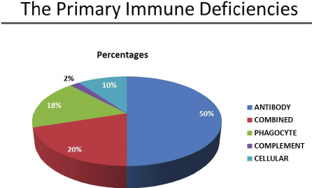
Distribution of primary immunodeficienciesn

Slide 6
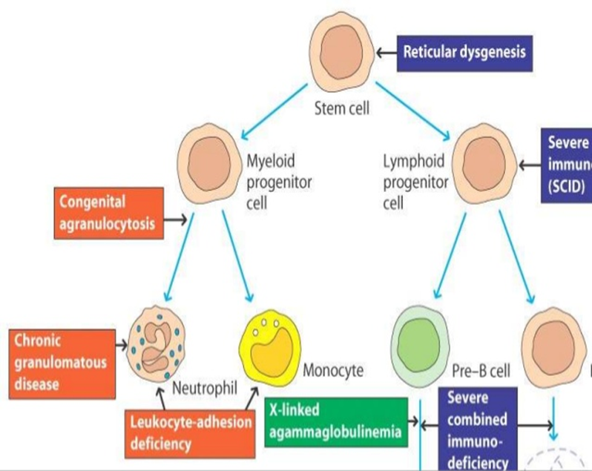
Primary Immunodeficiencies

Slide 7
B CELL DEFICIENCY
- X-linked gammaglobuinemia.
- IgA deficiency.
- IgG subclass deficiency.
- Transient hypogammaglobulinaemia of infancy.
- Common variable immundeficiency.

Slide 8
X-linked a gammaglobulinaemia
- X-linked agammaglobulinemia (X-LA), or Bruton’s hypogammaglobulinemia.
- Characterized by extremely low IgG levels and by the absence of other immunoglobulin classes.
- Babies born with this disorder have virtually no peripheral B cells ( 1%) and suffer from recurrent bacterial infections.

Slide 9
X-linked a gammaglobulinaemia
- B-cell development in the bone marrow is
arrested at the pro-B- to pre-B-cell stage, and the B lymphocytes in these patients remain in the pre-B stage, with heavy chains rearranged but light chains in their germ-line configuration.
- Present-day use of antibiotics and replacement therapy in the form of passively administered antibodies can make this disease quite manageable.

Slide 10
IgA and IgG subclass defeciency
- IgA deficiency is most common.
- About 20% lack IgG2 and IgG4.
- Susceptible to pyogenic infection.
- Result from failure in terminadifferentiation of B cells.
- Deletion of constant heavy chain genes or abnormalities of isotype switching may result in deficiencies of one or more of the IgG subclasses.
- Patients with recurrent infection should be treated aggressively with broad-spectrum antibiotics.

Slide 11
IgA and IgG subclass defeciency
-Sometimes this disorder is associated with other immunodeficiencies such as selective IgA deficiency or ataxia.
- Patients with selective IgA deficiency should not be treated with gamma globulins. Therapeutic gamma globulin contains only a small quantity of IgA and this is not likely to reach mucosal secretions through parenteral administration.

Slide 12
Hypogammaglobulinaemia of infancy
- All infants develop physiologic hypogammaglobulinemia at approximately 5 to 6 months of age. At this time, maternal IgG is slowly catabolized, the infant begins synthesizing its own IgG by this age.
- Infant may fail to initiate IgG synthesis at this time, resulting in a prolonged period of hypogammaglobulinemia termed transient hypogammaglobulinemia of infancy (THI).

Slide 13
Hypogamaglobulinaemia of infancy
- THI is more prolonged in premature infants because of decreased transplacental maternal IgG at birth.
- Infant with THI begins to recurrent respiratory tract infections and exhibit poor or absent antibody responses to vaccines. Spontaneous recovery occurs by 18 to 24 months.

Slide 14
Hypogamaglobulinaemia of infancy
- Some of these infants may benefit from intravenous immunoglobulin (IVIg) infusions or continuous antibiotic treatment.
- Infections may be caused by pneumococci, H. influenzae or other pyogenic organisms, chronic lung disease or intestinal malabsorption may be present.

Slide 15
Common Variable Immunodeficiency (CVID)
- There are defect in T cell signaling to B cells.
- May follow viral infection
- Pyogenic infection
- 80% of patients have B cells that are not functioning.
- B cells are not defective. They fail to receive signaling from T lymphocytes.

Slide 16
T CELL DEFICIENCY
- DiGeorge's syndrome (Congenital Thymic Aplasia, Immune Deficiency with Hypoparathyroidism) .
- Purine Nucleoside Phosphorylase
(PNP).

Slide 17
DiGeorge's syndrome
- During 6 to 8 weeks of intrauterine life, the thymus and parathyroid glands develop from epithelial evaginations.DiGeorge syndrome is the result of interference with normal embryonic development at approximately 12 weeks of gestation.
- The most frequent presenting sign in patients with this syndrome occurs in the first 24 hours of life with hypocalcemia that is resistant to therapy. Neonatal tetany and various types of congenital syndromes may also be present.

Slide 18
DiGeorge's syndrome
- Most patients develop recurrent and chronic infections with viral, bacterial, fungal or protozoal organisms. Failure to thrive may be present.
- Circulating T cells are reduced in numbers.
- Delayed hypersensitivity and graft rejection are depressed.
- Treatment is by transplantation of fetal thymus tissue.

Slide 19
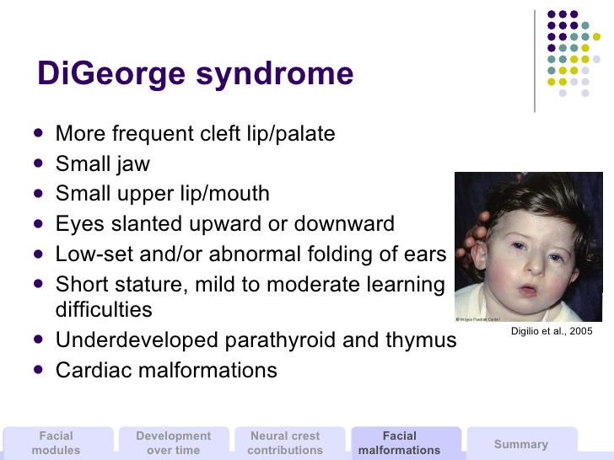
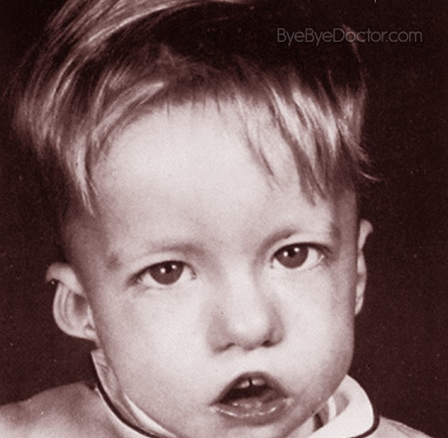

Slide 20
Purine Nucleoside Phosphorylase Deficiency
- Purine → hypoxanthine→ uric acid
- Is an enzyme which cleaves anucleoside by phosphorelating the ribose to produce nucleobase and ribose 1 phosphate.
- Patients, who have purine nucleoside phosphorylase (PNP) deficiency as an autosomal recessive, show recurrent or chronic infections. They usually present with anemia, recurrent pneumonia, diarrhea.
- Low serum uric acid level point out the diagnosis.

Slide 21
Combined Immune Deficiency T and B Cells
Wiskott-Aldrich Syndrome
- Associated with normal T cell numbers with reduced functions.
- IgM concentrations are reduced but IgG levels are normal
- Both IgA and IgE levels are normal.
- Boys with this syndrome develop severe eczema.
- They respond poorly to polysaccharide antigens and are prone to pyogenic infection.
- Treatment needs bone marrow transplantation therapy.

Slide 22
DISORDERS OF PHAGOCYTOSIS
- Disorders of phagocytosis may be due to intrinsic or extrinsic defects. Intrinsic defects are the defects within phagocytic cell (e.g. enzyme deficiency). Extrinsic defects are due to:
1. Deficiency of opsonic antibody, complement and other factors promoting phagocytosis.
2. Effect of drugs.

Slide 23
DISORDERS OF PHAGOCYTOSIS
Phagocytic dysfunction leads to increased susceptibility to infection ranging from mild recurrent skin infections to overwhelming systemic infections.

Slide 24
DISORDERS OF PHAGOCYTOSIS
Chronic granulomatous Disease(CGD)
- Chronic granulomatous disease is a familial disease manifests as recurrent infections with low-grade pathogens starting early in life.
- Chronic granulomatous lesions occur in the skin and lymph nodes.
- Catalase-positive pyogenic pathogens are the causative agents in the infections, because leukocytes from patients are unable to kill catalase-positive bacteria following phagocytosis.

Slide 25
Complement Component Deficiency
- Complement abnormalities also lead to increased susceptibility to infections.
- There are genetic deficiencies of various components of complement system, which lead to increased infections.

Slide 26
Complement Component Deficiency
- Complement component 3 (C3) deficiency is associated with recurrent pyogenic infections. C5, C8 deficiencies are associated with neisserial infections.
- C3b inactivation deficiency is associated with chronic recurrent pyogenic lesions.
-

Slide 27
Treatment is with androgens and aminocaproic acid (is aderivative and analogue of the amino aci lysine,which makes it an effective inhibitor for enzymez that bind that particular residue,proteolytic enzymes,like plasmin).

Slide 28
SECONDARY (ACQUIRED) IMMUNODEFICIENCIES
- Certain immunodeficiency diseases, instead of arising from genetic or developmental causes, may result from environmental exposure.These diseases are termed as secondary immune deficiencies.
- Among the environmental factors that affect adversely on the immune system are general health, therapeutic treatment, infections and malignancies, (drugs, malnutrition, minerals, vitamins).

Slide 29
SECONDARY (ACQUIRED) IMMUNODEFICIENCIES
- A large number of viruses evade host's immune mechanism by causing generalized immune suppression(depression). Among them measles, Cytomegalovirus (CMV) and HIV are common.
- In some cases, the virus directly destroys the lymphocytes and macrophages (HIV causing lysis of CD4 cells).
- Immune suppression may be due to cytokine imbalance.

Slide 30
SECONDARY (ACQUIRED) IMMUNODEFICIENCIES
- Therapeutic Treatment : Corticosteroids, in the treatment of autoimmune diseases, interfere the immune response by depletion of lymphocytes and there by reduction of cytokines. Cytotoxic drugs or radiation treatment for various cancers, frequently damage the dividing cells of the body including those of the immune system.

Slide 31
Infection: Many infectious agents evade the immune response generated against them , some bacteria secrete enzymes, which destroy the local immunoglobulin and complement components. Some bacteria and viruses protect themselves after ingestion by phagocytes by inhibition of several key phagocytic activities.
Parasites can cause disruption of lymphoid cells or tissue directly

Slide 32
HIV INFECTION AND AIDS
- The disease that HIV-1(Human immunodeficiency virus-1) causes, AIDS (Acquired Immunodeficiency Syndrome was first reported in the United States in 1981 in Los Angeles, New York and San Francisco,the virus directly destroys the lymphocytes and macrophages. In other cases, immune suppression may be due to cytokine imbalance. (HIV causing lysis of CD4 cells,HIV reduces the number of CD4 cells (T cells) in the body).
- T cells that carry CD4 receptors were sufficiently reduced in number, Site of attachment is the CD4 antigen found on a variety of cells:

Slide 33
HIV INFECTION AND AIDS
Helper T cells
Macrophages
Monocytes
B cells
Intestinal cells
HIV-infected cells reach the lymph nodes and other lymphoid tissues, which are the sites of active immune response against viral antigens.
T lymphocytes are activated on account of infection, but HIV replicates better in the activated cells. The peak in number of virus-expressing cells and the spread of virus throughout the lymphoid tissue precedes the increase in plasma viremia that is the virus in the blood. The virus spills over from lymph node.

Slide 34
HIV INFECTION AND AIDS
- The high risk for AIDS were homosexual males, heterosexual partners, intravenous drug users, persons who have received blood and blood products and the infants born to HIV infected mother.

Slide 35
IMMUNODEFCIENCY CAUSED BY DRUGS
METHOTREXATE
- Structural analogue of folic acid
- Blocks folic acid dependent synthetic pathways essential for DNA synthesis

Slide 36
IMMUNODEFECIENCY CAUSED BY DRUGS
CYCOLOSPORIN
- Severe effects on T cell signaling and functions.
-It binds to immunophilins which are believed to have a critical role in signal transduction.
- Inhibit IL 2 dependent signal transduction.

Slide 37
Refrences
- Immunology A Short Course (Seventh Edition-2015).Richard Coico&Geoffrey Sunshine.
- Textbook of Immunology(Second Edition-2014). Sunil Kumar Mohanty& K Sai Leela

Slide 38
THANK YOU
&
GOOD LUCK

