Slide 1
IMMUNOLOGICAL TOLERANCE AND AUTOIMMUNITY
Dr. Mayssaa Essam

Slide 2
immunological tolerance
Immunological tolerance is a state of unresponsiveness to a particular antigen to which a person has been exposed earlier.
The important aspect of tolerance is the self-tolerance, which prevents the body to mount immune response against self-antigens.
the immune cells (lymphocytes) possess vast diversities of antigen receptors, it is possible that some receptors may be self-reactive.

Slide 3
Immunological tolerance classified into central tolerance or peripheral tolerance depending on where the state is originally induced—in the thymus and bone marrow (central) or in other tissues and lymph nodes (peripheral).
Central tolerance is the main way the immune system learns to discriminate self from non-self.
Peripheral tolerance is key to preventing over-reactivity of the immune system to various environmental entities (allergens, gut microbes, etc).

Slide 4
The first evidence of self-tolerance was introduced by Traub in 1938, who inoculated mice, in utero, with lymphocytic choriomeningitis virus producing infection and maintained it throughout life. These inoculated mice, unlike normal mice did not produce neutralizing antibodies against the virus.
Tolerance could be induced, if some foreign antigens are administered during embryonic life and also in neonates.

Slide 5
The key factor determining the tolerance is not the developmental stage, but the state of maturity of the immune cells (lymphocytes) at the time of the encounter of the antigen. In unborn and neonates, the immune cells are still to mature and therefore, the individual remains unresponsive at this stage.

Slide 6
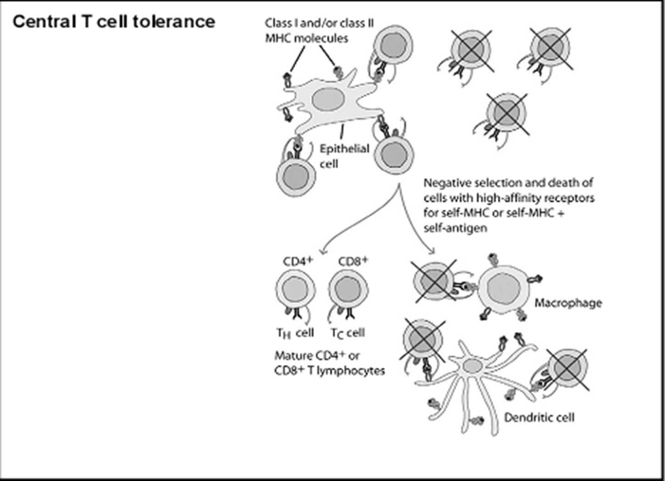
Central tolerance is established by deletion of lymphocytes in primary lymphoid organs (thymus for T cells and bone marrow for B cells) if they possess receptors that can react with self antigens or by the emergence of regulatory
T cells that can inhibit self-reactive cells.

Slide 7
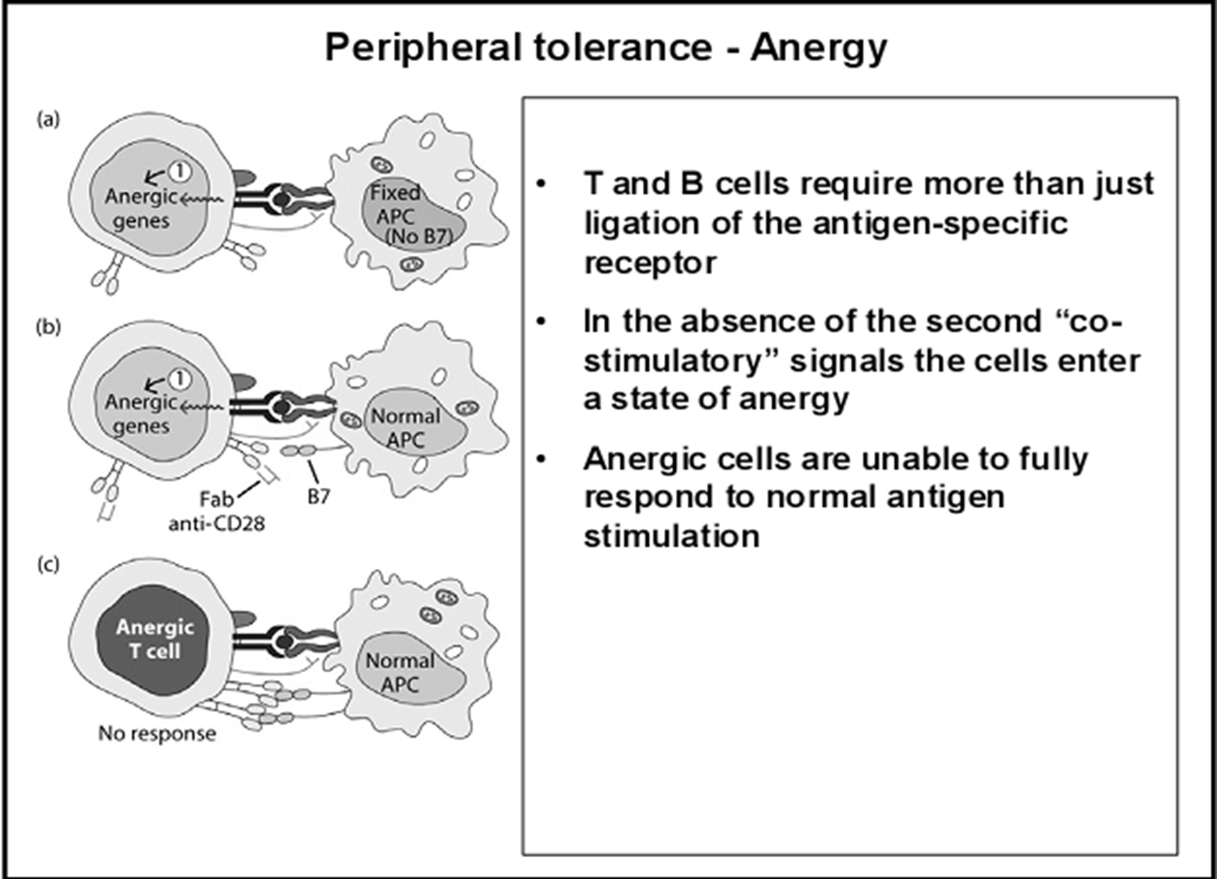

Slide 8
peripheral tolerance mechanisms
- Colonal ignorance.
The self-reactive lymphocyte is present in the periphery, but does not „see“ the antigen it is directed against Immune-privileged sites :-
• brain • eyes • testes • placenta, and fetus
Control of T-cell trafficking to tissues.
Naive cells recirculate through secondary lymphatic organs and bloodstream, but do not enter into tissues under normal conditions.

Slide 9
- Clonal anergy
Full activation of T cells requires costimulation through CD28 in addition to TCR ligation.
TCR ligation in the absence of costimulation leads to inability to express effector functions like cytokine secretion, and makes the cell unresponsive to further stimulation.
Control of the expression of the costimulatory molecules CD80 and CD86 (B7) is a major mechanism of peripheral tolerance .
- T cell suppression.

Slide 10
AUTOIMMUNITY
The term autoimmunity refers to a failure of the body’s immune system to recognize its own cells and tissues as “self”, Instead immune responses are launched against these cells and tissues as if they were foreign or invading bodies.
It occurs when mechanism of self-tolerance fail.

Slide 11
Mechanisms of autoimmunity
*Ag released from hidden location.
*Antigen generated by molecular changes.
*Molecular mimicry.
*Alteration in Ag processing.
*Infection.
*Genetic factors.

Slide 12
Mechanisms of autoimmunity
*Lymphocytes abnormalities.
*Failure of central tolerance.
*Overcome of peripheral tolerance.
*Polyclonal lymphocytes activation.

Slide 13
Ag related from hidden location
Many self Ag are found in hidden location eg. TESTES ,EYE (CORNEA)
organ damage
1. Hidden Ag released
2. Reaches blood stream
3 . Encounter Ag sensitive cells
4. Stimulate autoimmunity

Slide 14
Antigen generated by molecular changes
Development of completely new epitopes on normal protein.
1. Ab + Ag .
2. New epitopes exposed on Fc region of Ab.
3.Stimulate the formation of Rf .
4. Establishment of disease like rheumatiod artheritis.

Slide 15
Molecular mimicry
1.Sharing of epitopes between an infectious agent and its host.
2.Antibodies directed against the infectious.
3.Agents starts reacting with normal self Ag.
4.Triggers autoimmunity.

Slide 16
Alteration in Ag processing
1.T cell may fail to develop tolerance to an self
Ag simply because it is not efficiently procured.
2. Something happens to improve the processing, an autoimmune disease may be triggered.
3.This usually happens at the site of inflamation resulting in modified Ab.
eg. Thyrotoxicosis , Diabetese.

Slide 17
Infection
Autoimmunity is not due to infectious agent itself ,but results from dis- regulation of host immune response by the microbes.
This may be due to :
*Polyclonal lymphocyte activation.
* Enhanced stimulation of co stimulator.
*Alteration of self Ag(cross reactive neo-Ag).
Example: papilloma virus (HPV) and insulin receptor.

Slide 18
GENETIC FACTORS
The important genes that regulate the development of autoimmunity are located within MHC.
*MHC have got critical role in maturation of T cell .
*MHC ll genes are directly responsible for auto antigen processing and presentation.
*The structure of Ag binding groove will determine , if specific Ag will trigger an AU response.

Slide 19
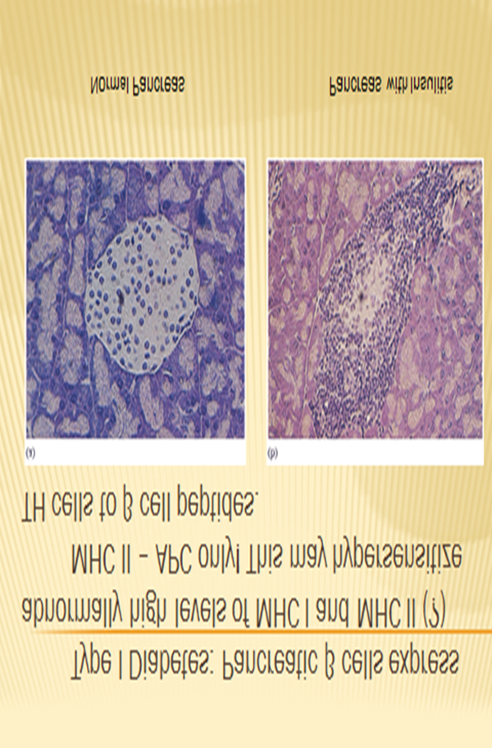

Slide 20
Lymphocytes abnormalities
* Primary abnormalities either in B cell or T cell.
Since these cells are critical regulators of all.
* MHC presentation of all antigenic peptide to these cells will be defective, in case the cells are abnormal.
* Abnormalities in lymphocytes could affect any one of the mechanism that normally maintains self tolerance.
Failure of central tolerance starts AU diseases.

Slide 21
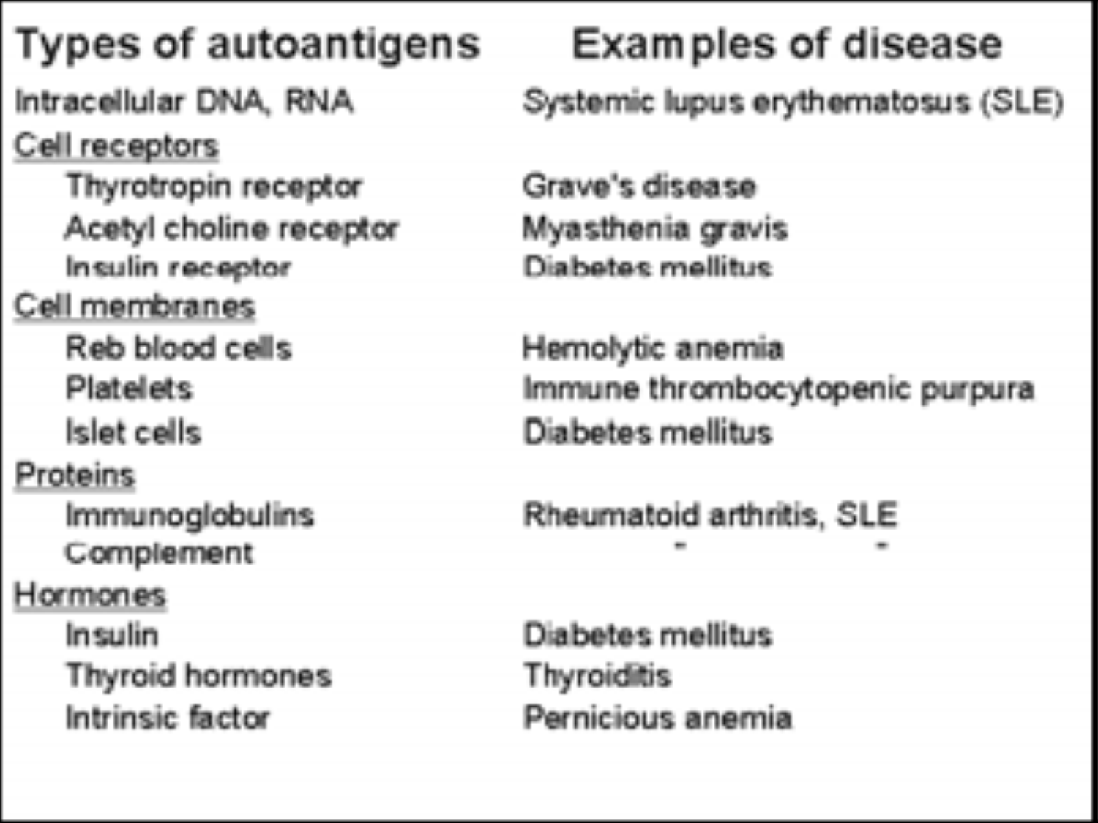

Slide 22
Refrences
- Textbook of Immunology(Second Edition-2014).
Sunil Kumar Mohanty &K Sai Leela.
- Oxford Handbook of Clinical Immunology and Allergy(Third edition-2013). Gavin P Spickett.

Slide 23
THANK YOU
&
GOOD LUCK

