Slide 1
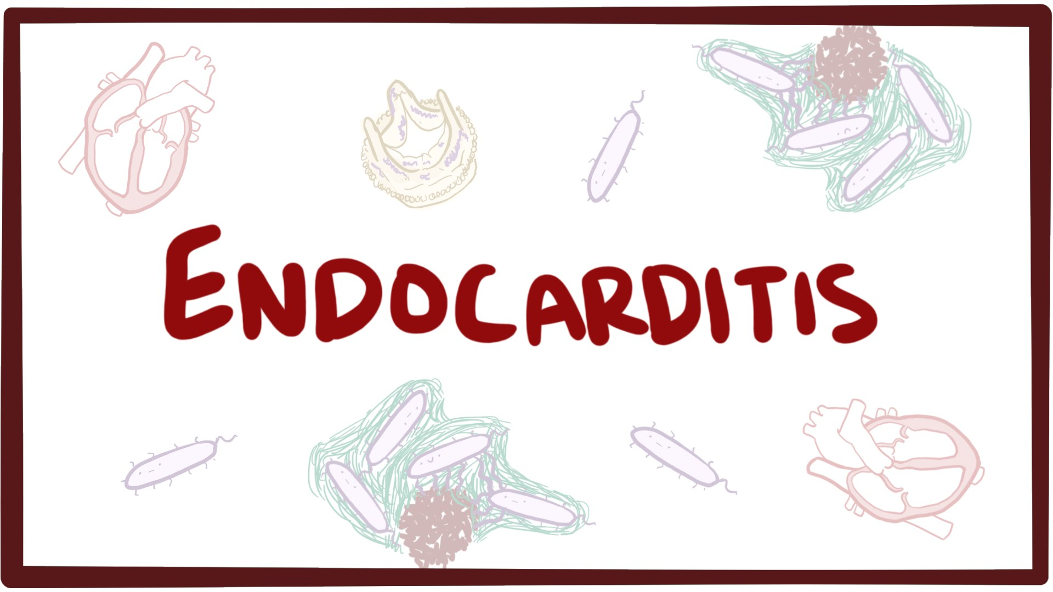

Slide 2
Endocarditis is an inflammation of the endocardium, the membrane lining the chambers of the heart and covering the cusps of the heart valves.
Infective endocarditis (IE) refers to infection of the heart valves by microorganisms, primarily bacteria.

Slide 4
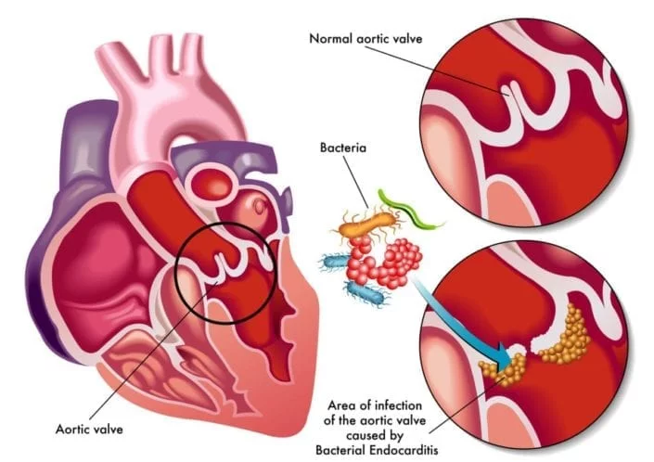

Slide 5
Risk Factors
Presence of a prosthetic valve (highest risk)
✓ Previous endocarditis (highest risk)
✓ Complex cyanotic congenital heart disease (e.g., single ventricle states)
✓ Surgically constructed systemic pulmonary shunts or conduits
✓ Acquired valvular dysfunction (e.g., rheumatic heart disease)
✓ Hypertrophic cardiomyopathy
✓ Mitral valve prolapse with regurgitation
✓ IV drug abuse

Slide 6
Causative organisms

Slide 7
Factors associated with increased mortality include the following:
Congestive heart failure
✓Culture-negative endocarditis
✓Endocarditis caused by resistant organisms such as fungi and gram negative bacteria
✓Left-sided endocarditis caused by S. aureus
✓Prosthetic valve endocarditis (PVE)

Slide 8
CLINICAL PRESENTATION
Symptoms
The patient may complain of fever, chills, weakness, dyspnea, night sweats, weight loss, and/or malaise.
Signs
Fever is common as well as a heart murmur (sometimes new or changing). The patient may or may not
have embolic phenomenon, splenomegaly, or skin manifestations (e.g., Osler’s nodes, Janeway lesions).

Slide 9
Laboratory tests
white blood cell count---- may be normal or only slightly elevated.
Nonspecific findings include
anemia (normocytic, normochromic),
thrombocytopenia,
elevated erythrocyte sedimentation rate (ESR)
elevated C-reactive protein, and
altered urinary analysis (proteinuria/microscopic hematuria).
The hallmark laboratory finding is continuous bacteremia; three sets of blood cultures should be collected over 24 hours.

Slide 10
Other diagnostic tests
An electrocardiogram,
chest radiograph,
Echocardiogram
Echocardiography to determine the presence of valvular vegetations; it should be performed in all suspected cases.

Slide 12
DESIRED OUTCOME
• Relieve the signs and symptoms of disease.
• Decrease morbidity and mortality associated with infection.
• Eradicate the causative organism with minimal drug exposure.
• Provide cost-effective antimicrobial therapy.
• Prevent IE in high-risk patients with appropriate prophylactic antimicrobials.

Slide 13
TREATMENT
Treatment usually is started in the hospital, but in selected patients, it may be completed in the outpatient setting.
• Large doses of parenteral antimicrobials usually are necessary.
• An extended duration of therapy is required,
Surgery is an important adjunct to management of endocarditis in certain patients.

Slide 14
STREPTOCOCCAL ENDOCARDITIS
Streptococci are a common cause of IE, with most isolates being viridans
streptococci.

Slide 15
The following conditions should all be present to consider a 2-week treatment regimen:
✓ The isolate is penicillin sensitive (MIC less than or equal to 0.1 mcg/mL).
✓ There are no cardiovascular risk factors such as heart failure, aortic insufficiency, or conduction abnormalities.
✓ No evidence of thrombotic disease.
✓ Native valve infection.
✓ No vegetation greater than 5 mm diameter.
✓ Clinical response is evident within 7 days.

Slide 16
STAPHYLOCOCCAL ENDOCARDITIS
S. aureus has become more prevalent as a cause of endocarditis because of
increased IV drug abuse,
frequent use of peripheral and central venous catheters,
valve-replacement surgery.
(represent 60%-8-% of s.aureus)

Slide 17
Treatment of Staphylococcus Endocarditis in IV Drug Abusers

Slide 18
Treatment of Staphylococcal Prosthetic Valve Endocarditis
• PVE that occurs within 2 months of cardiac surgery is usually caused by staphylococci implanted at the time of surgery. Methicillin-resistant organisms are common.
Vancomycin is the cornerstone of therapy.
• Because of the high morbidity and mortality associated with, combinations of antimicrobials are usually recommended.

Slide 19
ENTEROCOCCAL ENDOCARDITIS
Enterococci cause 5% to 18% of endocarditis cases.
no single antibiotic is bactericidal;
MICs to penicillin are relatively high (1 to 25 mcg/mL);
they are intrinsically resistant to all cephalosporins and relatively resistant to aminoglycosides
(4) combinations of a cell wall–active agent, such as a penicillin or vancomycin, plus an aminoglycoside are
necessary for killing;
(5) resistance to all available drugs is increasing.

Slide 20
ENTEROCOCCAL ENDOCARDITIS

Slide 21
EVALUATION OF THERAPEUTIC OUTCOMES
includes assessment of signs and symptoms,
blood cultures,
microbiologic tests,
serum drug concentrations,
other tests to evaluate organ function.
Persistence of fever beyond 1 week indicate ineffective antimicrobial,
blood cultures should be negative within a few days…

Slide 22
PREVENTION OF ENDOCARDITIS
Antimicrobial prophylaxis is used to prevent IE in patients believed to be at high risk.
Endocarditis prophylaxis is recommended for all dental procedures

Slide 24
GOOD LUCK

