Slide 1
Pharmacognosy Alkaloids
lec 8

Slide 2
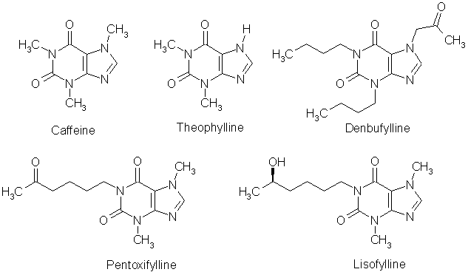
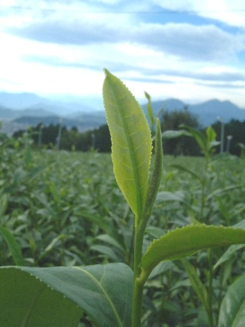
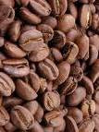
Purine alkaloids
Sometimes called alkaloids, xanthine derivatives are stimulants and bronchodilators. Caffeine 1,3,7-trimethyl xanthine is the most common and found in tea and coffee. The derivative theophylline (1,3-dimethylxanthine, found in trace amounts in tea) is used in the treatment of asthma.
Theobromine (3,7-dimethyl-xanthine) is found in chocolate – which is made from the beans of Theobroma cacao (NB: ‘Theobroma’ means food of the gods!)

Slide 3
Caffeine
Occurs in
Coffee ,tea , cacao, cola and mate. Although can be produce synthetically , but usually prepared from tea. Solubility in water can be markedly increased by the presence of citric acid or benzoic acid , medicinal compounds of this class are citrated caffeine which is suitable for intramuscular injection
To treat circulatory failure
Caffeine and related derivatives are CNS stimulant.
Green tea is prepared in China and Japan
By rapidly drying the fresh leaves in copper pans over a mild artificial heat.
Black tea the fresh leaves are left until fermentation began.

Slide 4
Lupinane alkaloid
Quinolizidine
The most important alkaloid is Sparteine is a class of antiarrythmic agent a sodium channel blocker. It is an alkaloid and can be extracted from scoparius broom. It is the predominant alkaloid in Lupinus mutabilis, and is thought to chelate the bivalents calcium and magnesium It is not FDA approved for human use as an antiarrhythmic agent, and it is not included in. is used as oxytocic (stimulate contraction of uterus
It is also used as a chiral base in Organic synthesis

Slide 5
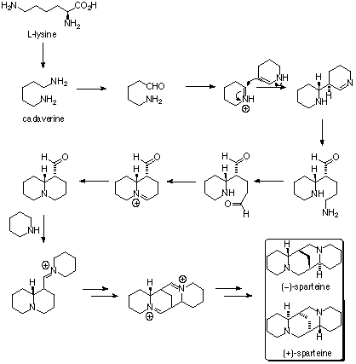
Biosynthesis of sparteine
Note: designate the type of reaction in each step

Slide 6
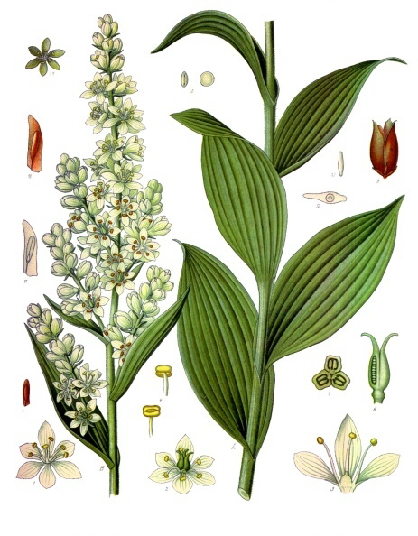
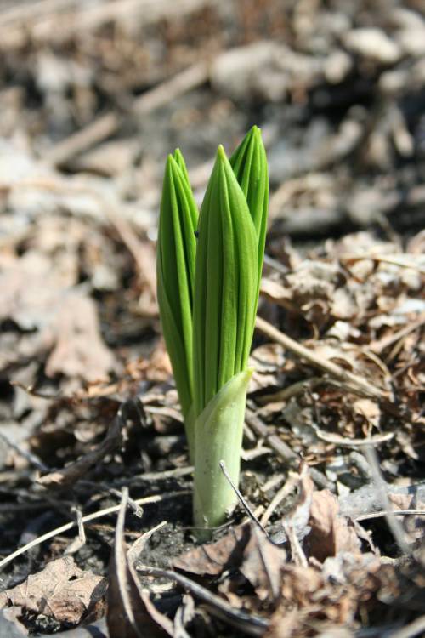
Pseudoalkaloids 1- Steroidal alkaloids
Veratrum album (the white veratrum) grown in europe used as pesticide
Verartrum viridi (green veratrum) contains the alkaloid
veratraine and protoveratrine
Veriloid is a mixture of veratrum alkaloid.Used as hypotensive agent.

Slide 7
Verartrum toxicity
Veratrum species produce highly toxic steroidal alkaloids only when the plants are in active growth. During the winter months, when the plant enters its dormant stage, it degrades and metabolizes most of its toxic alkaloids. Herbalists and Native Americans who used this plant for medicinal purposes harvested the roots during the winter months when the levels of toxic constituents were at their lowest.
The roots of V. nigrum and V. schindleri have been used in Chinese herbalist (where plants of this genus are known as "li lu is used internally as a powerful emetic of last resort, and topically to kill external parasites, treat tinea and stop itching.. Some herbalists refuse to prescribe li lu internally, citing the extreme difficulty in preparing a safe and effective dosage

Slide 8
Solanum alkaloids
A good number of plants belonging to the natural order Solanaceae have been found to accumulate favourably several steroidal alkaloids based on a C27 cholestane skeleton, such as: solasodine,

Slide 9
solanidine

Slide 10
Solanum alkaloids

Slide 11
Pseudo alkaloids
Terpenoid alkaloids
Aconite: Is the dried roots of Aconitum napellus (Ranunculaceae).
Aconite contains diterpine alkaloids aconine and aconitine.
Aconine
antineuralegic liniment a “counterirritant” for treating facial pain, joint pain
Aconite root contains chemicals that may improve circulation, but it also contains chemicals that can seriously harm the heart, muscles, and nerves.

Slide 12
Aconitine is ester of aconine
Used to treat neuralgia and induce arrhythmia in experimental animal
Notes:
Used to treat neuralgia and induce arrhythmia in experimental animal

Slide 13
Biosynthesis of aconite alkaloids

Slide 14
The end
Thank you for listining

