Slide 1
Pharmacognosy Alkaloids
Lec 7

Slide 2
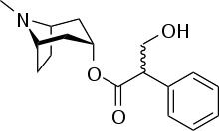
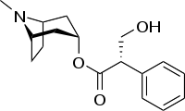
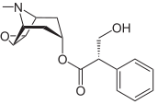
Tropane alkaloids
Atropine, hyoscyamine and hyosine (scopalamine)
Atropine (racemic alkaloid), hyosyamine L- form, scopalamine is epoxy-hyosyamine

Slide 3
Belladonna, Henbane and Thornapple
(-)-Hyoscyamine: from Atropa belladonna and Hyoscyamus niger.
Atropine: the racemic mixture (±) of hyoscyamine, found in A. belladonna
Formerly used as a smooth muscle relaxant – now used in eye examinations to open the pupil (=mydriatic) and in acute arrythmias
Hyoscine (scopolamine): from Datura stramonium etc. used to prevent travel sickness and to dry up nasal secretions before anaesthesia
All are anti-cholinergic (anti-muscarinic)

Slide 4
Follow the label
Feeding study

Slide 5
Datura stramonium Thornapple

Slide 6
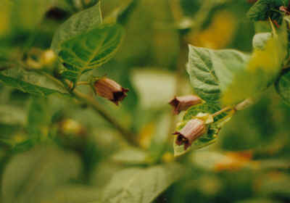
Deadly nightshade Atropa belladonna
The name Atropa comes from the ancient Greek Fate, who in mythology cut the thread of life.
‘belladonna’ comes from the Italian for beautiful lady, and refers to the use of the juice of the berries of this is plant by ladies in the 16th century to dilate the pupils of the eye, considered an attractive feature

Slide 7
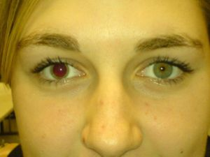
Atropine
Atropine is used as to dilate the pupil of the eye. It degrades slowly, typically wearing off in 2 to 3 days, so tropicamide (a synthetic shorter-acting cholinergic antagonist) is generally preferred as a mydriatic. The effects of atropine can last up to two weeks.
Atropine induces mydriasis by blocking contraction of the circular pupillary sphincter muscle, which is normally stimulated by acetylcholine release, thereby allowing the radial pupillary dilator muscle to contract and dilate the pupil. Atropine is contraindicated in patients predisposed to narrow angle glaucoma.
Dilation of the pupil

Slide 8
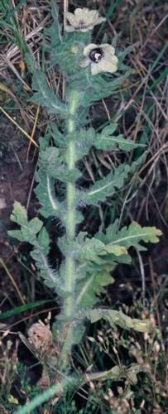
Henbane Hyoscyamus niger
The name henbane came from the Anglo-Saxon hennbana = "killer of hens".
It was traditionally used in German pilsner beers as a flavouring, until the Bavarian Purity Law was passed in 1516 and outlawed the use of Henbane and allowed only the use of hops
Henbane was also known to have been used as an anaesthetic in the first Arab hospitals

Slide 9
Tropane alkaloids 2: Cocaine
From Coca leaves - a shrub, Erythroxylum coca, found only at high altitudes, in the Andes (Peru, Bolivia, and Columbia)
Coca (still) used by locals to ease altitude sickness and reduce hunger and fatigue
Cocaine is a CNS stimulant widely used illicitly, as the salt, the ‘free base’ and now as ‘crack’ (made with sodium bicarbonate)
cocaine rarely used medicinally now, and only as a local anaesthetic in eye surgery

Slide 10
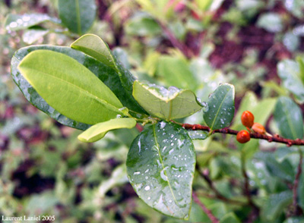
Coca: Erythroxylum coca
Cocaine occurs in the leaf as the free base – but this is not very stable so it is extracted using a dilute acid, to form the salt – and this is the form used pharmaceutically (e.g. cocaine hydrochloride)
It may later be converted back into the free base form because absorption is much faster for non-ionic (i.e. lipophilic) substances

Slide 11
Cocaine
Prepared semisynthetically from of ecgonine
Adrenergic stimulant, local ansthetic cause addiction

Slide 12
Alkaloid chemistry: crack cocaine
Base (alkaloid) + acid → alkaloid salt + water
e.g. Morphine + sulphuric acid → morphine sulphate + water
Cocaine base + HCl → cocaine HCl + water
But a weak acid or base is displaced by a stronger one….. so
Cocaine HCl + stronger alkali (e.g. NaHCO₃) → cocaine base (crack) + salts + water
To make crack, ‘powder’ cocaine the salt is dissolved in a mixture of water and either ammonia or sodium bicarbonate (baking soda) added. The mixture is boiled to separate out the solid, and then it's cooled. The solid is then dried and cut up into small nuggets, or "rocks."
Although crack cocaine is a form of non-ionic cocaine, because production doesn't require the use of flammable solvents, it is safer to make than ‘freebase’

Slide 13
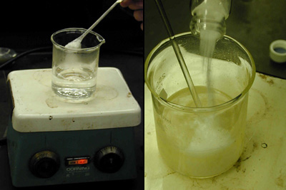
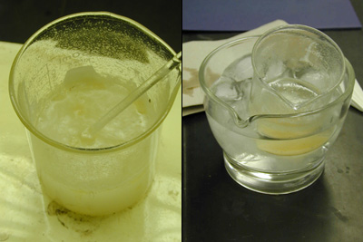
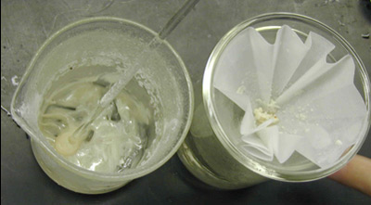
Alkaloid chemistry: making crack (base) cocaine from the salt
Step 1 (left): Dissolving powder cocaine in hot water
Step 2 (right): Adding sodium bicarbonate to the mixture
Step 3 (left): Boiling the solution to separate out the solids Step 4 (right): Cooling the separated mixture
Step 5: Filtering the cooled mixture–
→

Slide 14
The end
Than you for listining

