Slide 1
Pharmacognosy Alkaloids lec6
.

Slide 2
Protoalkaloids (biological amine)
Alkaloids do not contain a heterocyclic ring.
The nitrogen at the side chain.
They are derived from the common amino acids, phenylalanine or tyrosine.
Some of the alkaloids in this category whose biosynthesis has been studied using labeled precursor include mescaline, ephedrine, cathinone and colchicin.

Slide 3
Ephedrine
Ephedrine is derived from Ephedra sinica, Gnetaceae.
Ephedrine possess CNS stimulatory, vasoconstrictor and bronchodialatory properities.
Ephedrine has two stereogenic (chiral) centres and therefor has four possible isomer.
Ephedrine used for sever asthma while pseudoephedrine is used in cough preparation for it’s bronchodilatory properties.

Slide 4
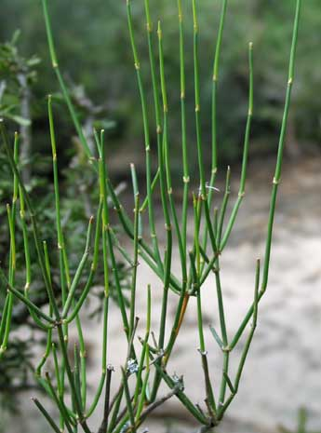
Ephedrine
Ephedrine
Pseudoephedrine (isomer) less stimulant in effect
Ephedra sinica,
Ma Huang
Note - the nitrogen is in the side chain, not the heterocyclic ring!

Slide 5
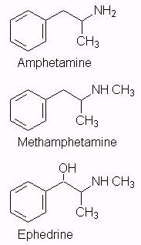
Herbal Ephedra has recently
gained notoriety as herbal ecstasy
due to the high similarity in
structure of ephedrine and ecstasy,
these herbal preparations are
dangerous and should therefore be
avoided.
This is why the sale of pseudoephedrine may be banned....ephedrine is already tightly controlled

Slide 6
colchicine
An alkaloid obtained from various species of Colchicum Fam. Liliaceae.
Colchicin has one amido nitrogen atom. The compound lacks pronounced basicity and does not form a well-defined series of salts as do other alkaloids. Nevertheless, it is precipitated by many alkaloid reagents and is conventionally considered an alkaloid.
Colchicine used in the treatment of gout, it is highly cytotoxic and antimitotic.

Slide 7
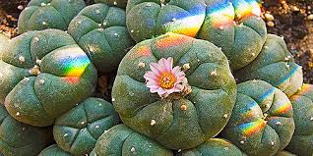
Mescaline
Mescaline is the biologically active natural product present in cactus peyote which is responsible for it’s hallucinogenic properity.
Ingestion of pure mescaline fails to give the same response as consumption of peyote which is possibly due to the contribution of other compounds present in the plant material.

Slide 9
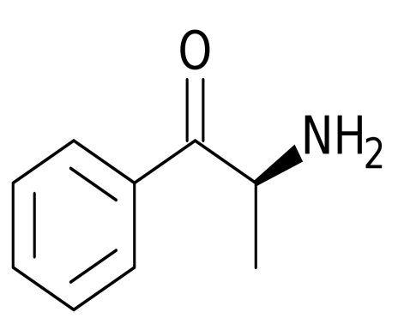
Khat or Abyssinian tea
Khat contains a potent phenylalkylamine alkaloid called (-)-cathinone. It has pharmacological properties analogous to those of (+)-amphetamine.
The young fresh leaves contain the optimum amount of cathinone, while in older leaves, it is converted to the weakly active compound (+)-norpseudoephedrine (80%) and (-)-norephedrine(20%).

Slide 10
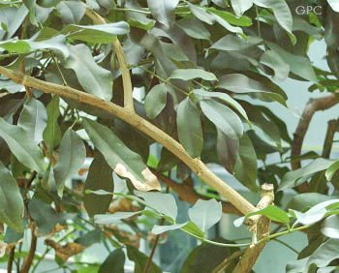
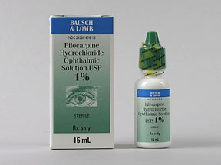
Imidazole alkaloids
Pilocarpine is cholinergic agent and is used to stimulate muscarinic receptors of the eye in the treatment of
Glaucoma

Slide 11
Thank you for listining
The end

