Slide 1
pharmacognosy
Alkaloids
Lec 5

Slide 2
Quinoline alkaloids
Alkaloids containing quinoline as their basic nucleus include those obtained from cinchona bark (Cinchona succirubra) ( quinine, quinidine, cinchonine, and cinchonidine).
Cinchonine which is isomeric with cinchonidine, is the parent alkaloid of the quinine series.
Quinine and it's isomer quinidine represent 6-methoxycinchonine.

Slide 3
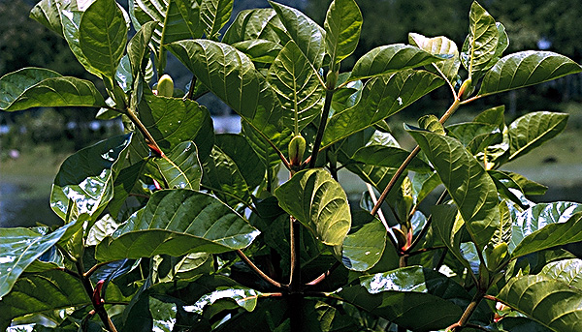
Cinchona bark

Slide 4
Quinine
.
Quinine: An antimalarial from which newer drugs (e.g. chloroquine, mefloquine) have been developed. Also acts as an anti-arrhythmic, so avoid in heart disease. Used in ‘tonic water’
Quinidine: closely related to quinine, a more potent
anti-arrhythmic
Biosynthesis: quinine is metabolically derived from monoterpenoid- tryptophan pathway.

Slide 5
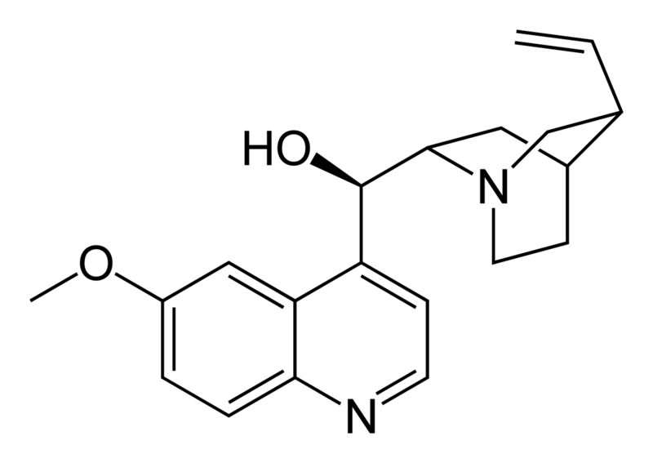
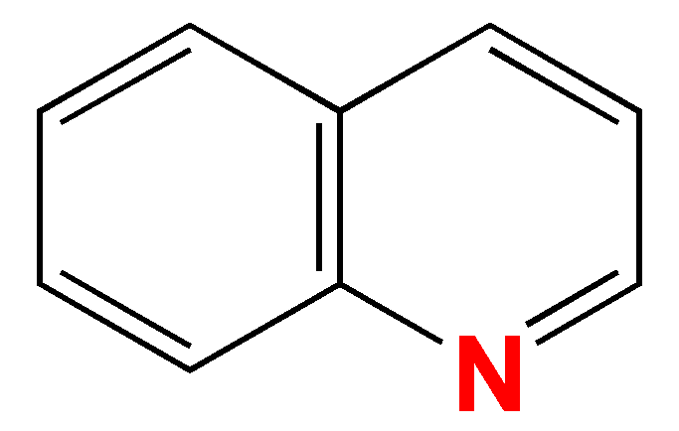
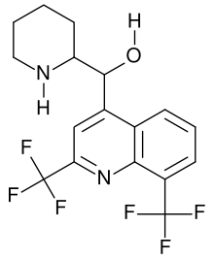
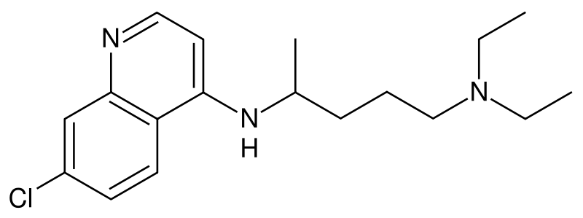
Quinine and derivatives
Quinine (natural)
Quinoline nucleus
Mefloquine (synthetic)
Chloroquine, based on quinine (synthetic)

Slide 6
Cinchonism
Overdose of cinchona products result in temporary loss of hearing and in impaired sight.
Ringing in the ears is symptoms of toxicity.
When these symptoms are produced as the result of continuous use of cinchona or of quinine, the condition has been called cinchonism.

Slide 7
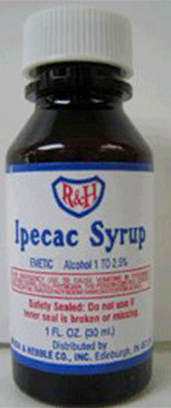
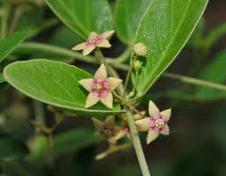
Isoquinoline Alkaloids
Ipecac
Consists of the dried rhizome and roots of Cephaelis ipecacuanah , it contain two isoquinoline alkaloids emetine and cephaeline.
Ipecac in the form of syrup, is used in the treatment of drug overdose and in certain poisonings.

Slide 8
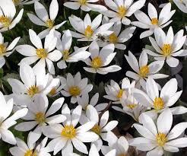
Sanguinaria
Is the dried rhizome of Sanguinaria
Canadensis Fam. Papaveraceae. it contain isoquinoline alkaloids sanguinarine, chelerythrine, protopine and allocryptopine.
Sanguinaria has stimulating expectorant and emetic properities.
in toothpaste and mouthwash for the prevention of the development of dental plaque and subsequent periodontal disease.

Slide 9
(Benzyl)isoquinoline alkaloids 1:
The Opium
Opium is the gummy exudate obtained by incising the unripe capsules of the opium poppy (Papaver somniferum, papaveraceae).
Opiate:-nataural alkaloids contains more than 30 alkaloids, of which the major components are morphine, codeine, thebaine, papaverine and noscapine.

Slide 10
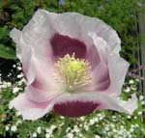
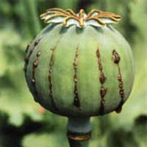
Opium poppy
Papaver somniferum

Slide 11
Morphine
Morphine possesses both a basic tertiary amine and an acidic phenolic functional group, these groups allow morphine to be readily purified by acid and base.
Morphine is an excellent analgesic.
Morphine is readily converted into the drug of abuse, heroin by acetylation of both hydroxyl groups using acetic unhydride.
Heroin is more potent analgesic than morphine that it’s useful in patient with terminal cancer.

Slide 12
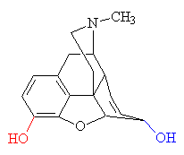
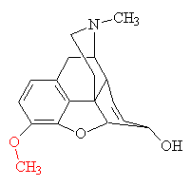
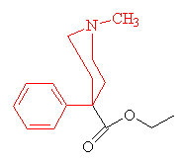
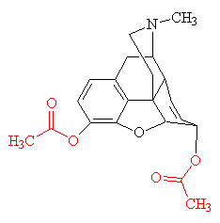
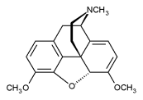
Benzylisoquinoline alkaloid structures
morphine
pethidine
codeine
thebaine
Diamorphine (heroine)
Notes:
thebaine

Slide 13
Codeine is an over the counter analgesic , cough suppressant and in small doses used to treat diarrhea due to it’s antiperistalitic.
Codeine is formulated with other analgesic agents such as aspirin and paracetamol.
thebaine is the starting point for the synthesis of many agents, including codeine and veterinary sedative such as etorphine.

Slide 14
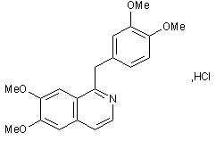
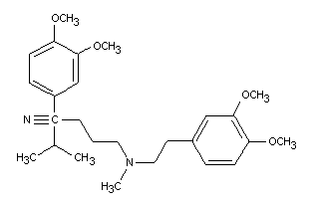
Papaverine and verapamil
Papaverine (top) is a smooth muscle relaxant – it was investigated for its calcium antagonist activity
This led to the development of verapamil (bottom), a widely used calcium channel blocker

Slide 15
Curare
A generic term for these arrow poisons
Most are mixtures of poisons from various plants of unrelated species and some animal toxins)
They cause paralysis of muscle required to breathe when injected (e.g. using an arrow!) but are destroyed by stomach acid, so meat from animals killed by curare can be eaten
Different strengths are used for different purposes – not always to kill

Slide 16
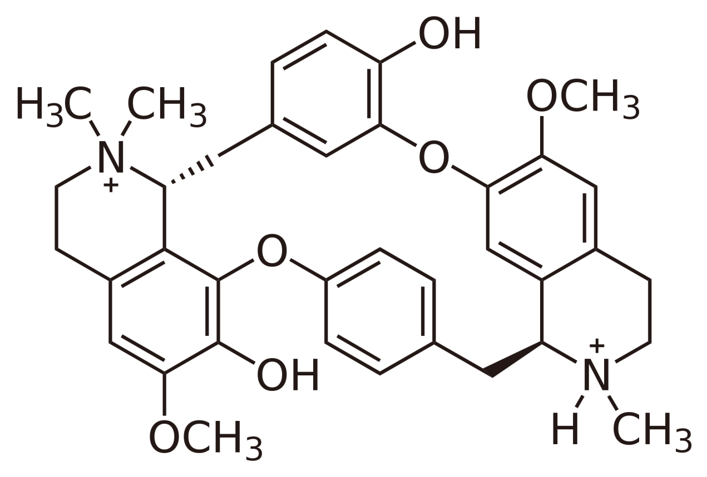
The major active component of curare is tubocurarine.
Tubocurarine use as a muscle relaxant in surgical procedures . It’s also a template for the development of other muscle relaxant such as atracurium.

Slide 17
Thank you for listining
The end

