Slide 1
lec4
Pharmacognosy
alkaloids

Slide 2
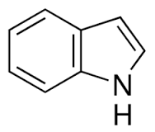
INDOLE ALKALODS
a class of alkaloid containing a structural moiety of indole; many indole alkaloids also include isoprene groups and are thus called terpene indole or secologanin tryptamine alkaloids. it is one of the largest classes of alkaloids. Many of them possess significant physiological activity and some of them are used in medicine.

Slide 3
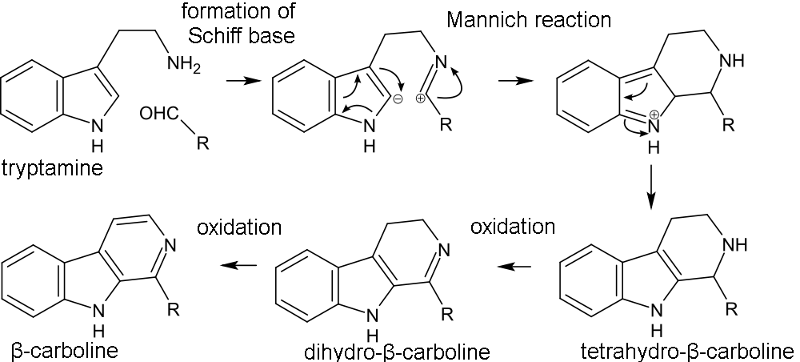
BIOSYNTHESIS

Slide 4
reserpine

Slide 5
physostigmine,neostigmine,pridospermin

Slide 6
Semisynthetic physostigmine

Slide 7
Ergot alkalods

Slide 8
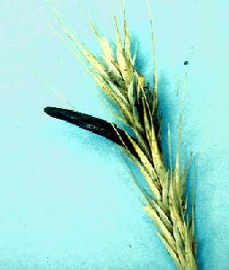
Ergotamine
Is used to relief migraine and is still used today
It reduces vasodilatation , side effects include gangrene

Slide 9
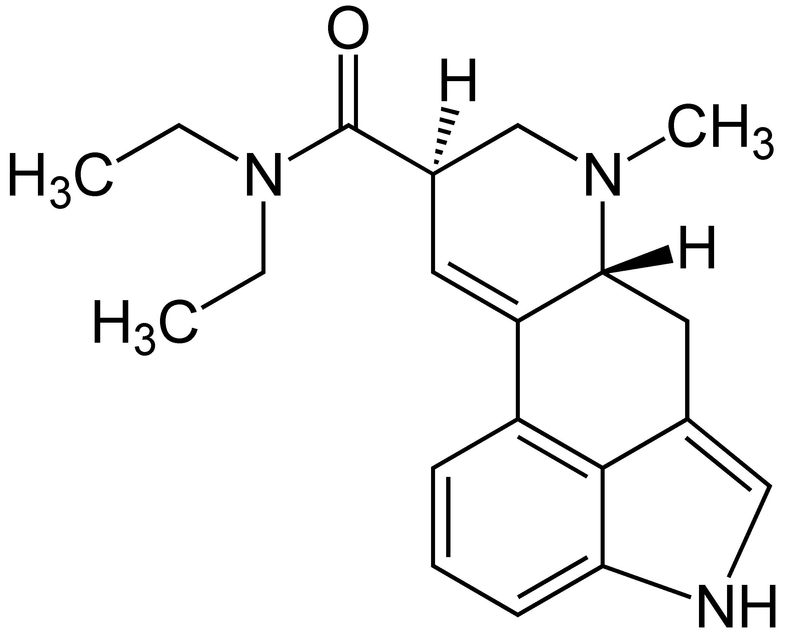
The ergot alkaloid were used as a template for the semi-synthetic of bromocriptine, pergolide and cabergolide, which have use in neurological disorder such as Parkinson’s disease.
Ergot can cause hallucination and the hallucinogenic drug of abuse LSD(lysergic acid diethylamide) is structurally relatted to them.
LSD

Slide 10
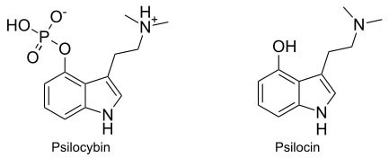
psilocybin
Mushrooms of the genera Psilocybe, Panaeolus, Conocybe and Stropharia are known to produce psychoactive substance such as psilocybin, which is salt in the fungi and is converted into psilocin in vivo.

Slide 11
Vinca rosa

Slide 15
Thank you for listining

