Slide 1
Pharmacognosy lec 3
Alkaloid

Slide 2
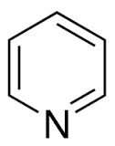
Pyridine-piperidine alkaloids
On reduction, the tertiary base, pyridine, is converted into the secondary base, piperidine.
These two nuclei form the basis of this group.
pyridine
piperidine

Slide 3
biosynthesis

Slide 4
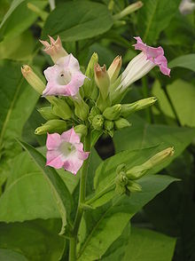
nicotine

Slide 5
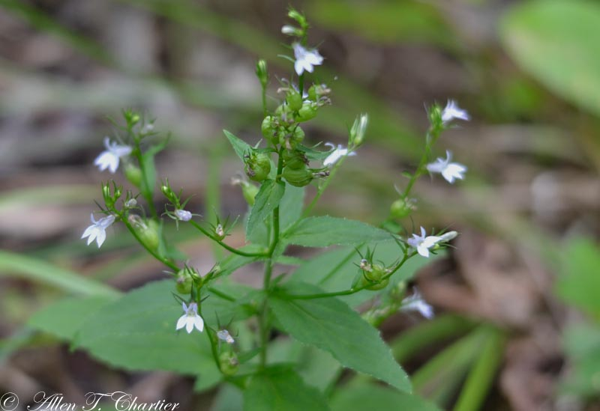
lobeline

Slide 6
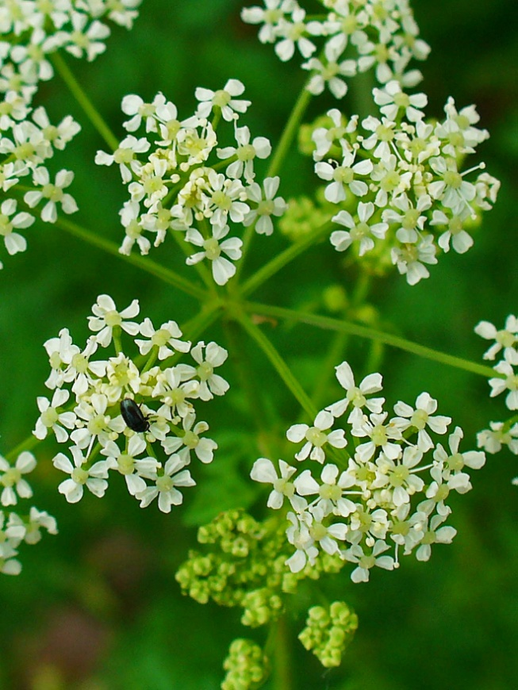
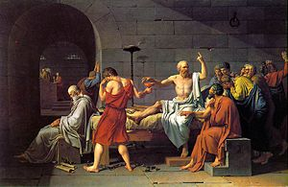
coniine

Slide 7
castanospermine

Slide 8
arecoline

Slide 9
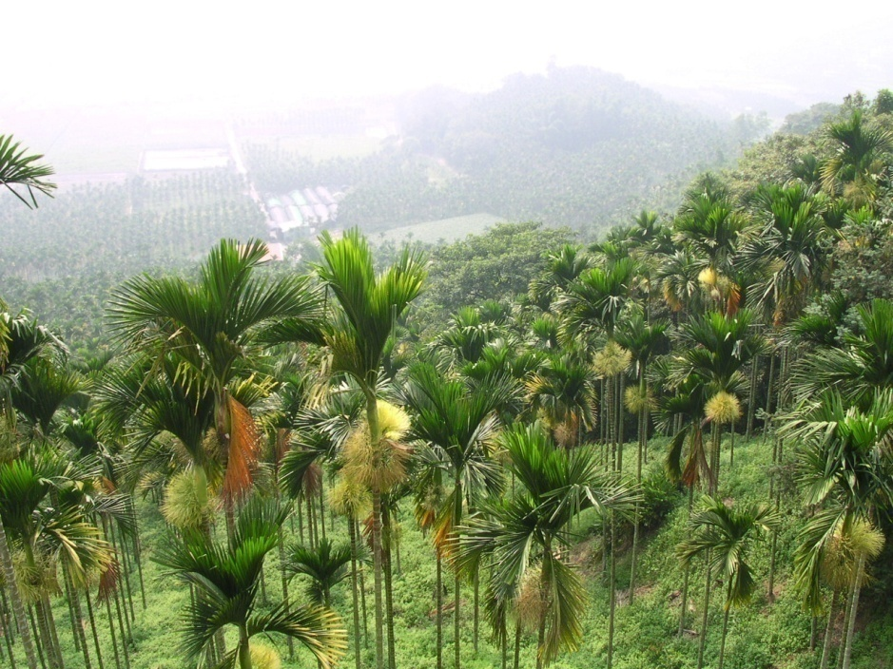
Areca contain several alkaloids that are piperidine alkaloids.
Among them are arecoline, arecaidine, guvacine, and guvacoline.
Arecoline, the most abundant and physiologically most active alkaloids.
Areca is classified as an anthelmintic in veterinary practice.

Slide 10
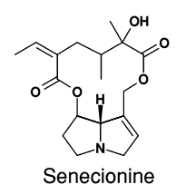
senecionine
Is a member of pyrrolizidine class of alkaloids which have hepatotoxic properities.
These compounds possess a reactive carbon, which is readily alkylated by reactive thiol groups present in many enzymes found in liver. This accounts for the withdrawal of comfry (Symphytum officinale, Boraginaceae) which contain this alkaloid.

Slide 11
Thank you for listiningg

