Slide 1
Pharmacogosy
Lec. 1
Alkaloids

Slide 2
Alkaloids
Definition:-
Alkaloids are natural compounds display an expceptionally wide array of biological activities and have a wide distribution , being present in plants, fungi, bacteria, insects, marine, animal and man.
Many drugs and poisons are alkaloids and many are well-known, such as:-
Morphine, codeine, strychnine, nicotine, and cocaine.

Slide 3
Ditribution of alkaloids
In the plants kingdom, the alkaloids appear to have a restricted distribution in certain families and genera.
Among the angiosperms, the Apocyanaceae, Papaveraceae, Ranunculaceae, Rubiaceae, Solanaceae, and beberidaceae are outstanding for alkaloids-yielding plants.
Although it has been claimed that monocotyledons do not produce alkaloids, investigation indicate that the Amarylidaceae and Liliaceae are two of the most promising families in which to search for alkaloids- yielding plants.

Slide 4
Specific alkaloids are ordinarily confined to specific plant families (hyoscyamine in Solanaceae, colchicine in Liliaceae).
There are an exception to this rule such as:-
Nicotine, which is found in a number of widely scattered plant families.
Ergot alkaloids in the fungus Claviceps pupurea

Slide 5
Alkaloids may occur in various parts of the plants
In seeds ( physostigma, areca).
In underground stems ( sanguinaria).
In roots ( belladonna root).
In rhizome and root ( ipecac, hydrastic).
In barks ( cinchona).
They also found in fungi ( ergot).

Slide 6
Names of alkaloids
From the generic name of the plant yielding them as atropine ( Atropa belladona).
From the specific name of the plant yielding them as belladonine ( Atropa belladona).
From the common name of the drug yielding them as ergotamine ( Ergot).
From their physiologic activity as emetine (Ipecac cause emesis).
From the discoverer as pelletrine.

Slide 7
A suffix is added sometimes to designate the alkaloids which are similar in structure but differ their stereochemitry . For example quinine and quinidine.
A prefix is added to designate alkaloids found in the same plant example hydroquinine.
Alkaloids name should end with ine.

Slide 8
Classification of alkaloids
True alkaloids ( characterized by a hetrocyclic ring with a nitrogen atom and are derived from amino acid).
Proto alkaloids ( characterized by absence of the heterocyclic ring but derived from amino acid).
Pseudo alkaloids (characterized by a heterocyclic ring with a nitrogen atom, but are not derived from amino acids)( steroidal alkaloids).

Slide 9
In general the alkaloids are classified according to the chemical structure into two broad division:-
Non-hetrocyclic or a typical alkaloids or biological amines.
Hetrocyclic or typical alkaloids divided into 14 group according to their structure:-
Pyrrol and pyrrolidine.
Pyrrolizidine.
Pyridine and piperidine.
Tropane.
Quinoline.

Slide 10
6- isoquinoline.
7- aprophine.
8- norlupinane.
9- indole.
10- indolizidine.
11- imidazole.
12- purine.
13- steroids.
14- terpenoid.

Slide 11
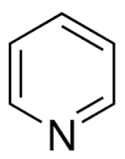
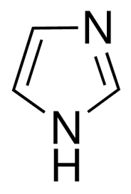


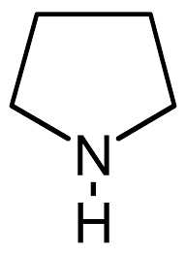
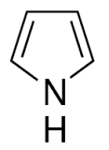
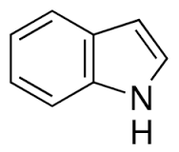

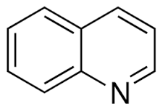
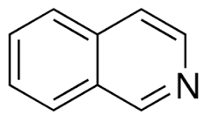
pyridine
piperidine
pyrrolizidine
imidazole
pyrrolidine
pyrrole
indole
indolizidine
quinoline
isoquinoline

Slide 12
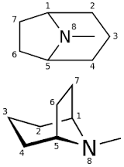
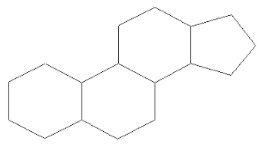
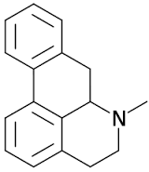
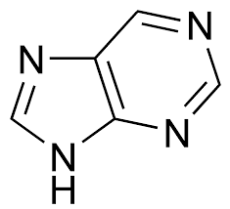
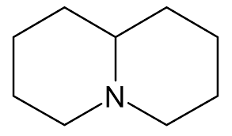
You should know the skeletal type but not the individual structure
steroid
aporphine
tropane
norlupinane
purine

Slide 13
Thank you for listining
The end

