Slide 1
Adrenergic Agonists

Slide 2
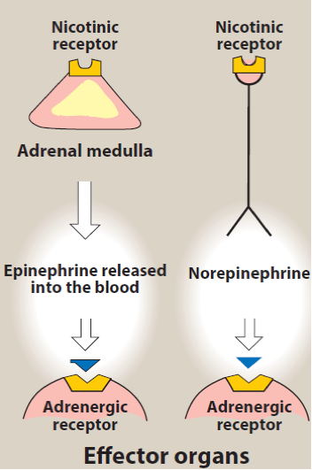
Sympathetic Nervous System
Adrenalin, Noradrenalin
Sympathomimetics (direct & indirect)
Sympatholytics
Adrenergic Receptors

Slide 3
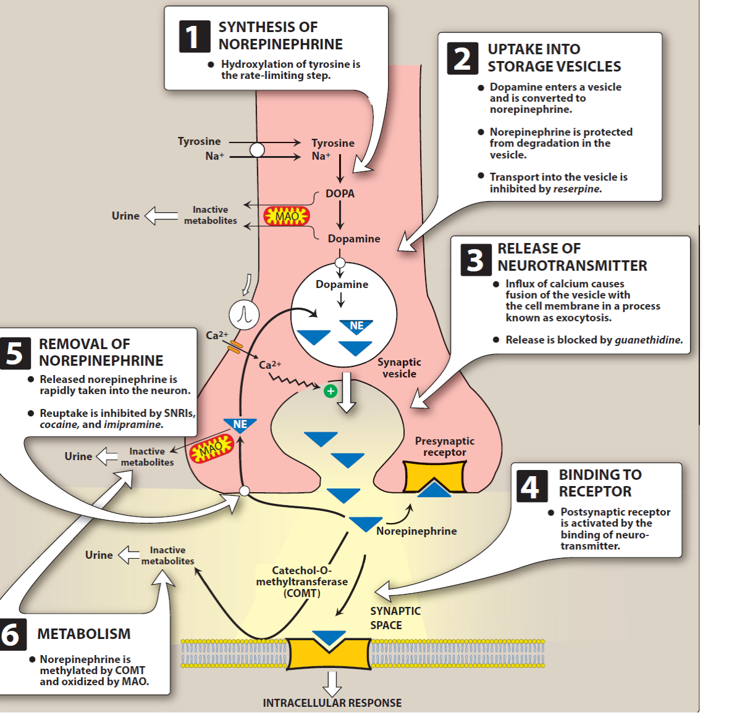

Slide 4
Removal of Norepinephrine
Diffuse out of the synaptic cleft
Metabolized by COMT
Reuptake into the neuron
Tricyclic antidepressants (TCA, imipramine)
Serotonin-NE reuptake inhibitors (duloxetine)
Cocaine
Fate of NE /taken up by vesicles/amine transporter system
Release
Protected pools
Oxidized by MAO

Slide 5
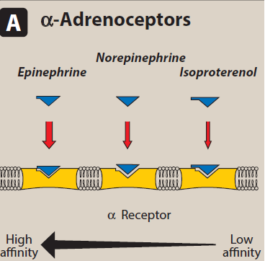
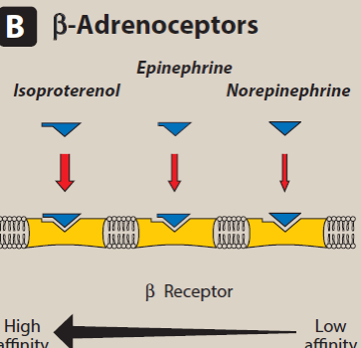
Adrenergic Receptors

Slide 6
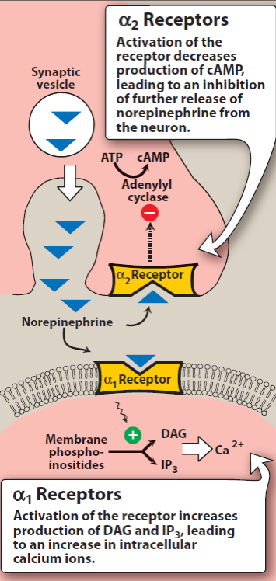
α-receptors
Epinephrine ≥ NE >> isoproterenol
α₁ Receptors
postsynaptic
Constriction of SM
Gptn-coupled Rs (phospholipase C)
α ₂ Receptors
inhibitory autoreceptos
inhibitory heterreceptors
Inhibition of adenylyl cyclase
Subdivisions
α_{1A}, α_{1B}, α1C, α_{1D---------}Tamsulosin
α_{2A}, α_{2B}, α_{2C}

Slide 7
β-adrenergic Receptors
Isoproterenol > epinephrine > NE
Β₁, β ₂, β₃:
Β₁ epinephrine = NE
Β₂: epinephrine >> NE
Activation of adenylyl cyclase
SkM vasculature β₂ >> β₁
Myocardium β₁ >>>> β₂
Responses of adrenergic Rs

Slide 8
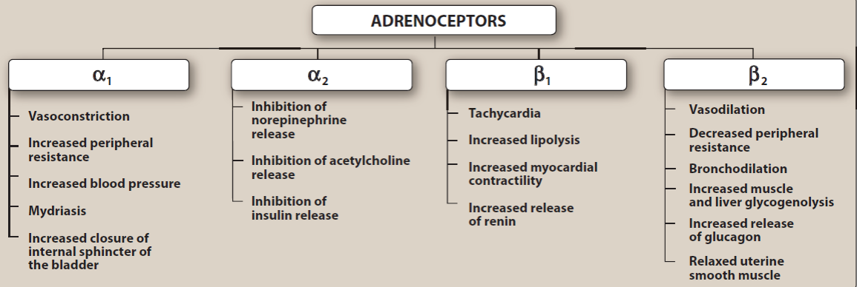

Slide 9
Desensitization of Receptors
Sequestration of Rs
Down-regulation
Inability to couple G ptn

Slide 10
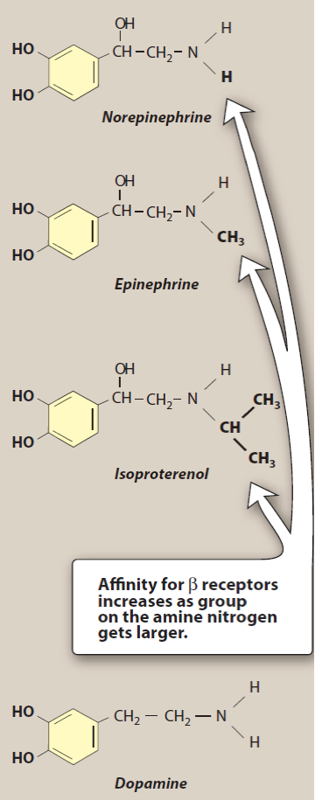
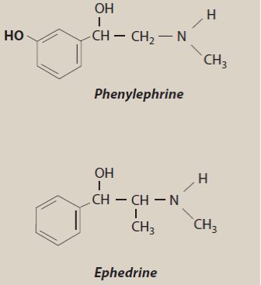
Adrenergic Agonists
A-Catecholamine
B-Non-catecholamine
C-Mixed-acting agonist

Slide 11
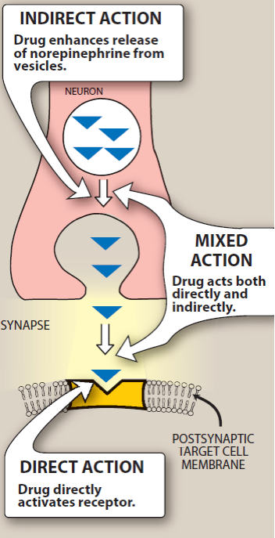

Slide 12
Epinephrine
Direct acting
Naturally occurring neurotransmitter
Adrenal medulla (80% Epi, 20% NE)
α & β
At low dose β (vasodilation)
At high doses α (vasoconstriction)

Slide 13
Epinephrine- CVS
+ve inotropic (β₁)
+ve chronotropic (β₁)
CO is increased
Oxygen demand is increased
β₁ in Kidneys---renin release---angiotensin II---???
α in arterioles in skin---???
β ₂ vessels going to liver & SkMs---???
Renal BF is decreased
Cumulative effect is increased sys BP & slight decrease in dias. BP

Slide 14
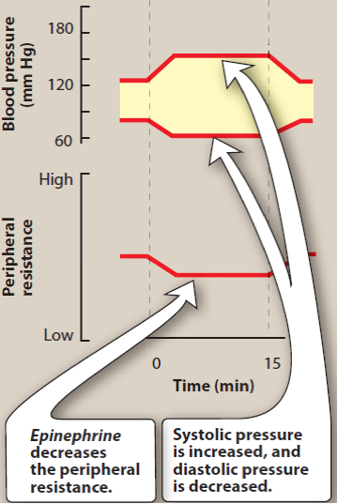
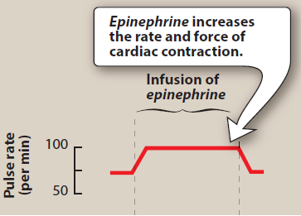

Slide 15
Epinephrine- cont.
Respiratory
Bronchodilation β ₂
Inhibit release of allergy mediators e.g. histamine from mast cells
Liver
Hyperglycemia due to increased glycogenolysis ???
Increased glucagon release ???
Decreased insulin release ???
Adipose tissues
Increased lipolysis ???
Increased cAMP --- hormone sensitive lipase ---hydrolyze TG to FFA & glycerol

Slide 16
Therapeutic Uses of Epinephrine
Bronchospasm
Drug of choice in acute asthma & anaphylactic shock
Selective β₂ agonists are preferred in chronic asthma (albuterol)
Anaphylactic shocks
Cardiac arrest
Anesthetics (1: 100 000)

Slide 17
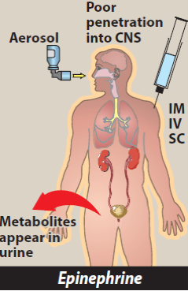
Pharmacokinetics
Rapid onset, short duration
IM, IV, SC, inhalation, endotracheal intubation
MAO, COMT---metanephrine, VMA
Adverse effects
CNS (anxiety, fear, tension, headache & tremor
Cardiac arrhythmias
Pulmonary edema
CVS / hyperthyroidismm
Inhalation / tachycardia
Increase endogenous glucoses--- diabetes
Non-selective β-blockers???

Slide 18
Norepinephrine
CVS
Increase peripheral resistance
Increase syst. & diast. BP
Weak β₂ activity
Baroreceptor reflex (chronotropic effect)
Atropine + NE ???
Therapeutic uses ----- shock
Kinetics: IV, short duration of action, metabolized by COMT & MAO, excreted in urine
Adverse effects: blanching & sloughing of skin, T necrosis (extravasation)
Antagonized by phentolamine

Slide 19
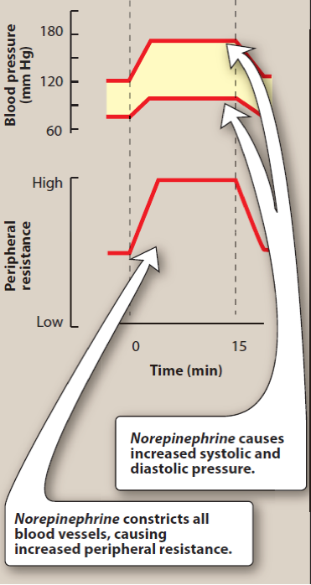
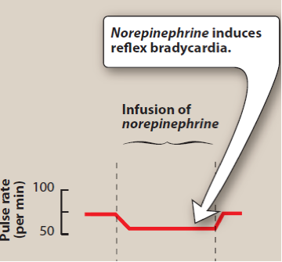

Slide 20
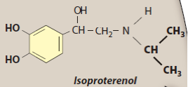
Isoproterenol
Direct acting, synthetic
Stimulates both β₁ & β₂, nonselective
Insignificant α effects
+ ve chronotropic & inotropic effect, increase HR & CO
Decrease PR ????
Syst. P increased ???
Diast. P decreased ????, Mean Arterial P???
Bronchodilator ???
Used in AV block

Slide 21
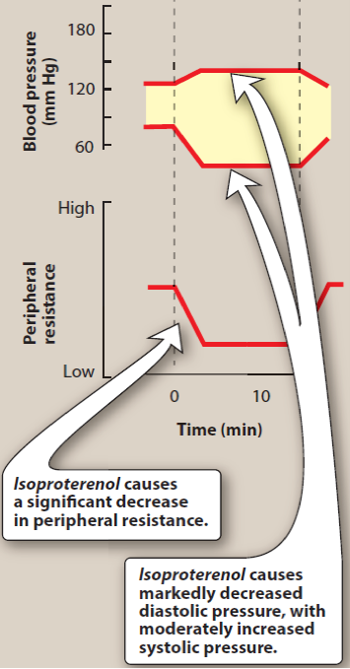
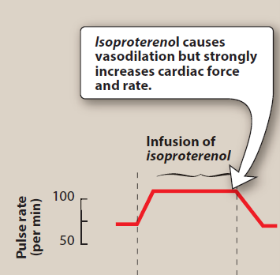

Slide 22
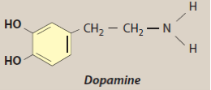
Dopamine
Metabolic precursor to NE
CNS (basal ganglia) and adrenal medulla
High dose ----vasoconstriction
Low doses ----- cardiac stimulation (+ve inotropic & chronotropic)
D₁ D₂ Rs (peripheral mesenteric & renal vascular bed)----???
Presynaptic D₂ Rs -----???

Slide 23
Dopamine, cont
Therapeutic uses: D of choice in cardiogenic & septic shock (contin. infusion) & superior to NE?????
Used for hypotension & severe HF
Adverse effects:
Sympathetic stimulation
Rapid metabolism with COMT, MAO
Nausea, hypertension & arrhythmia

Slide 24
Fenoldopam
Agonist for peripheral D₁
Used in severe hypertension (coronary arteries, kid. Arterioles, mesenteric arteries)
R isomer is active
Extensive 1st pass effect (te1/2=10min after IV infusion)
Headache, flushing, dizziness, vomiting & tachycardia

Slide 25
Dobutamine
Synthetic, direct acting catecholamine, direct β₁ effect
Increases HR & CO without effect on O₂ demand
Used with caution in atrial fibrillation ???
Tolerance may develop

Slide 26
Oxymetazoline
Direct acting, synthetic cpd
Act on α₁ & α₂
In OTC as nasal spray & ophthalmic drops
Systemic absorption, ———headache, nervousness & trouble sleeping
Rebound congestion

Slide 27
Phenylephrine
Synthetic, direct Acting, mainly α₁
Increases both syst. & diast. BP
Reflex bradycardia
Decongestant (topically or orally)
It replaced pseudoephedrine
Induces mydriasis

Slide 28
Clonidine
α₂ agonist used in hypertension
Used to reduce opiates, tobacco and & benzodiazepine withdrawal symptoms???
Centrally, presynaptic----
Side effects: lethargy, sedation, constipation & xerostomia
Avoid abrupt withdrawal????

Slide 29
Albuterol & Terbutalin
Short acting β₂ agonists
bronchodilation, / metered dose inhaler
Acute asthma-----albuterol
Terbutaline used as off labeled----uterine relaxation
Side effects: tremor, restlessness, apprehension & anxiety, (tachycardia, arrhythmia after oral admin.)
MAOIs are cntraindicated???

Slide 30
Salmeterol & formoterol
LABAs / β₂ agonist
Single dose ----- sustained bronchodilation (12 hrs)
Salmeterol, delayed onset of action
Recommended for combination therapy (+ corticosteroids, e.g.
flutecazone, budesonide)
Nocturnal asthma
LABAS showed increased risk of asthma-related deaths

Slide 31
Merabegron
β₃ agonist
Relaxes detrusor SM & increases bladder capacity
Used in overactive bladder
Increases BP
Increase level of digoxin
Inhibits CYP2D6———— D-D interaction e.g. Metoprolol

Slide 32
Indirect Acting Adrenergic Agonists
Amphetamine
Centrally acting
α₁ & β₁
Increase nonvesicular release of catecholamines
Tyramine
No therapeutic use
Oxidized by MAO
MAOIs ???
Mechanism ???

Slide 33
Indirect Acting Adrenergic Agonists, cont.
Cocaine
Unique local anesthetic
Block (Na⁺/ Cl⁻)- dependent transporter
Enhanced sympathetic activity
Prolong duration of action of Epi & NE

Slide 34
Mixed-Action Adrenergic Agonists
Ephedrine & Pseudoephedrine
Direct & indirect
Not a catecholamines, COMT & MAO ?????
Absorption, distribution & elimination
Syst. & diast. BP
Bronchodilation
CNS stimulation, FDA???
Pseudoephedrine treat nasal & sinus congestion
Pseudoephedrine & methamphetamine

