Slide 1
Infection part lll
Done by Assis. Lec.
Shaymaa Hasan Abbas

Slide 2
Antifungals

Slide 3
Triazole antifungals
Fluconazole is very well absorbed after oral administration. It also achieves good penetration into the cerebrospinal ﬂuid to treat fungal meningitis. Fluconazole is excreted largely unchanged in the urine and can be used to treat candiduria.
dose: Vaginal candidiasis ▶ BY MOUTH ▶ Child 16–17 years: 150 mg for 1 dose ▶ Adult: 150 mg for 1 dose
Vulvovaginal candidiasis (recurrent) ▶ BY MOUTH ▶ Adult: Initially 150 mg every 72 hours for 3 doses, then 150 mg once weekly for 6 months
CONTRA-INDICATIONS Acute porphyrias
SIDE-EFFECTS ▶ Abdominal discomfort, diarrhoea, ﬂatulence, nausea, rash, headache.

Slide 4
Triazole antifungals
PREGNANCY: Manufacturer advises avoid—multiple congenital abnormalities reported with long-term high doses.
BREAST FEEDING: Present in milk but amount probably too small to be harmful
DIRECTIONS FOR ADMINISTRATION ▶ With intravenous use in children. For intravenous infusion, give over 10–30 minutes; do not exceed an infusion rate of 5–10mL/minute.
tablets, 50,150 mg,200 mg, oral suspension 50 mg/5ml, Infusion 2 mg/1ml

Slide 5
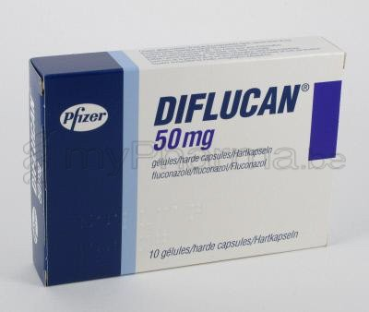
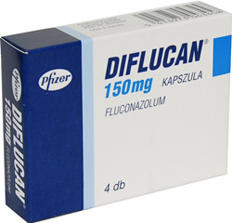
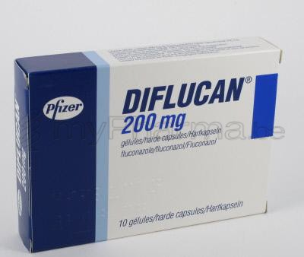

Slide 6
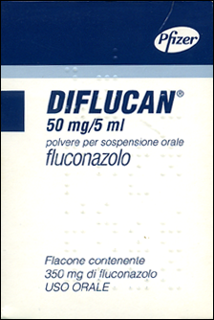
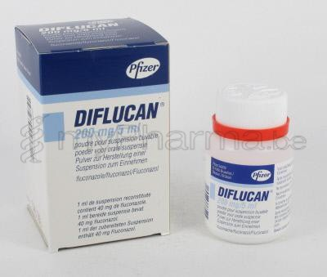

Slide 7
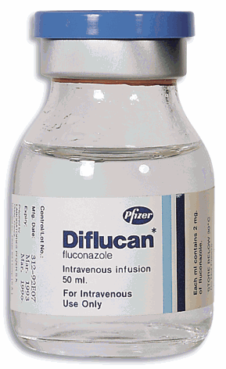
Solution for iv infusion 2mg/ml
Diflucan vial

Slide 8
Triazole antifungals (continue)
Itraconazole is active against a wide range of dermatophytes
Itraconazole capsules require an acid environment in the stomach for optimal absorption.
Itraconazole has been associated with liver damage and should be avoided or used with caution in patients with liver disease; ﬂuconazole is less frequently associated with hepatotoxicity.
Dose: Vulvovaginal candidiasis ▶ Adult: 200 mg twice daily for 1 day
Vulvovaginal candidiasis (recurrent) ▶ Adult: 50–100 mg daily for 6 months
Systemic candidiasis where other antifungal drugs inappropriate or infective
By mouth ▶ adults ▶100-200mg once daily
By IV infusion ▶ Adult ▶ 200 mg every 12 hours for 2 days, then 200mg once daily for max. 12 days
CONTRA-INDICATIONS Acute porphyrias .
SIDE-EFFECTS ▶ Abdominal pain. diarrhea. dyspnea. headache. hepatitis. hypokalemia. nausea. rash. taste disturbances. vomiting

Slide 9
Triazole antifungals
Cautions : active liver disease, history of hepatotoxicity with other drugs, susceptibility to CHF
Conception and contraception: ensure effective contraception during treatment and until the next menstrual period following end of treatment
PREGNANCY: Manufacturer advises use only in life threatening situations (toxicity at high doses in animal studies).
BREAST FEEDING: Small amounts present in milk—may accumulate; manufacturer advises avoid
MONITORING REQUIREMENTS
Monitor liver function if treatment continues for longer than one month, if receiving other hepatotoxic drugs, or in hepatic impairment.
Patients should be told how to recognize signs of liver disorder and advised to seek prompt medical attention if symptoms such as anorexia, nausea, vomiting, fatigue, abdominal pain or dark urine develop.

Slide 10
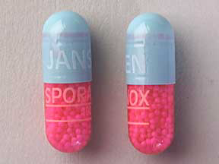
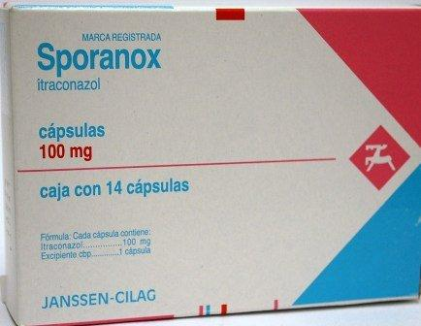

Slide 11
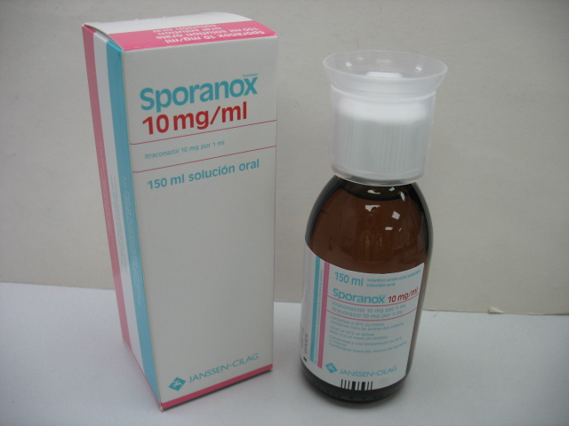

Slide 12
Triazole antifungals
Posaconazole : is licensed for the treatment of invasive fungal infections unresponsive to conventional treatment.
Voriconazole: is a broad-spectrum antifungal drug which is licensed for use in life-threatening infections such as Invasive aspergillosis

Slide 13
Imidazole antifungals
Clotrimazole, Econazole nitrate, Ketoconazole, Miconazole and Tioconazole .
They are used for the local treatment of vaginal candidiasis and for dermatophyte infections.
Miconazole can be used locally for oral infections and intestinal infections.
Systemic absorption may follow use of miconazole oral gel and may result in signiﬁcant drug interactions.

Slide 14
Polyene antifungals
Amphotericin and Nystatin neither drug is absorbed when given by mouth.
Amphotericin by intravenous infusion is used for the treatment of systemic fungal infections and is active against most fungi and yeasts
amphotericin is toxic when given parenterally and side-effects are common.

Slide 15
Polyene antifungals
Lipid formulations of amphotericin (Abelcet®) are signiﬁcantly less toxic and are recommended when the conventional formulation of amphotericin is contra-indicated because of toxicity, especially nephrotoxicity or when response to conventional amphotericin is inadequate
lipid formulations are more expensive.
S E. GIT disorder ,blood disorder. Abnormal liver function ,disturbance in kidney function, electrolyte disturbance, BP change
PREGNANCY Not known to be harmful but manufacturers advise avoid unless potential beneﬁt outweighs risk.
BREASTFEEDING No information available.
Nystatin is used for oral, oropharyngeal, and perioral infections by local application in the mouth.
Nystatin is also used for Candida albicans infection of the skin.

Slide 16
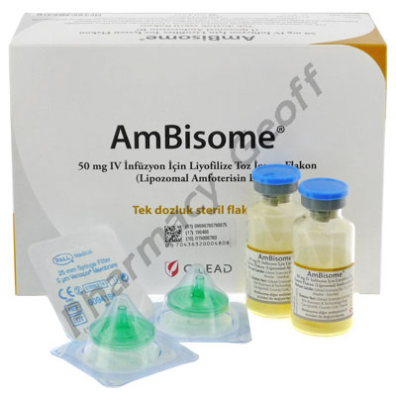
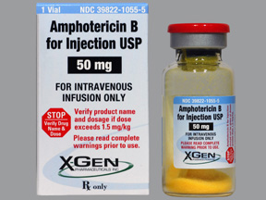

Slide 17
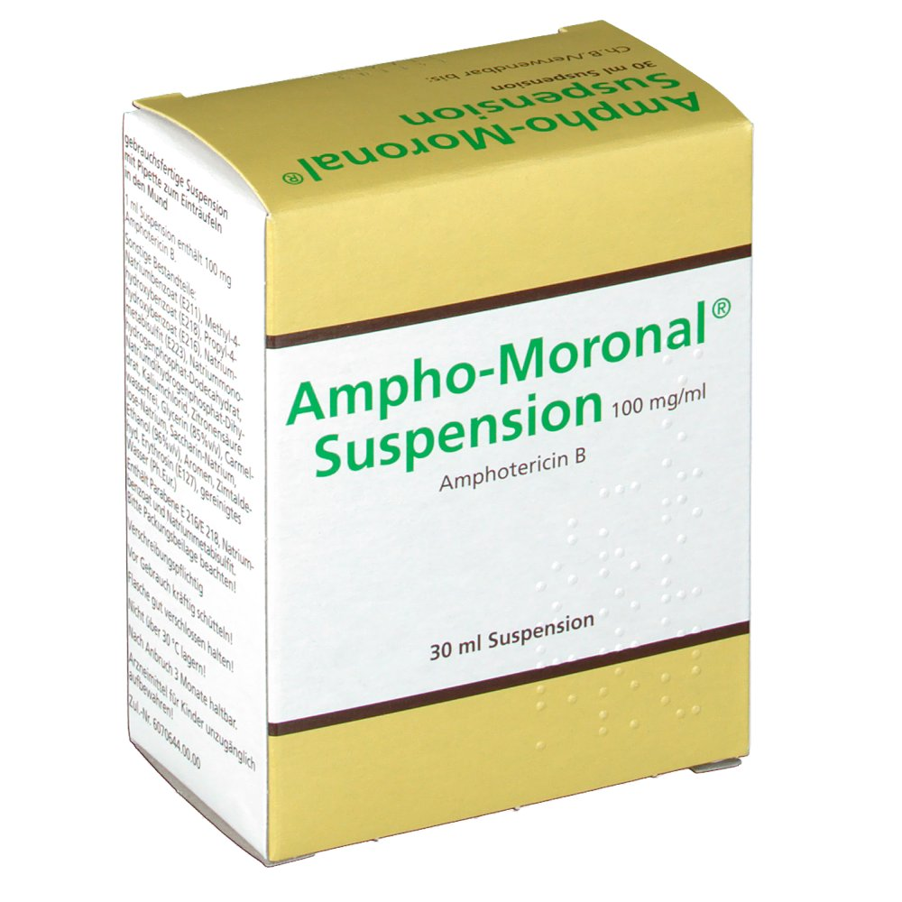
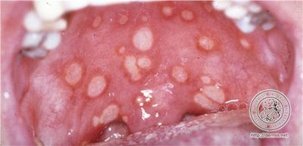
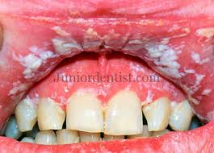

Slide 18
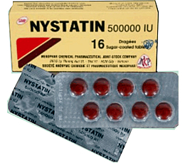
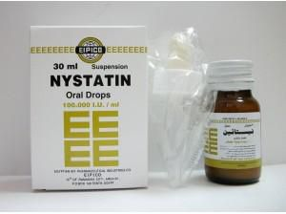

Slide 19
Echinocandin antifungal
Caspofungin: is active against Aspergillus spp. and Candida spp.
Echinocandins are not effective against fungal infections of the CNS.
Dose, BY INTRAVENOUS INFUSION ▶ Adult : 70 mg once daily for 1 day, then 50 mg once daily
DIRECTIONS FOR ADMINISTRATION
For intravenous infusion (Mycamine®), give intermittently in Glucose 5% or Sodium chloride 0.9%. Reconstitute each vial with 5mL infusion ﬂuid; gently rotate vial, without shaking, to dissolve; dilute requisite dose with infusion ﬂuid to 100mL (ﬁnal concentration of 0.5–2mg/mL); protect infusion from light; give over 60 minutes.

Slide 20
Other antifungals
Griseofulvin below is effective for widespread or intractable dermatophyte infections but has been superseded by newer antifungals, particularly for nail infections.
C I. acute porphyrias and SLE
It is the drug of choice for trichophyton infections in children.
Effective contraception required during and for at least 1 month after administration to women (important: effectiveness of oral contraceptives may be reduced, additional contraceptive precautions e.g. barrier method, required).
Men should avoid fathering a child during and for at least 6 months after administration
PREGNANCY Avoid (fetotoxicity and teratogenicity in animals).
BREASTFEEDING Avoid—no information available

Slide 21
Tinea faciei caused by Trichophyton

Slide 22
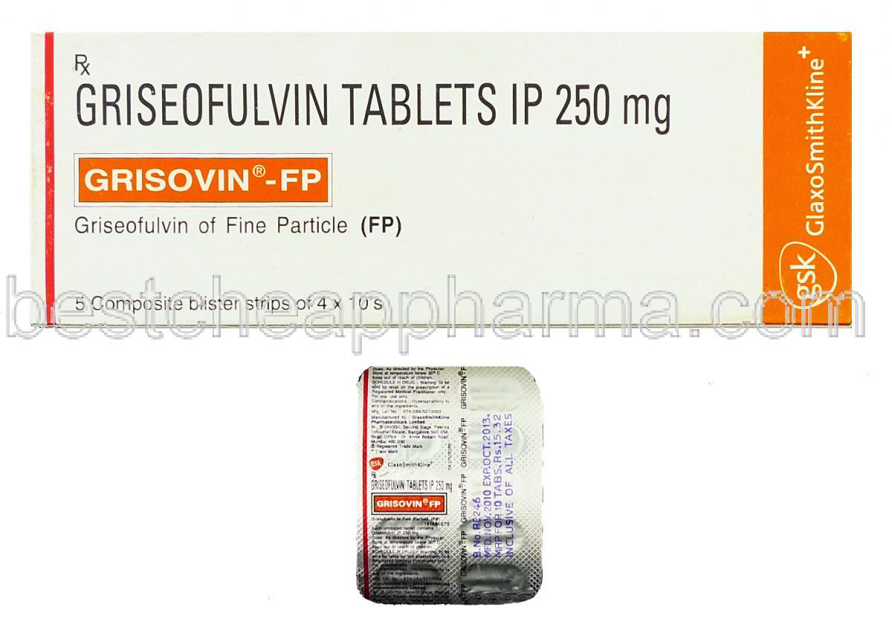

Slide 23
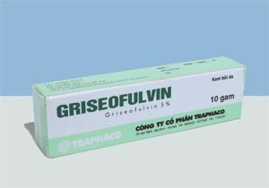

Slide 24
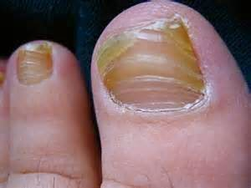
Other antifungals
Terbinaﬁne is the drug of choice for fungal nail infections and is also used for ringworm infections where oral treatment is considered appropriate.
Flucytosine has a role in the treatment of systemic candidiasis and cryptococcal meningitis.
Resistance to ﬂucytosine can develop during therapy and sensitivity testing is essential before and during treatment.

Slide 25
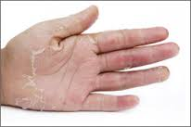

Slide 26
Antiprotozoal infection

Slide 27
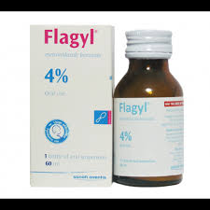
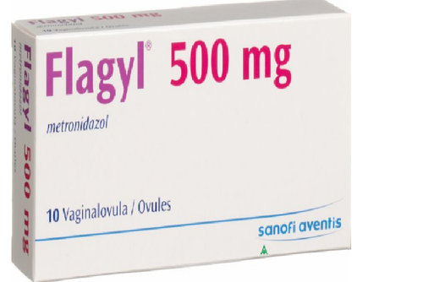
Metronidazole

Slide 28
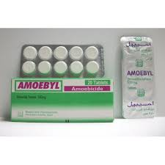
Diloxanide furoate

Slide 29
Anthelmintic drugs
Drugs for threadworms
Mebendazole is the drug of choice for treating threadworm infection in patients of all ages over 6 months.
Child 6 months–17 years and adults: 100 mg for 1 dose, if reinfection occurs, second dose may be needed after 2 weeks
SIDE-EFFECTS ▶ Common or very common Abdominal pain
PREGNANCY Manufacturer advises avoid—toxicity in animal studies.
BREAST FEEDING Amount present in milk too small to be harmful but manufacturer advises avoid.
tablet 100 mg, Chewable tablet 100mg, oral suspention 100/5 mg

Slide 30
Ascaricides (common roundworm infections)
Mebendazole is effective against Ascaris lumbricoides and is generally considered to be the drug of choice.
Child 1 year: 100 mg twice daily for 3 days ▶ Child 2–17 years: 100 mg twice daily for 3 days, alternatively 500 mg for 1 dose ▶ Adult: 100 mg twice daily for 3 days, alternatively 500 mg for 1 dose
Levamisole is an alternative when mebendazole cannot be used. It is very well tolerated.
BY MOUTH ▶ Adult: 120–150 mg for 1 dose
PREGNANCYE Embryotoxic in animal studies, avoid if possible.
BREAST FEEDING No information available.
Tablet 50mg

Slide 31
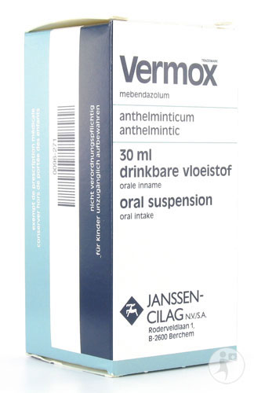
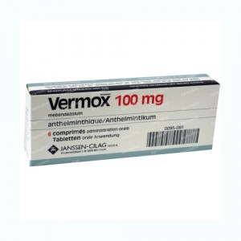

Slide 32
Drugs for tapeworm infections
Niclosamide is the most widely used drug for tapeworm infections
sideeffects are limited to occasional gastro-intestinal upset, lightheadedness, and pruritus; it is not effective against larval worms.
an antiemetic can be given before treatment and a laxative can be given 2 hours after niclosamide.
Praziquantel is as effective as niclosamide.

Slide 33
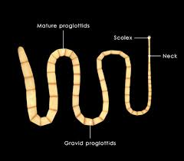

Slide 34
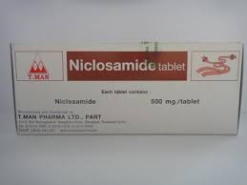

Slide 35
Hydatid disease
Surgical treatment remains the method of choice in many situations. Albendazole below is used in conjunction with surgery to reduce the risk of recurrence or as primary treatment in inoperable cases. Alveolar echinococcosis due to E. multilocularis is usually fatal if untreated. Surgical removal with albendazole cover is the treatment of choice, but where effective surgery is impossible, repeated cycles of albendazole (for a year or more) may help.
Careful monitoring of liver function is particularly important during drug treatment.

Slide 36
Drugs for hookworms
Hookworms (ancylostomiasis, necatoriasis) live in the upper small intestine and draw blood from the point of their attachment to their host. An iron-deﬁciency anaemia may occur and, if present, effective treatment of the infection requires not only expulsion of the worms but treatment of the anaemia.
Mebendazole has a useful broad-spectrum activity, and is effective against hookworms.
Child 1–17 years: 100 mg twice daily for 3 days ▶ Adult: 100 mg twice daily for 3 days
Albendazole is an alternative.
dose ▶ Adult: 400 mg for 1 day
Levamisole is also effective in children.

Slide 37
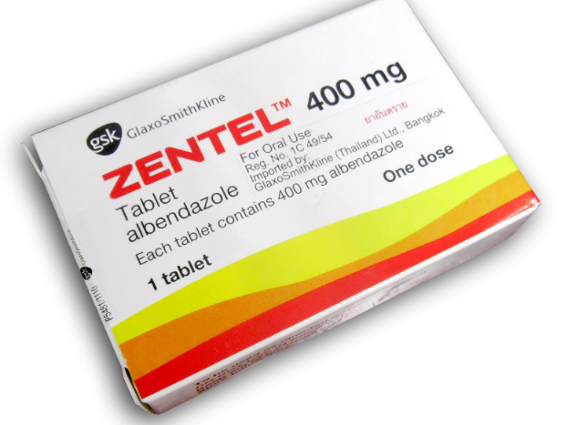
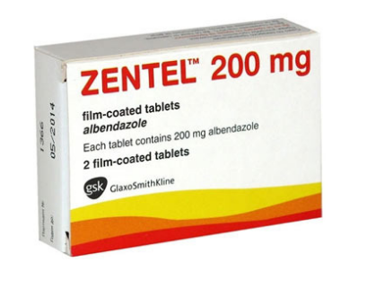
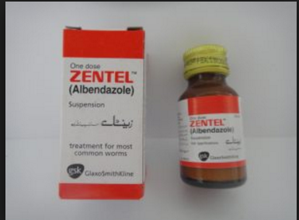

Slide 38
Schistosomicides (bilharziasis)
Praziquantel is effective against all human schistosomes.
No serious adverse effects have been reported. Of all the available schistosomicides, it has the most attractive combination of effectiveness, broad-spectrum activity, and low toxicity.

Slide 39
Drugs for strongyloidiasis
Ivermectin is the treatment of choice for chronic Strongyloides infection in adults and children over 5 years.
Adult: 200 micrograms/kg daily for 2 days
S.E. Aggravation of itching. aggravation of rash
Ivermectin 3 mg, 6mg tablets
Albendazole is an alternative given to adults and children over 2 years.
Adult: 400 mg twice daily for 3 days, dose may be repeated after 3 weeks if necessary

Slide 40
