Slide 1
Blood Phosphorus
Presented By
Assist.Lecturer Aseel Ghassan Daoud
M.Sc. In pharmacy/ Clinical laboratory sciences

Slide 2
What is phosphorus?
It is a mineral that combines with other substances to form organic and inorganic phosphate compounds.
What are functions of phosphates?
Energy production
Muscle and nerve function
Bone growth
Buffer that maintains acid-base balance

Slide 3
What are phosphorus rich foods?

Slide 4
How can the body regulate blood phosphate level ?
How much it absorbs from the intestines
How much it excretes via kidneys
It is also affected by parathyroid hormone (PTH), calcium and vitamin D.

Slide 5
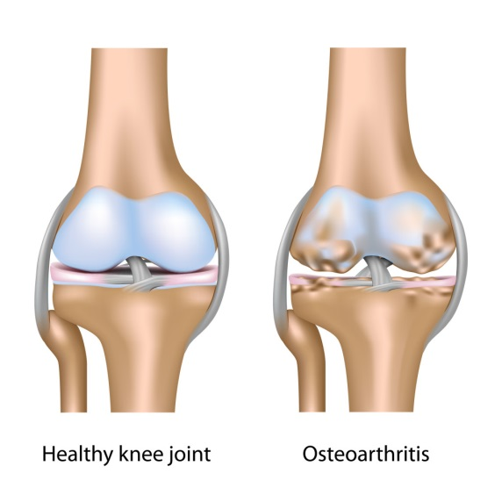
What are symptoms of low phosphate levels?

Slide 6
Causes of hypophosphatemia:
Hypercalcaemia and high level of PTH
Overuse of diuretics
Malnutrition
Diabetic ketoacidosis
Hypothyroidism
Hypokalemia
Rickets due to vit. D deficiency
Sever burns
Alcoholism
Chronic antacid use

Slide 7
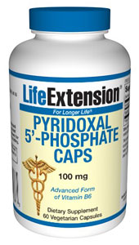
Causes of hyperphosphatemia:
Kidney failure
Hypoparathyroidism
Hypocalcaemia
Diabetic ketoacidosis (first seen)
Phosphate supplementation

Slide 8
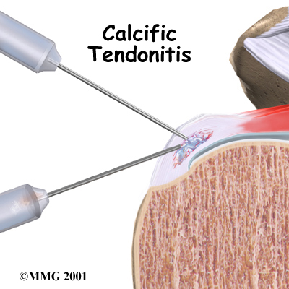
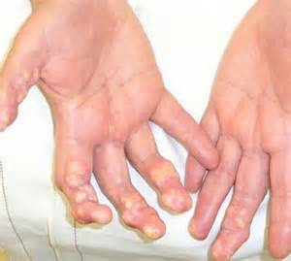
High phosphorus level can lead to organ damage, why?
due to calcification, deposits of calcium phosphate in tissues.

Slide 9
Reference level:
12-60 years : 2.7-4.5 mg/dl
Why are phosphate levels in children higher than in adults?

