Slide 1
part I

Slide 2
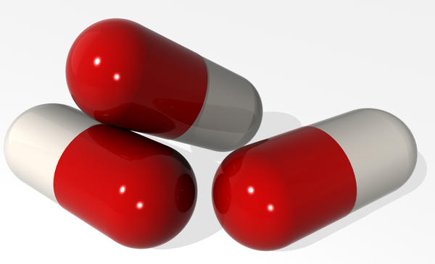
PENICILLINS

Slide 3
Penicillins
DRUG ACTION: The penicillins are bactericidal and act by interfering with bacterial cell wall synthesis. They diffuse well into body tissues and fluids, but penetration into the cerebrospinal fluid is poor except when the meninges are inflamed. They are excreted in the urine in therapeutic concentrations.
SIDE-EFFECTS Common or very common: Anaphylaxis . angioedema . diarrhoea . fever . hypersensitivity reactions . joint pains . rashes . serum sickness-like reaction . urticaria .
SIDE-EFFECTS Frequency not known: Antibiotic-associated colitis .

Slide 4
Penicillins
Diarrhoea frequently occurs during oral penicillin therapy. It is most common with broad spectrum penicillins, which can also cause antibiotic associated colitis.
CNS toxicity: A rare but serious toxic effect of the penicillins is encephalopathy due to cerebral irritation. This may result from excessively high doses or in patients with severe renal failure. The penicillins should not be given by intrathecal injection because they can cause encephalopathy which may be fatal.
CAUTIONS: History of allergy .

Slide 5
Allergy & Cross-Sensitivity
The most important side-effect of the penicillins is hypersensitivity which causes rashes and anaphylaxis and can be fatal.
Allergic reactions to penicillins occur in 1–10% of exposed individuals; anaphylactic reactions occur in fewer than 0.05% of treated patients.
Patients with a history of atopic allergy (e.g. asthma, eczema, hay fever) are at a higher risk of anaphylactic reactions to penicillins.

Slide 6
Allergy & Cross-Sensitivity
Patients who are allergic to one penicillin will be allergic to all because the hypersensitivity is related to the basic penicillin structure.
Patients with a history of immediate hypersensitivity to penicillins may also react to the cephalosporins and other beta-lactam antibiotics, they should not receive these antibiotics.
If a penicillin (or another beta-lactam antibiotic) is essential in an individual with immediate hypersensitivity to penicillin then specialist advice should be sought on hypersensitivity testing or using a beta-lactam antibiotic with a different structure to the penicillin that caused the hypersensitivity.

Slide 7
Broad-spectrum penicillins
Ampicillin is active against certain Gram-positive and Gram-negative organisms but is inactivated by penicillinases including those produced by Staphylococcus aureus and by common Gram-negative bacilli such as Escherichia coli. Almost all staphylococci, approx. 60% of E. coli strains and approx. 20% of Haemophilus influenzae strains are now resistant.
The likelihood of resistance should therefore be considered before using ampicillin for the ‘blind’ treatment of infections; in particular, it should not be used for hospital patients without checking sensitivity.

Slide 8
Broad-spectrum penicillins
Ampicillin is well excreted in the bile and urine. It is principally indicated for the treatment of exacerbations of chronic bronchitis and middle ear infections, both of which may be due to Streptococcus pneumoniae and H. influenzae, and for urinary-tract infections.
Ampicillin can be given by mouth but less than half the dose is absorbed, and absorption is further decreased by the presence of food in the gut.

Slide 9
Broad-spectrum penicillins
Maculopapular rashes commonly occur with ampicillin (and amoxicillin) but are not usually related to true penicillin allergy. They almost always occur in patients with glandular fever; broad-spectrum penicillins should not therefore be used for ‘blind’ treatment of a sore throat.
The risk of rash is also increased in patients with acute or chronic lymphocytic leukemia or in cytomegalovirus infection.
Amoxicillin is a derivative of ampicillin and has a similar antibacterial spectrum. It is better absorbed than ampicillin when given by mouth, producing higher plasma and tissue concentrations; unlike ampicillin, absorption is not affected by the presence of food in the stomach (500 mg every 8 hours, increased if necessary to 1 g every 8 hours; maximum 12 g).

Slide 10
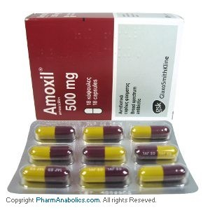

Slide 11
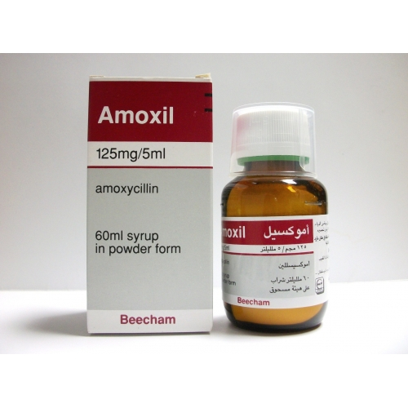
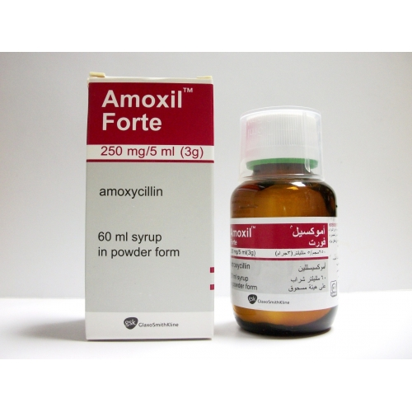

Slide 12
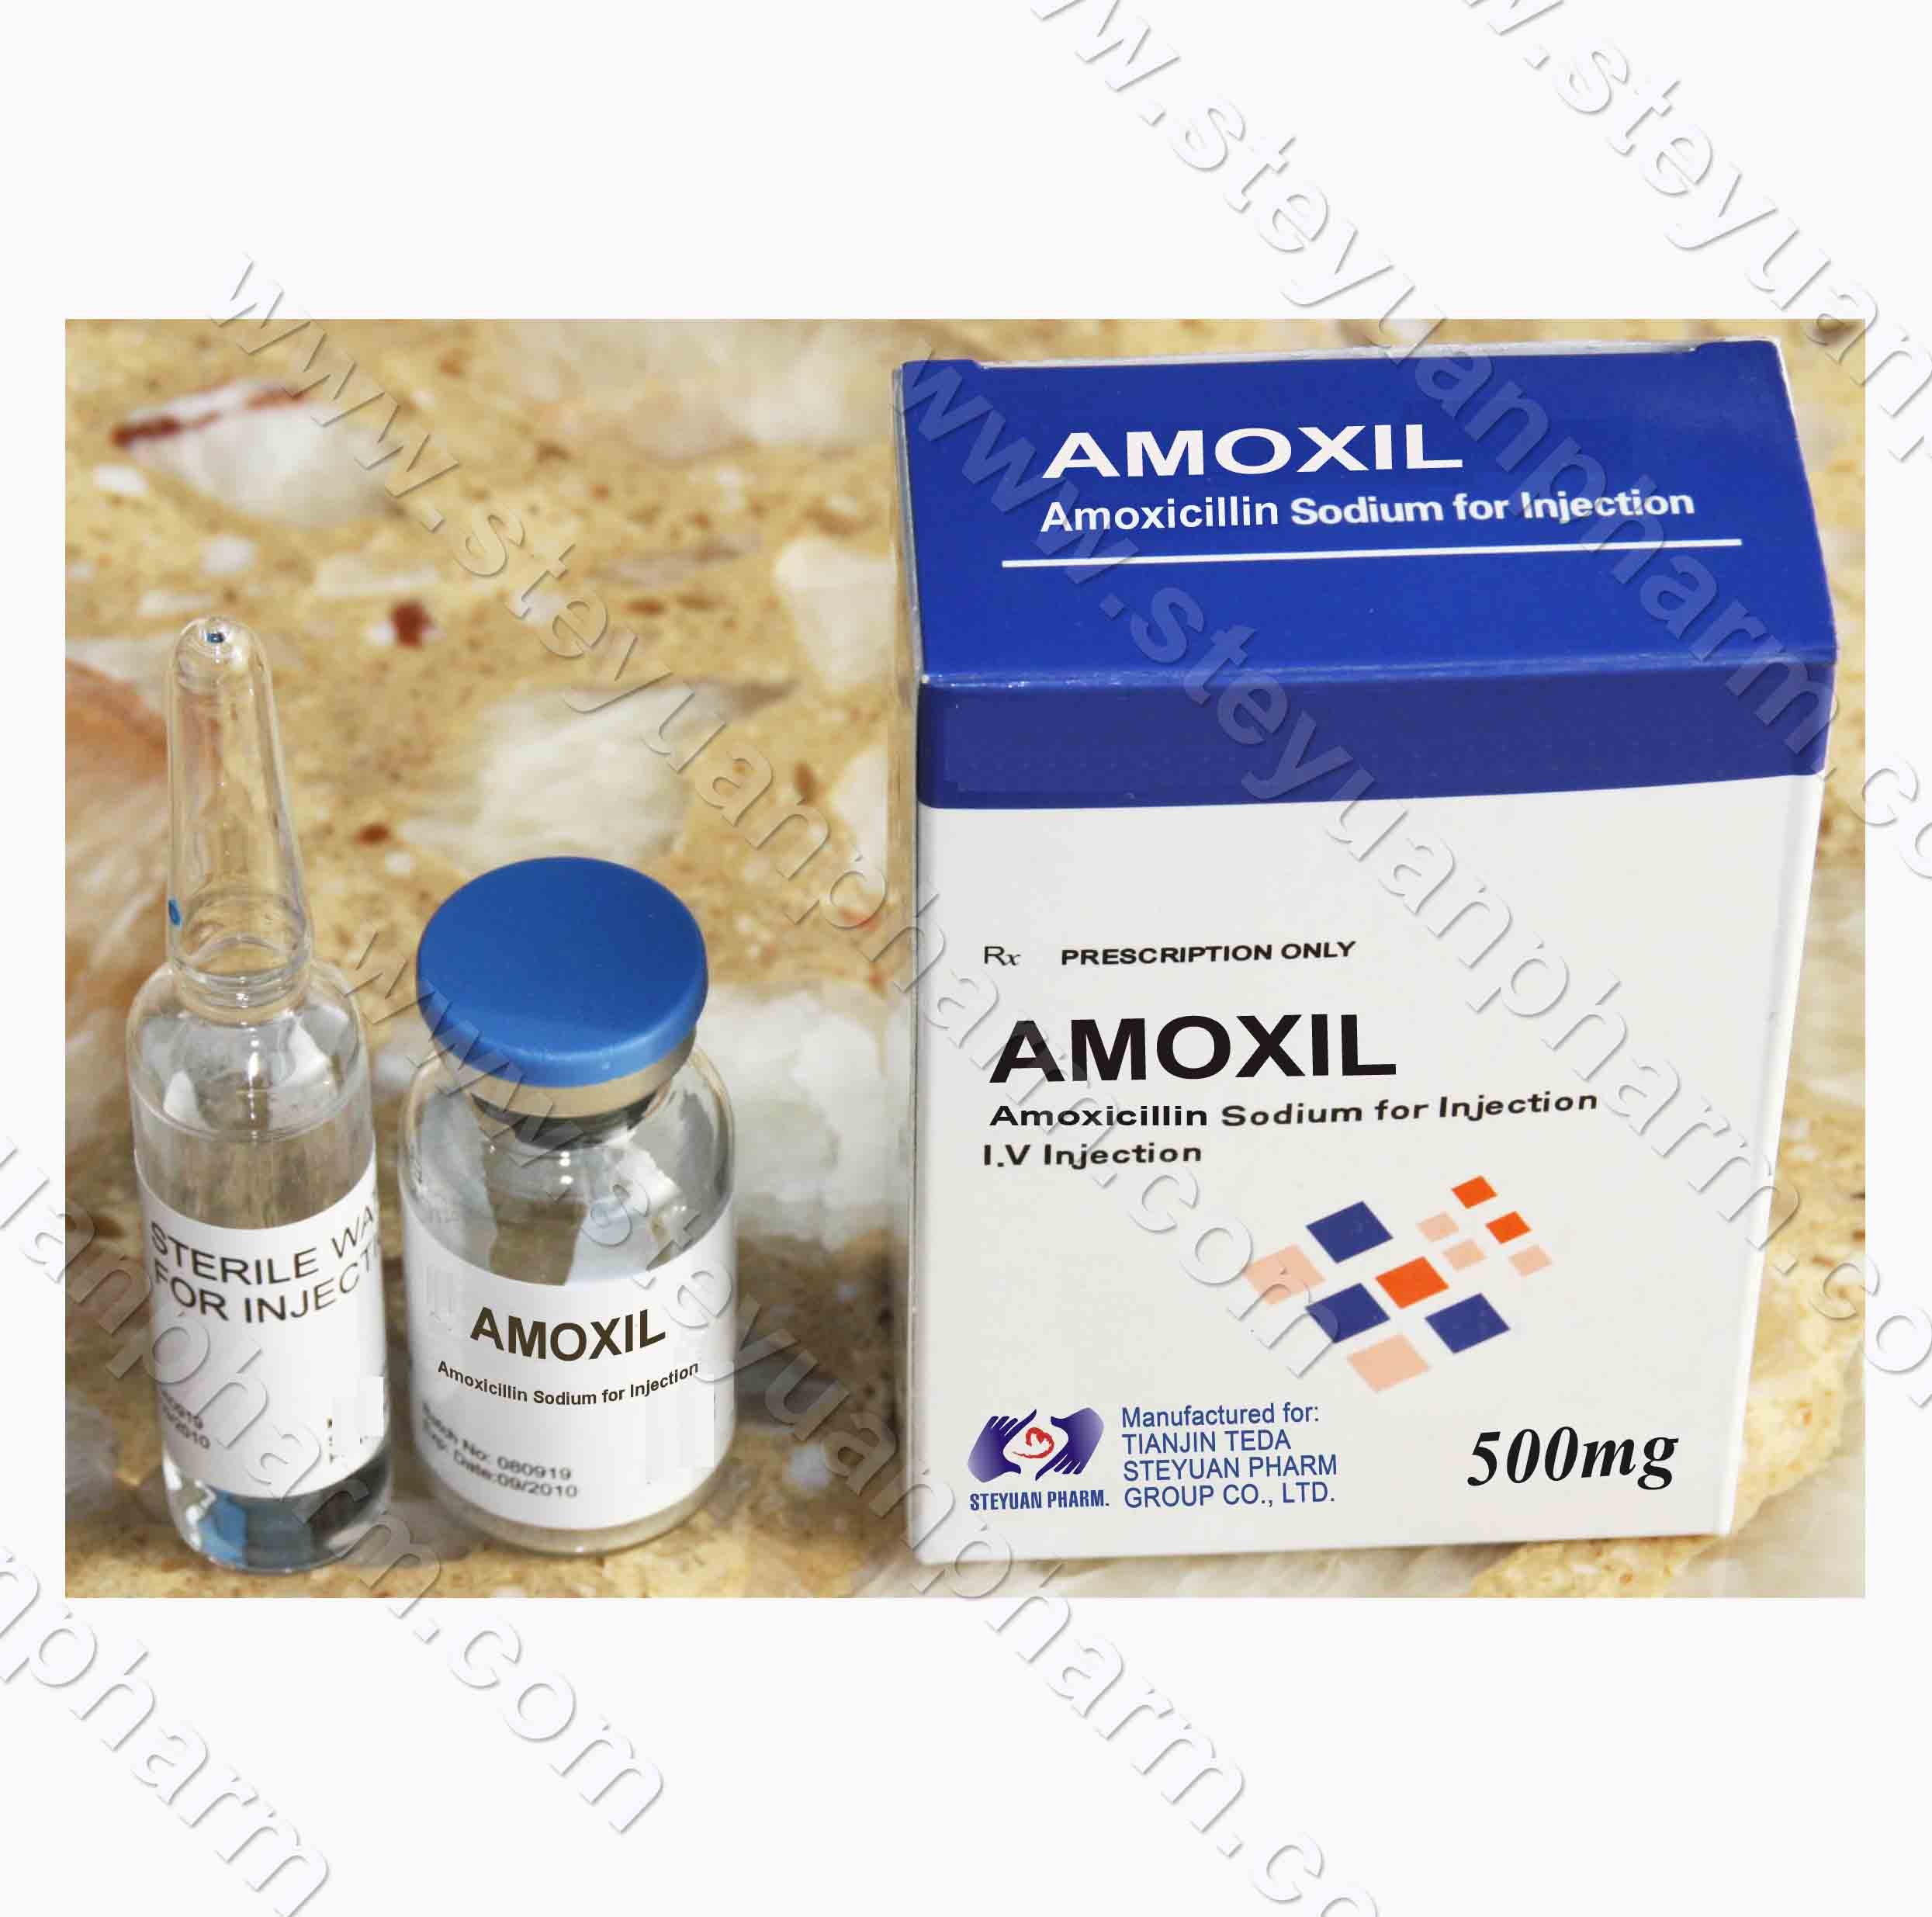

Slide 13
Broad-spectrum penicillins
Co-amoxiclav consists of amoxicillin with the beta-lactamase inhibitor clavulanic acid. Clavulanic acid itself has no significant antibacterial activity but, by inactivating beta-lactamases, it makes the combination active against beta-lactamase-producing bacteria that are resistant to amoxicillin. These include resistant strains of Staph. aureus, E. coli, and H. influenzae, as well as many Bacteroides and Klebsiella spp.
Co-amoxiclav should be reserved for infections likely, or known, to be caused by amoxicillin-resistant beta-lactamase-producing strains.

Slide 14
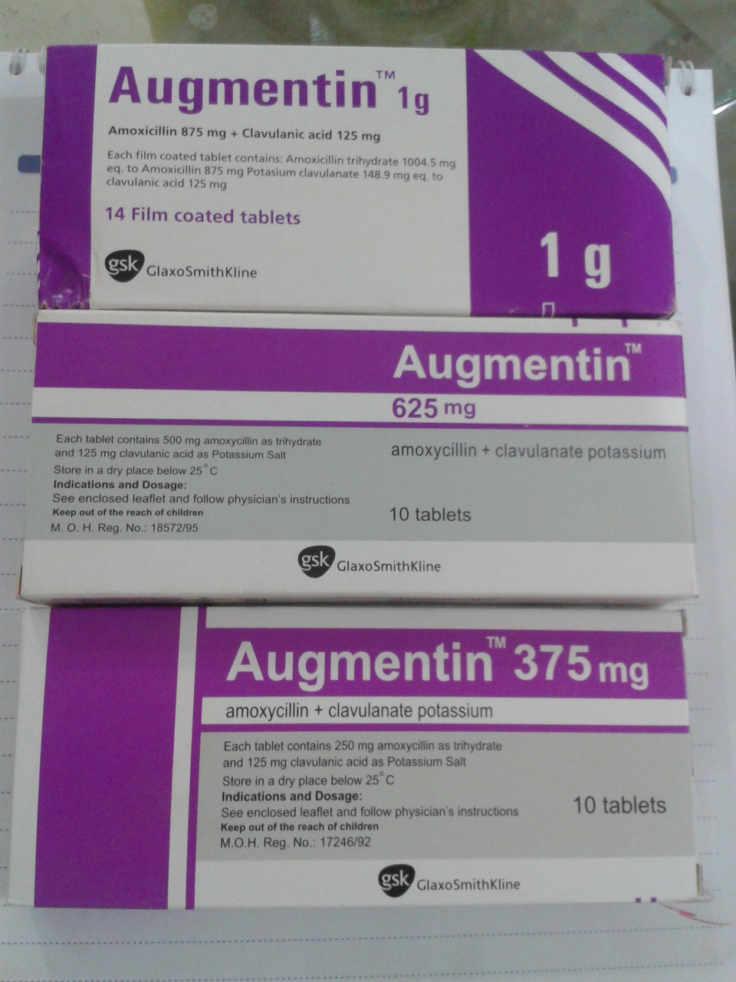

Slide 15
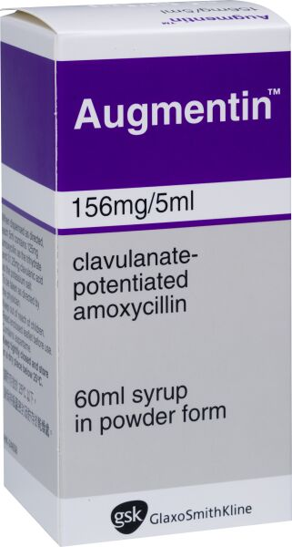
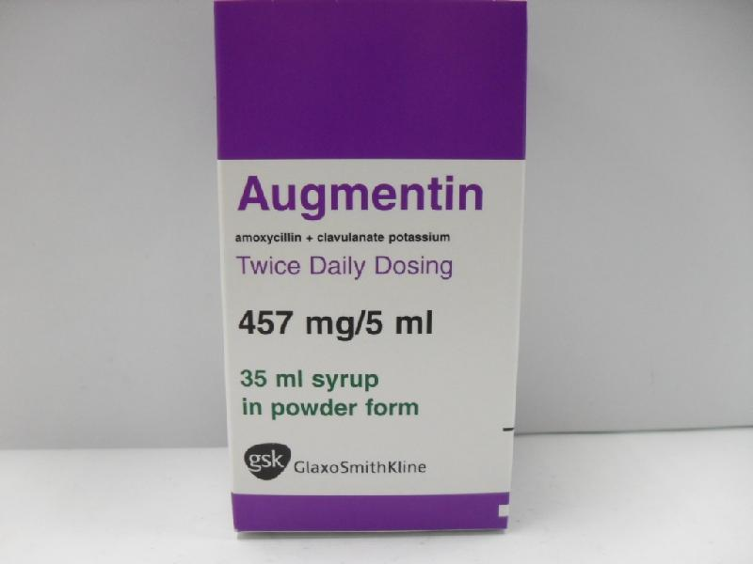

Slide 16
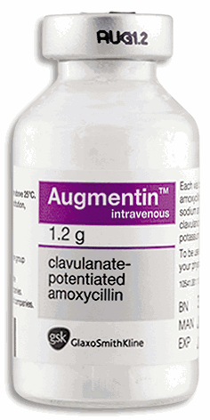

Slide 17
Penicillinase-resistant penicillins
Most staphylococci are now resistant to benzylpenicillin because they produce penicillinases.
Flucloxacillin, however, is not inactivated by these enzymes and is thus effective in infections caused by penicillin-resistant staphylococci, which is the sole indication for its use (250–500 mg 4 times a day; maximum 8 g).
Flucloxacillin is acid-stable and can, therefore, be given by mouth as well as by injection. Flucloxacillin is well absorbed from the gut.
Temocillin is active against Gram-negative bacteria and is stable against a wide range of beta-lactamases. It should be reserved for the treatment of infections caused by beta-lactamase-producing strains of Gram-negative bacteria, including those resistant to third-generation cephalosporins.

Slide 18
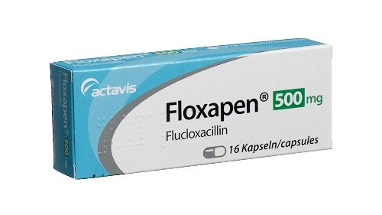
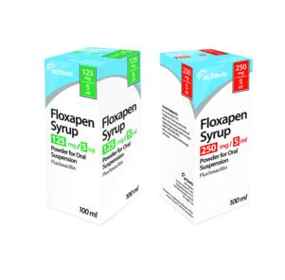
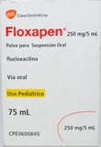

Slide 19
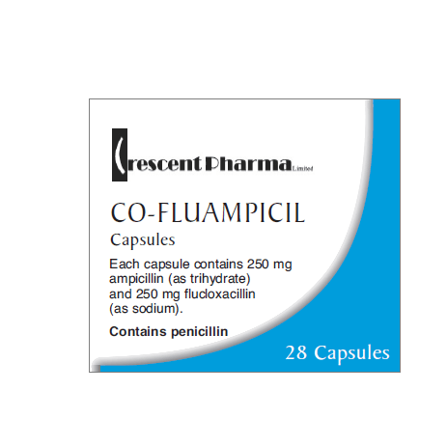
A combination of ampicillin with flucloxacillin (as co-fluampicil) is available to treat infections involving either streptococci or staphylococci (e.g. cellulitis).

Slide 20
Antipseudomonal penicillins
Piperacillin, a ureidopenicillin, is only available in combination with the beta-lactamase inhibitor tazobactam (ratio of 8:1).
Has a broad spectrum of activity against a range of Gram-positive and Gram-negative bacteria, and anaerobes.
Piperacillin with tazobactam has activity against a wider range of Gram-negative organisms than ticarcillin with clavulanic acid and it is more active against Pseudomonas aeruginosa.

Slide 21
Antipseudomonal penicillins
They are used in the treatment of septicemia, hospital-acquired pneumonia, and complicated infections involving the urinary tract, skin and soft tissues, or intra-abdomen (piperacillin with tazobactam 4.5 g every 8 hours).
For severe pseudomonas infections these antipseudomonal penicillins can be given with an aminoglycoside (e.g. gentamicin) since they have a synergistic effect.
CAUTIONS: High doses may lead to hypernatremia (owing to sodium content of preparations).
EFFECT ON LABORATORY TESTS: False-positive urinary glucose (if tested for reducing substances).

Slide 22
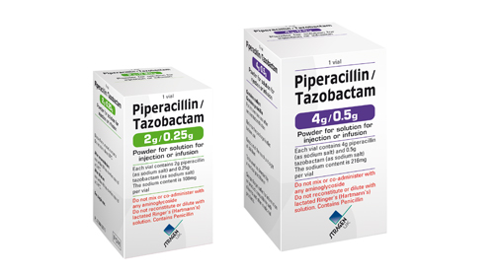

Slide 23
Carbapenems
Meropenem (0.5–1 g every 8 hours) and ertapenem are stable to the renal enzyme which inactivates imipenem and therefore can be given without cilastatin.
Side-effects
Meropenem has less seizure-inducing potential and can be used to treat central nervous system infection.

Slide 24
Meropenem
SIDE-EFFECTS Common or very common: Abdominal pain . diarrhoea . disturbances in liver function tests . headache . nausea . pruritus . rash . Thrombocythemia (overproduction of platelets) . Vomiting .
ALLERGY AND CROSS-SENSITIVITY: Avoid if history of immediate hypersensitivity reaction to beta-lactam antibacterials. Use with caution in patients with sensitivity to beta-lactam antibacterials.
EFFECT ON LABORATORY TESTS: Positive Coombs’ test.
DIRECTIONS FOR ADMINISTRATION: Intravenous injection to be administered over 5 minutes. For intravenous infusion (Meronem®), give intermittently in Glucose 5% or Sodium chloride 0.9%. Dilute dose in infusion fluid to a final concentration of 1–20 mg/mL; give over 15–30 minutes.

Slide 25
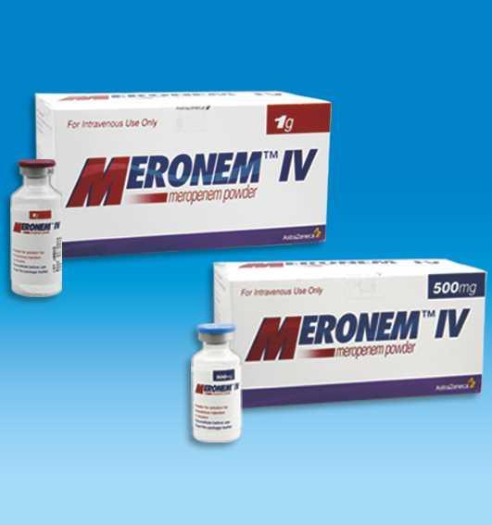
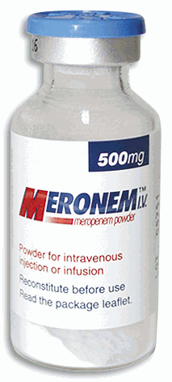

Slide 26
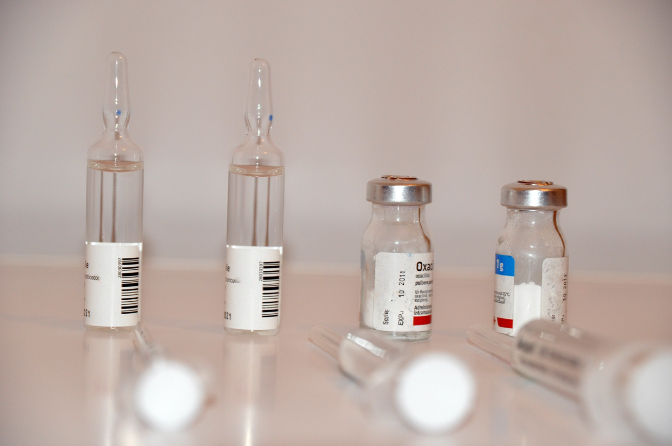
Cephalosporines

Slide 27
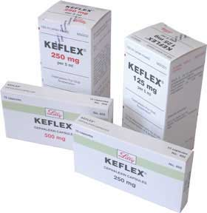

Slide 28
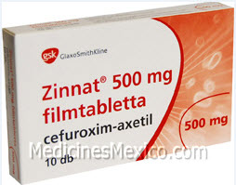

Slide 29
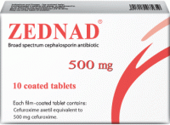

Slide 30
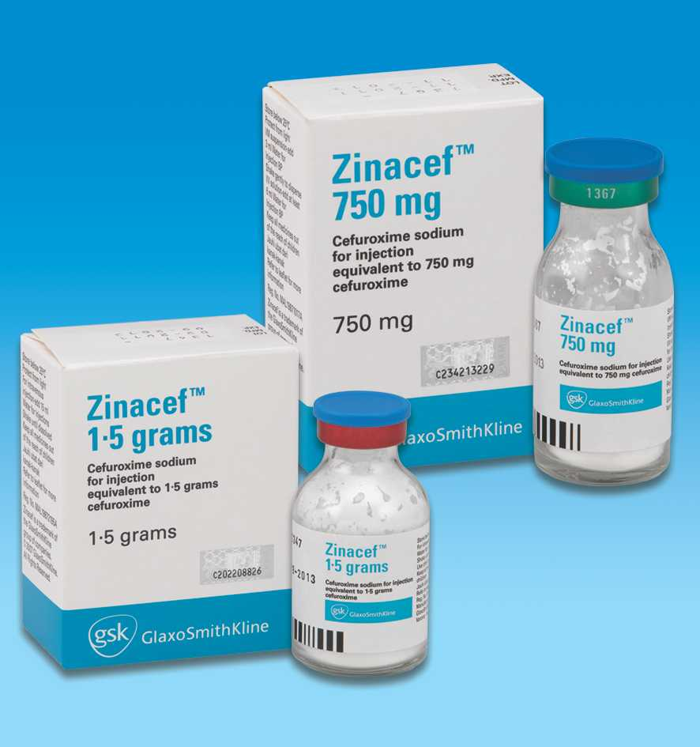
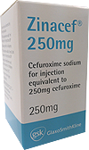

Slide 31
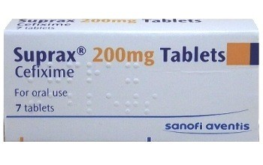
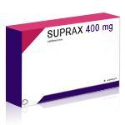
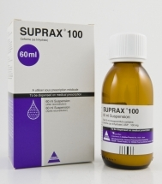
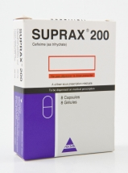

Slide 32
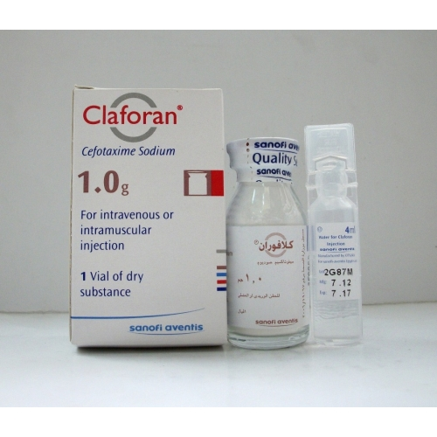
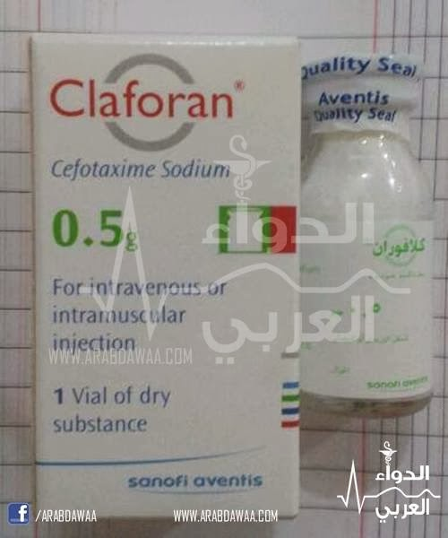

Slide 33
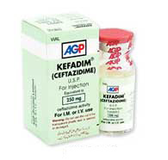
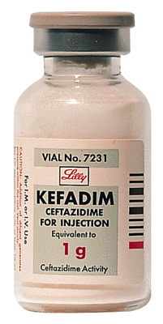
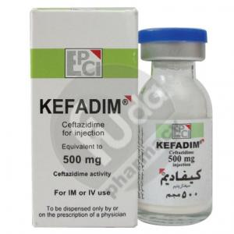

Slide 34
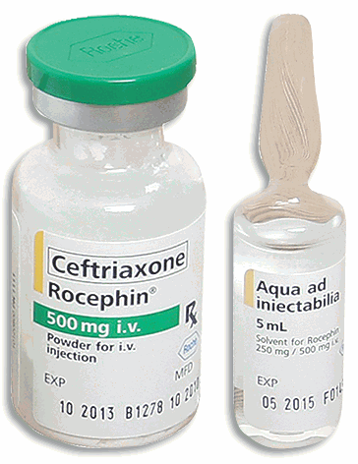
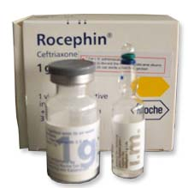
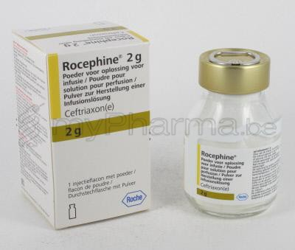

Slide 35
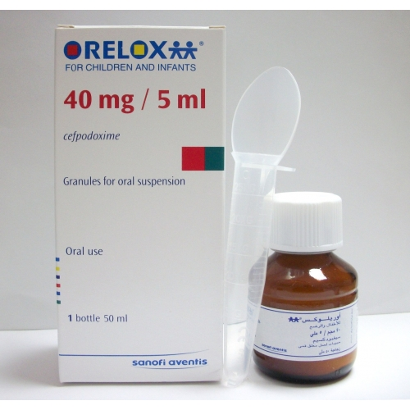
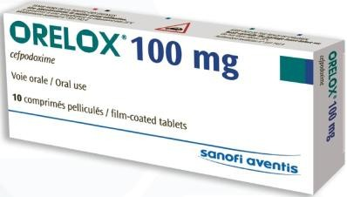

Slide 36
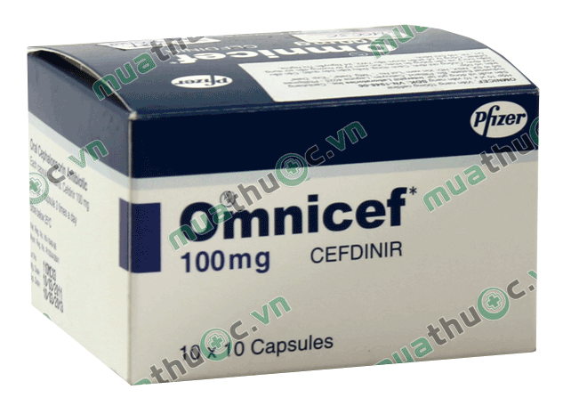

Slide 37
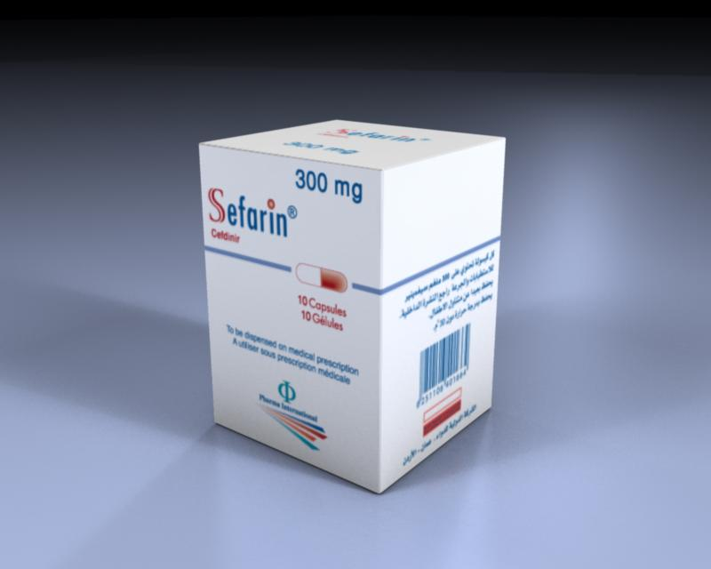

Slide 39
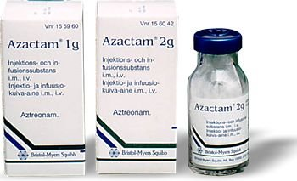

Slide 40
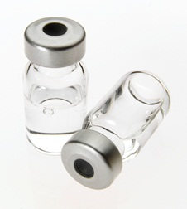
Aminoglycoside

Slide 41
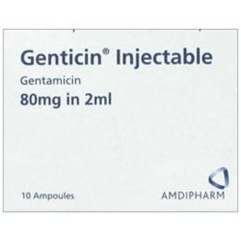
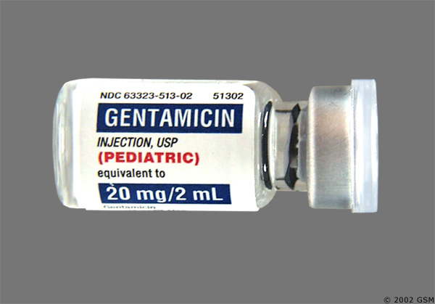

Slide 42
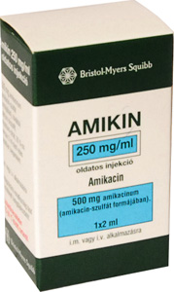
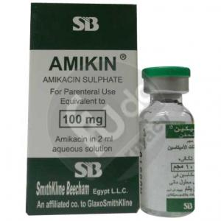

Slide 43
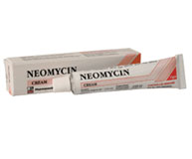
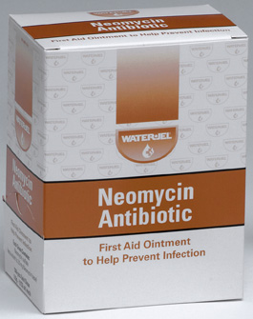
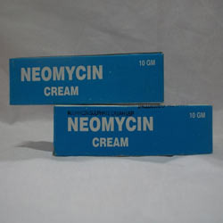

Slide 44
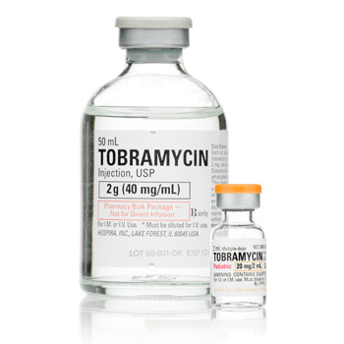

Slide 45
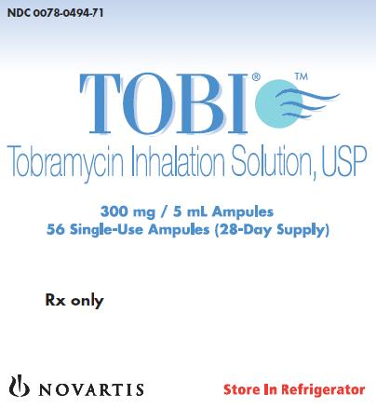

Slide 47
