Slide 1
Dilutions and concentrations
Lab 7

Slide 2
Dilution and Concentration
Dilution means when a given solution of a mixture of high concentration is diluted by addition of the suitable diluents or admixture with solution of lower concentration.
While concentration means when a given solution of a mixture of low concentration are concentrated either by addition of active ingredient or by admixture with higher strength solution or by evaporation of the diluents.
We have different types of dilution either of liquids or solids.

Slide 3
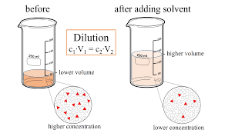

Slide 4
Dilution Law
C₁ V₁ = C₂ V₂
The concentration is expressed either by normality, molarity or percent (%).
Normality is an expression of the concentration of the solution in terms of equivalent per liter of solution (number if gram eq.wt per 1000ml).
Morality is the concentration of the solution in terms of moles per liter.

Slide 5
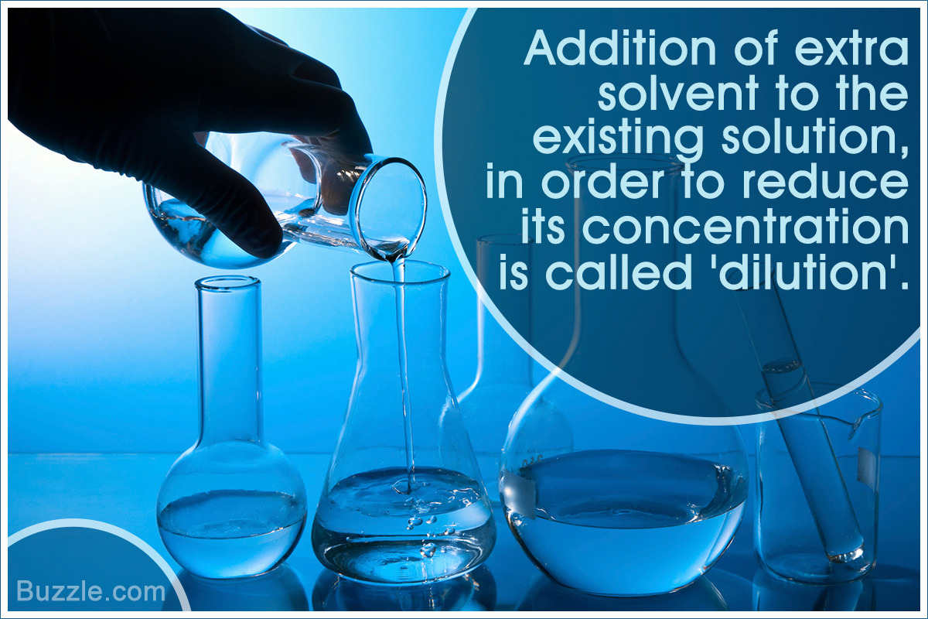

Slide 6
Note: We have two rules wherever they may be applied will simplify the calculation :
When ratio strength are given, convert them to % before setting.
Ex: 1:10=10%
Wherever proportional parts enter into calculation, reduce them to the lowest terms.
Ex: 75:25 simplify to 3:1

Slide 7
Dilution of alcohol
When alcohol is diluted with water a noticeable contraction in volume occur so it is difficult to calculate the amount of water to be add because alcohol interaction with water by bounding (H-bond) and lead to contraction but this contraction of volume not affect the weight of alcohol and water added.
Examples
Rx Boric acid 10gm
Alcohol 70% 30ml
Alcohol available 90%
How many mls of 20% alcohol can be used to prepare 25ml of 10% alcohol?
C1V1=C2V2
20% x V1 =10% x 25ml
V1 =12.5ml of 20% alcohol and complete the volume to 25ml.

Slide 8
Problems
If 500ml of 15% v/v solution are diluted to 1500ml. What will be the percentage strength?
C1V1 = C2V2
15% x 500ml =C2 x 1500ml
C2=5%
How many mls of a 1:5000 (w/v) solution of potassium permanganate can be made from 50ml of a 0.5% solution?
1:5000 = 0.02%
C1V1=C2V2
50ml x 0.5% = 0.02% x V2
V2= 1250ml

Slide 9
Problems
How much water should be mixed with 5000ml of 85% alcohol to make 50% (v/v) solution?
C1V1 = C2V2
5000ml x 85% = 50% x V2
V2 = 8500ml
8500 – 5000 = 3500ml of H2O.
Note
Standard solution is a solution of known concentration (normality, molarity and molality) or it’s concentration is exactly measured.
Standardization is determination of the molarity or normality of the solution.

Slide 10
Reducing and Enlarging Formula
Pharmacist may have to reduce or enlarge the formula in pharmaceutical preparation. In large manufacturing the official formula must be enlarged, while in the pharmacy or on small products the official formula must be reduced

Slide 11
Factor= desired amount/ specified amount
Examples:
Rx Codeine phosphate gr V
Amaranth solution ɱ XV
Alcohol 10 % fƷ ss
D.W. q.s fƷ l
1. Mitt f Ʒ II
2. Mitt f Ʒ ss
Calculation(1):
5/15= 0.3 g of codeine phosphate
15/15 = 1 ml of amaranth
fƷ ss= 2 ml fƷ = 30 ml f Ʒ II= 60 ml
factor= 60/30= 2
0.3×2= 0.6 g of codeine phosphate
1×2= 2 ml of amaranth
2×2= 4 ml of alcohol
60×3/4= 45 ml
45-(4+2)= 39 ml

Slide 12
Procedure(1):
1. Weigh 0.6 g of codeine phosphate and put it in a beaker.
2. Dissolve the amount of codeine phosphate in 39 ml of D.W.
3. Add 2 ml of amaranth and 4 ml of alcohol into the content of the beaker.
4. Transfer the content of the beaker into a measuring cylinder and complete the volume to 60 ml by D.W.
5. Convert the content of the measuring cylinder into a wide mouth bottole and put a suitable label.

Slide 13
Calculation
f Ʒ ss= 15 ml factor= 15/ 30= 0.5
0.3 × 0.5= 0.15 g of codeine phosphate
1×0.5= 0.5 ml of amaranth
2×0.5=1 ml of alcohol
30×0.5=15 ml
15×3/4=11.25 ml
11.25-(0.5+1)=9.75ml
Procedure
Follow the same of the above procedure.

Slide 14
Home works
Rx Calamine 80 g
Zinc oxide 80 g
Glycerin 20 ml
Bentonite magma 250 ml
Calcium hydroxide qs 1000 ml
Mitt gallon
Rx Atropine sulfate gr XX
Camphor water ɱ XV
D.W qs fƷ I
Mitt fƷ V

